Slide 1


2026
RENEWABLE CONNECTED SYSTEMS
INVESTOR PRESENTATION
Mobility
& Energy
Confidential. For discussion only. Not an offer to sell or a solicitation of an offer to buy any security. Draft for discussion. Do not use, rely on or distribute. Figures and terms may change.
DATE
27 SEP 2026
STATUS
DRAFT

Slide 2

INVESTOR DECK
OCEAN RCS
Agenda
01
PLATFORM
One platform and its revenue logic
02
PIPELINE
Mobility hubs and capital gates
03
CAPITAL
Underwriting and monetization
04
NEXT STEPS
Milestone-based capital
OCEAN RCS · CONFIDENTIAL · FOR DISCUSSION ONLY · DRAFT · DO NOT USE

Slide 3


01
Connected infrastructure,
disciplined capital
ENERGY, MOBILITY, STORAGE, SMART SITES AND QUALIFIED COMPUTE SHARE ONE INTEGRATION PLATFORM.
OCEAN RCS · CONFIDENTIAL · FOR DISCUSSION ONLY · DRAFT · DO NOT USE

Slide 4

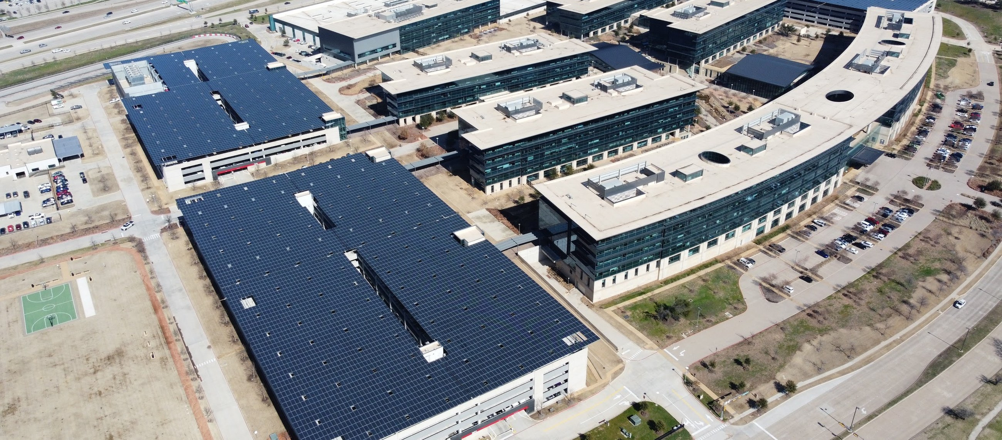
PAGE
PLATFORM
PIPELINE
CAPITAL
NEXT STEPS
INVESTOR DECK
01
02
03
04
04
OCEAN RCS
01 PLATFORM
Three systems,
one platform
OCEAN RCS DEVELOPS INFRASTRUCTURE FOR
ELECTRIFIED MOBILITY, DISTRIBUTED ENERGY
AND SELECTIVE MODULAR COMPUTE.
RENEWABLE ENERGY
Solar, storage, electrical, controls
CONNECTED MOBILITY
Charging, fleet energy, site operations
QUALIFIED COMPUTE
Power, fiber, liquid cooling, partners
Representative image: solar parking structures on a corporate campus.
OCEAN RCS · CONFIDENTIAL · FOR DISCUSSION ONLY · DRAFT · DO NOT USE

Slide 5
PAGE
PLATFORM
PIPELINE
CAPITAL
NEXT STEPS
INVESTOR DECK
01
02
03
04
05
OCEAN RCS
01 PLATFORM
Develop, build
and operate
01
02
03
Develop
Build
Operate
Site screening, utility review and
customer strategy.
Solar, storage, EVSE and site
infrastructure.
Monitoring, O&M, billing and reporting.
Ocean controls the integration layer.
OCEAN RCS · CONFIDENTIAL · FOR DISCUSSION ONLY · DRAFT · DO NOT USE

Slide 6


02
Parallel lanes,
protected stages
OCEAN RCS · CONFIDENTIAL · FOR DISCUSSION ONLY · DRAFT · DO NOT USE
Notes:
Mobility hubs, parallel pipelines and capital gates.

Slide 7


PAGE
PLATFORM
PIPELINE
CAPITAL
NEXT STEPS
INVESTOR DECK
01
02
03
04
07
OCEAN RCS
02 PIPELINE
A mobility hub is
more than charging
SITE FORMATS CAN COMBINE ENERGY, MOBILITY,
RETAIL, FLEET AND SERVICE REVENUE.
CHARGING
Public DC fast charging
FLEET
Charging and staging
ENERGY
Solar canopy and BESS
SERVICES
Retail, amenities, wash
Representative image: infrastructure concept, not an Ocean site.
OCEAN RCS · CONFIDENTIAL · FOR DISCUSSION ONLY · DRAFT · DO NOT USE

Slide 8
PAGE
PLATFORM
PIPELINE
CAPITAL
NEXT STEPS
INVESTOR DECK
01
02
03
04
08
OCEAN RCS
02 PIPELINE
Several project lanes
move at once
OCEAN DOES NOT WAIT TO COMPLETE ONE LANE
BEFORE ADVANCING ANOTHER.
LANE | WHAT GOVERNS ADVANCEMENT
Energy EPC | Screen · control · validate · fund · build · operate · monetize
Third-party EVSE | The same evidence-based gates, applied independently
Mobility hubs | Site readiness
Fleet and car wash hubs | Customer demand and operating requirements
Modular compute | Qualified power, fiber and demand
EACH ASSET RECEIVES CAPITAL ONLY AFTER TECHNICAL, COMMERCIAL, UTILITY AND FINANCING GATES CLEAR.
OCEAN RCS · CONFIDENTIAL · FOR DISCUSSION ONLY · DRAFT · DO NOT USE

Slide 9
PAGE
PLATFORM
PIPELINE
CAPITAL
NEXT STEPS
INVESTOR DECK
01
02
03
04
09
OCEAN RCS
02 PIPELINE
Capital is deployed
in protected stages
INVESTOR PROTECTIONS AND ASSET-LEVEL
CONTROLS ARE IN PLACE BEFORE PROJECT
FUNDING.
01 · CONTROL
02 · VALIDATE
03 · APPROVE
04 · EXECUTE
Site or customer
control
Utility and permits
Financing and
collateral
Build and operate
Secure the site or the customer
before spending capital.
Confirm the utility path and the
permits.
Approve financing and collateral.
Build, operate and expand.
OPPORTUNISTIC EQUIPMENT: TITLE, CONDITION, SERVICEABILITY AND SITE FIT VERIFIED BEFORE PURCHASE.
OCEAN RCS · CONFIDENTIAL · FOR DISCUSSION ONLY · DRAFT · DO NOT USE

Slide 10

03
Contracted revenue first,
optionality second
BASE-CASE UNDERWRITING DEPENDS ON CUSTOMER CONTRACTS, SITE-SPECIFIC MODELS AND CONFIRMED
ECONOMICS.
OCEAN RCS · CONFIDENTIAL · FOR DISCUSSION ONLY · DRAFT · DO NOT USE

Slide 11

PAGE
PLATFORM
PIPELINE
CAPITAL
NEXT STEPS
INVESTOR DECK
01
02
03
04
11
OCEAN RCS
03 CAPITAL
Revenue begins with
contracted work
01
02
03
Base revenue
Contracted expansion
Optionality
EPC margin, O&M, monitoring, solar and
BESS value.
Fleet charging, site services and
memberships.
Advertising, compute and future fleet
services. Excluded from the base
case.
OCEAN RCS · CONFIDENTIAL · FOR DISCUSSION ONLY · DRAFT · DO NOT USE

Slide 12
PAGE
PLATFORM
PIPELINE
CAPITAL
NEXT STEPS
INVESTOR DECK
01
02
03
04
12
OCEAN RCS
03 CAPITAL
Qualified sites
require evidence
PHYSICAL, UTILITY, COMMERCIAL AND OPERATING
CONDITIONS MUST SUPPORT DEPLOYMENT.
TEST | EVIDENCE REQUIRED
Physical site | Access, parking, setbacks and a safe service area
Power and utility | Load, interconnection and the utility path
Commercial demand | Charging, fleet, tenant or compute use
Construction scope | Civil, electrical and site-cost clarity
Operating model | O&M, billing, access and support plan
FORWARD-LOOKING AND SUBJECT TO DILIGENCE; NOT A GUARANTEE OF RETURNS.
OCEAN RCS · CONFIDENTIAL · FOR DISCUSSION ONLY · DRAFT · DO NOT USE

Slide 13

CAPITAL
8
stage gates from
origination to monetization
BASIS
PORTFOLIO PROCESS
STATUS
DRAFT
OCEAN RCS · CONFIDENTIAL · FOR DISCUSSION ONLY · DRAFT · DO NOT USE
Notes:
Gates: originate, screen, control, validate, fund, build, operate, monetize.

Slide 14
PAGE
PLATFORM
PIPELINE
CAPITAL
NEXT STEPS
INVESTOR DECK
01
02
03
04
14
OCEAN RCS
04 NEXT STEPS
Milestone-based capital
MONETIZATION FOLLOWS STABILIZATION:
REFINANCE, SELL, RECAPITALIZE OR FORM JOINT
VENTURES.
CAPITAL SOUGHT
01
[TBD]
Confirm investor mandate
02
Define first funded asset
First funded asset
[TBD]
Terms
[TBD]
03
Complete diligence package
04
Approve stage-gated capital
OCEAN RCS · CONFIDENTIAL · FOR DISCUSSION ONLY · DRAFT · DO NOT USE

Slide 15

NOTICE
Important notice
This presentation is confidential and is provided for discussion
purposes only. It is not an offer to sell or a solicitation of an offer
to buy any security. Any project, equipment acquisition,
incentive, utility service, fleet relationship, charging utilization,
compute deployment, financial return or exit transaction is
subject to final diligence, written agreements and applicable law.
Ocean RCS is the market-facing operating brand for the
platform. Project-specific legal entities may be formed at
equipment acquisition, property closing, financing or operations
launch. Forward-looking statements, projections and estimates
are not guarantees. Do not copy, forward or distribute without
the written consent of Ocean RCS.
OCEAN RCS · CONFIDENTIAL · FOR DISCUSSION ONLY · DRAFT · DO NOT USE

