Slide 1


2026
LAYOUT REFERENCE
COMMERCIAL ENERGY
Rooftop Solar
+ Storage
Confidential. Prepared for Ocean RCS. Do not copy, forward or distribute without the written consent of Ocean RCS. Design specimen with illustrative figures and representative images. Do not use for any
commercial purpose.
PREPARED FOR
CLIENT NAME
DATE
26 SEP 2026
STATUS
SPECIMEN

Slide 2

PAGE
SITE
SYSTEM
LAYOUT REFERENCE
01
02
02
OCEAN RCS
01 SITE
The roof is ready and
the service has room
A new TPO roof, clear array zones and an existing 2,000
A service mean the site can carry about 412 kW without
a service upgrade.
BOTTOM LINE
No service upgrade needed for the first phase.
OCEAN RCS · CONFIDENTIAL · DESIGN SPECIMEN · DO NOT USE

Slide 3

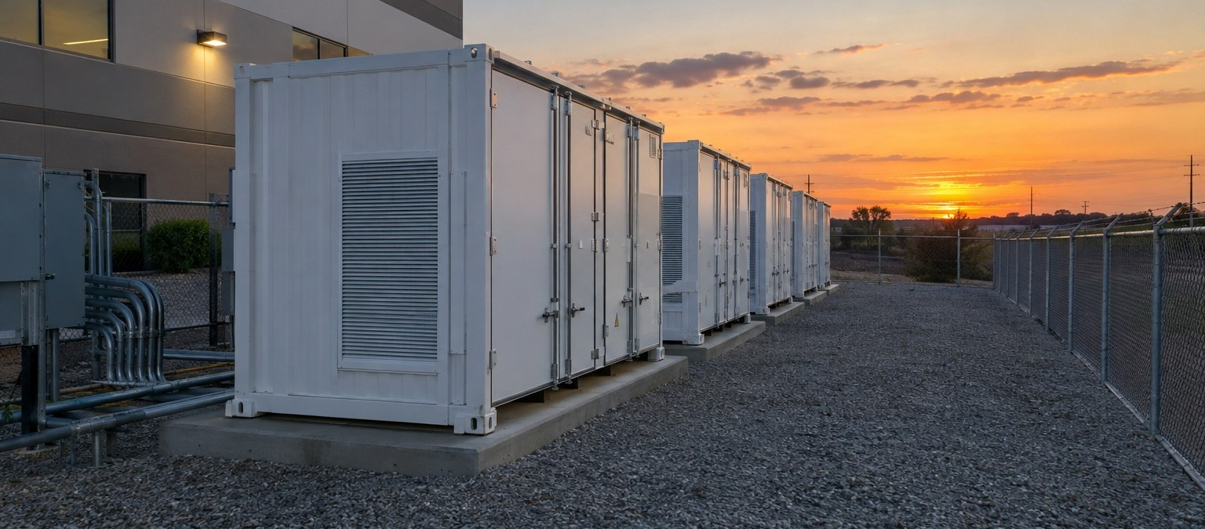
PAGE
SITE
SYSTEM
LAYOUT REFERENCE
01
02
03
OCEAN RCS
02 SYSTEM
Solar and storage sized
to the building
ONE ARRAY, TWO CABINETS, ONE
INTERCONNECTION.
SOLAR
412 KW DC
STORAGE
1.2 MWH
INTERCONNECTION
Line-side tap
Representative image of a comparable storage installation.
OCEAN RCS · CONFIDENTIAL · DESIGN SPECIMEN · DO NOT USE

Slide 4

38%
Lower grid electricity
spend from the first
year
Notes:
Basis: 12-month interval data
Status: Illustrative

