Slide 1


2026
LAYOUT REFERENCE
COMMERCIAL ENERGY
Rooftop Solar
+ Storage
Confidential proposal for Client name. Pricing valid for 30 days. Not binding until a contract is signed by both parties. Design specimen with illustrative figures and representative images. Do not use for any
commercial purpose.
PREPARED FOR
CLIENT NAME
DATE
26 SEP 2026
STATUS
SPECIMEN

Slide 2

PROPOSAL
OCEAN RCS
Agenda
01
SITE
What the roof and service can carry
02
SYSTEM
Solar, storage and interconnection
03
ECONOMICS
Savings, incentives and payback
04
NEXT STEPS
Decisions and schedule
OCEAN RCS · CONFIDENTIAL PROPOSAL · DESIGN SPECIMEN · DO NOT USE

Slide 3

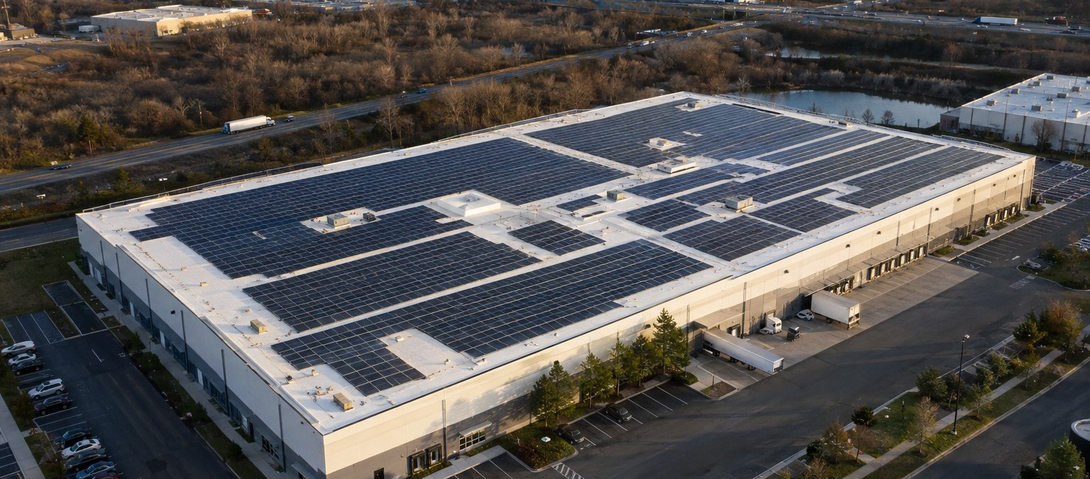
PAGE
SITE
SYSTEM
ECONOMICS
NEXT STEPS
PROPOSAL
01
02
03
04
03
OCEAN RCS
01 SITE
The roof can carry about
412 kW of solar
A NEW TPO ROOF, CLEAR ARRAY ZONES AND AN
EXISTING 2,000 A SERVICE.
ARRAY SIZE
412 KW DC
USABLE ROOF
68,400 FT²
SERVICE
2,000 A · 480 V
Representative image of a comparable rooftop array.
OCEAN RCS · CONFIDENTIAL PROPOSAL · DESIGN SPECIMEN · DO NOT USE

Slide 4
PAGE
SITE
SYSTEM
ECONOMICS
NEXT STEPS
PROPOSAL
01
02
03
04
04
OCEAN RCS
01 SITE
Four figures define
the opportunity
ILLUSTRATIVE FIGURES FOR THE SPECIMEN.
ARRAY SIZE
STORAGE
SERVICE
PAYBACK
412 kW
1.2 MWh
2,000 A
6.4 yrs
After keep-outs
Two cabinets
To be confirmed
After incentives
ILLUSTRATIVE FIGURES · SPECIMEN
BOTTOM LINE
Payback in 6.4 years with the existing service.
OCEAN RCS · CONFIDENTIAL PROPOSAL · DESIGN SPECIMEN · DO NOT USE

Slide 5


PAGE
SITE
SYSTEM
ECONOMICS
NEXT STEPS
PROPOSAL
01
02
03
04
05
OCEAN RCS
02 SYSTEM
Built and verified
by our own crews
Every cabinet is tested, torqued
and logged before handover.
One team owns the work
from design to commissioning.
OCEAN RCS · CONFIDENTIAL PROPOSAL · DESIGN SPECIMEN · DO NOT USE

Slide 6
PAGE
SITE
SYSTEM
ECONOMICS
NEXT STEPS
PROPOSAL
01
02
03
04
06
OCEAN RCS
02 SYSTEM
Three parts, one
integrated system
EACH PART IS ENGINEERED TO THE SITE.
01
02
03
Solar array
Battery storage
Interconnection
412 kW DC on the new TPO roof, laid
out around keep-outs and access
paths.
Two 600 kWh cabinets shave peaks
and carry critical loads.
A line-side tap on the existing 2,000 A
service, subject to utility approval.
OCEAN RCS · CONFIDENTIAL PROPOSAL · DESIGN SPECIMEN · DO NOT USE

Slide 7

PAGE
SITE
SYSTEM
ECONOMICS
NEXT STEPS
PROPOSAL
01
02
03
04
07
OCEAN RCS
03 ECONOMICS
Savings grow each year
as utility rates rise
ANNUAL BILL SAVINGS, YEARS 1–10, $K. YEAR 10
HIGHLIGHTED.
Savings rise from
$62K to $104K a year.
BOTTOM LINE
10-year savings of $819K. Payback in 6.4 years.
OCEAN RCS · CONFIDENTIAL PROPOSAL · DESIGN SPECIMEN · DO NOT USE

Slide 8


ECONOMICS
38%
Lower grid electricity
spend from the first year
BASIS
12-MONTH INTERVAL DATA
STATUS
ILLUSTRATIVE
OCEAN RCS · CONFIDENTIAL PROPOSAL · DESIGN SPECIMEN · DO NOT USE

Slide 9
PAGE
SITE
SYSTEM
ECONOMICS
NEXT STEPS
PROPOSAL
01
02
03
04
09
OCEAN RCS
04 NEXT STEPS
Close with the decision
and its next steps
VERIFIED PROJECT AMOUNT
01
[TBD]
Review the evidence
02
Resolve open assumptions
Approved scope
[TBD]
Terms
[TBD]
03
Confirm the agreed next action
OCEAN RCS · CONFIDENTIAL PROPOSAL · DESIGN SPECIMEN · DO NOT USE
Notes:
Draft layout placeholder. Release mode blocks unresolved values.

