Slide 1


2026
RENEWABLE CONNECTED SYSTEMS
COMPANY OVERVIEW
Company &
Leadership
Confidential. Prepared for Ocean RCS. Do not copy, forward or distribute without the written consent of Ocean RCS. Draft for discussion. Do not use, rely on or distribute. Figures and terms may change.
DATE
27 SEP 2026
STATUS
DRAFT
Notes:
Source PDF page 1. Ocean RCS means Renewable Connected Systems.

Slide 2

COMPANY OVERVIEW
OCEAN RCS
Agenda
01
PLATFORM
Services and operating model
02
TEAM
Leadership and responsibilities
03
PARTNERS
Specialist execution network
04
CONTACT
Company contact details
OCEAN RCS · CONFIDENTIAL · DRAFT · DO NOT USE

Slide 3

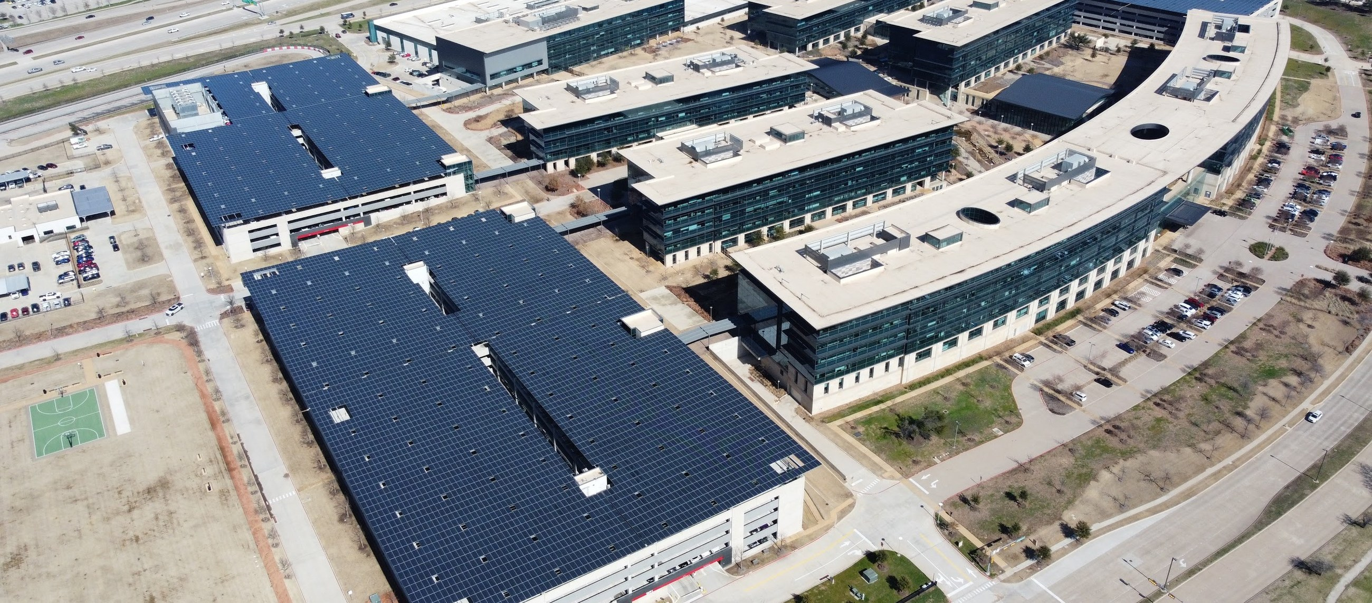
PAGE
PLATFORM
TEAM
PARTNERS
CONTACT
COMPANY OVERVIEW
01
02
03
04
03
OCEAN RCS
01 PLATFORM
Connected infrastructure,
one commercial layer
FOUR OPERATING PILLARS SHARE COMMERCIAL
STRATEGY AND EXECUTION STANDARDS.
ENERGY
Solar, storage, electrical, controls
MOBILITY
EV charging, fleets, smart sites
WATER
Treatment, wells, conservation
COMPUTE
Power, fiber, cooling, partners
Ocean project photo: solar parking structures, DJI_0482
OCEAN RCS · CONFIDENTIAL · DRAFT · DO NOT USE
Notes:
Source page 2. Energy includes efficiency. Water includes atmospheric water. Compute is partner-enabled deployment, not hyperscale development. DJI_0482 confirmed by Ocean leadership as a real Ocean project.

Slide 4
PAGE
PLATFORM
TEAM
PARTNERS
CONTACT
COMPANY OVERVIEW
01
02
03
04
04
OCEAN RCS
01 OPERATING MODEL
Develop, build
and operate
A LEAN CORE TEAM COORDINATES AI-ENABLED
OPERATIONS AND SPECIALIST PARTNERS.
01
02
03
Develop
Build
Operate
Commercial strategy, customer
relationships and project integration.
Qualified partners support licensed
and project-specific execution.
Ocean retains standards and
accountability across the operating
model.
OCEAN RCS · CONFIDENTIAL · DRAFT · DO NOT USE
Notes:
Source pages 2-3. The fourth operating function, Integrate, connects strategy, standards and accountability across these three stages.

Slide 5

PAGE
PLATFORM
TEAM
PARTNERS
CONTACT
COMPANY OVERVIEW
01
02
03
04
05
OCEAN RCS
02 LEADERSHIP
Commercial, operating
and technical leadership
Stansfield Thomas
Sierra Zymola
Mark Greene
FOUNDER
DIRECTOR OF OPERATIONS
ELECTRICAL DIRECTOR
Leads strategy, commercial development,
partnerships, capital relationships and
market expansion. Background spans
technology commercialization, direct sales,
connected technologies, operations,
marketing and renewable-energy financial
strategy.
Supports organizational strategy, executive
operations, communications, project
coordination and stakeholder alignment
across energy, construction, water and
infrastructure initiatives.
Director of Electrical & Infrastructure. Master
Electrician with 30+ years in commercial and
industrial electrical systems, renewables, EV
charging, fiber, data-center infrastructure,
commissioning and field delivery.
OCEAN RCS · CONFIDENTIAL · DRAFT · DO NOT USE
Notes:
Source pages 4-5. Names, titles, credential and experience are supplied claims retained for Ocean approval. No stock or generated portraits.

Slide 6
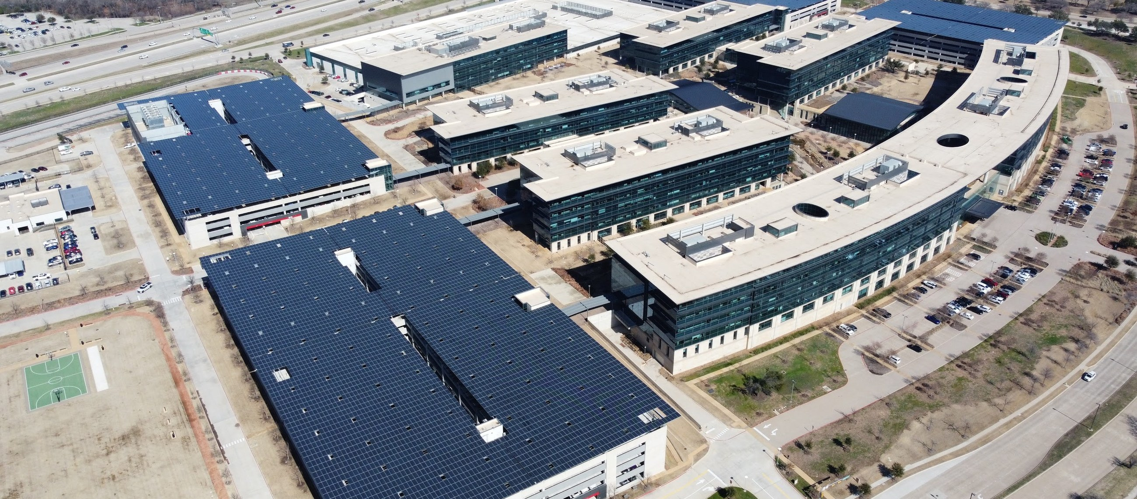
PAGE
PLATFORM
TEAM
PARTNERS
CONTACT
COMPANY OVERVIEW
01
02
03
04
06
OCEAN RCS
02 EXECUTION
Ocean retains
project accountability
SPECIALISTS SUPPORT DELIVERY WITHIN OCEAN
COMMERCIAL AND OPERATING STANDARDS.
COMMERCIAL
Customer relationship and strategy
INTEGRATION
Project coordination and standards
EXECUTION
Qualified specialist partners
Ocean project photo: DJI_0482; no performance figures inferred
OCEAN RCS · CONFIDENTIAL · DRAFT · DO NOT USE
Notes:
Source pages 2, 3 and 6. Same verified project photograph reused for continuity, with a different crop.

Slide 7

PAGE
PLATFORM
TEAM
PARTNERS
CONTACT
COMPANY OVERVIEW
01
02
03
04
07
OCEAN RCS
03 PARTNERS
Specialist support
for project execution
FUNCTION | SUPPORT
Legal / risk | Counsel, insurance and risk specialists
Finance / tax | CPA, controller and incentive professionals
Engineering | Licensed engineering partners
Construction | Contractors, trades and commissioning resources
Technology | EV, storage, water, fiber and controls partners
Capital | Investors, lenders and strategic capital
OCEAN RCS · CONFIDENTIAL · DRAFT · DO NOT USE
Notes:
Source page 6. These are support categories, not representations of signed partner agreements.

Slide 8


PLATFORM
4
operating pillars share one
integration layer
BASIS
OPERATING MODEL
STATUS
DRAFT
OCEAN RCS · CONFIDENTIAL · DRAFT · DO NOT USE
Notes:
Source page 2: Energy, Mobility, Water and Compute. The figure counts supplied categories, not projects or customers.

Slide 9
PAGE
PLATFORM
TEAM
PARTNERS
CONTACT
COMPANY OVERVIEW
01
02
03
04
09
OCEAN RCS
04 CONTACT
Company contact
& capabilities
COMPANY
CAPABILITIES
www.oceanrcs.com
Energy, mobility and water
info@oceanrcs.com
Construction and qualified compute
OCEAN RCS · CONFIDENTIAL · DRAFT · DO NOT USE
Notes:
Source page 7. Contact information retained from the supplied PDF.

