Slide 1
高等計算機架構midterm report
2026年11月
Sebastian Fieldhouse
馮澤善
Notes:
實習的過程
交叉點
了解需求
多給建議

Slide 2
implemented custom instrcutions
base ISA is rv64imc_zicsr
we custom implement 6 custom instructions: xqmac8, xqmac8u, xrequant, xsqmac8, xsaccrd, xsaccclr
Contents
basic implementation (xqmac8, xqmac8u)
sparse computation and xsqmac8
results

Slide 3
Xqmac8 rd, rs1, rs2
usage: xqmac8 rd, rs1, rs2
-> we load 8 packed weights into rs1 with ld
-> we can load 8 packed activations into rs2 with ld
-> then we perform MAC on these two registers

Slide 4
instruction trace example
(original)
lbu (x2)
lb (x4)
mul (x8)
add (x8)
(repeat 8 times)
this is a lot of instructions

Slide 5
instruction trace example
(with xqmac8u, same 64 MACs)
ld (x2) ← 8 activations per load
ld (x4) ← 8 weights per load
xqmac8u (x8) ← replaces 8 mul + 8 add each
(no repeat)
this is a lot fewer instructions

Slide 6
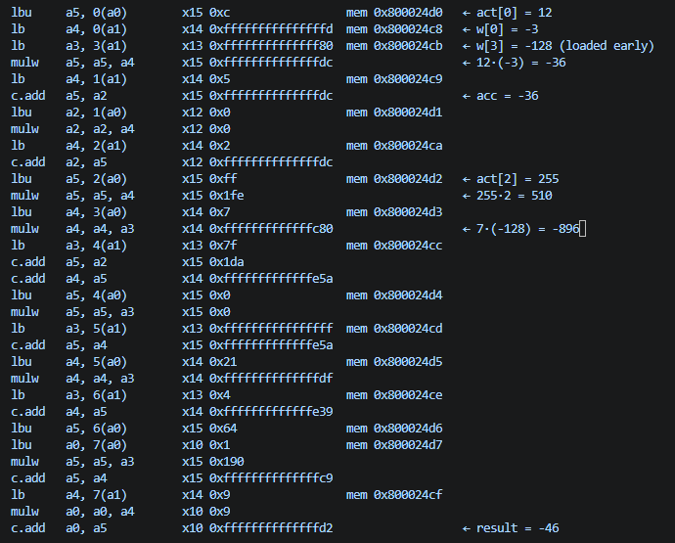
instruction trace example – 8 macs
(no xqmac)

Slide 7

instruction trace example – 8 macs

Slide 8
Results – Model tuning and quantization
Config | Custom instructions | Normal mode | High-sparsity model | Vs B0
B0 Naïve | - | 13,351 M | 13,352 M | -
X1 | xqmac8 | 586 M | 588 M | 22.7x
X2 | xqmac8 + xrequant | 554M | 554M | 24.1x

Slide 9
Sebastian talks about software hardware codesign

Slide 10
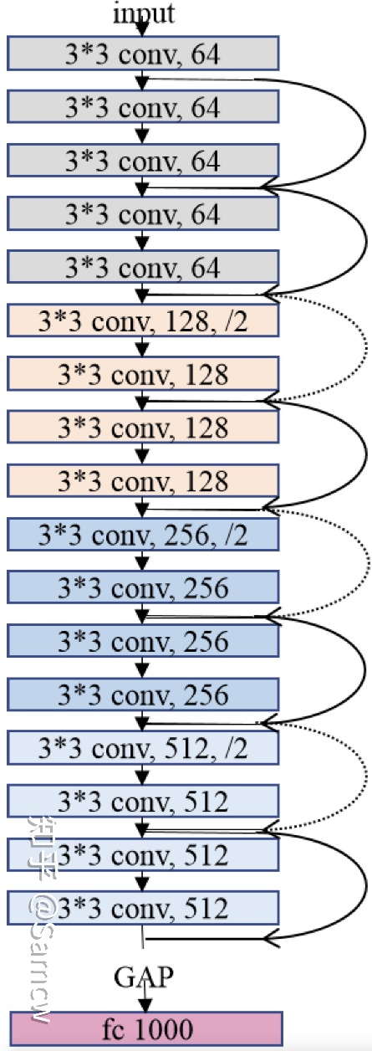
Neural Networks
Resnet-18

Slide 11
Neural Networks
Neural Networks are all heavily overparameterized [1]
FP32 Model
[1] The Lottery Ticket Hypothesis: Finding Sparse, Trainable Neural Networks, Frankle et al (ICLR 2019)

Slide 12
Neural Networks
Neural Networks are all heavily overparameterized [1]
FP32 Model
Computational Expression of Learned Function
[1] The Lottery Ticket Hypothesis: Finding Sparse, Trainable Neural Networks, Frankle et al (ICLR 2019)

Slide 13
Neural Networks
Neural Networks are all heavily overparameterized [1]
[1] The Lottery Ticket Hypothesis: Finding Sparse, Trainable Neural Networks, Frankle et al (ICLR 2019)

Slide 14
Neural Networks
Neural Networks are all heavily overparameterized [1]
[1] The Lottery Ticket Hypothesis: Finding Sparse, Trainable Neural Networks, Frankle et al (ICLR 2019)

Slide 15
Neural Networks
Neural Networks are all heavily overparameterized [1]
FP32 Model
INT8 Model
Computational Expression of Learned Function
[1] The Lottery Ticket Hypothesis: Finding Sparse, Trainable Neural Networks, Frankle et al (ICLR 2019)

Slide 16
Neural Networks
Neural Networks are all heavily overparameterized [1]
FP32 Model
INT4 Model
Computational Expression of Learned Function
Fundamental information loss due to lossy overcompression !!
[1] The Lottery Ticket Hypothesis: Finding Sparse, Trainable Neural Networks, Frankle et al (ICLR 2019)

Slide 17
Neural Networks
Neural Networks are all heavily overparameterized [1]
FP32 Model
INT8 Model + Trained Sparsity
Computational Expression of Learned Function
Fundamental information loss due to lossy overcompression
[1] The Lottery Ticket Hypothesis: Finding Sparse, Trainable Neural Networks, Frankle et al (ICLR 2019)

Slide 18
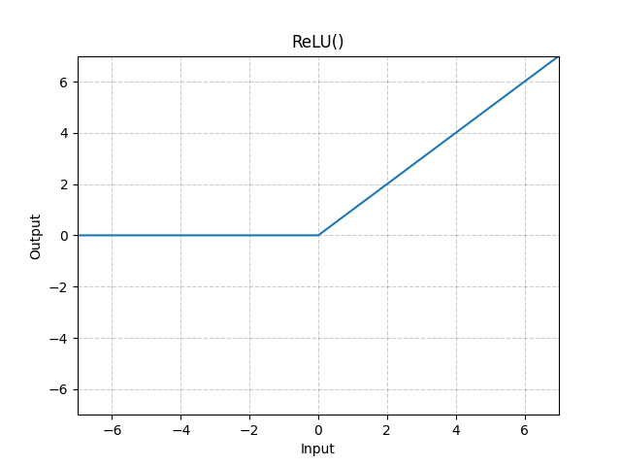
ReLU activation function

Slide 19
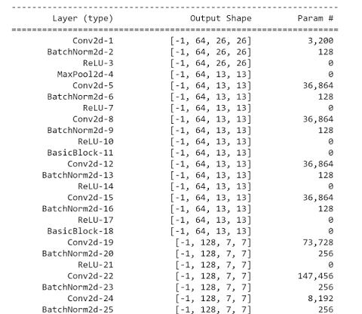
Neural Networks
Resnet-18

Slide 20
Neural Networks
Resnet-18

Slide 21
ReLU activation function
HAPPY ZONE

Slide 22
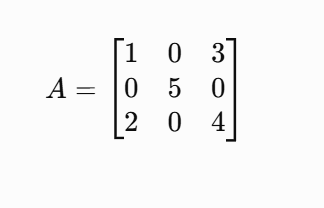
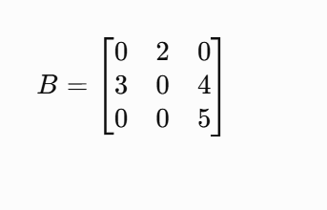
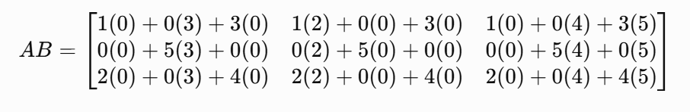
0s -> skip calculations -> cpu go fast (zoooom)

Slide 23
Neural Networks
Neural Networks are all heavily overparameterized [1]
FP32 Model
INT8 Model + Trained Sparsity
Computational Expression of Learned Function
Fundamental information loss due to lossy overcompression
[1] The Lottery Ticket Hypothesis: Finding Sparse, Trainable Neural Networks, Frankle et al (ICLR 2019)

Slide 24
How do we take advantage of these 0s in our architecture
Is there a way to increase the number of 0s in the model without decreasing accuracy

Slide 25
sparse mac instruction xsqmac8
xsqmac8 g, rs1, rs2
for i in 0...7: ACC[g*8 + i] += uint(rs1[7:0]) x int8(rs2.byte[i])
-> need to use an extra accumulator
-> rs1: only the low byte is used, and it is the activation value
-> rs2: 8 packed in8 weights, which are the weights from this input channel to 8 consecutive output channels
-> ACC: internal accumulator file, 64 int32 values (8 groups x 8)
- Read-back: xsaccrd rd, rs1 copies ACC[x[rs1]] into a normal regiser and clears it

Slide 26
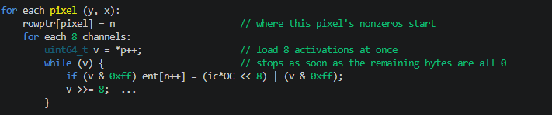
instruction trace example
-> during run time work out where the zeros are
-> before each sparse conv, we scan each conv’s input tensor once
-> this produces compressed list
-> ent[] one 32-bit entry per nonzero activation, holding the weight-row offset in the upper bits and the value in the low byte
-> rowptr[] for each input pixel and where its nonzeros start in ent[]. Conv uses this to jump straight to nonzeros of each of the 9 tapes in its 3x3 window

Slide 27
Model training
Python model
model code in C
machine code
gcc compile
weights
Finetuning & quantization

Slide 28
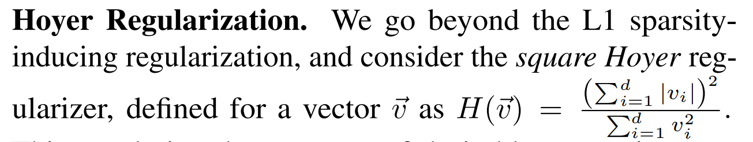
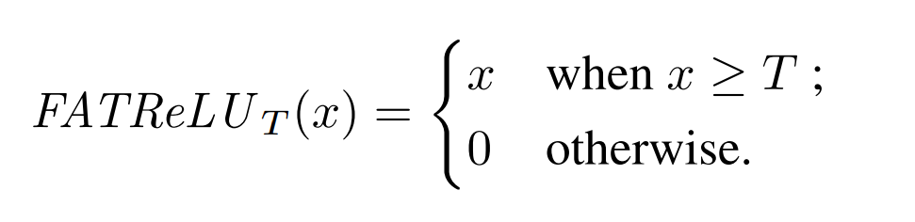
Fine Tuning Method
Add hoyer sparsity loss to increase sparsity of model – taken from Kurtz et al. 2020 [2]
[2] Inducing and Exploiting Activation Sparsity for Fast Neural Network Inference
PMLR 2020 Kurtz et al.

Slide 29
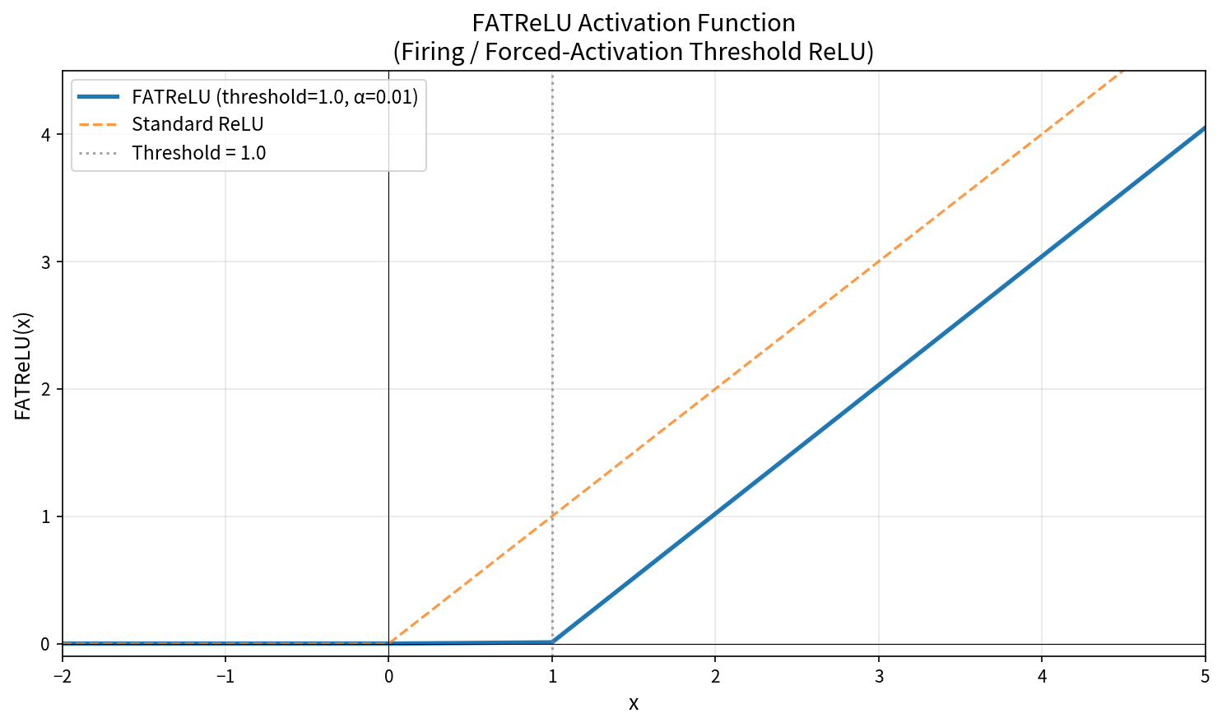
Model Fine Tune Method

Slide 30
Model Fine Tune Method

Slide 31
Results – Model tuning and quantization
Model | FP32 top-1 | INT8 top-1 | Activation Sparsity FP32 | Activation Sparsity INT8
Normal | 69.76% | 69.58% | 53.4% | 54.1%
Induced Activation Sparsity | 69.55% | 69.67% | 67.6% | 66.5%

Slide 32
Results – Model tuning and quantization
Config | Custom instructions | Normal mode | High-sparsity model | Vs B0 | Vs X2
B0 Naïve | - | 13,351 M | 13,352 M | -
X1 | xqmac8 | 586 M | 588 M | 22.7x
X2 | xqmac8 + xrequant | 554M | 554M | 24.1x
S1 sparse | xsqmac8 | 844 M | 785 M | 17.0x
S2 all | xsqmax8 + xqmac8 + xrequant | 341 M | 280 M | 47.7x | 1.98x

