Slide 1

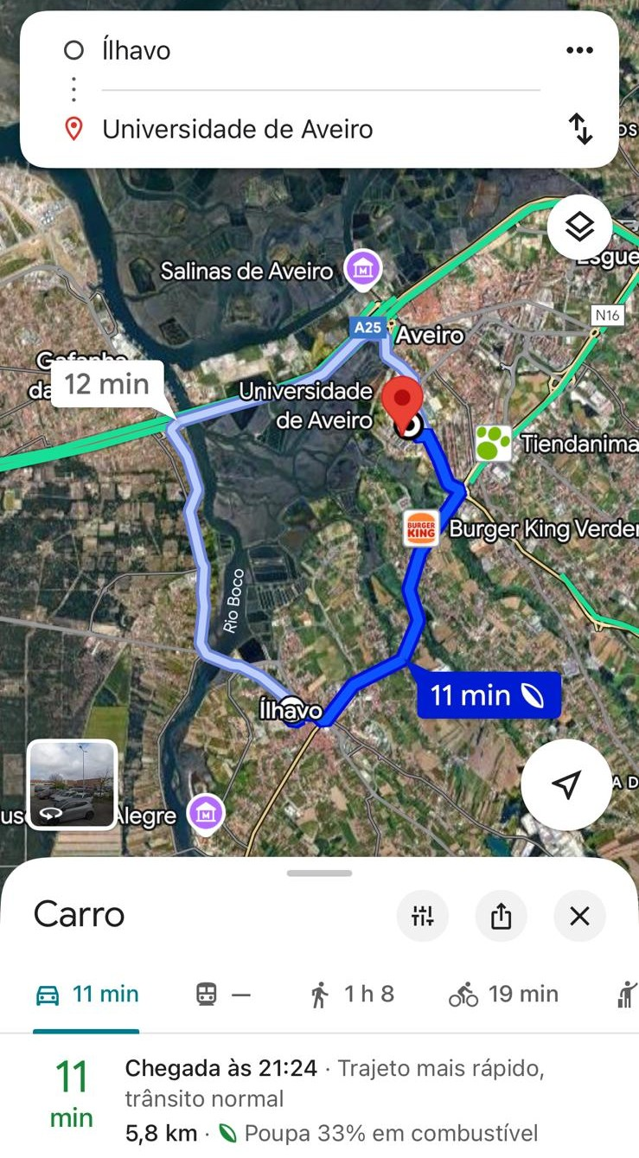
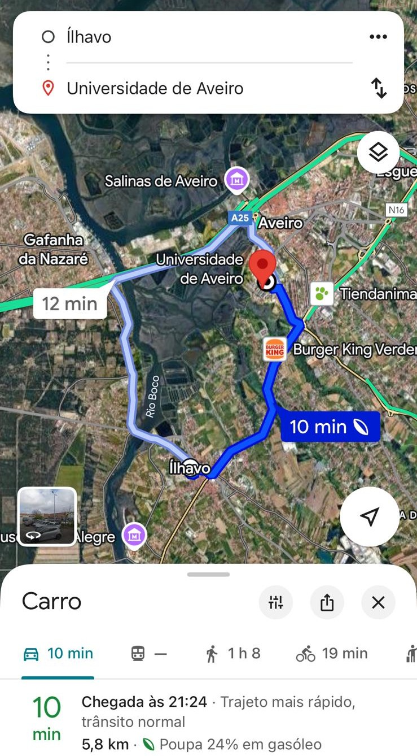
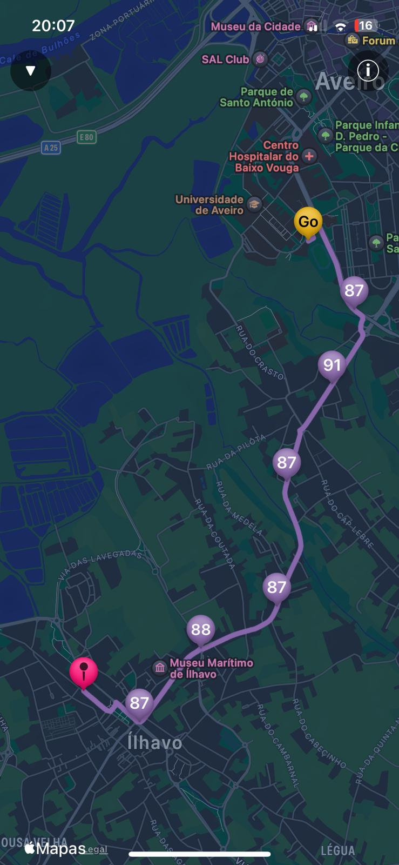
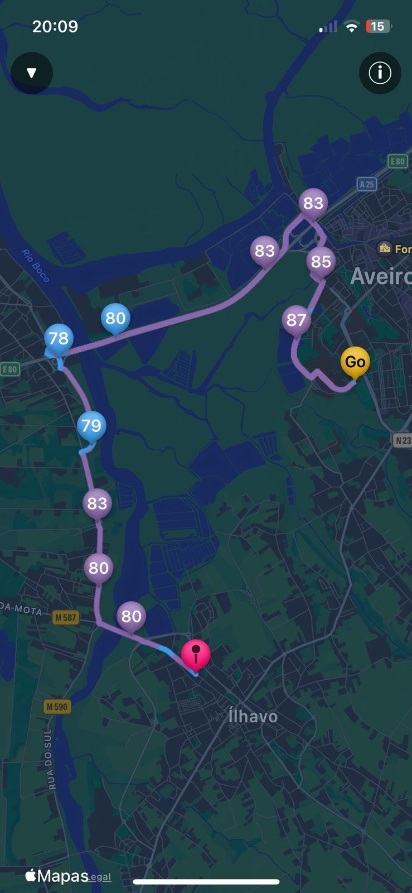

Beyond Fuel and Energy Savings: A Holistic Assessment of Google Maps:
Eco-Routing on Emissions, Urban Impact, and Driver Stress
Samuel Figueira (a), Paulo Fernandes (a), (b)1,2, Eloísa Macedo (a), (b)1,2 Jorge M. Bandeira (a), (b)1,2
(a) Department of Mechanical Engineering; University of Aveiro
(b) 1 TEMA - Centre for Mechanical Technology and Automation, Department of Mechanical Engineering, University of Aveiro, 3810-193 Aveiro, Portugal
(b) 2 LASI - Intelligent Systems Associate Laboratory, Guimarães, Portugal
samuel.figueira@live.ua.pt; paulo.fernandes@ua.pt; macedo@ua.pt; jorgebandeira@ua.pt
Abstract
This study evaluates Google Maps’ eco-routing feature through real-world experiments in Portugal using diesel, hybrid, gasoline, and electric vehicles across urban, intercity, and regional routes. Second-by-second data were collected with PEMS, GPS, and OBD-II, complemented by physiological driver monitoring. Results show that eco-routes generally reduce total fuel consumption and CO₂ emissions by 20–40%, aligning well with Google Maps estimates. However, many eco-routes follow shorter secondary roads where emissions per distance increase, even though total trip emissions remain lower. Heart rate and vehicular jerk analyses indicated slightly higher physiological demand and reduced comfort on intercity and regional eco-routes, while urban routes performed better. Overall, eco-routing effectively lowers total GHG emissions but may and cause greater local impacts in terms of exposure to air pollutants in specific situations and shift environmental and comfort burdens. Future systems should adopt multi-objective optimization balancing efficiency, local impacts, and driver well-being.
Methodology
Real-World Second-by-Second Data Collection
Different vehicle technologies
Trip replication
Ensure robustness
Vehicle Instrumentation
PEMS
GPS
OBD
Modelling through Vehicle Specific Power (VSP) Approach
Estimating instantaneous emissions
Estimating energy consumption
Development of Vehicle-Specific Emssion Factor
Physiological Monitoring of Drivers
Heart Rate
Vehicular jerk (second derivative of speed)
Preliminary results
Case Study – University of Aveiro ↔ Ílhavo Route Combination of urban and rural segments to simulate realistic commuting conditions.
Estimated eco-routing benefits (Google Maps):
Diesel: ~24% fuel reduction (Fig. 1)
Hybrid: ~33% fuel reduction (Fig. 2)
Experimental results:
CO₂, CO, NOx, and HC emissions 20–30% lower on the eco-route, consistent with Google Maps estimates.
When normalized per kilometer, emissions were higher on the eco-route (Figs. 5–8).
Overall, the eco-route achieved the lowest total emissions.
Electric vehicle (EV) analysis:
Identified the route with minimum energy use, confirming eco-routing efficiency for EVs.
Physiological evaluation:
Driver heart rate (smartwatch) slightly higher on the eco-route, possibly due to driving style, traffic, or route familiarity (Figs. 3–4).
Vehicular jerk analysis showed that eco-routes nearly doubled the frequency of comfort threshold violations (< –0.95 or > 0.9 m/s³) per distance unit on intercity and regional routes, but fewer in urban areas.
Fig.1- Estimations provided by Google Maps – Hybrid
Fig. 2 - Estimations provided by Google Maps – Diesel
Fig.3-Heartrate during the eco-route
Fig.4- Heartrate during the alternative-route
Fig.5 – CO₂ Emissions
Fig.6 –CO Emissions
Fig.7 - NOx Emissions
Fig.8 – HC Emissions
Conclusions & Research Contributions
Comprehensive real-world evaluation of Google Maps’ eco-routing across multiple vehicle technologies (diesel, hybrid, gasoline, electric).
Integration of physiological monitoring (heart rate, jerk) with emissions and energy data - a novel holistic assessment of eco-routing impacts.
Eco-routing effectively reduces total emissions and energy use - total CO₂, CO, NOₓ, and HC emissions decreased by 20-40%, consistent with Google Maps’ estimates.
Per-distance emissions can increase because eco-routes often use shorter secondary roads with traffic control treatments (roundabouts, traffic lights), presence of active modes that cause more stopping, or traffic variations.
Driver comfort and stress may be slightly affected, with higher heart rates and more frequent comfort threshold violations (vehicular jerk) on intercity/regional eco-routes.
References
Bandeira, Jorge M., Claudio Guarnaccia, Paulo Fernandes, and Margarida C Coelho. 2018. “Advanced Impact Integration Platform for Cooperative Road Use.” International Journal of Intelligent Transportation Systems Research 16(1): 1–15. http://link.springer.com/10.1007/s13177-016-0133-z.
Acknowledgements
This work is funded by national funds through FCT – Fundação para a Ciência e a Tecnologia, I.P., under the project/support UID/00481 – Centre for Mechanical Technology and Automation (TEMA), and the Interreg Europe projects SPOTLOG 01C0055 and EMBRACER 01C0056. Paulo Fernandes acknowledges FCT support 2021.02488.CEECIND (https://doi.org/10.54499/2021.02488.CEECIND/CP1659/CT0013).

