Slide 1
Housing Prices in Seoul
Ohil Kwon, Sangmin Lee, Sunho Tae

Slide 2
Outline
Hypothesis
About the Dataset
Libraries
Data Pre-processing
Visualization
Conclusion

Slide 3

Simple Question
Which district (구) do you expect to have the highest housing prices in Seoul?

Slide 4
Hypotheses
Assumption 1: The districts around the Han-river are relatively higher than the other districts
Assumption 2: The districts with the highest housing prices among them have still been rising in the last five years

Slide 5
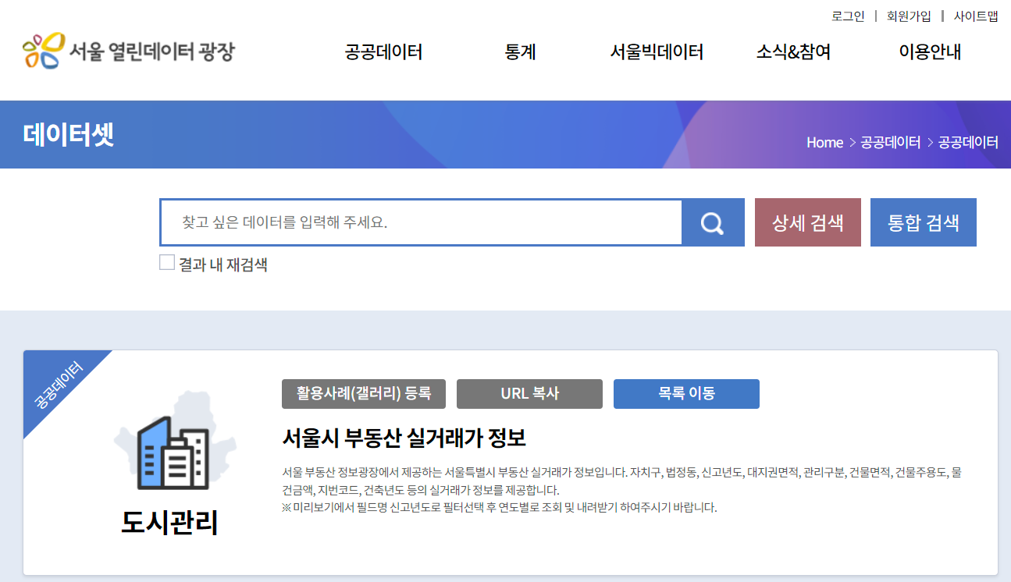
About the Dataset
Dataset source: https://data.seoul.go.kr/dataList/OA-21275/S/1/datasetView.do

Slide 6
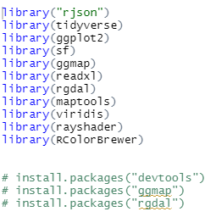

Libraries & Packages

Slide 7
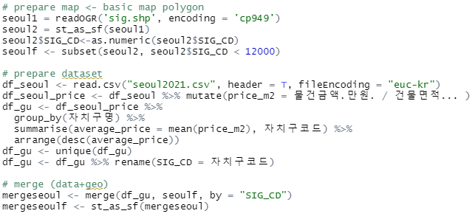
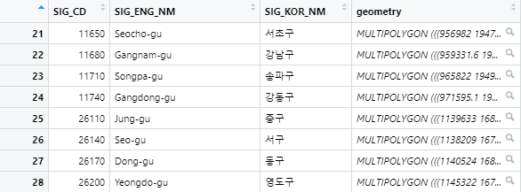
Data Pre-processing 1

Slide 8
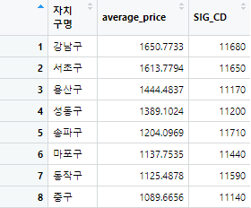
Data Pre-processing 1

Slide 9
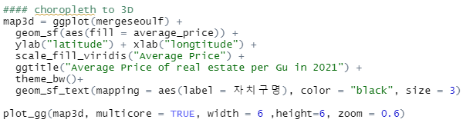
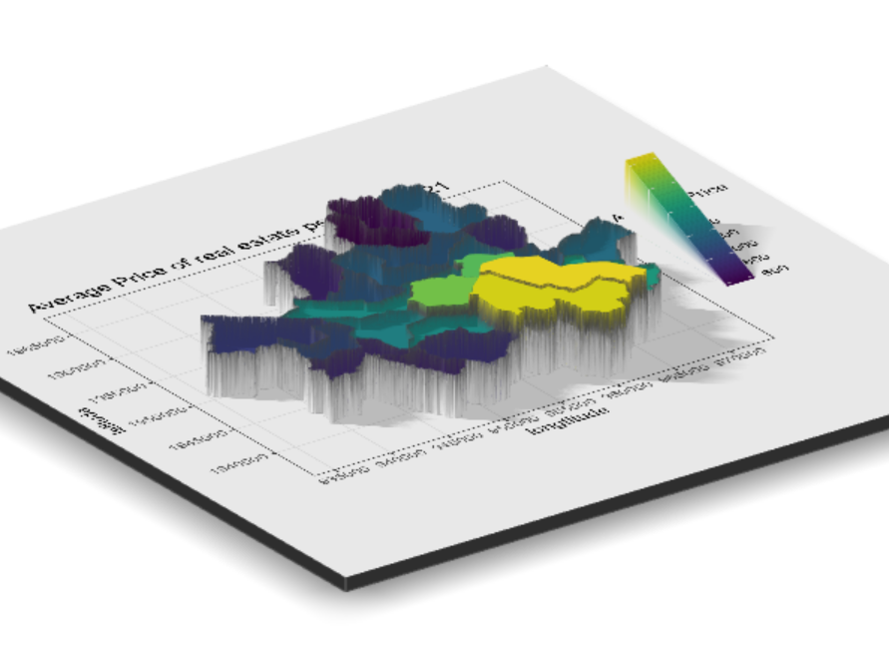
Visualization 1

Slide 10
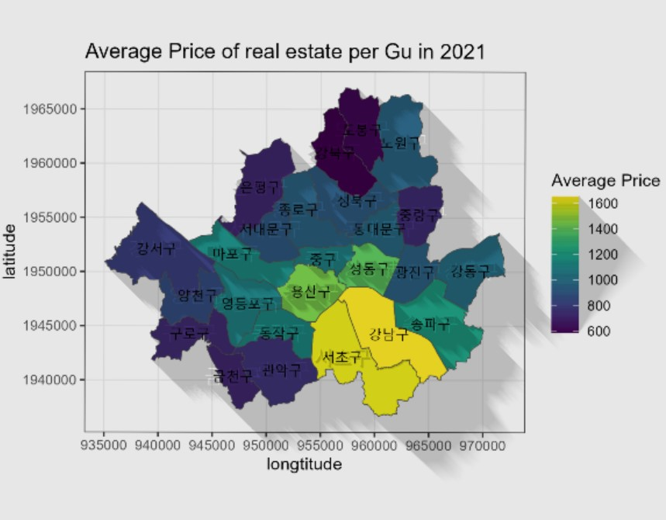
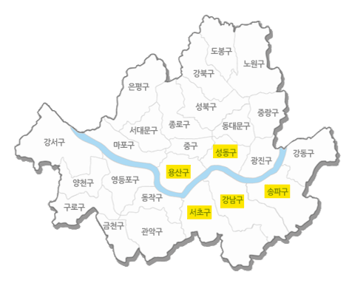
Result 1

Slide 11
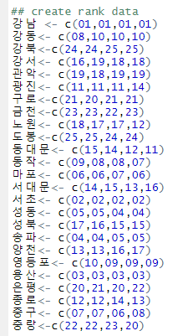

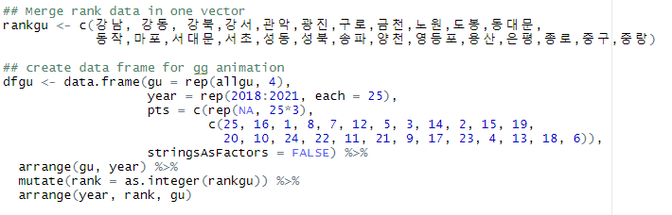
Data pre-processing2

Slide 12
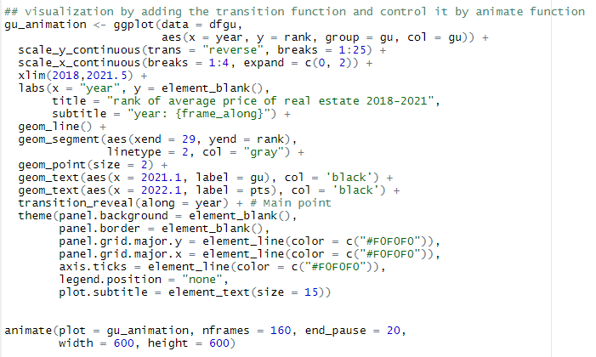
Visualization2

Slide 13

Result2

Slide 14
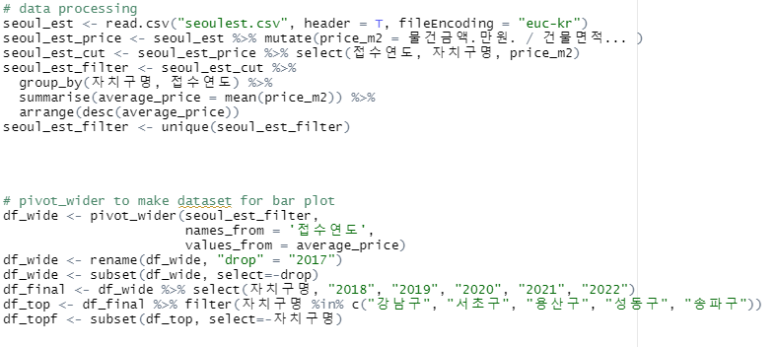
Data Pre-processing 3

Slide 15
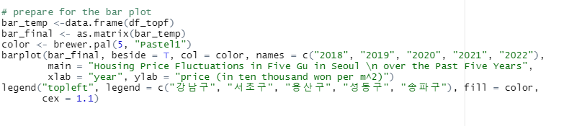
Visualization 3

Slide 16
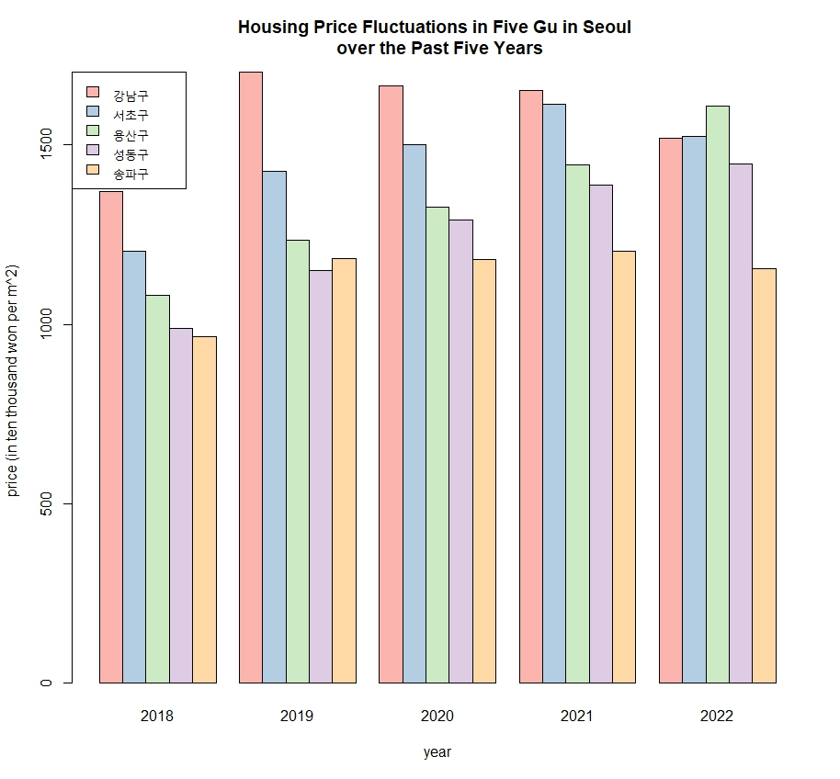
Result 3

Slide 17
Conclusion
Assumption 1
Districts near the Han-river
were more expensive than other areas
Assumption 2
Not all five top most expensive districts increased constantly during the five years

Slide 18
Thank you

