Slide 1

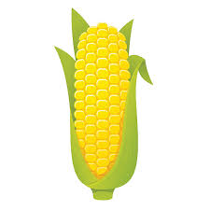


1
2
2x
Explanation of fertilizer payout under good rain.

Slide 2
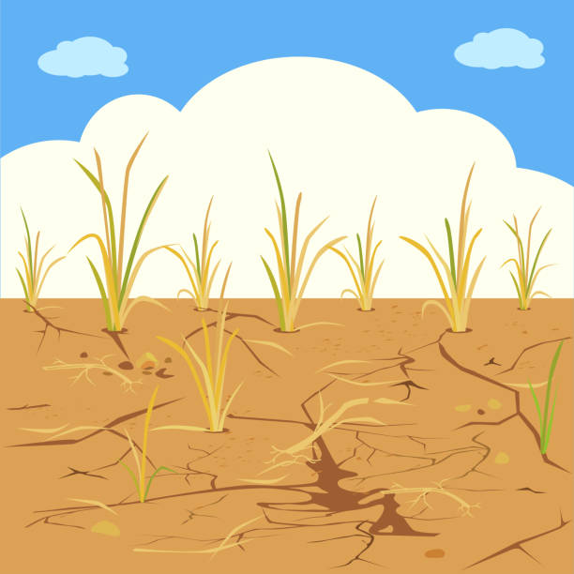
1
0
0x
Explanation of fertilizer payout under poor rain.

Slide 3
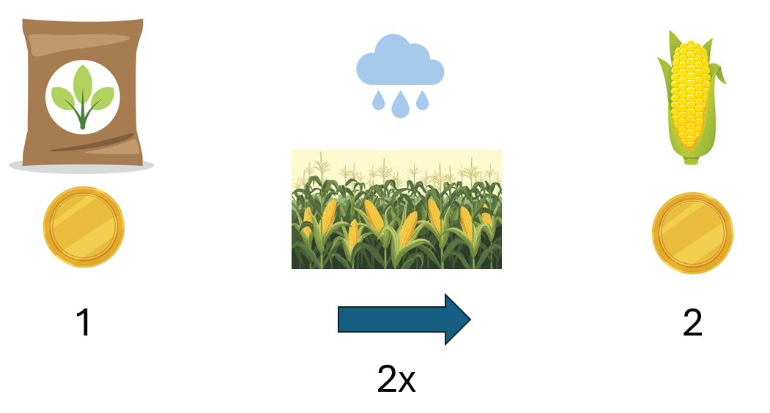
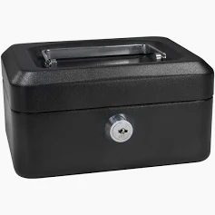
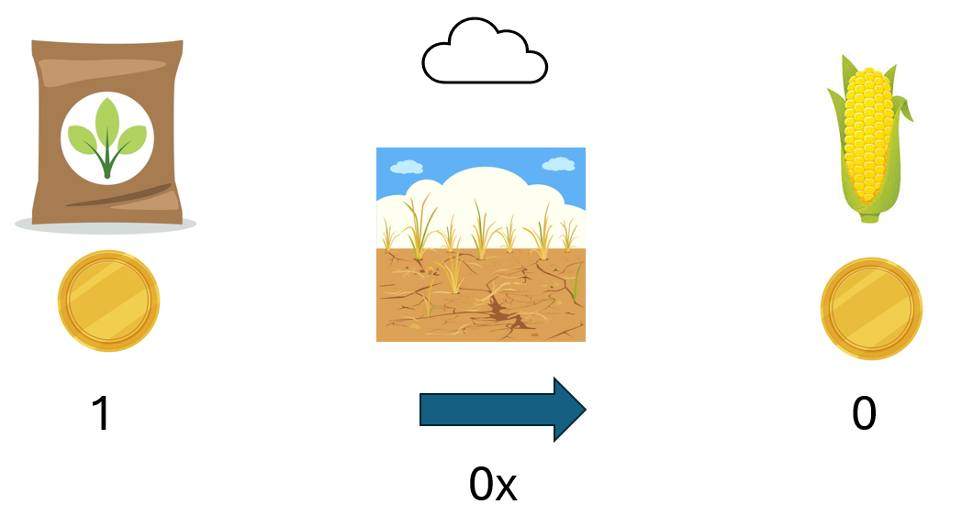
Practice round and round 1 decision screen. Total in the lock box should update as participants select fertilizer purchase amounts. Possible payout reminder box.
25
0

Slide 4
Positive rainfall realization

Slide 5
Negative rainfall realization

Slide 6

Choice to watch a video explaining insurance
1

Slide 7

Round 2, Version 1 decision screen. Total in the lock box should update as participants select input purchase amounts. If possible, insurance icon should be grayed out until seed is also purchased.
1
10
2
0
0
0
25

Slide 8
Round 2, Version 2 decision screen. Total in the lock box should update as participants select input purchase amounts.
1
12
25
0
0

Slide 9
Example payout summary screen
5
0
10
0
10
25
0
0
10
10

