Slide 1

Java Microservices and Spring Boot
By Shreyas Patil

Slide 2
Hospital Management Application
By Shreyas Patil

Slide 3


Use of Hospital Mangement Application
With the help of this application we can manage the work of hospital so that it will become easy for Doctor and Patient to book appointment, see appointment, view prescription, view patient history.
Patient can book their Appointment, View their Prescription.
Doctor can see their Appointment, Give Prescription.
History of Patient can be save in the Application.

Slide 4
Tools Used
Maven
Docker
Java
Spring Boot
MongoDB
RabbitMQ

Slide 5

Maven is a popular open-source build tool developed by the Apache Group to build, publish, and deploy several projects at once for better project management.
MAVEN Commands
mvn clean install
mvn spring-boot :run

Slide 6
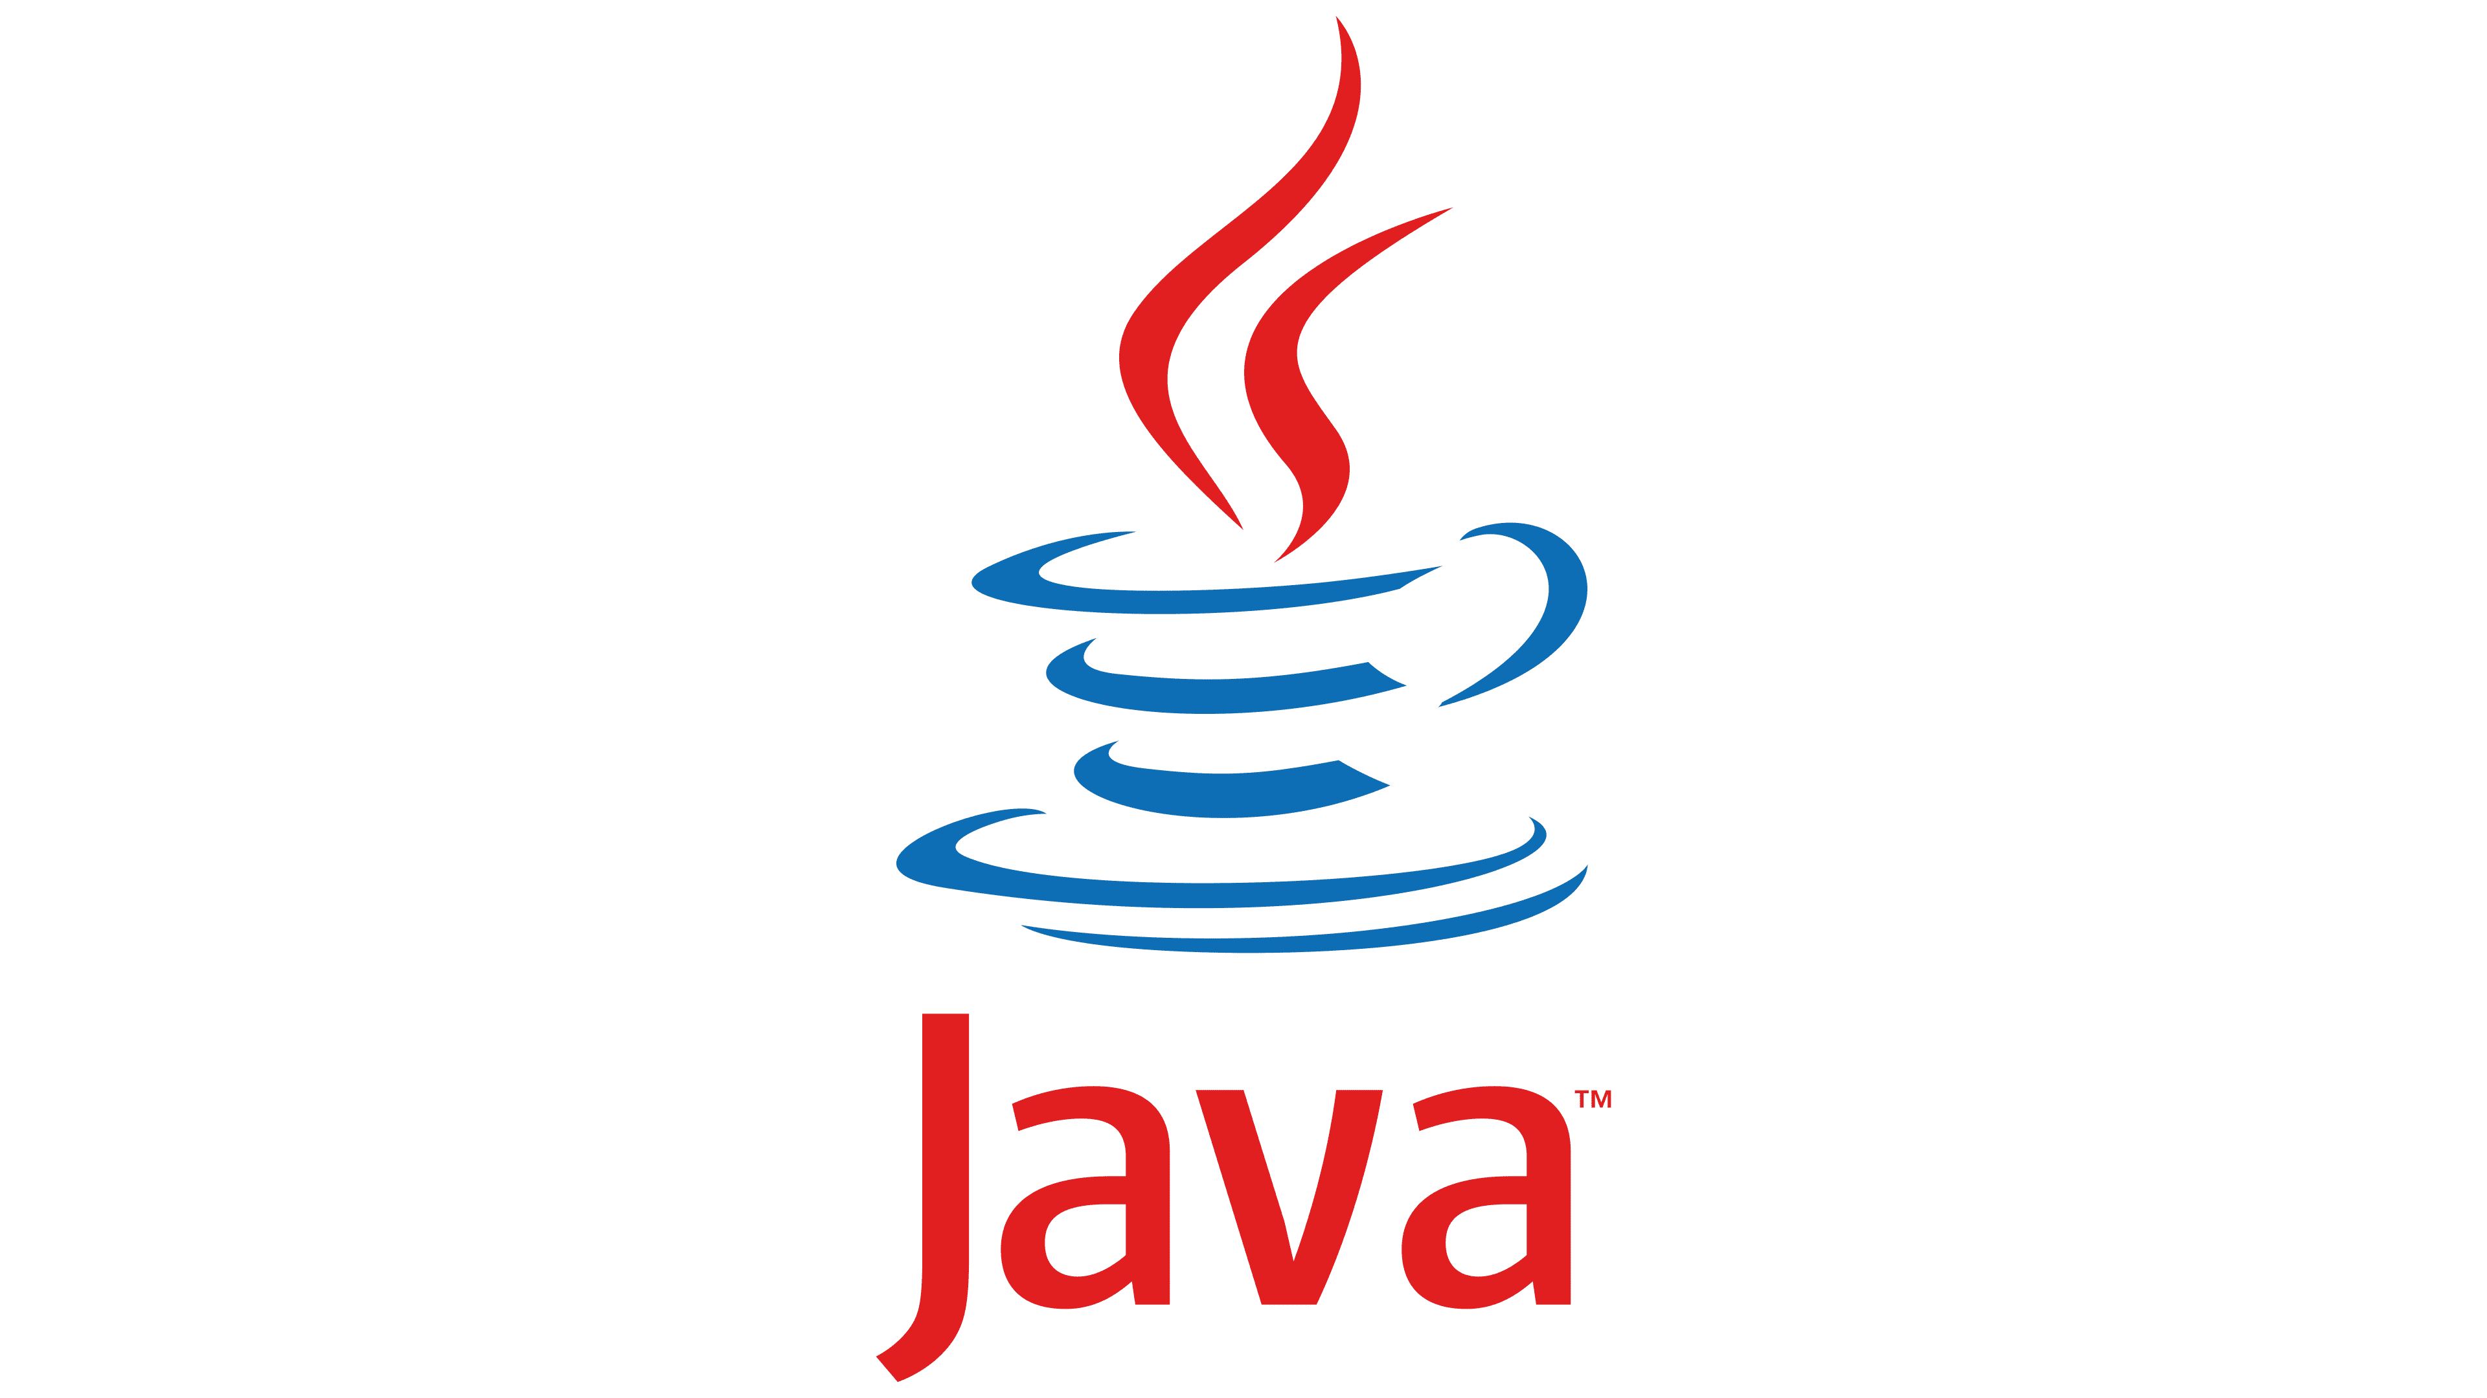
Spring Boot. This is a popular framework for building Java applications, especially microservices, because it simplifies much of the setup and configuration process for getting your applications running. Swagger. This is a Java framework for building APIs. This also can help with the communications layer between microservices.
JAVA
al growth

Slide 7
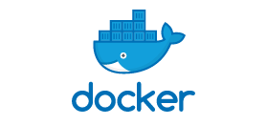
DOCKER
Docker is a software platform that allows you to build, test, and deploy applications quickly. Docker packages software into standardized units called containers that have everything the software needs to run including libraries, system tools, code, and runtime. Using Docker, you can quickly deploy and scale applications into any environment and know your code will run.
Running Docker on AWS provides developers and admins a highly reliable, low-cost way to build, ship, and run distributed applications at any scale

Slide 8


Spring Boot
What is Spring Boot?
Java Spring Framework (Spring Framework) is a popular, open source, enterprise-level framework for creating standalone, production-grade applications that run on the Java Virtual Machine (JVM).
Java Spring Boot (Spring Boot) is a tool that makes developing web application and microservices with Spring Framework faster and easier through three core capabilities:
Autoconfiguration
An opinionated approach to configuration
The ability to create standalone applications

Slide 9
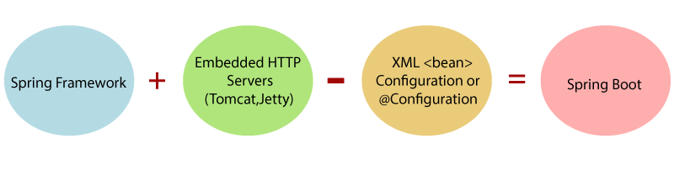

Slide 10

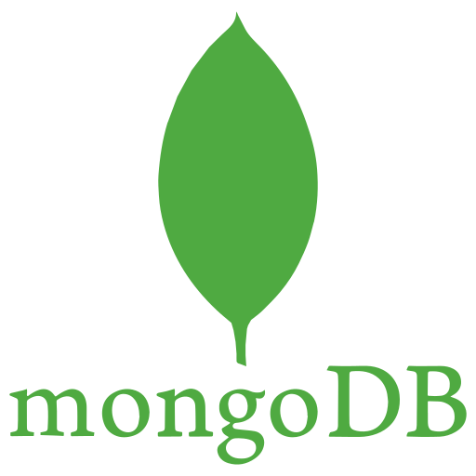
MONGO DB
MongoDB is an open-source document database built on a horizontal scale-out architecture that uses a flexible schema for storing data. Founded in 2007, MongoDB has a worldwide following in the developer community.
Instead of storing data in tables of rows or columns like SQL databases, each record in a MongoDB database is a document described in BSON, a binary representation of the data. Applications can then retrieve this information in a JSON format.

Slide 11
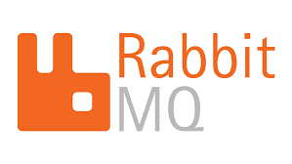
RABBITMQ
RabbitMQ is an open source messaging server that makes use of the AMQP (Advanced Message Queuing Protocol) protocol. Rabbit is compatible with many programming languages and allows you to handle message traffic simply and reliably. It is worth mentioning that it also has a native administration interface and is cross-platform.

Slide 12
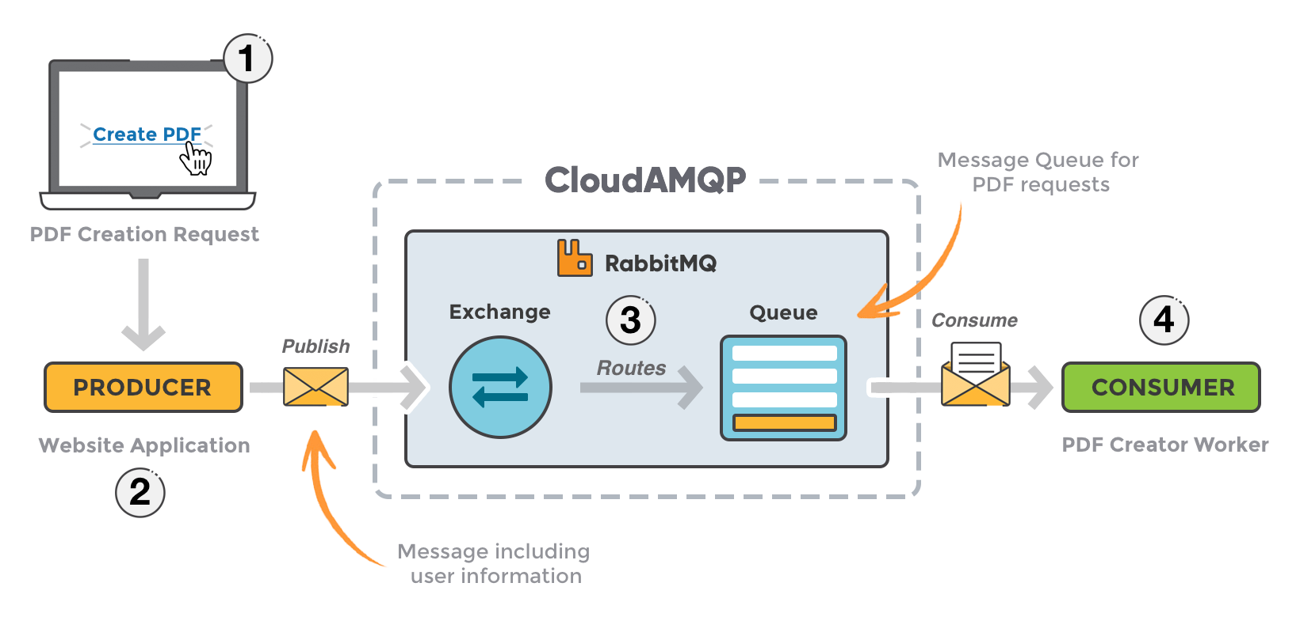

Slide 13

THANK YOU

