Slide 1
Pension Management System
Mrudal Salekar
Assistant System Engineer-Trainee

Slide 2
Contents :
Indroduction
Microservices
SpringBoot
Docker
Features
Architectures
Admin View
User view
Procedure
Advanteages
conclusion

Slide 3
Introduction:-
The purpose of building this application is to build a system that gives employee or employer various functionality for their pension management system.
This application includes various function like create applicant , check status , check balance ,check application,issue pension ,load pension using spring boot framework

Slide 4
MicroSerices:-
"The microservice architectural style is an approach to develop single application as a suit of small services, each running in its own process & communication with light weight mechanism"
"Microservices are SMALL & AUTONOMUS services that work together."
There is no specific technology used to build MS.
Benefits :
1) Easy deployment 2)Simple scalability
3)Easy Development Compatible with containers
4)Reusable Code Less production time

Slide 5
Spring Boot:-
>"Spring Boot provides a good platform for Java developers to develop a stand-alone and production grade application that you can just run.“
>"Spring Boot provides a good platform for Java developers to develop a stand-alone and production grade application that you can just run.“
>It offers annotation-based spring application.
Benefits :1) Easy to understand
2)Increase productivity
3)Reduces development time

Slide 6
Docker:-
It simplifies collaboration by allowing anyone to work on the same project.
Multiple Development environments can be run from the same host.
Projects can be tested on different servers.
It gives us instant application portability.

Slide 7
Features:-
Employees can easily apply for pension.
Fast pension approval system.
Pension can be easily issued to applicants.
Easily transfer monthly balance amount to working employees.
Authentication based system

Slide 8
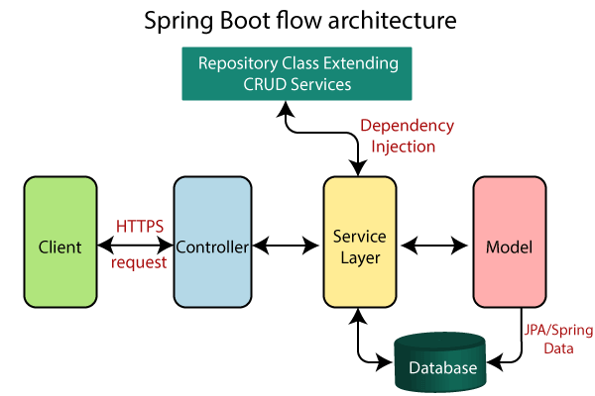
Architecture:-

Slide 9
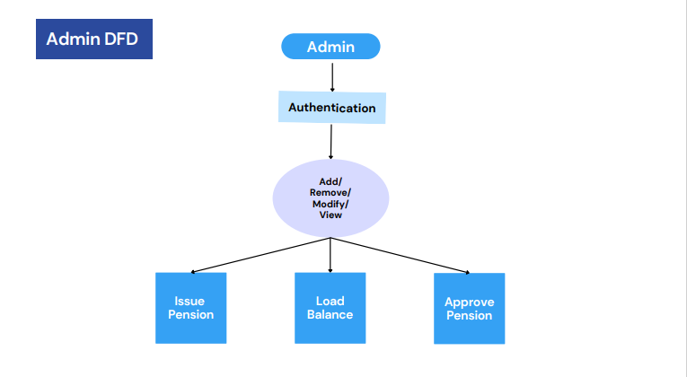

Slide 10
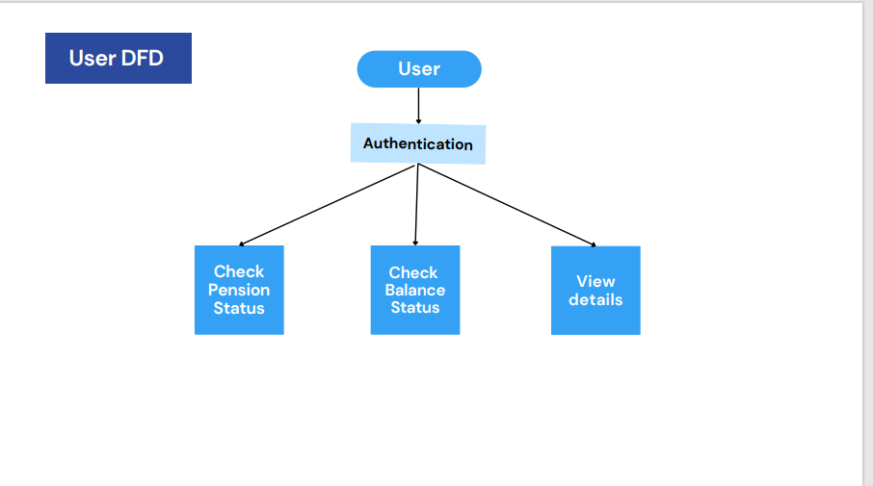

Slide 11
Procedure:-
Create Application structure using Spring Intillizer by adding requirement , dependency and versions.
Download zip from spring initializer and extract that and open it from IDE.
Write required functionality.
We have to build the application by using maven clean install.
Start mysql image in docker using Docker-compose -f docker-compose-mysql.yml up -d.
Run the Spring Boot Application.

Slide 12
Tomcat server will be started.
Check all functionality from postman.
Check the data in Postman by using url https://localhost: port number/method name.
Now we can perform the actions of methods on the data.

Slide 13
Advantages:-
Easy to use/User friendly.
Due to database it minimize data redundancy.
Easy to perform operations like add, update, search, delete etc.

Slide 14
Conclusion:-
This Pension Management System is designed to manage pension activities for both applicants and pension admins.
It is beneficial to a pension management organization as well as employee because it is easy to use and user friendly Thus, the basic aim of carrying out this project is to develop a solution that will largely, help in the aspect of pension management which would help eliminate the problems associated with the manual process and easy to manage pensions.

