Slide 1

Dive into Microservices

Slide 2

Architectural style

Slide 3

SOA
service
oriented
architecture
Modernized version of SOA
New world:
Speed of delivery
Scalability
Innovation / experimentation
Cloud / devops
Notes:
3

Slide 4
VS
monolith
microservices
Notes:
4

Slide 5
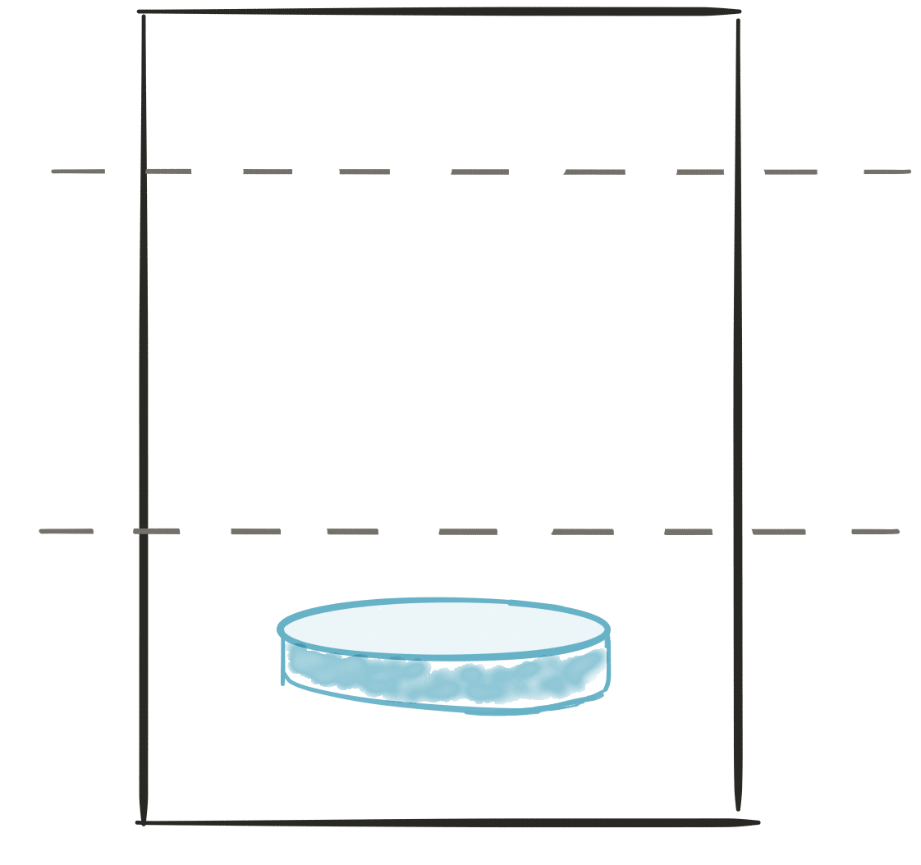
A monolith
Module
A
Module
B
Module
c
Module
D
PRESENTATION LAYER
BUSINESS LOGIC LAYER
DATABASE LAYER

Slide 6
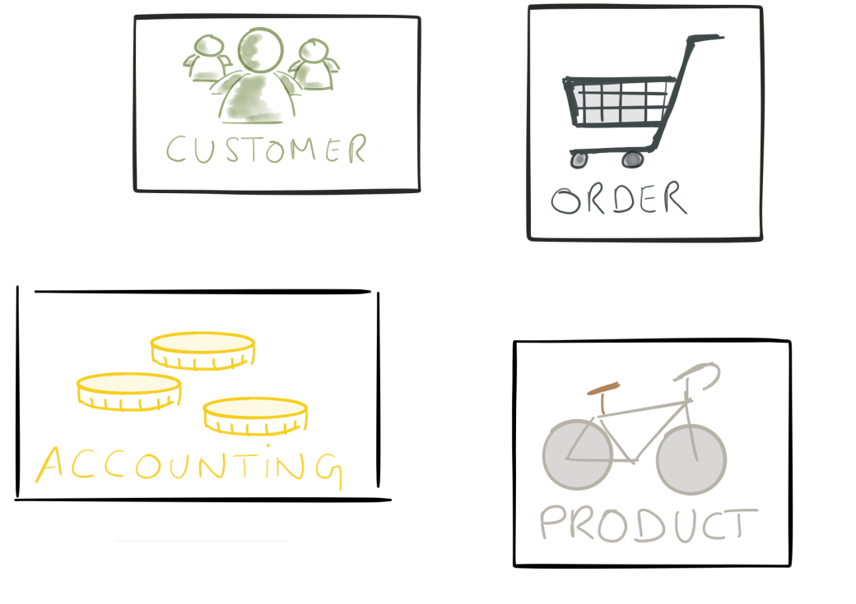
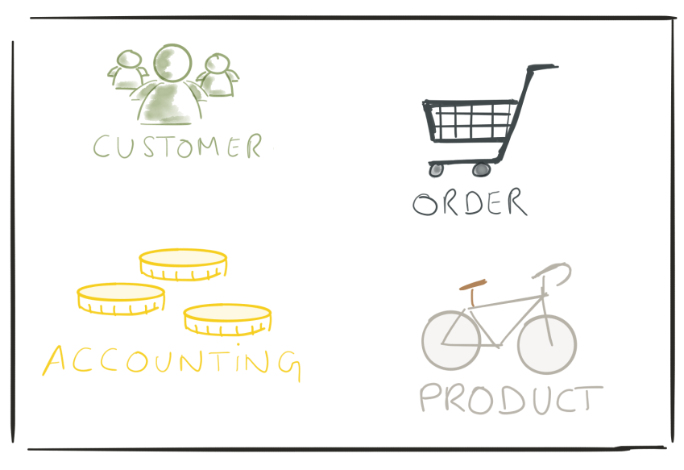
VS
monolith
microservices
Notes:
6

Slide 7
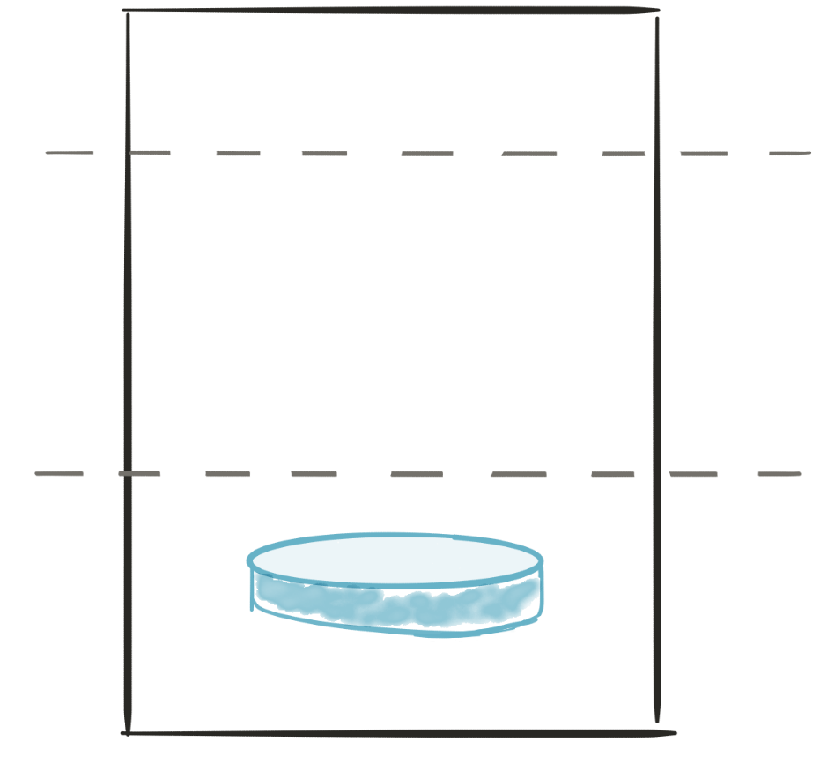
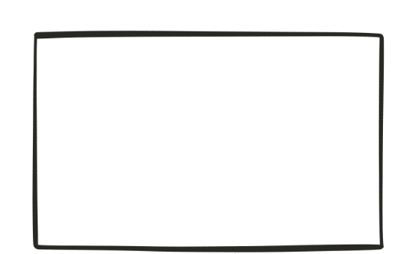
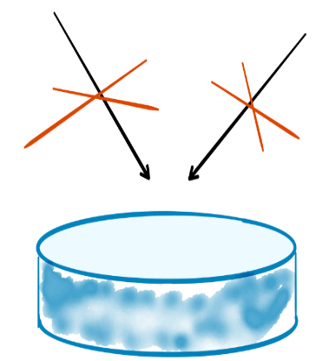
microservices
API
API
PRESENTATION LAYER
consume
Produce
BUSINESS LOGIC
LAYER
BUSINESS LOGIC LAYER
DATABASE LAYER
DATABASE LAYER
Microservice 2
Microservice 1
Notes:
7

Slide 8

principles
Modularity
Autonomous
hide implementation details
automation
Stateless
highly observable

Slide 9
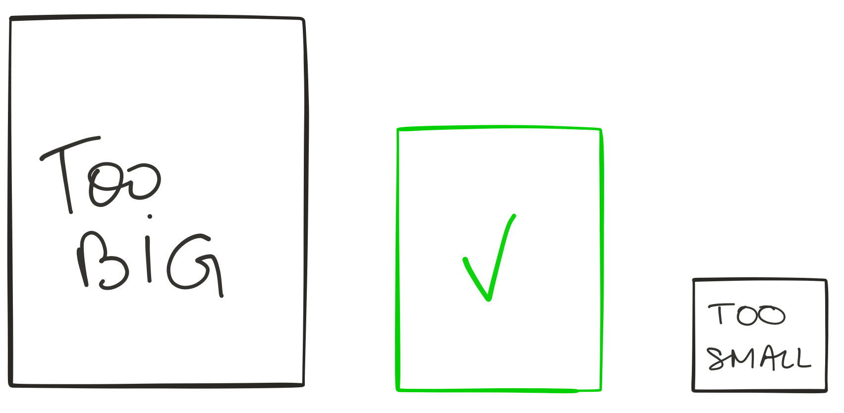
modularity

Slide 10

modularity
ModeLled around business capability
Single responsibility
Single data domain
Separation of concerns
Low coupling
Understandable by a person
Notes:
10

Slide 11
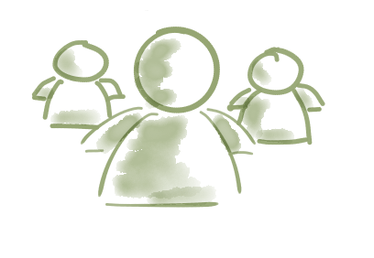
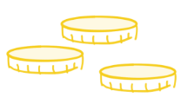

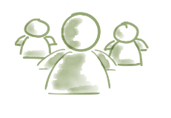


Modularity (TEAM)
A product not a project
UI - team
UI
dba
SERVER
SERVER - team
UI
dba
SERVER
Dba - team
UI
dba
SERVER
monolith
microservices

Slide 12


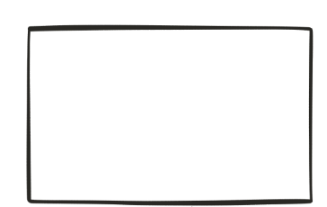
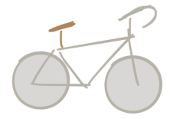
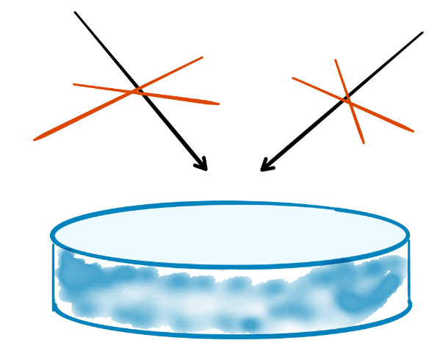
autonomous
Notes:
12

Slide 13
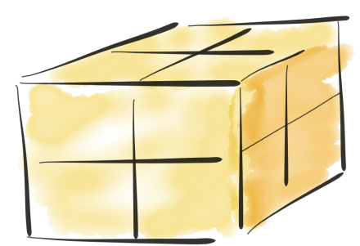
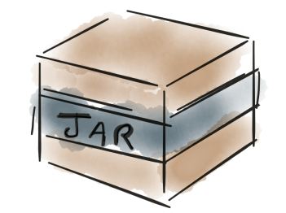

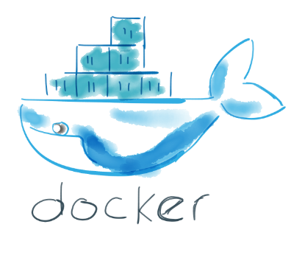

autonomous
- Libraries
- http listener
monolith
microservices

Slide 14
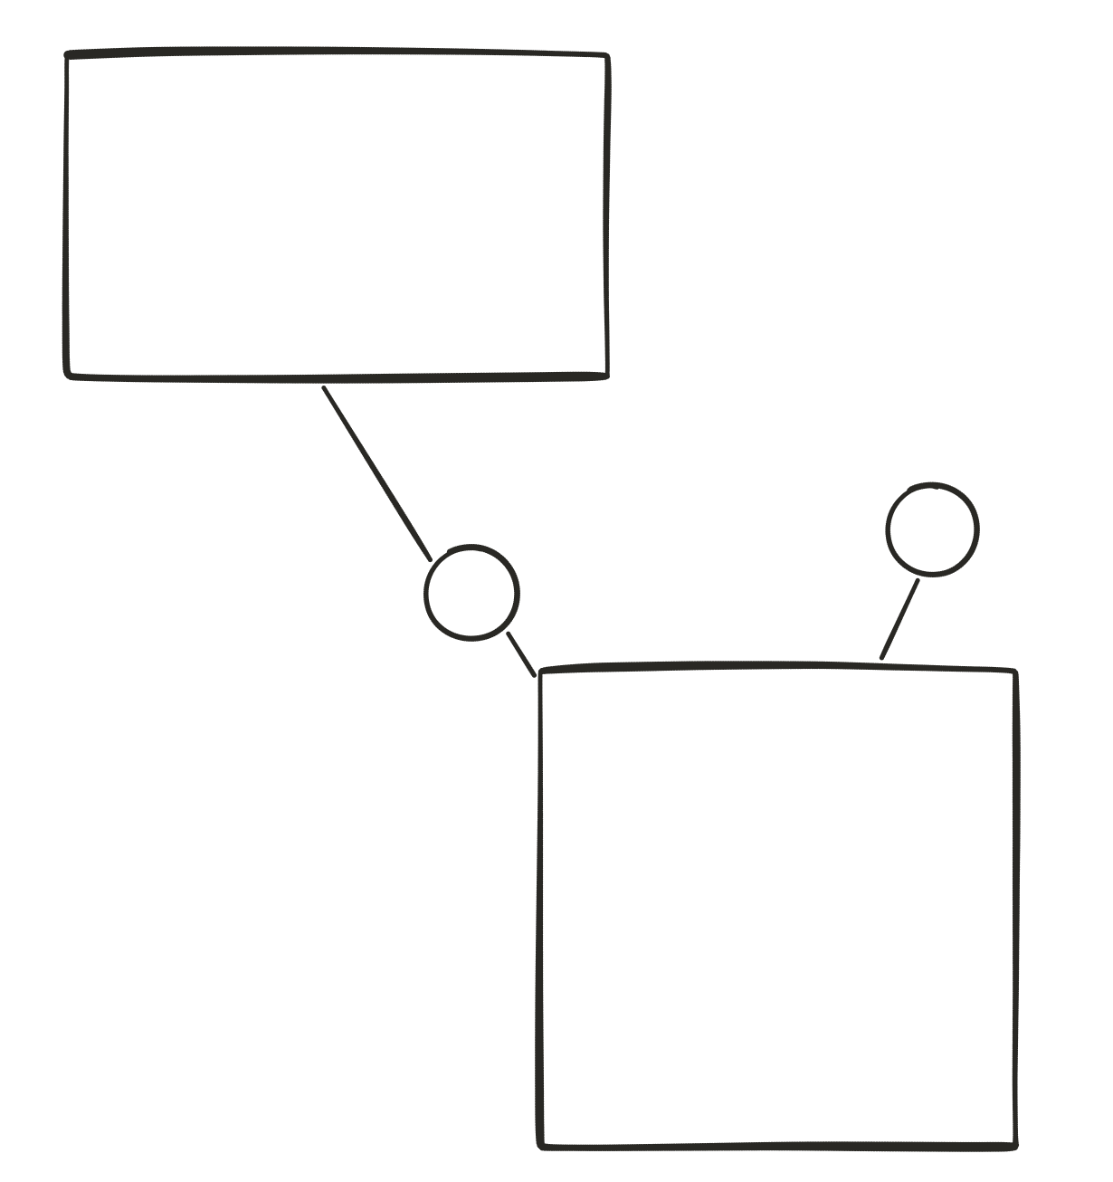

autonomous
v2
v1

Slide 15
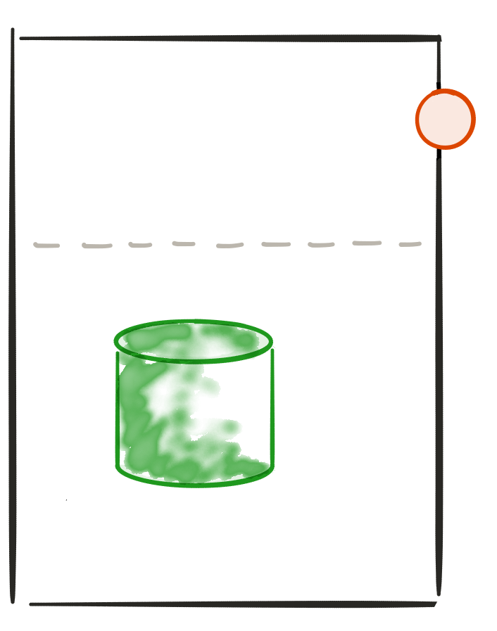
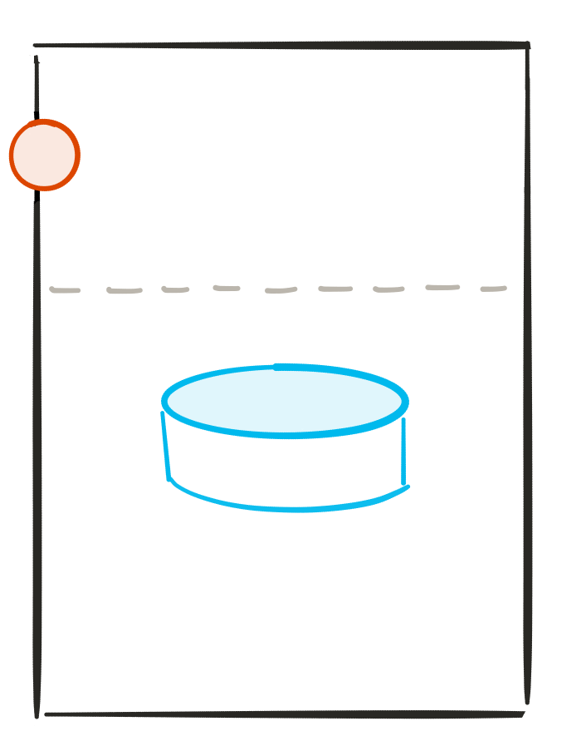






hide implementation details
API
-http
-rest
-json
API
http-
Rest-
Json-

Slide 16

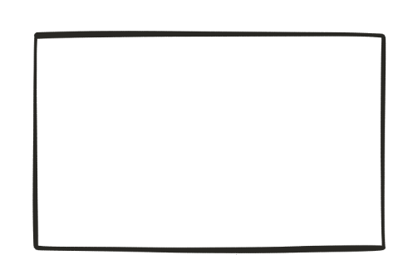
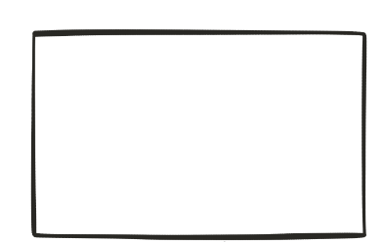




automation
Deploy
On dev/TEST
Deploy on
prod
build
testing
Continuous integration
Continuous deployment

Slide 17
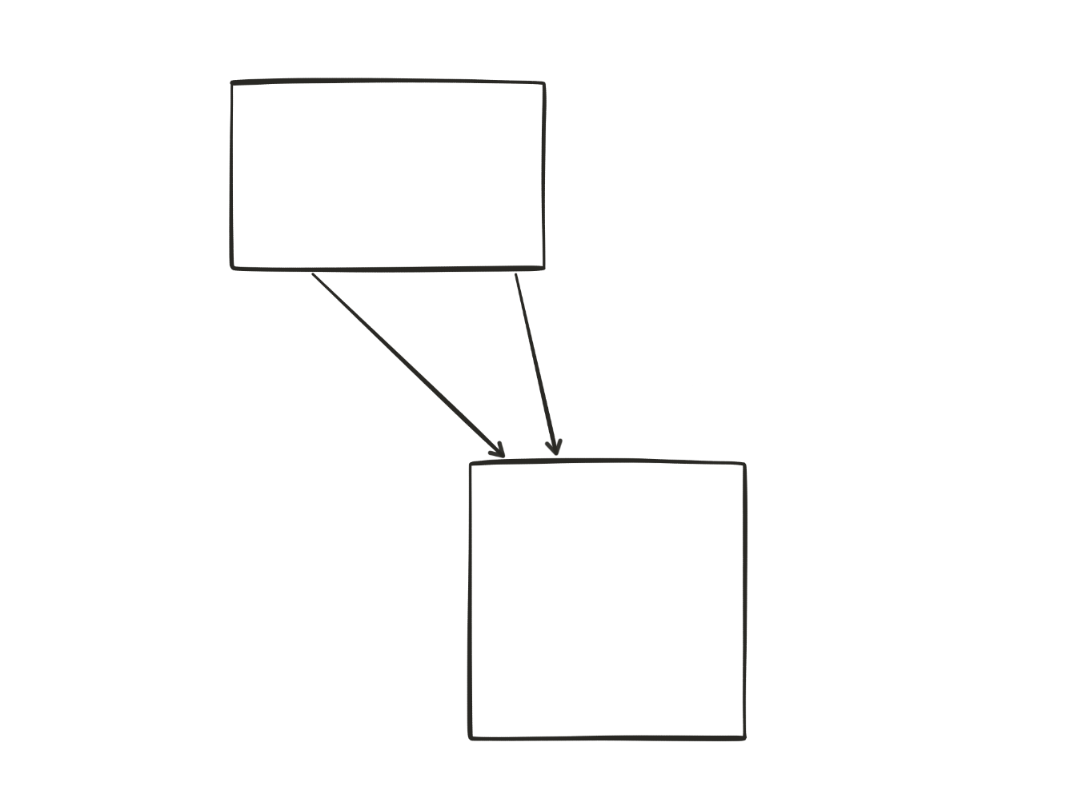
stateless
(2)
(1)
Notes:
Easier to scale / recover from failure
17

Slide 18

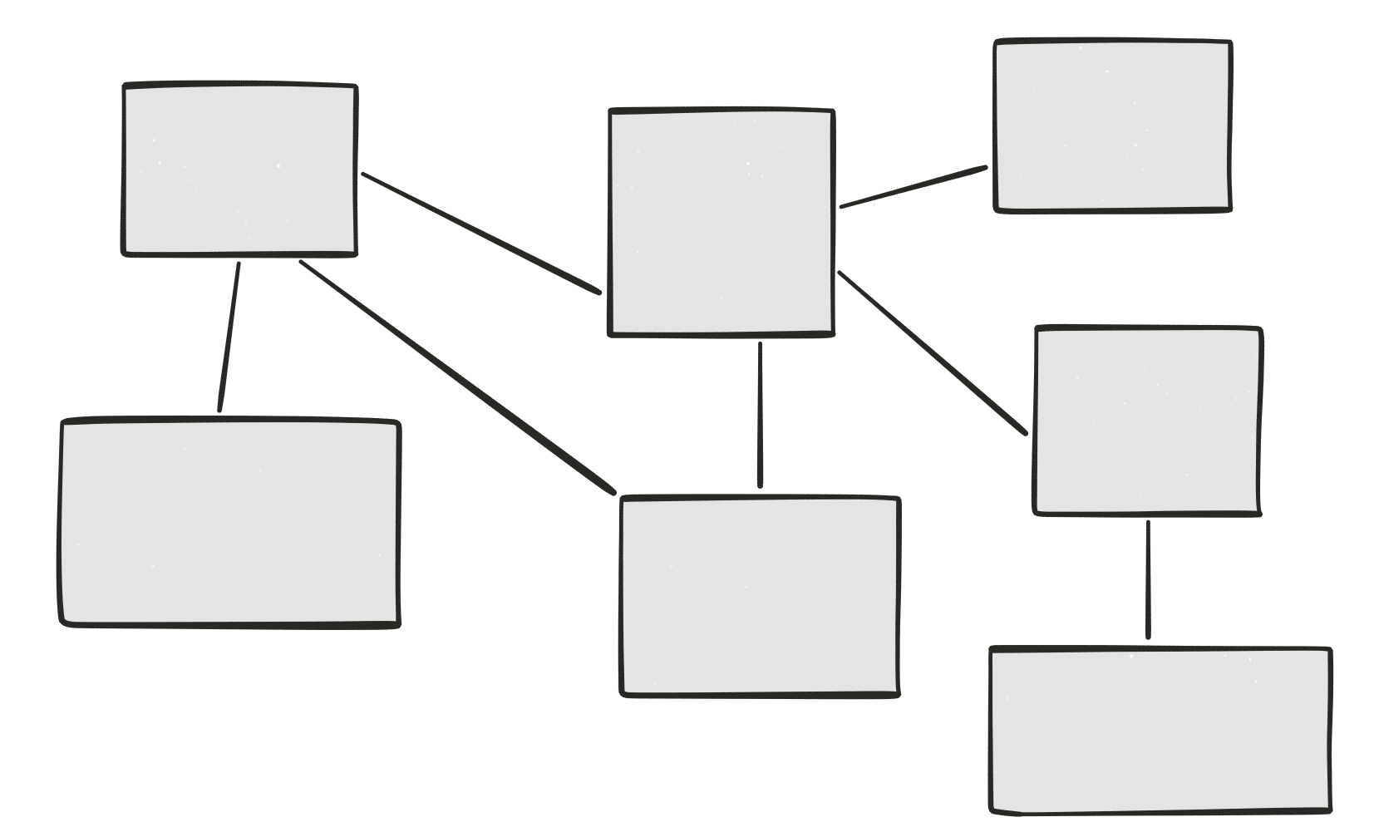
Highly observable
Logs
Notes:
18

Slide 19
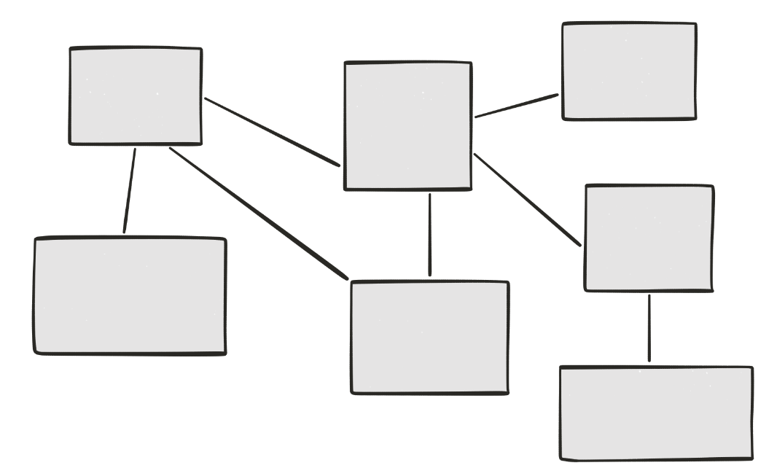

Highly observable
Centralized logging

Slide 20
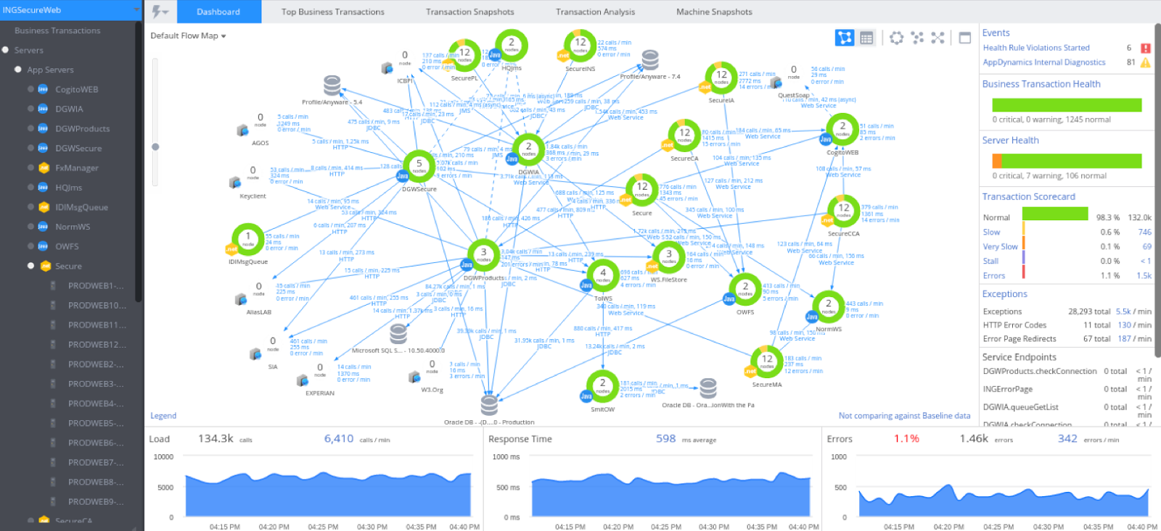
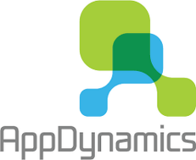
Highly observable
monitoring

Slide 21
Highly observable
Correlation ids
ID 5678
ID 5678
ID 5678
ID 5678
Notes:
21

Slide 22

principles
Modularity
Autonomous
hide implementation details
Automation
Stateless
highly observable

Slide 23
Advantages

Slide 24
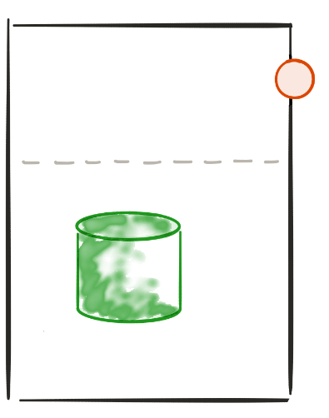
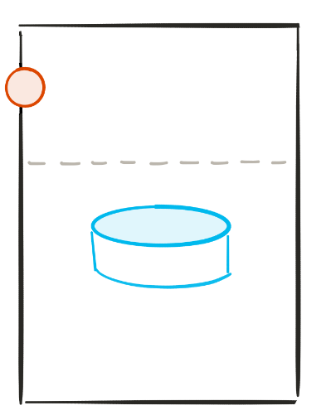


Polyglot architecture
The right technology for the job
reduce technical debt

Slide 25
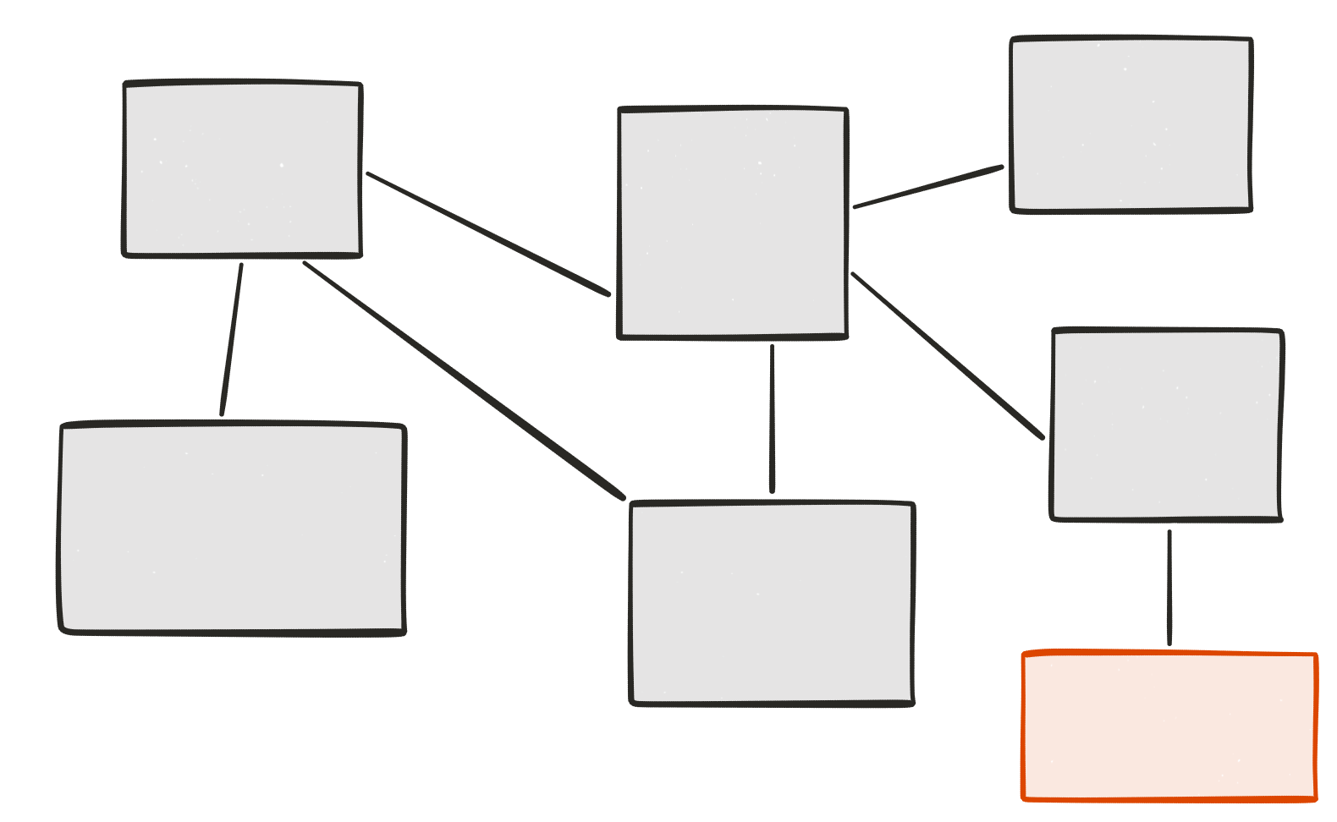
Evolutionary design
Remove
Add
Replace
Experimental microservice
Grow at “no” cost

Slide 26
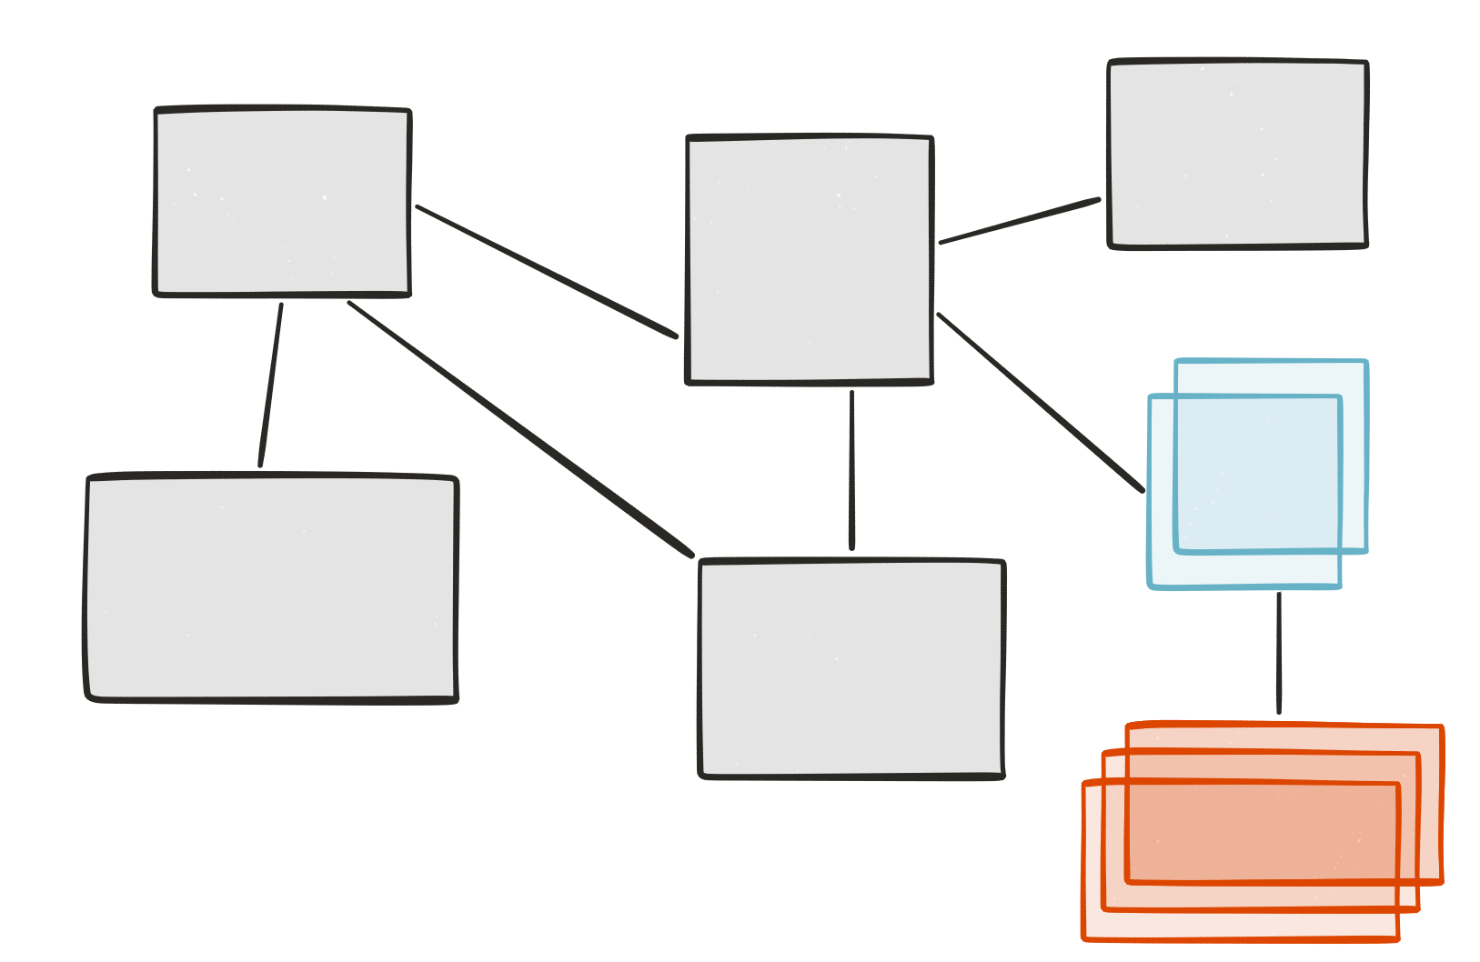
Selective scalability
Nb users > 500
Notes:
26

Slide 27
Big vs small
Smaller code base
Simpler to develop / test / deploy / scale
Start faster
Easier for new developers
Notes:
27

Slide 28
drawbacks

Slide 29
Distributed system
Consistency
Transaction
Request travelling
Slow (http)
Requires an ecosystem
Synchronous vs asynchronous
Integration tests
Conclusion:
The Microservices architecture is more complex
Than a monolith.
This the cost of growing and scaling easily
Notes:
29

Slide 30
Microservices ecosystem

Slide 31

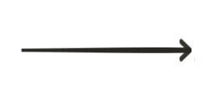

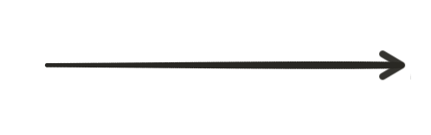
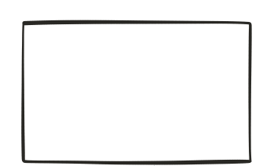
Load balancer
Load balancer

Slide 32

Load balancer (client side)
Load balancer

Slide 33
Service discovery
Service discovery
server
register
register

Slide 34
Service discovery
Service discovery
server
I want TO TALK TO THE PRODUCT SERVICE !
Here is the product service !

Slide 35
Service discovery (load balancing)
Service discovery
server
I want TO TALK TO THE PRODUCT SERVICE !
Here is one instance of product service !

Slide 36
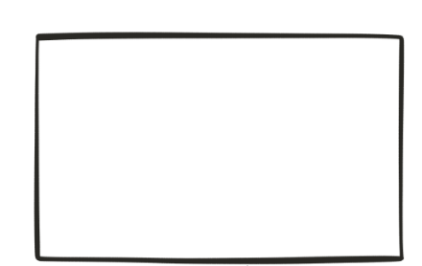

Api Gateway
Browser UI
e.g. angular 2
Mobile app
API Gateway
e.G. (ZUUL)
Notes:
API gateway
Insulates the clients from how the application is partitioned into microservices
insulate the clients from the problem of determining the locations of service instances
Provides the optimal API for each client
Reduces the number of requests / roundtrips.
Backend for front end
36

Slide 37
This is not new!
The old new thing...
Principles
Modularity
Autonomous
hide implementation details
Automation
Stateless
highly observable
advantages
Polyglot architecture
Evolutionary design
Selective scalability
Big vs small
drawbacks
Distributed system
Synchronous vs asynchronous
Slow (http)
Requires an ecosystem
ecosystem
Load balancer
Service discovery
api gateway

Slide 38
12 Factor Apps
https://12factor.net/

Slide 39
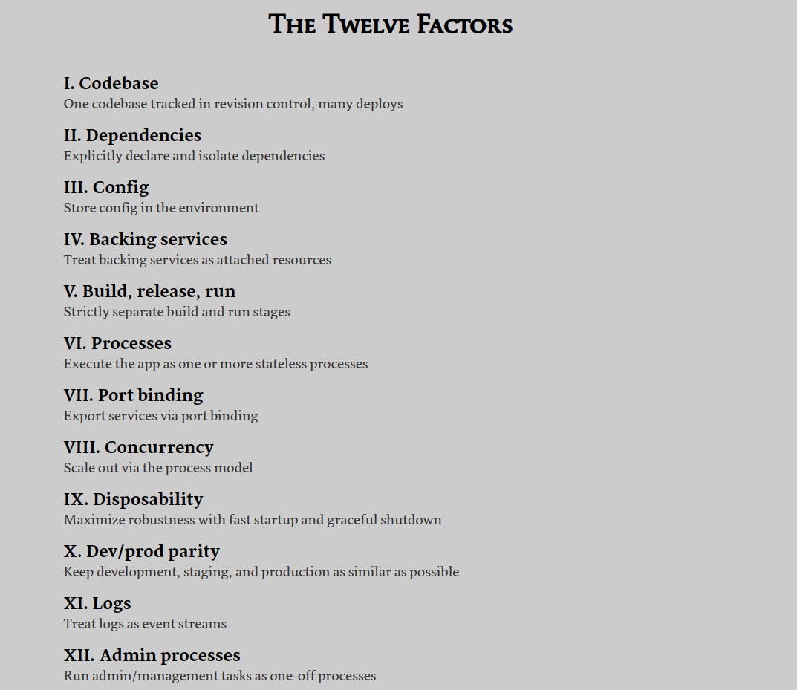

Slide 40
THANKS !

