Slide 1
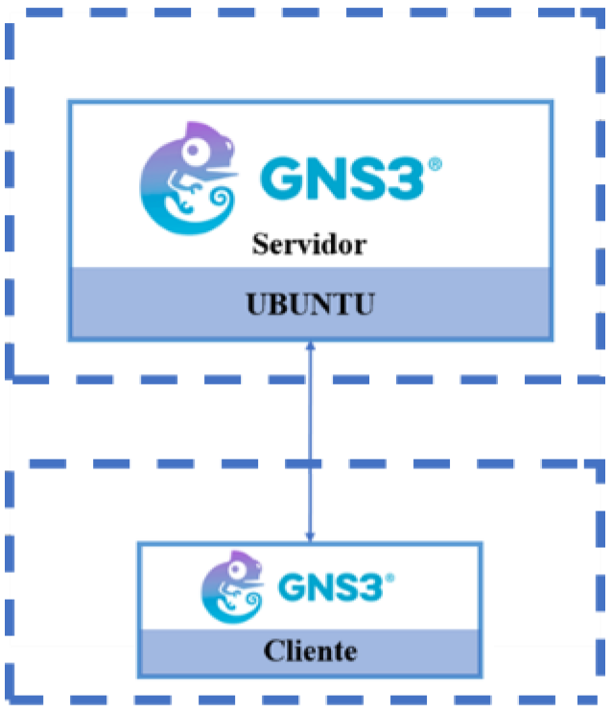
EC₂ instance
Server
Ubuntu 20.04
Local PC
Client

