Slide 1
Chess board and piece recognition
Student: Samarghitan Flaviu, group 30434
Supervisor: Varga Robert
21.05.2018

Slide 2
Introduction
The recording of moves during a chess game is a tedious manual task that impedes the flow of the game, especially in formats such as speed chess
More recently, chess playing AI have relied on either specialized equipment or human assistance in order to function. To create an autonomous chess-playing robot would require the ability to detect a chessboard and pieces through vision.
This is where this project intervenes !

Slide 3
State of the Art
Most of the previous computer vision work related to chess has focused on the area of board recognition. General techniques for board recognition can be separated into corner-based approaches and line-based approaches.
Corner-based approaches use corner detection, then either perform Hough transforms to identify the lines of the board or assign coordinates to the corners directly
Line-based approaches use edge detection on the input image to identify lines of the chess board. Domain knowledge such as the fact that the board can be identified by 18 total lines and the orientations of half those lines will be orthogonal to the other half, makes line-based approaches more robust to noise, and is therefore the more popular technique

Slide 4
State of the Art
Not as much work has gone into piece recognition.
Game-tracking applications assume the starting positions of the pieces, and there can use differences in intensity values after each move to track the movement of pieces.
Techniques that do not assume a starting position focus on color segmentation to detect pieces and then use shape descriptors to identify them.
However, color segmentation often relies heavily on the ability to distinguish the four major colors on a chessboard – the colors of white squares, black squares, white pieces, and black pieces. Often, squares and pieces of the same color are difficult to distinguish, so unreasonable constraints must be placed, such as the usage of a red-and-green chessboard

Slide 5
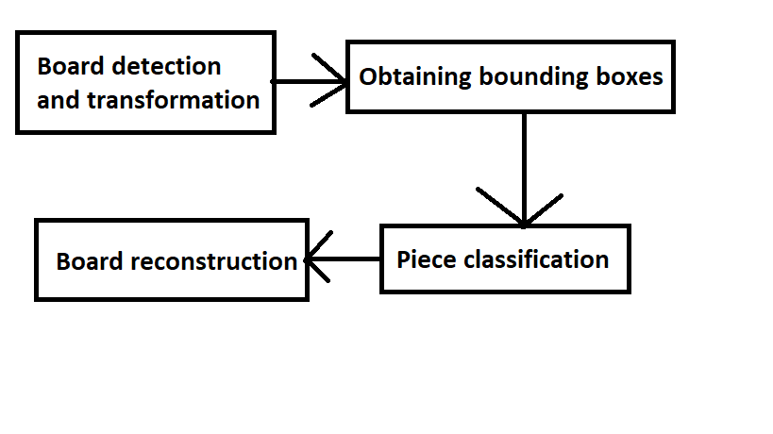
Proposed solution

Slide 6
Board detection and transformation
In order to avoid errors while detecting the board, the user is prompted to select the corners of the board (the focus falling on piece recognition accuracy)
The 2D coordinates of these corners are then used to calculate a projective transformation that maps the board in the image to a 640 pixel by 640 pixel rectified board
All the following operations are performed on the rectified board, containing only the board and pieces
Function used: opencv's findHomography()

Slide 7
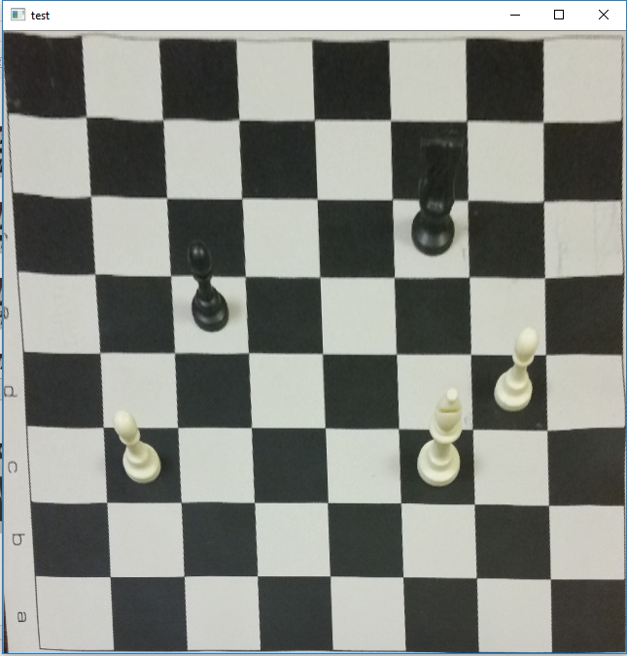
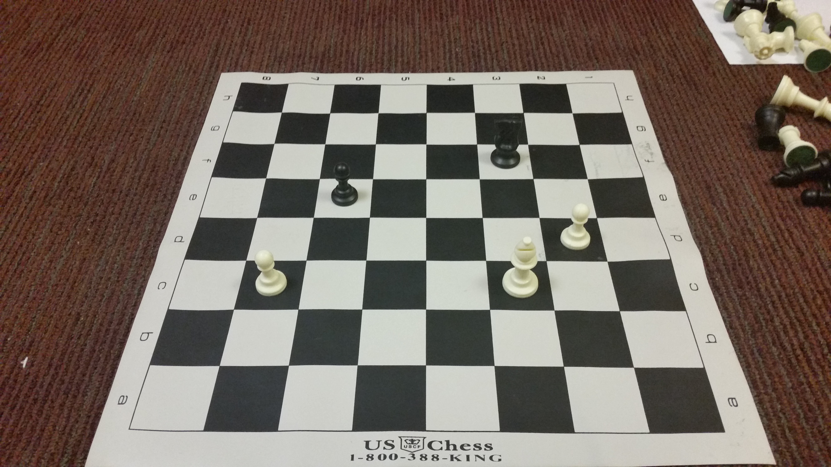
Board detection and transformation

Slide 8
Obtaining bounding boxes
Using knowledge about our domain (the chess board), extracting the bounding boxes can be done easily
In our 640x640 rectified image, we know we should have 64 squares, each square having an area of 80x80 pixels
The input for our classifier will be an image with a ratio of 1:2. This ratio has been chosen in order to encapsulate all features present for some of the taller pieces (like the queen or the king). A discussion about why multiple ratios should/ shouldn't been considered is present at the end

Slide 9
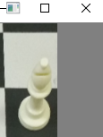
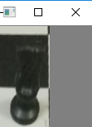
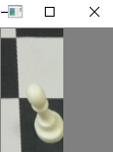



Obtaining bounding boxes
Extracted pieces:
Training pieces:

Slide 10
Piece classification
In order to ensure the resulting features were of the same size, all
images in the database were resized to 64 pixels by 128 pixels.
Features were constructed using dense SIFT (scale invariant feature transform).This should perform better when performing recognition on small images
For each extracted piece, a histogram of features was constructed and fed to a series of classifiers in order to determine the piece

Slide 11
Training
There does not currently exist an extensive database of labeled chess pieces (small labeled database with a total of 330 images, ratio 2:1)
K-means was run over extracted keypoints for each training image, thus obtaining the centroids, which we refer to as words
These centroids are used to construct the histogram of features, mapping each feature obtained with SIFT to the closest centroid
Libraries/ functions used: VLfeat for DSIFT, opencv's kmeans

Slide 12
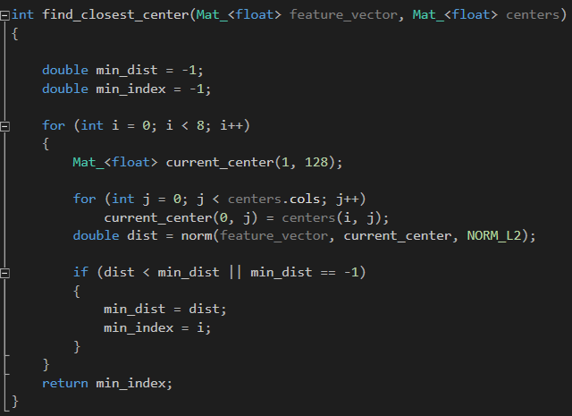
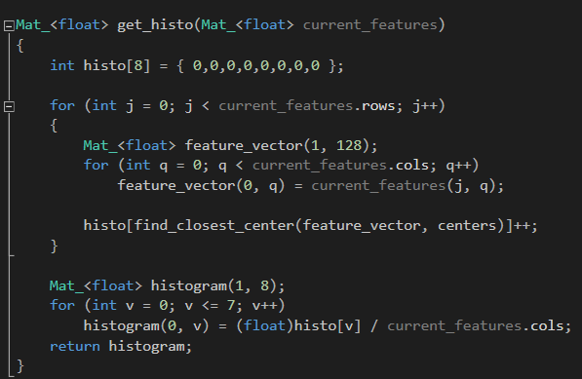
Training

Slide 13
Training
The learning algorithm uses SVM. The inputs are the labeled histograms of features.
The histograms of features have size equal to the number of centroids obtained by the k-means clustering. Each feature of the piece image looks for the centroid it is closest to and increases the position corresponding to it in the the histogram. Then the histogram is normalized
Multiple classifiers are used (One vs. All approach). The one which yields the highest probability is selected as our predicted class
Functions: opencv's SVM

Slide 14
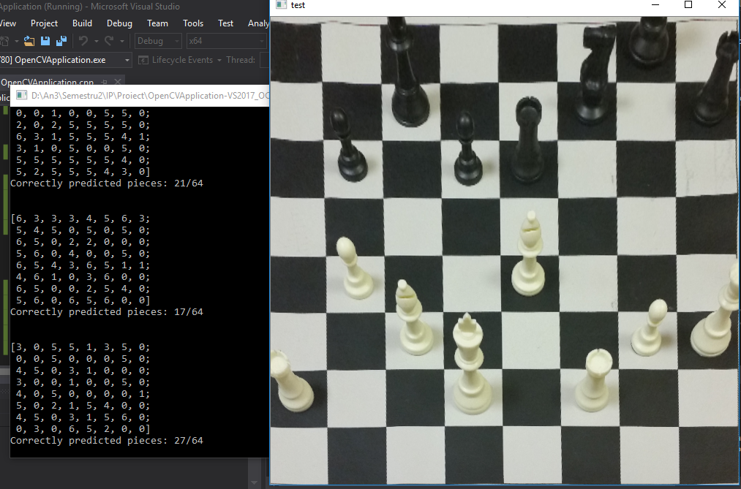
Board reconstruction and result
After iterating through the whole board and checking each slot for the corresponding piece,
the board is put toghether
and outputed as a matrix
The results have around 40 %
accuracy

Slide 15
Conclusion
We have proved that this kind of approach to piece recognition has some merit and could be looked more into
Some of the problems that arise and should be improved:
Low data availability
Optimal size of bounding box
Classification algorithm improvement
Automatic board recognition
Discussion!
- Bounding box size – multiple ratios and feature duplication

Slide 16
Bibliography
https://web.stanford.edu/class/cs231a/prev_projects_2016/CS_231A_Final_Report.pdf - chess vision research paper
http://www.vlfeat.org/overview/dsift.html - VLFeat DSIFT documentaiton
http://answers.opencv.org/questions/ - Machine learning questions (openCV)
https://en.wikipedia.org/wiki/Scale-invariant_feature_transform - understanding SIFT

Slide 17
Thank you !

