Slide 1
Principal component analysis
Extracting relevant features from pedestrian contours
Samarghitan Flaviu 30444

Slide 2
1. Introduction

Slide 3
1.1 Topic context
In machine learning and statistics, feature selection, also known as variable selection, attribute selection or variable subset selection, is the process of selecting a subset of relevant features (variables, predictors) for use in model construction. Feature selection techniques are used for four reasons:
simplification of models to make them easier to interpret by researchers/users
shorter training times
to avoid the curse of dimensionality
enhanced generalization by reducing overfitting (formally, reduction of variance)

Slide 4
1.2 Issues that should be solved
Interpreting large sets of data can prove to be very difficult for humans, especially generalizing a dataset that shows no visible correlation between features percievable by the human eye
But numbers do not lie. The PCA algorithm is used in order to eliminate the irrelevant features that are messing with the existing classification's algorithms implementations. The redundant features result in possible incorrect classifications and longer run times.

Slide 5
1.2 Issues that should be solved
But when the objective is not classification, PCA can also be used exactly in the opposite way, the irrelevant features are the ones that stay linearly constant in our examples.
These features are very generic and can be used to get a glimpse of the resemblance between our data points.

Slide 6
1.3 Proposed objective
Our objective is to use the PCA algorithm in a manner that is not usually associated with it. We will try to form the image of a generic pedestrian from our dataset.
After finding the irrelevant features from each of our contour, we remove them and see a glimpse of how our pedestrians will look without the features that usually distinguish them.

Slide 7
2.Theoretical background

Slide 8
2.1 PCA definition
a mathematical procedure that transforms a number of (possibly) correlated variables into a (smaller) number of uncorrelated variables called principal components
uses an orthogonal transformation(linear transformation which preserves a symmetric inner product)
means of dimensionality reduction, compression and also visualization

Slide 9
2.2 PCA usage
preprocess a dataset to reduce its dimension before running a supervised learning learning
detecting redundant features and linear dependencies
noise reduction algorithm
finding patterns in data of high dimension
Domains of application:
Computer vision
Neuroscience
Quantitative finance

Slide 10
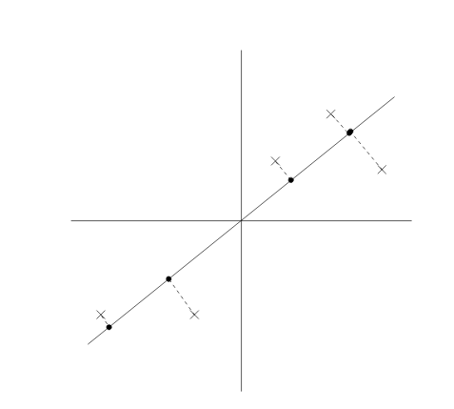
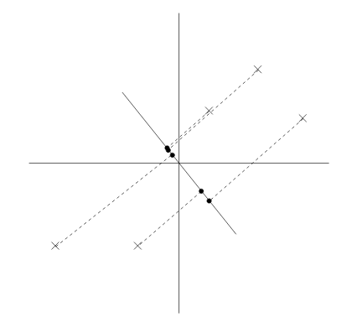
2.2 Intuitive example
High variance
Low variance

Slide 11

2.2 PCA exlpanation
Steps:
1.Mean normalization (mean centering) and feature scaling
Compute mean and subtract from each data point on every dimension
Scale each feature according to its magnitude
2. Calculate covariance matrix
Covariance shows the tendency in the linear relationship between random variables
Measures how much the dimensions vary from the mean with respect to eachother
We are interested in maximizing the preserved variance

Slide 12
2.2PCA explanation
3. Calculate the unit eigenvectors and eigenvalues of the covariance matrix
Find the axes along which the covariance is maximal
Eigenvectors : vectors that "reflect on themselves" accoring to our linear transformation (defined by covariance matrix)
Can only be found of square matrices (not all), scaling does not affect their direction, they are othogonal (perpendicular) to each other
4. Selecting relevant components
The eigen vector with highest eigenvalue is the principal component of our dataset
Order eigenvectors by eigenvalues, choose k most significant ones

Slide 13
2.2 PCA explanation
6. Deriving new dataset
Multiply components selected (feature vector) with original dataset (both transposed)
The result is the old data set expressed only by the components we have chosen
7. (optional) Getting our old data back
Perform reverse operation of step 6 (some data might be lost due to component selection)

Slide 14
2.3 Dataset chosen
The dataset chosen is the PedCut Benchmark dataset. It contains 785 pedestrian cutouts capured with a stereo camera from an on-screen board
Applying PCA on the pedestrian contours (after normalization), and then reconstructing a pedestrian contour from the extracted vector

Slide 15
3. Design and implementation

Slide 16
3.1 Step analysis
1. Extracting contours and normalizing data
2. Use the PCA algorithm to find the irrelevant features on both axis
3. Find the best selection algorithm based on the average of the sorted eigenvalue positions
4. Reconstruct the data from the vectors obtained
5. Find the average of the reconstructed points and form the "generic" pedestrian

Slide 17
3.1.1 Extracting contours and normalizing data
The contours are selected from the points on the edge of the cut-outs (having points with different coloured neighbours)
We correct the density of points, removing points at a fixed distance (choosing between 80-120 points)
We subtract the mean and divide by the variance
I have implemented these in the densityFIx(contour), getPointsFromContours(), getMean2DVector(vector), getVariance2DVector(vector) and preprocess(Data)

Slide 18
3.1.2 Implementing the PCA algorithm
Multiple attempts at choosing the correct way of interpreting the data that should be fed to the PCA has been attempted:
a. Applying PCA with the points as data => this results in choosing between the x and y axis when it comes to feature reduction, the points representing the features. This is a bad approach, since we want to find the points that are redundant to our contour.
b. Applying PCA with contours as data and taking both axis into account simmultaneously => The problem with this approach is that the data takes form as a matrix, not as a vector, each point being represented by 2 coordinates. When taking both coordinates into account, the covariance matrix starts taking a different meaning. I have tried 2 ways of computing the variance between features:

Slide 19
3.1.2 Implementing the PCA algorithm
b.1 Using the dot product between 2 points as the inner operation between points (implemented in the getCovarianceFromMatrix(matrix))
b.2 Using imaginary numbers as inner product -> this approach is done considering the X axis as the real number axis and the Y axis as the imaginary one.
Both of these approaches lack precision when reconstructing the data, not treating the axis separately can bring too much influence from one another.
The aproach I chose is the following:
c. Using X axis and Y axis as different datasets when computing the PCA and taking into account both sorted vectors of the eigenvalues when selecting the point as a features.

Slide 20
3.1.2 Implementing the PCA algorithm
The methods I have implmented for the third option are: pca(inputData, nrComponents), doublePCA(inputData, nrComponents).
The eigenvalues are sorted in ascending order (descending sorting is used before classification algorithms).

Slide 21
3.1.3 Interpret eigenvalues
After perfoming PCA separately on the axes, we need to combine the results in order to take the whole point into account
We use numpy's "argsort" method toghether with my constructVectorOrder(vector, size) method, that gives us an array of the indices of the position corresponding to the sorted vector
With this implementation, each axis does not dirrectly influence the computation of the other's covariance and will only influence the final result

Slide 22
3.1.4 Reconstruct the data
The data is reconstructed using the dot product between the transposed selected eigenvectors and the initial data
After this product, the two channels are merged back toghether and the points are interpreted

Slide 23
3.1.5 The average pedestrian interpretation
The technique I am currently using simply performs the average of all the extracted points from the contour at each position.
This technique is suboptimal and should be looked more into.

Slide 24




4. Experimental results
Different size of the components have been taken into account (70-80-90-100), each showing more and more the position of the redundant features (untill the human is no longer distinguishable

Slide 25
Bibliography
1.PRS Laboratory 7 -PCA
http://users.utcluj.ro/~igiosan/Resources/PRS/L7/lab_07e.pdf
2.Stanford Machine Learning course notes
http://cs229.stanford.edu/notes/cs229-notes10.pdf
3. Lindsay Smith- PCA tutorial
https://faculty.iiit.ac.in/~mkrishna/PrincipalComponents.pdf
4. Wikipedia Feature selection page
https://en.wikipedia.org/wiki/Feature_selection

