Slide 1
Trash Classifier with Level Detection
Prerana Samant
Zeal Patel
Ashish Pant

Slide 2
Introduction
Waste management is critical to maintain proper hygiene in our surrounding. Recycling is important to prevent the elements like plastic from deteriorating the environment.
Waste is sorted into proper categories
Organic waste
Recyclable waste
This project will have two aspects.
The first feature will distinguish between the type of garbage after scanning the object
the second feature will detect when the garbage bin is full and send an indication to the centralized garbage management system.

Slide 3
Motivation
We got this motivation after observing in the college cafeteria that the students throw trash into bins without looking at the appropriate category.
They throw all the waste items into a single bin.
This is cumbersome for the garbage management system to sort the items after collecting the trash.
A smart system will help people to dispose of the waste into proper bins. This will lead to proper recycling of waste and organic waste can be processed to create biofuels and compost.

Slide 4
Goals and Objective
Our goal is to implement a smart trash detector to make the garbage management system more effective. Our object is to build a basic model first which will sort the trash into just two categories. Based on the type of trash it will detect it's type and indicate the smart bin which lid to open for discarding the item. The second objective is to detect if the bin is full and indicate the management system with a notification indicating the need to empty the bin.

Slide 5
Features
Garbage type detection- organic waste or recyclable
Camera mounted on Dustbin- It will automatically capture the image and activate the appropriate bin based on image- processing
Android app- Use the camera of mobile phone to click the image of the trash item
Machine-learning models to detect the type of trash
Wireless connectivity of Android mobile with Arduino
Ultrasonic sensor- Detect if the garbage bin is full
Notification-Give alert e-mail to the garbage management system for emptying the bin.

Slide 6
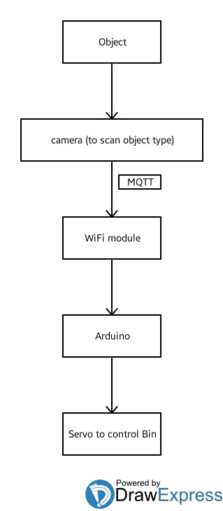
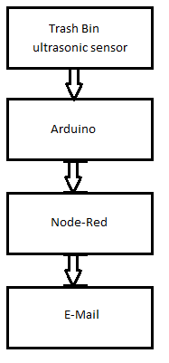
Block Diagram
Feature 1
Feature 2

Slide 7
Implementation Plan
We will be developing an Android app which will have access to a phone camera. Camera will click an image of the trash item and it will compare with the model data to distinguish into either organic waste or recyclable category.
The Android app will be developed using MIT app inventor 2. Once the category is figured out by the app, it will indicate the Arduino of the type of trash using Bluetooth or WiFi connection.

Slide 8
Implementation Plan
Arduino will turn on the respective motor depending upon the input from the Arduino app. The motors will open the lid of the respective garbage bin. For. eg. if the item detected by app is plastic bottle then it will open the recyclable bin out of the two bins.
We will also be using an ultrasonic sensor to detect if the garbage bin is full. When the garbage is full, it will indicate the Arduino through and Arduino will communicate with Node-Red to send an alert E-mail to the garbage management system.

Slide 9
Application
This system can be used at any public places like colleges, movie theater, bus/railway stations, etc. It can be further improved to add more data samples to detect the type of trash. It can also be extended to have more defined categories.

Slide 10
References
Smart_Dustbin
SmartGarbageMonitoringSystem
We will be using all the learning from the Module 1 ICPs for the implementation of the project.

Slide 11
Thank You! Suggestions?

