Slide 1


OUTLINE
Introduction
Why Freelancing?
Earning Skills
Marketplace
How It Works?
Bidding Strategies
Demo

Slide 2
WHO
IS A FREELANCER?
a self-employed person
who provides services
in one or more skillsets

Slide 3
WHAT
IS FREELANCING?
a business started by
an individual that
markets a service

Slide 4
FREELANCING IS A TYPE OF
SELF-EMPLOYMENT

Slide 5
FREELANCE BUSINESS MODEL
A business model that - allows you to get started with virtually no overheads - can be easily launched with minimum time
Passion is the key.

Slide 6


Slide 7
WHY
ONLINE FREELANCING?
allows almost anyone to make money without leaving their bed

Slide 8
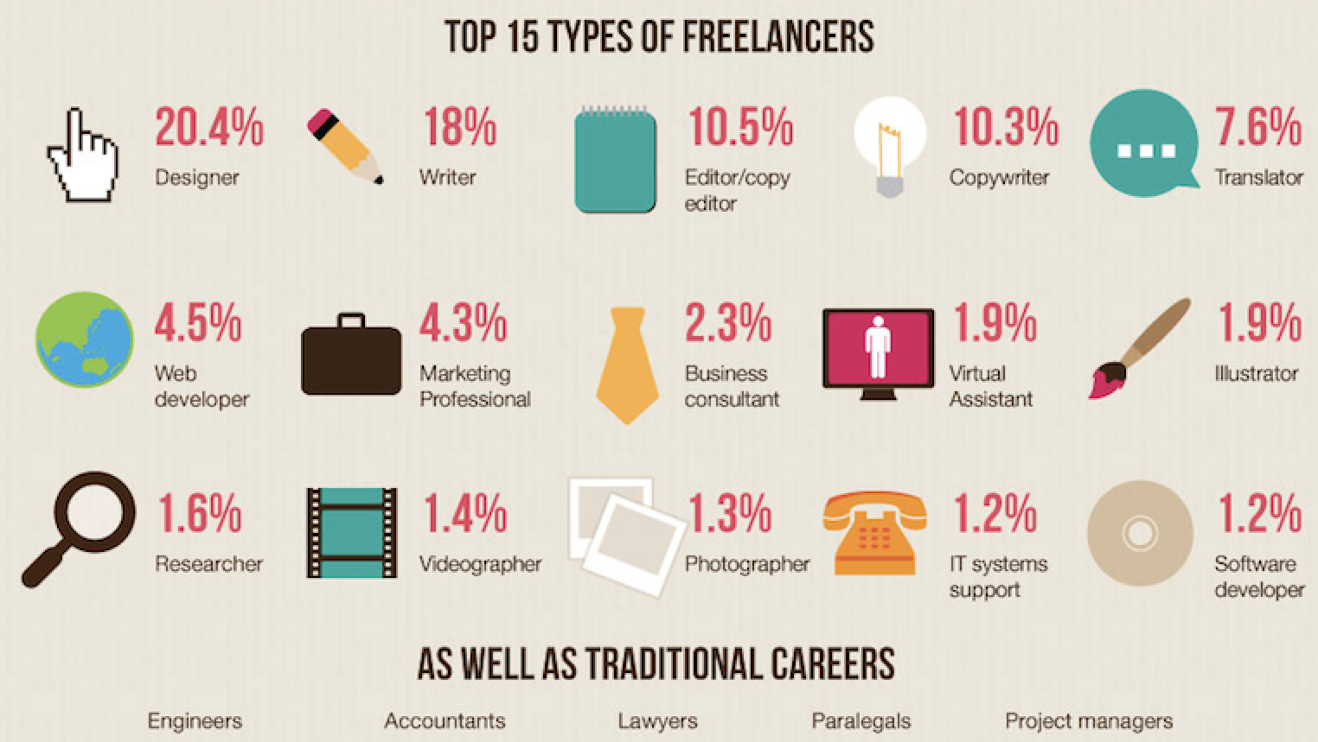

Slide 9
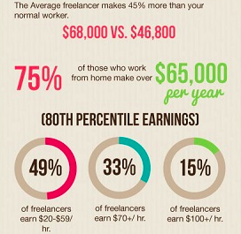
Don’t think you have what it takes?
Almost everyone can do it

Slide 10


Slide 11
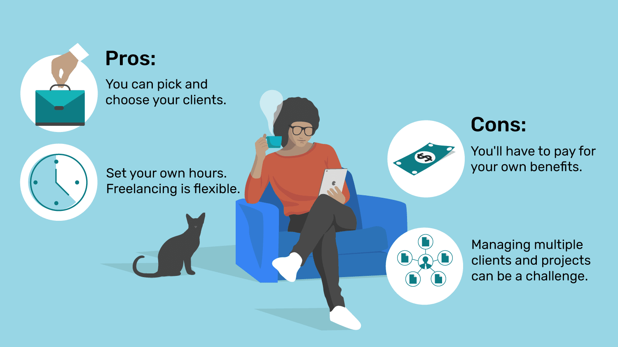

Slide 12
WHICH
SKILL IS RIGHT
FOR YOU?
picking your freelancing niche is an important step so that you can minimize learning and start earning

Slide 13
WHY CHOOSING A NICHE IS IMPORTANT?
If you haven’t narrowed down your freelance niche, there are good reasons you should do it now:
You become an expert in that one specific area.
Your unique selling point becomes more clearer and precise.
You can tailor of your marketing efforts to that speciality and command better rates.
Notes:
First, you become an expert in that one specific area, you can dig deeper and offer more than the generalist.
Second, your unique selling point becomes clearer and more precise. You can dump the vague terms for succinct ones, helping you find your audience and target it easily. People already want your specific service, so you won’t have to laboriously persuade them to change their minds. You only have to persuade that smaller audience that you’re the best to offer what they need.
Finally, you can tailor all of your marketing efforts to that specialty and command better rates.

Slide 14
HOW TO CHOOSE A NICHE?
Three most important factors in choosing your niche are your skills, passion and market viability. You should check:
What are your areas of command?
Which types of works or projects gives you most satisfaction?
Is there evidence that people need and pay what you offer?
Notes:
First, what are some areas of your work that you get the most commendations for? If you’re an accountant, for example, are you particularly skilled in tax, forensic, auditing or public accounting? This will give you solid clues about where your expertise lies.
Second, which types of work or projects give you the most satisfaction and make you lose track of time as you work on them? This is a clue to your true passion within your generalist area. What types of projects or areas of your work sap your energy and enthusiasm? These are the types of freelance work you want to leave behind as you narrow your niche. Don’t keep doing them or your reputation could suffer. A big part of successful freelance business is satisfied clients you can use as references.
Finally, is there evidence that people need and pay for what you offer? One quick way to know is to use relevant keywords related to your niche to search for jobs posted on freelancing sites like Upwork.com and Freelancer.com. Do you see many relevant jobs posted frequently and with decent budgets?

Slide 15

MAJOR FREELANCING PLATFORMS

Slide 16

HOW IT WORKS
After signing up on a Freelancing website,
getting started is as easy as
1 2 3

Slide 17

TUTORIAL: GET STARTED WITH FREELANCER.COM

Slide 18
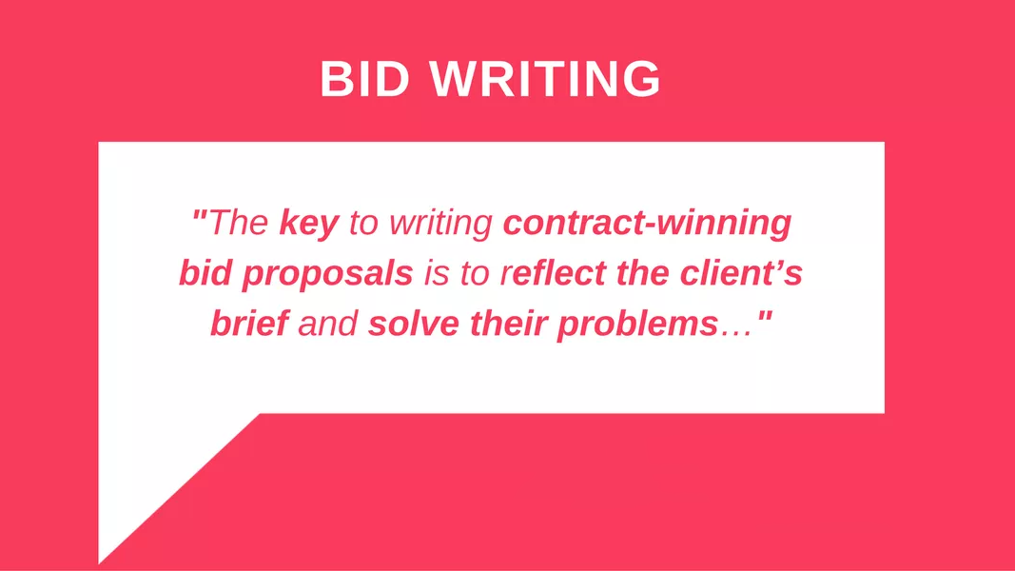

Slide 19


Slide 20


REFRESHMENT BREAK
Enjoy your break and we’ll go for CERTIFICATE DISTRIBUTION after that...

Slide 21
Getting Started
Enroll in one of our courses below aimed to develop EARNING SKILLS, and start freelancing today!
Fiverr / Upwork / Freelancer Training Course
Writing Training Course
Web Development
Android Development
Graphics Designing
Video Editing

