Slide 1
IBM University Engagement Project Submission
“Exploring the Power of Agentic AI with IBM Granite and RAG”

Slide 2

Project Tile –
Admit AI
Domain of Project –
Education
Student Name | Recent Passport Photo | Email ID | Mobile number [WhatsApp]
Sadaf Fatima Mansoori |  | sfmansoori.tech06@gmail.com | 7999654606

Slide 3
Problem Statement -
Problem Statement : College Admission AI
The Challenge
Every year, thousands of students struggle to choose the right college because admission information is scattered across multiple websites, PDFs, brochures, and government portals.
Students often face problems such as:
Difficulty understanding eligibility criteria
Confusion about admission procedures
Lack of personalized college recommendations
Difficulty comparing colleges
Uncertainty about scholarships and fee structure
Missing important deadlines
As a result, students spend hours searching online and may still make poor admission decisions.

Slide 4
The Objective: Build an ai-powered college admission assistant that provides personalized, reliable, and real-time admission guidance. The system should: 1.Recommend suitable colleges based on student profile 2. Retrieve authentic admission information using RAG 3. Answer admission-related questions 4.Compare colleges 5. Explain eligibility criteria 6.Provide scholarship information 7. Guide students through the complete admission process

Slide 5
Proposed Solution -
Proposed Solution: AI-Powered College Admission Assistant
The proposed solution is an intelligent multi-agent admission assistant built using IBM Granite Models, Lang Flow, Watsonx.ai, and Retrieval-Augmented Generation (RAG).
Instead of manually searching multiple websites, students simply interact with the AI assistant.
The assistant retrieves verified information from college brochures, admission guidelines, FAQs, and official documents using a RAG pipeline.
The system includes multiple specialized AI agents:
Admission Information Agent
Retrieves admission rules, eligibility criteria, important dates, and application procedures.

Slide 6
College Recommendation Agent
Suggests suitable colleges based on:
1. Marks
2. Category
3. Preferred location
4. Branch
5. Budget
Scholarship Agent
Provides information about scholarships, fee waivers, and financial assistance.
FAQ Agent
Answers common admission-related queries instantly.
Document Guidance Agent
Helps students understand required documents and the admission checklist.
A user-friendly web interface allows students to ask questions naturally and receive personalized guidance within seconds.

Slide 7
IBM Technologies
IBM Cloud Lite
Project Deployment
Cloud Hosting
Secure Environment
IBM watsonx.ai
IBM Granite LLM
Answer Generation
Natural Language Understanding
IBM Granite
Generates contextual answers
Hallucination reduction
RAG integration

Slide 8
Technology Stack
Frontend | Backend | AI | Database
HTML | Flask | IBM Granite | FAISS
CSS | Python | LangChain | Vector DB
JavaScript | REST API | HuggingFace | PDF Documents

Slide 9
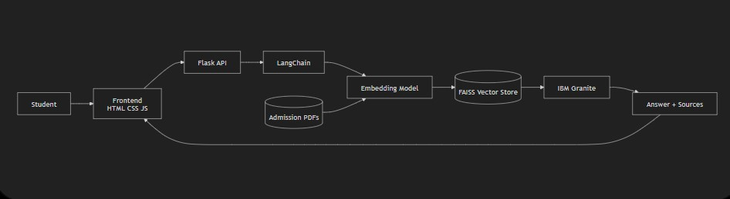
System Architecture

Slide 10
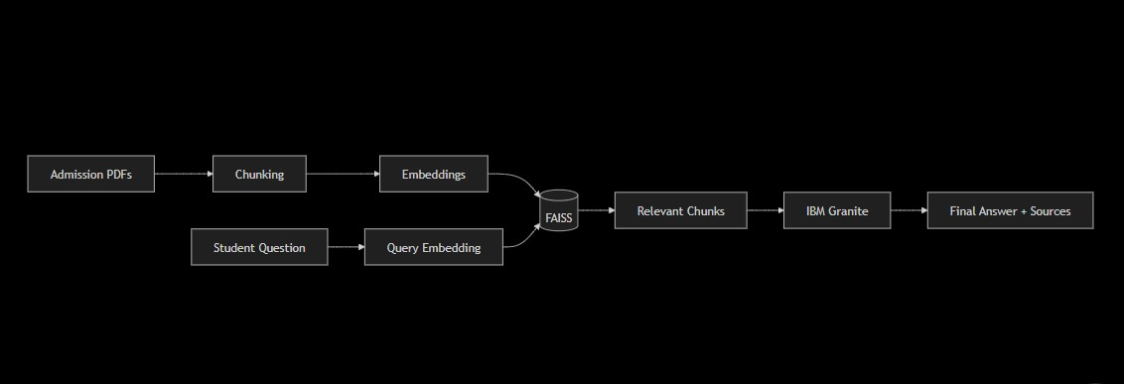
RAG Work Flow

Slide 11
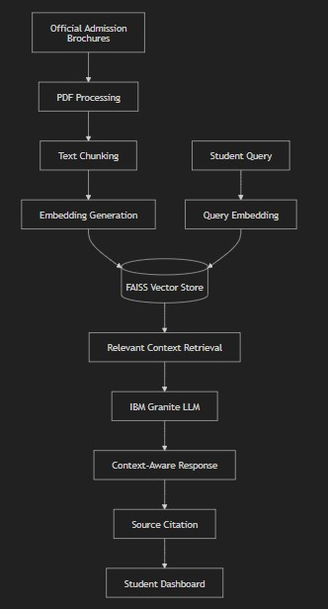
Project Work Flow

Slide 12
🌟 Key Features of Admit_AI
🎓 Smart College Admission Guidance
Get instant answers about admission procedures, eligibility criteria, and important deadlines.
🤖 AI-Powered Conversational Chatbot
Interact naturally with an AI assistant using IBM Granite LLM for human-like responses.
📄 Official PDF-Based Knowledge
Answers are generated only from official admission brochures and documents, ensuring authenticity.
🔍 Retrieval-Augmented Generation (RAG)
Retrieves the most relevant information from PDFs before generating responses, reducing hallucinations.
💰 Fee Structure Information
Provides detailed tuition fees, hostel fees, and other academic expenses.

Slide 13
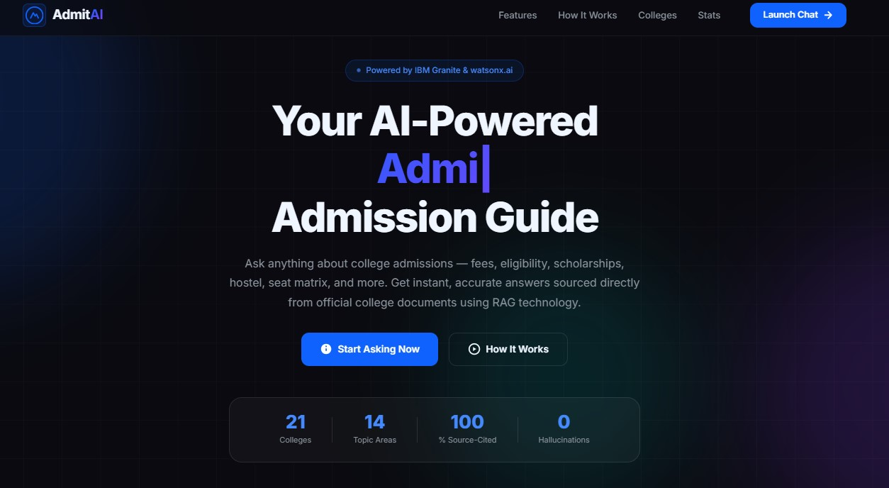

Slide 14
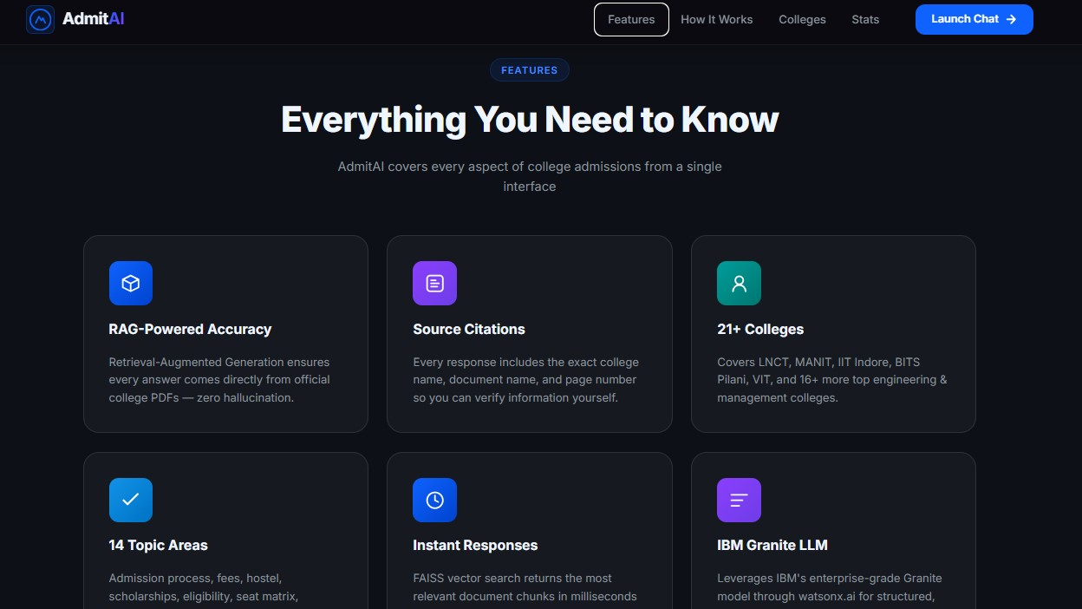

Slide 15
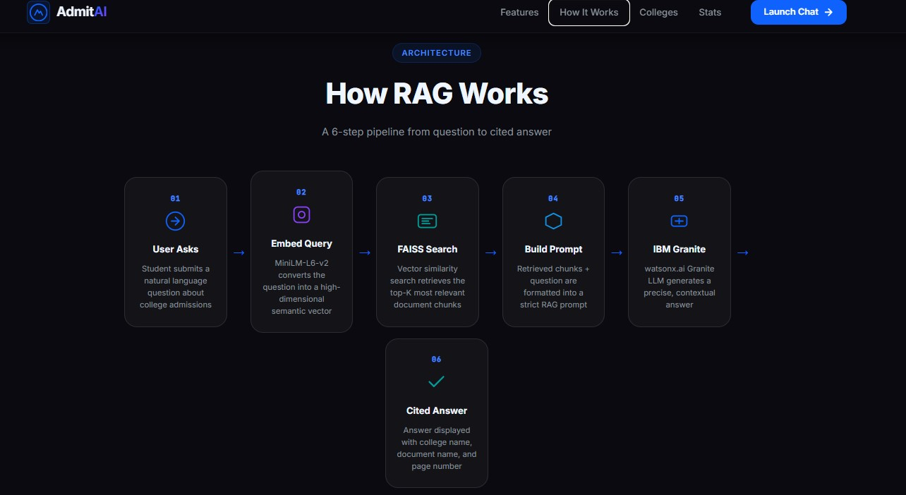

Slide 16
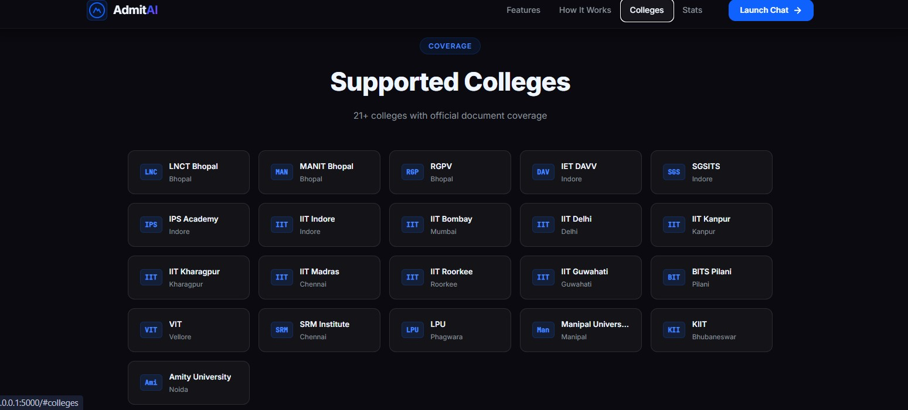

Slide 17
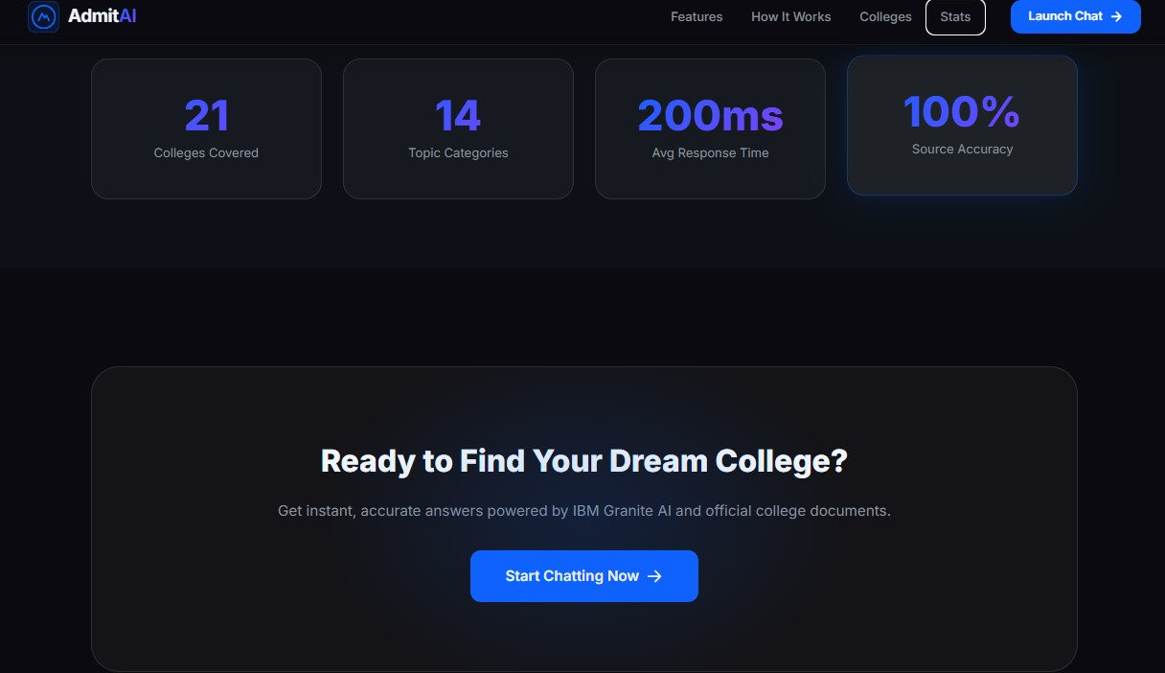

Slide 18
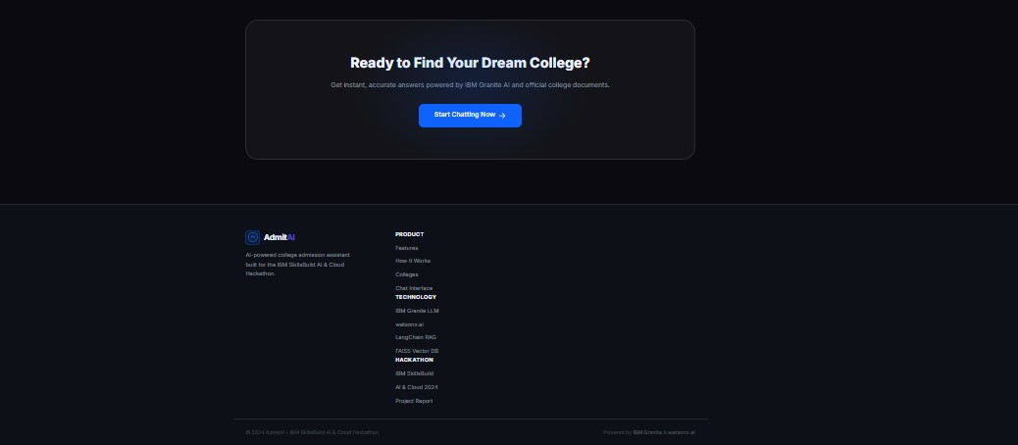

Slide 19
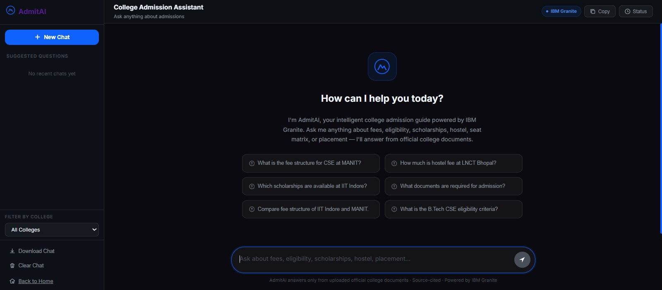

Slide 20
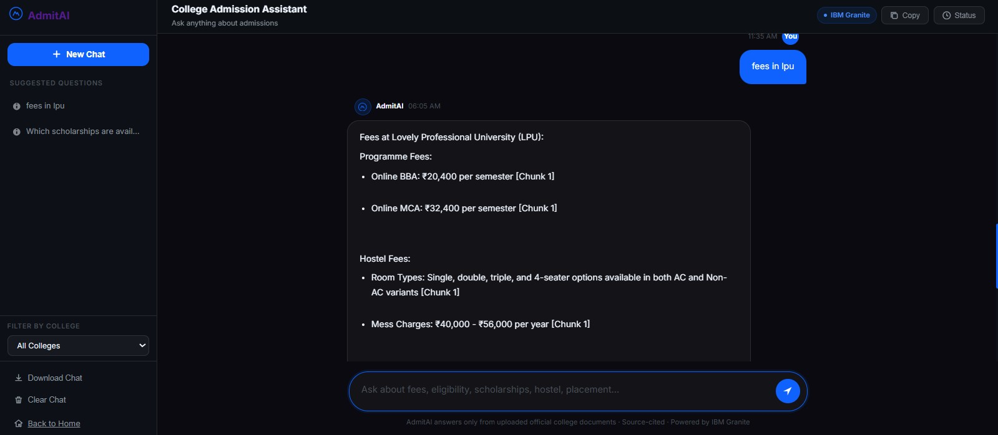

Slide 21
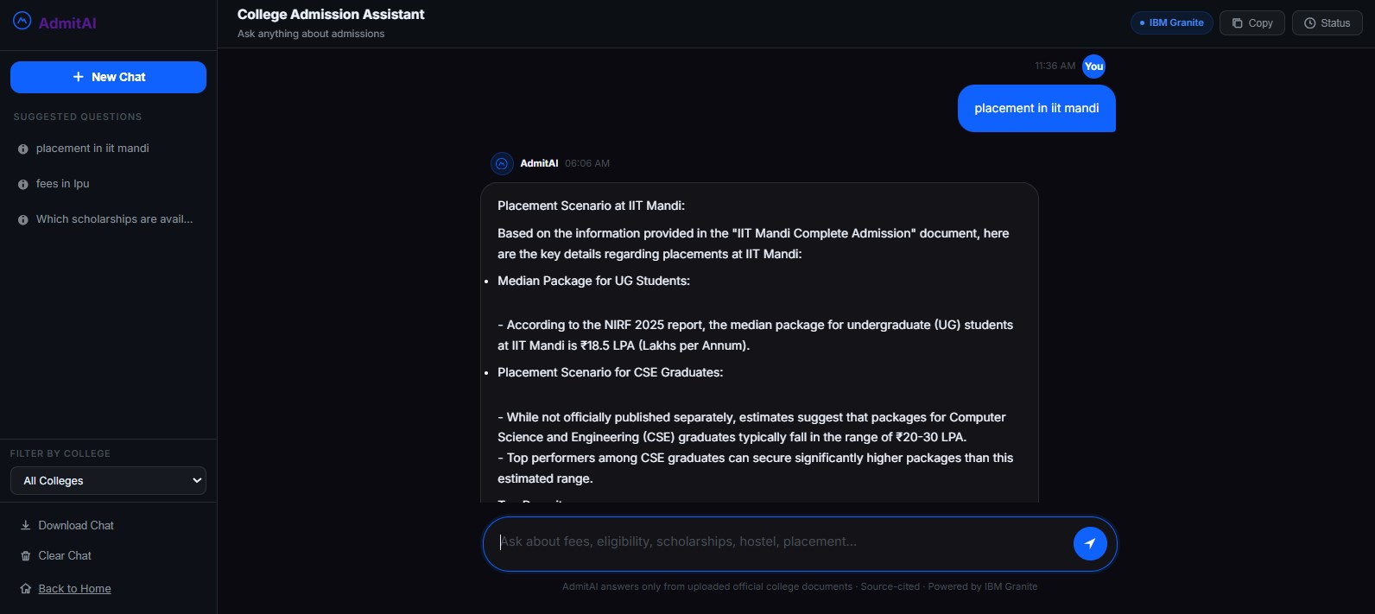

Slide 22
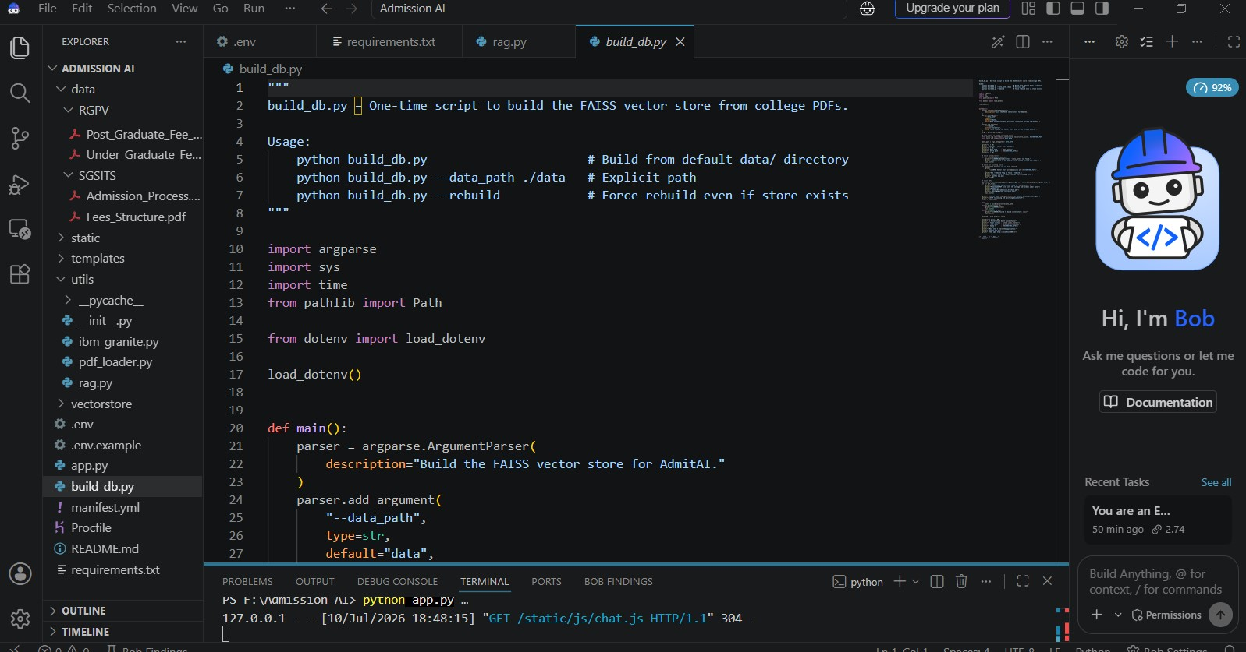

Slide 23
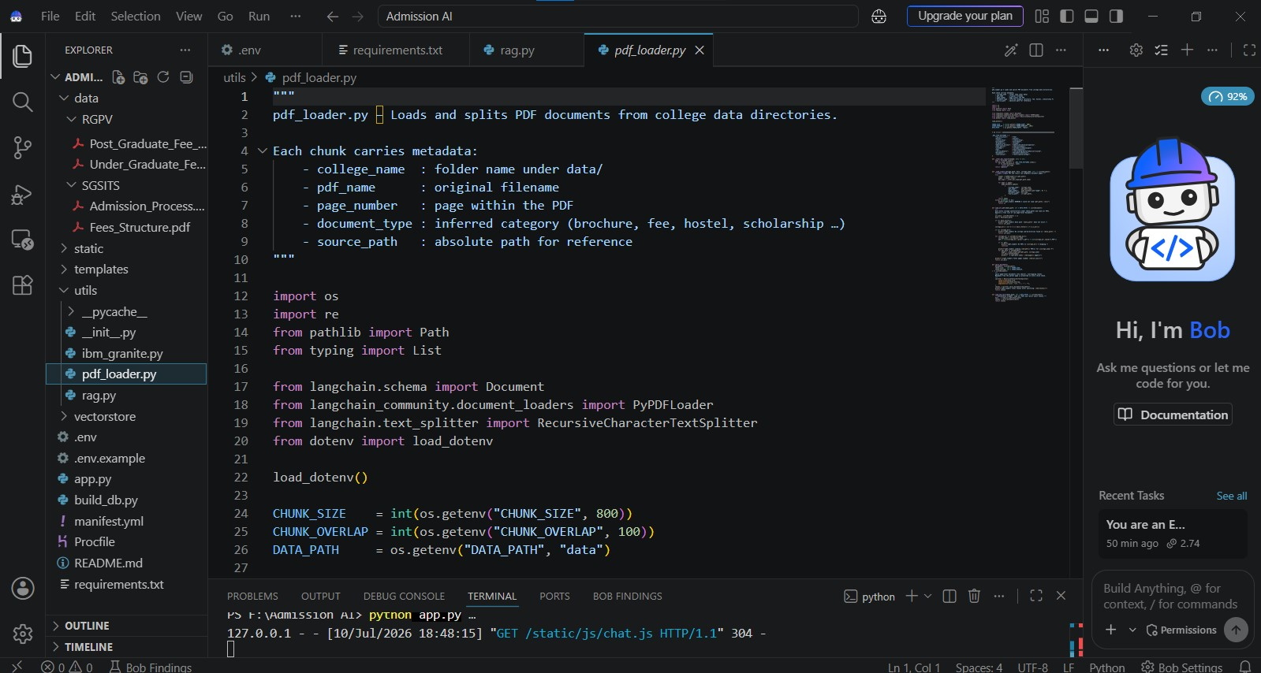

Slide 24
🌟 Key Features of AdmitAI
🎓 Smart College Admission Guidance
Get instant answers about admission procedures, eligibility criteria, and important deadlines.
🤖 AI-Powered Conversational Chatbot
Interact naturally with an AI assistant using IBM Granite LLM for human-like responses.
📄 Official PDF-Based Knowledge
Answers are generated only from official admission brochures and documents, ensuring authenticity.
🔍 Retrieval-Augmented Generation (RAG)
Retrieves the most relevant information from PDFs before generating responses, reducing hallucinations.
💰 Fee Structure Information
Provides detailed tuition fees, hostel fees, and other academic expenses.

Slide 25
🌟 What Makes Admit_AI Unique?
🎯 1. Official Document-Based AI
Unlike generic AI chatbots, AdmitAI answers questions only from official college admission brochures and documents, ensuring reliable and authentic information.
🤖 2. IBM Granite + RAG Integration
Instead of generating answers from general knowledge, the system first retrieves relevant information using RAG (Retrieval-Augmented Generation) and then uses IBM Granite LLM to produce context-aware responses.
🔄 3. Easy to Update
New college brochures can be added easily. Rebuilding the vector database automatically expands the AI's knowledge base without changing the application.
🏫 4. Multi-College Knowledge Base
Supports admission information from multiple colleges and universities (IITs, State Universities, Private Colleges) within a single platform.

Slide 26
Git Hub Link
Git hub URL –
https://github.com/sfmansooritech06-cmd/Admission_AI
·
·

Slide 27
Future Scope
️ Voice Assistant –
Enable students to interact with the AI using voice commands for a hands-free experience.
🌍 Regional Language Support –
Support multiple Indian languages (Hindi, Marathi, Tamil, Telugu, Bengali, etc.) to improve accessibility.
💬 WhatsApp Integration –
Allow students to receive admission updates, reminders, and ask queries directly through WhatsApp.
🎯 Personalized College Recommendation –
Recommend the best colleges based on marks, rank, location, budget, and preferred branch.
📊 Application Tracking –
Let students monitor the real-time status of their admission applications and document verification.
👤 Student Dashboard –
Provide a personalized dashboard to view application status, saved colleges, deadlines, and notifications.
·

Slide 28
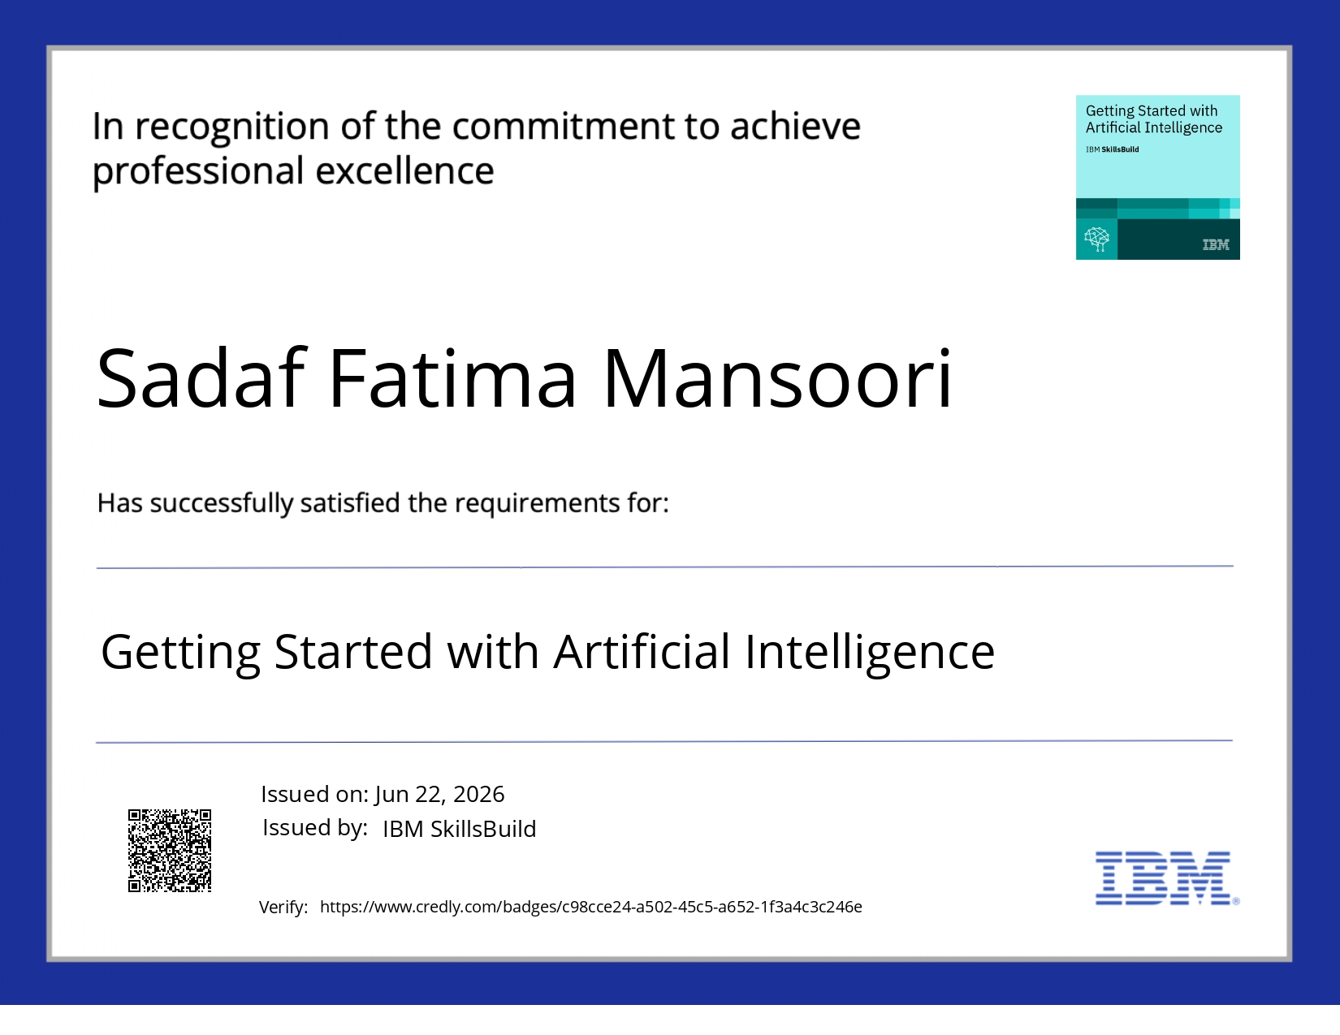

Slide 29


Slide 30
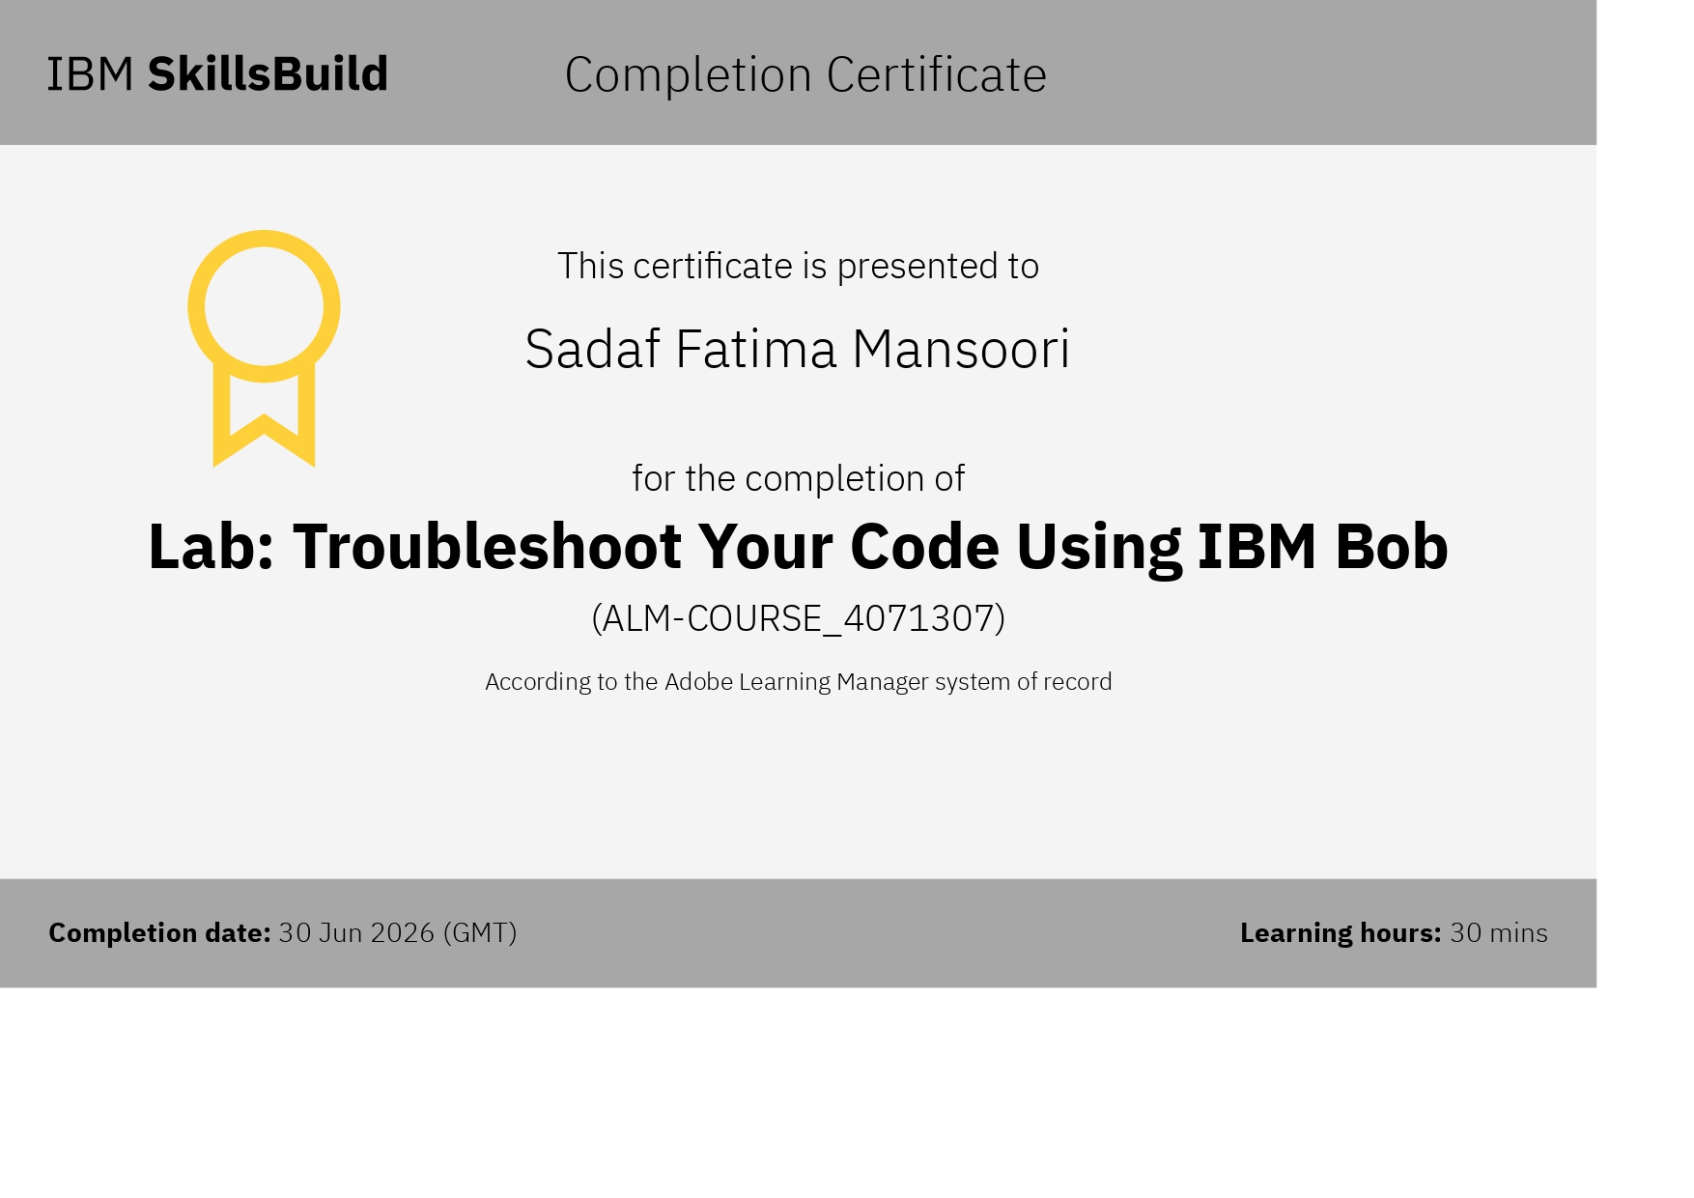

Slide 31


