Slide 1
Orion: Development Tools for the Web, on the Web
Wayne Beaton, The Eclipse Foundation
Susan McCourt, IBM

Slide 2
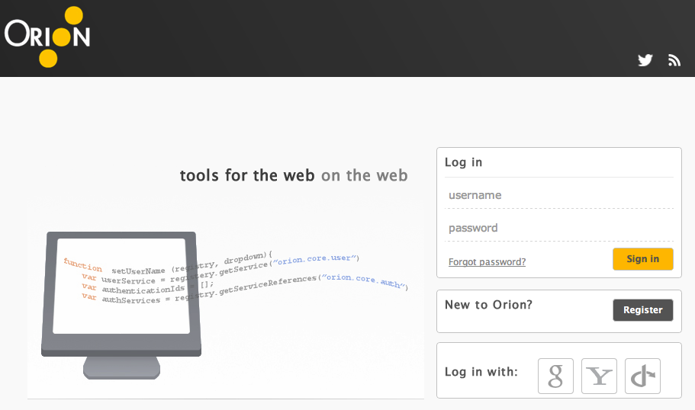
Demo coming...want to follow along?
orionhub.org

Slide 3
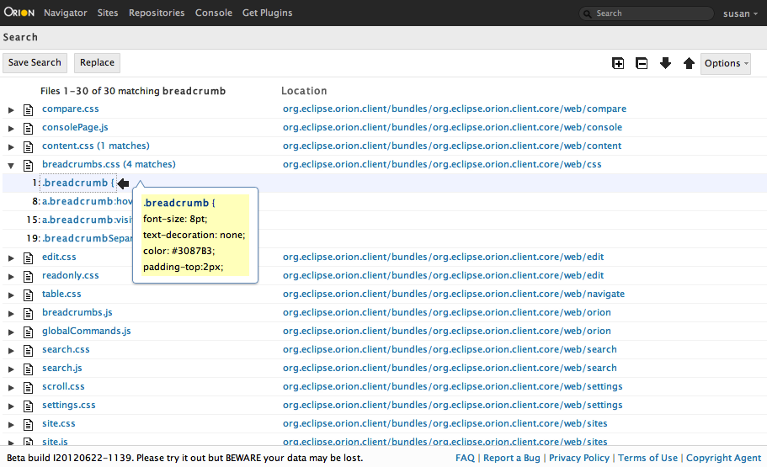
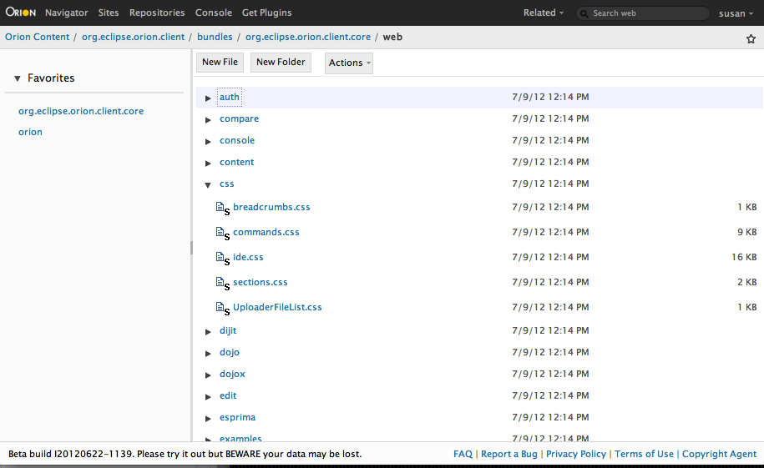
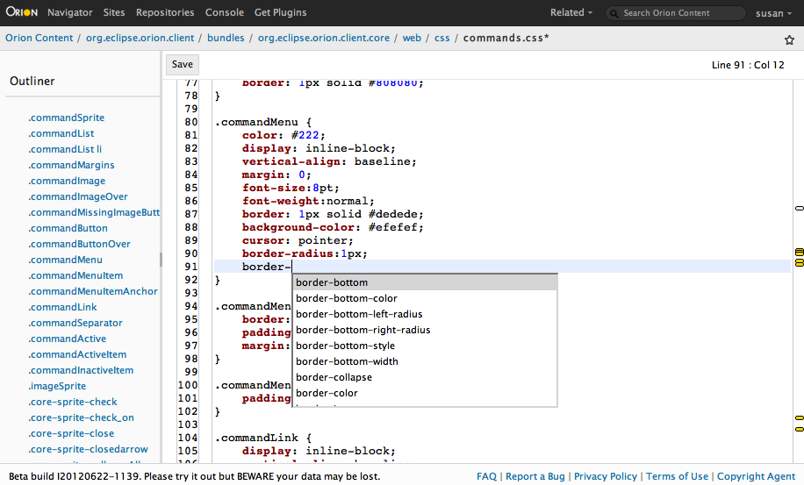
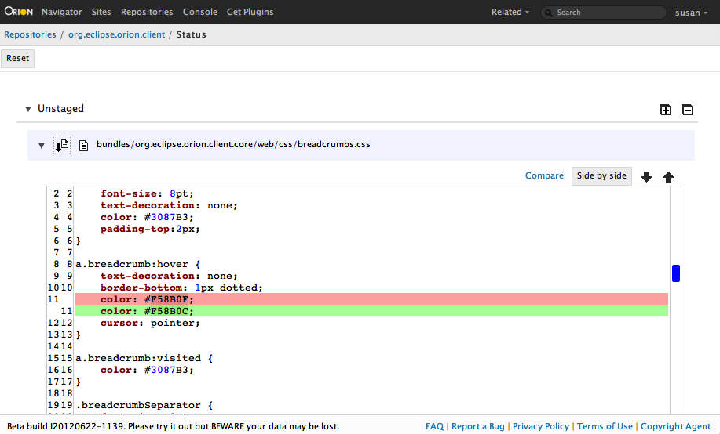
Software development in a browser
Workflows across a set of linked web pages
Collaboration via shared data and links
Not like a desktop IDE
  The web is the platform

Slide 4
Orion Design Principles
Don't fight the browser
Use native browser capabilities
  Real hyperlinks, back button, bookmarking, link sharing, ...
Functionality on separate pages
  Page = Task + Resource
Performant and lightweight
  Speed trumps power

Slide 5
Strengths of the Web
Highly distributed content
Scalable computing power
Simple connectivity -- links
Trivial update mechanism
Powerful rendering engine
Large, active community

Slide 6
Integration Possibilities
Hyperlinks as an integration mechanism.
OSLC, OAuth: Consume and produce server APIs.
Client-side extensions (plug-ins): adding commands to existing UI.
Integrate with browser debuggers: Firebug, WebKit Inspector
Host additional UI components, e.g. OpenSocial Gadgets.

Slide 7
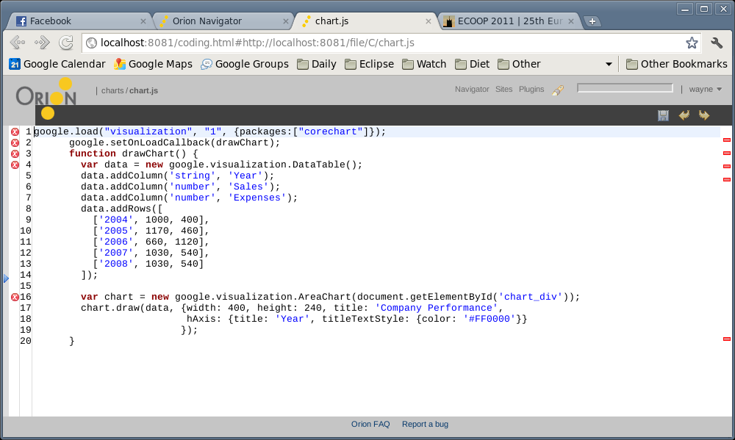
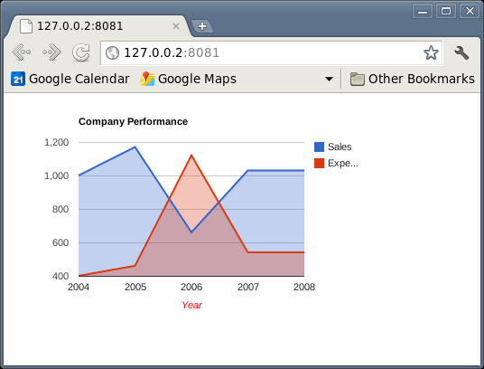

Slide 8
Orion 0.5 demo
Project setup, navigation, editing HTML, CSS, JS
Site hosting
Using plug-ins
Version control (git) support

Slide 9

Scenario: Orion on Our Server
OrionHub
Git Repo
Orion
code
code
test
Limited testing; backend resources not available.
Staging
Production
code
data
code
data
test

Slide 10
Scenario: Orion on Your Server
Staging
Git Repo
Orion
code
code
test
data
Production
Deploy Orion directly on your server; immediate access to data required for test.
code
data

Slide 11
Some History
Early demos of “Eclipse on the Web” in spring 2008
Bespin project from Mozilla in spring 2009
  Extensible web-based code editing framework
  Eclipse experimental server
Revisit the problem in fall 2010
  Web development (HTML, CSS, JS)
  Contribute to Eclipse Foundation in early 2011
orionhub launched in spring 2011

Slide 12
Core coding activities + extensions
Platform provides basic tasks for web development
    HTML, CSS, JS editing in a performant, robust editor
    Version control (git) support
    Global search, site hosting, unit testing
Linking in additional features
    Outward bound links via navigation bar, related pages, navigator
    Inward bound links via URI Templates for invoking Orion functions
Extend capabilities of existing pages
    Editor capabilities, content manipulation, alternate editors
Extend core capabilities
    Content hosting (S3, WebDAV, HTML5 local files)
    Authentication strategies

Slide 13
Plug-ins: Extending the system
Users install plug-ins from other domains
    Pages request necessary micro-services from plug-in/service registry
    Plug-ins loaded as needed (hidden iframes)
    Don't call us, we'll call you (today)
    Authentication, licensing (1.0)
UI extension points
    Narrowly defined contributions
    Semantic in nature (for flexibility in changing our UI)
Core extension points
    Alternate file systems
    Authentication strategies

Slide 14
Plug-ins: Micro Services Example (1/2)
Declarative behavior - “Related” links menu
window.onload = function() {
var provider = new eclipse.PluginProvider();
provider.registerServiceProvider("orion.page.link.related", null, {
nameKey: "Git Status",
id: "eclipse.git.status2",
tooltipKey: "Go to Git Status",
nls: "git/nls/gitmessages",
validationProperties: [{
source: "StatusLocation|Clone:StatusLocation",
variableName: "GitStatusLocation"
}],
uriTemplate: "{OrionHome}/git/git-status2.html#{GitStatusLocation}"
});
}

Slide 15
Plug-ins: Micro Services Example (2/2)
Asynchronous javascript implementation – i18n validator
provider.registerServiceProvider("orion.edit.validator", {
checkSyntax: function(title, contents) {
var problems = [];
// a bunch of implementation detail finding and pushing problems...
problems.push({
reason: "Non externalized string literal " + strings[j][0],
line: i + 1,
character: strings[j].index + 1,
end: strings[j].index + strings[j][0].length,
severity: "warning" });
}
return { problems: problems };
}},{
contentType: ["application/javascript"]
}
);

Slide 16
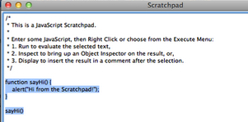
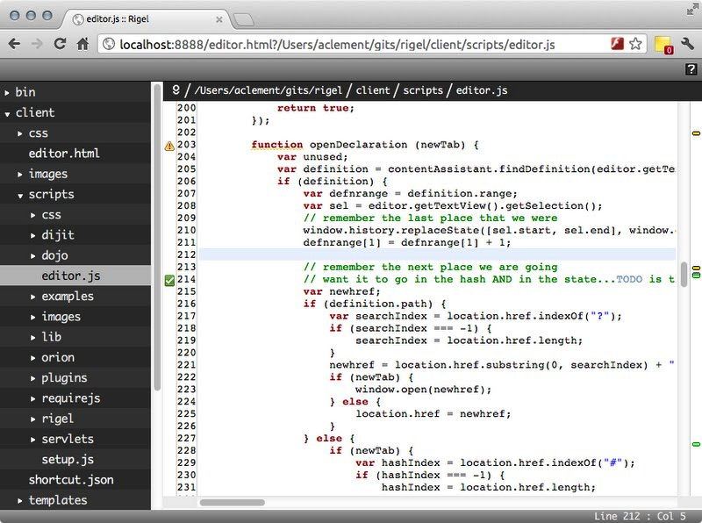
Consuming Orion: The Editor
Mozilla Dev Tools (Scratchpad)
  http://blog.mozilla.org/devtools/2011/08/15/introducing-scratchpad/
Rigel (VMWare)
    Lightweight editing of local files
    Node app serving up local files
    Content assist and navigation based on commonjs or Amd module
    systems

Slide 17
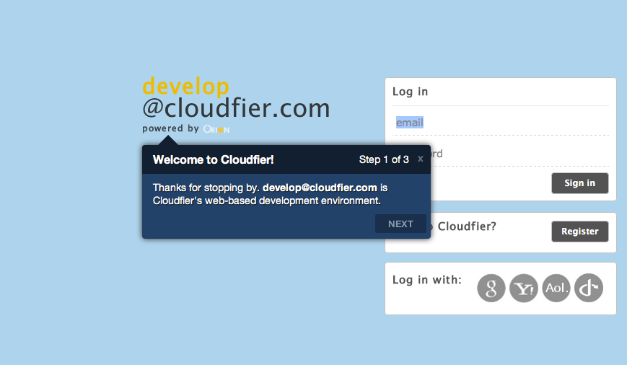
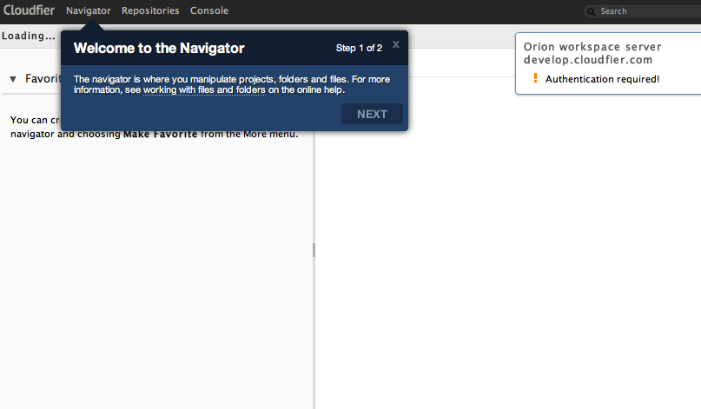
Consuming Orion: extending and rebranding
Cloudfier - http://cloudfier.com/

Slide 18
Building a Community
Orion Hub: a demo for users to experiment
  Success = a community of users, adopters and contributors
Focus is on a federation of tooling
  All development does not need to be done at Eclipse Foundation
Initial code contribution
  Generate discussion, ideas and community
Please use and look at the code; we want feedback

Slide 19
Contributing to Orion
Get involved
  Use Orion
  Adopt Orion
  Contribute to Orion
  Join the project!
Bug tracking
Project forum
  www.eclipse.org/forums/eclipse.orion
Project dev list
  www.eclipse.org/mail

Slide 20
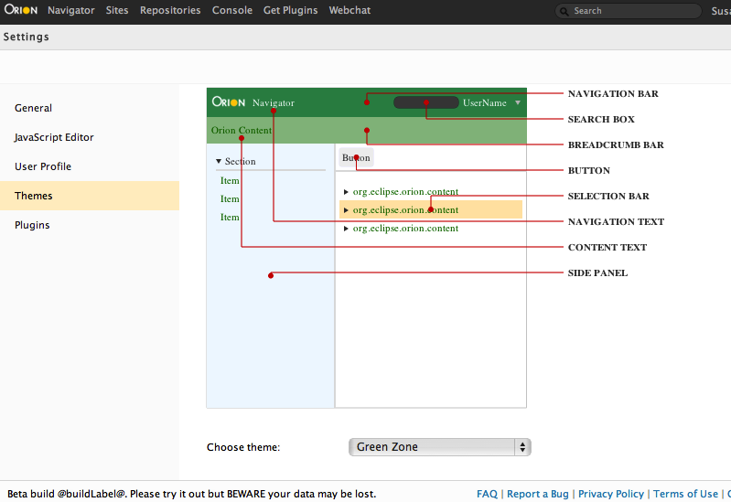
Coming in Orion 1.0
Robustness
    Performance, consumability of components, code quality, API
    Finish up accessibility, i18n
    Reevaluate js framework usage
Key missing features (not committed yet)
    Theme Builder (LESS)
    Offline support (investigating)
    Consumable (and relocatable) Navigator
M1 8/10/2012, M2 9/21/2012, Release October 2012

Slide 21
Learning more
orionhub.org - Kick the tires
@orionhub on Twitter
http://wiki.eclipse.org/Orion
    Downloading builds, git repos, contributions
    Architecture and programmer doc
    User doc
planetorion.org – news and articles

Slide 22
