Slide 1
Concurrency Control
Lock-Based Protocols
Deadlock Handling
Multiple Granularity

Slide 2
Lock-Based Protocols
A lock is a mechanism to control concurrent access to a data item
Data items can be locked in two modes :
1. exclusive (X) mode. Data item can be both read as well as
written. X-lock is requested using lock-X instruction.
2. shared (S) mode. Data item can only be read. S-lock is
requested using lock-S instruction.
Lock requests are made to concurrency-control manager. Transaction can proceed only after request is granted.

Slide 3
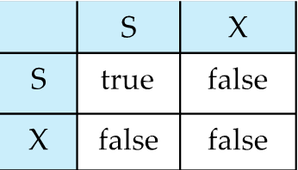
Lock-Based Protocols (Cont.)
Lock-compatibility matrix
A transaction may be granted a lock on an item if the requested lock is compatible with locks already held on the item by other transactions
Any number of transactions can hold shared locks on an item, but if any transaction holds an exclusive on the item no other transaction may hold any lock on the item.
If a lock cannot be granted, the requesting transaction is made to wait till all incompatible locks held by other transactions have been released. The lock is then granted.

Slide 4
Lock-Based Protocols (Cont.)
Example of a transaction performing locking:
T₂: lock-S(A);
read (A);
unlock(A);
lock-S(B);
read (B);
unlock(B);
display(A+B)
Locking as above is not sufficient to guarantee serializability
if A and B get updated in-between the read of A and B, the displayed sum would be wrong.
A locking protocol is a set of rules followed by all transactions while requesting and releasing locks. Locking protocols restrict the set of possible schedules.

Slide 5
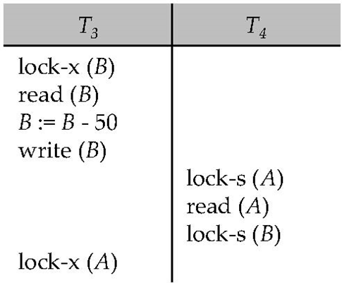
Pitfalls of Lock-Based Protocols
Consider the partial schedule
Neither T₃ nor T₄ can make progress — executing lock-S(B) causes T₄ to wait for T₃ to release its lock on B, while executing lock-X(A) causes T₃ to wait for T₄ to release its lock on A.
Such a situation is called a deadlock.
To handle a deadlock one of T₃ or T₄ must be rolled back and its locks released.

Slide 6
Pitfalls of Lock-Based Protocols (Cont.)
The potential for deadlock exists in most locking protocols. Deadlocks are a necessary evil.
Starvation is also possible if concurrency control manager is badly designed. For example:
A transaction may be waiting for an X-lock on an item, while a sequence of other transactions request and are granted an S-lock on the same item.
The same transaction is repeatedly rolled back due to deadlocks.
Concurrency control manager can be designed to prevent starvation.

Slide 7
The Two-Phase Locking Protocol
Two-Phase Locking is a protocol which ensures conflict-serializable schedules.
Phase 1: Growing Phase
transaction may obtain locks
transaction may not release locks
Phase 2: Shrinking Phase
transaction may release locks
transaction may not obtain locks
The protocol assures serializability. It can be proved that the transactions can be serialized in the order of their lock points (i.e. the point where a transaction acquired its final lock).

Slide 8
The Two-Phase Locking Protocol (Cont.)
Two-phase locking does not ensure freedom from deadlocks
Cascading roll-back is possible under two-phase locking. To avoid this, follow a modified protocol called strict two-phase locking. Here a transaction must hold all its exclusive locks till it commits/aborts.
Rigorous two-phase locking is even stricter: here all locks are held till commit/abort. In this protocol transactions can be serialized in the order in which they commit.
Strict two-phase locking and rigorous two-phase locking(with lock conversions) are used extensively in DBMS.

Slide 9
The Two-Phase Locking Protocol (Cont.)
There may be conflict serializable schedules that cannot be obtained through two-phase locking protocol.
To obtain conflict serializable schedules though non-two-phase locking protocol, we need:
Either to have additional information about the transactions
Or to impose some structure or ordering on the set of date items in the database.

Slide 10
Lock Conversions
Lock Conversions: Only acquire X lock when necessary.
Provide a mechanism for upgrading a S lock to a X lock.
Two-phase locking with lock conversions:
– First Phase:
can acquire a lock-S on item
can acquire a lock-X on item
can convert a lock-S to a lock-X (upgrade)
– Second Phase:
can release a lock-S
can release a lock-X
can convert a lock-X to a lock-S (downgrade)
This protocol assures serializability. But still relies on the programmer to insert the various locking instructions.

Slide 11
Automatic Acquisition of Locks (Commercial DBMS Uses)
A transaction T_{i} issues the standard read/write instruction, without explicit locking calls.
The operation read(D) is processed as:
if T_{i} has a lock on D
then
read(D)
else
begin
if necessary wait until no other
transaction has a lock-X on D
grant T_{i} a lock-S on D;
read(D)
end

Slide 12
Automatic Acquisition of Locks (Cont.)
write(D) is processed as:
if T_{i} has a lock-X on D
then
write(D)
else
begin
if necessary wait until no other trans. has any lock on D,
if T_{i} has a lock-S on D
then
upgrade lock on D to lock-X
else
grant T_{i} a lock-X on D
write(D)
end;
All locks are released after commit or abort

Slide 13
Implementation of Locking
A Lock manager can be implemented as a separate process to which transactions send lock and unlock requests
The lock manager replies to a lock request by sending a lock grant messages (or a message asking the transaction to roll back, in case of a deadlock)
The requesting transaction waits until its request is answered
The lock manager maintains a data structure called a lock table to record granted locks and pending requests
The lock table is usually implemented as an in-memory hash table indexed on the name of the data item being locked

Slide 14
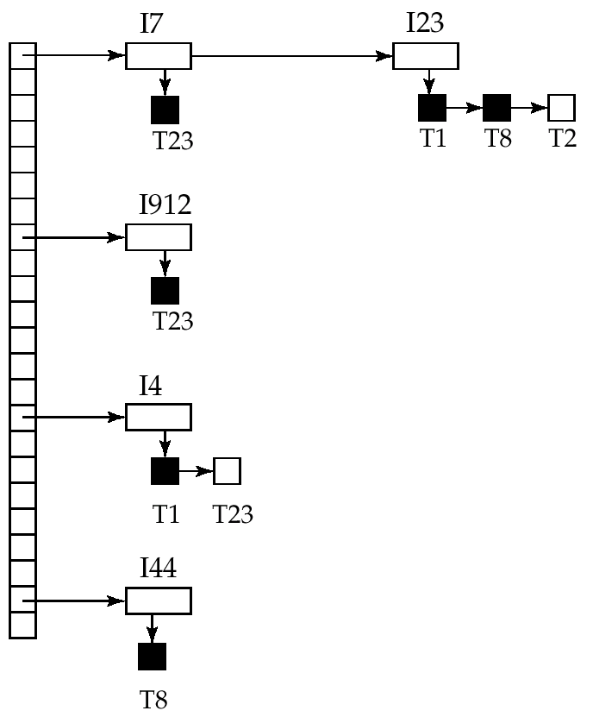
Lock Table
Black rectangles indicate granted locks, white ones indicate waiting requests
Lock table also records the type of lock granted or requested
New request is added to the end of the queue of requests for the data item, and granted if it is compatible with all earlier locks
Unlock requests result in the request being deleted, and later requests are checked to see if they can now be granted
If transaction aborts, all waiting or granted requests of the transaction are deleted
lock manager may keep a list of locks held by each transaction, to implement this efficiently

Slide 15
Deadlock Handling
System is deadlocked if there is a set of transactions such that every transaction in the set is waiting for another transaction in the set.
Deadlock prevention protocols ensure that the system will never enter into a deadlock state. Some prevention strategies :
Require that each transaction locks all its data items before it begins execution (predeclaration).
Impose partial ordering of all data items and require that a transaction can lock data items only in the order specified by the partial order (graph-based protocol).

Slide 16
More Deadlock Prevention Strategies
Following schemes use transaction timestamps for the sake of deadlock prevention alone.
wait-die scheme — non-preemptive
older transaction may wait for younger one to release data item. Younger transactions never wait for older ones; they are rolled back instead.
a transaction may die several times before acquiring needed data item
wound-wait scheme — preemptive
older transaction wounds (forces rollback) of younger transaction instead of waiting for it. Younger transactions may wait for older ones.
may be fewer rollbacks than wait-die scheme.

Slide 17
Wait-die vs. Wound-wait
Three transactions: A, B , C ordered by starting time. B held a lock on data item Y. Then
 | Wait-die | Wound-wait
A acquire Y | Wait | B rollback; A granted the lock on Y
C acquire Y | C rollback | Wait

Slide 18
Deadlock prevention (Cont.)
Both in wait-die and in wound-wait schemes, a rolled back transactions is restarted with its original timestamp. Older transactions thus have precedence over newer ones, and starvation is hence avoided.
Timeout-Based Schemes :
a transaction waits for a lock only for a specified amount of time. After that, the wait times out and the transaction is rolled back.
thus deadlocks are not possible
simple to implement; but starvation is possible. Also difficult to determine good value of the timeout interval.

Slide 19
Deadlock Detection
Deadlocks can be described as a wait-for graph, which consists of a pair G = (V,E),
V is a set of vertices (all the transactions in the system)
E is a set of edges; each element is an ordered pair T_{i} →T_{j}.
If T_{i} → T_{j} is in E, then there is a directed edge from T_{i} to T_{j}, implying that T_{i} is waiting for T_{j} to release a data item.
When T_{i} requests a data item currently being held by T_{j}, then the edge T_{i} T_{j} is inserted in the wait-for graph. This edge is removed only when T_{j} is no longer holding a data item needed by T_{i}.
The system is in a deadlock state if and only if the wait-for graph has a cycle. Must invoke a deadlock-detection algorithm periodically to look for cycles.

Slide 20
Deadlock Detection (Cont.)
Wait-for graph without a cycle
Wait-for graph with a cycle

Slide 21
Deadlock Recovery
When deadlock is detected :
Some transaction will have to rolled back (made a victim) to break deadlock. Select that transaction as victim that will incur minimum cost.
Rollback -- determine how far to roll back transaction
Total rollback: Abort the transaction and then restart it.
Partial rollback: More effective to roll back transaction only as far as necessary to break deadlock. Partial rollback requires the system to maintain additional information about the running trasactions.
Starvation happens if same transaction is always chosen as victim. Include the number of rollbacks in the cost factor to avoid starvation

Slide 22
Multiple Granularity
Allow data items to be of various sizes and define a hierarchy of data granularities, where the small granularities are nested within larger ones
Can be represented graphically as a tree
When a transaction locks a node in the tree explicitly, it implicitly locks all the node's descendents in the same mode.
Granularity of locking (level in tree where locking is done):
fine granularity (lower in tree): high concurrency, high locking overhead
coarse granularity (higher in tree): low locking overhead, low concurrency

Slide 23
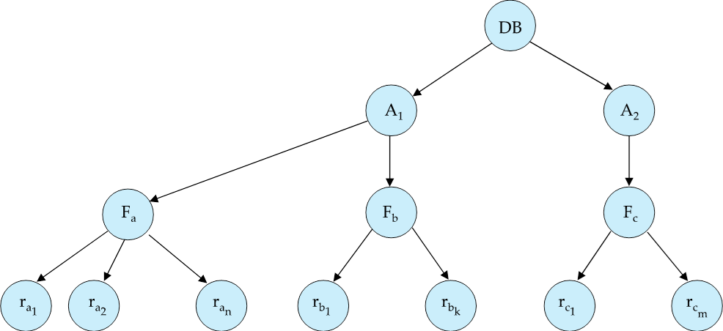
Example of Granularity Hierarchy
The highest level in the example hierarchy is the entire database.
The levels below are of type area, file and record in that order.

Slide 24
Intention Lock Modes
In addition to S and X lock modes, there are three additional lock modes with multiple granularity:
intention-shared (IS): indicates explicit locking at a lower level of the tree but only with shared locks.
intention-exclusive (IX): indicates explicit locking at a lower level with exclusive or shared locks
shared and intention-exclusive (SIX): the subtree rooted by that node is locked explicitly in shared mode and explicit locking is being done at a lower level with exclusive-mode locks.
intention locks allow a higher level node to be locked in S or X mode without having to check all descendent nodes.

Slide 25
Compatibility Matrix with Intention Lock Modes
The compatibility matrix for all lock modes is:
IS
IX
S
S IX
X
IS
✓
✓
✓
✓
×
IX
✓
✓
×
×
×
S
✓
×
✓
×
×
S IX
✓
×
×
×
×
X
×
×
×
×
×

Slide 26
Multiple Granularity Locking Scheme
Transaction T_{i} can lock a node Q, using the following rules:
1. The lock compatibility matrix must be observed.
2. The root of the tree must be locked first, and may be locked in any mode.
3. A node Q can be locked by T_{i} in S or IS mode only if the parent of Q is currently locked by T_{i} in either IX or IS mode.
4. A node Q can be locked by T_{i} in X, SIX, or IX mode only if the parent of Q is currently locked by T_{i} in either IX or SIX mode.
5. T_{i} can lock a node only if it has not previously unlocked any node
(that is, T_{i} is two-phase locking).
6. T_{i} can unlock a node Q only if none of the children of Q are currently locked by T_{i}.
Observe that locks are acquired in root-to-leaf order, whereas they are released in leaf-to-root order.
Lock granularity escalation: in case there are too many locks at a particular level, switch to higher granularity S or X lock

