Slide 1
SQL (Lecture 2)
Nested Subqueries
Join expressions
Modification of the Database
Views
Notes:
1

Slide 2
Nested Subqueries
SQL provides a mechanism for the nesting of subqueries. A subquery is a select-from-where expression that is nested within another query.
The nesting can be done in the following SQL query select A₁, A₂, ..., A_{n} from r₁, r₂, ..., r_{m} where P
as follows:
A_{i} can be replaced be a subquery that generates a single value.
r_{i} can be replaced by any valid subquery
P can be replaced with an expression of the form:
B <operation> (subquery)
Where B is an attribute and <operation> to be defined later.

Slide 3
Subqueries in the Where Clause
The most common use of subqueries is in the where clause, which is to perform tests for
set membership in
set comparisons
Empty relations most powerful subquery
Absence of duplicate tuples

Slide 4
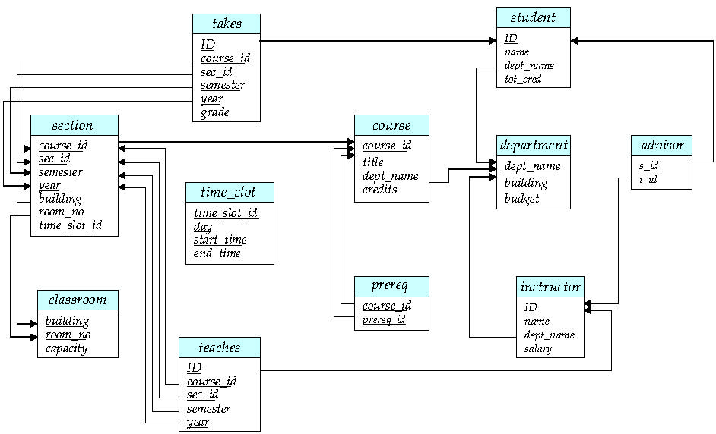
Schema Diagram for University Database
A key

Slide 5
Set Membership
Find courses offered in Fall 2009 and in Spring 2010
Find courses offered in Fall 2009 but not in Spring 2010
select distinct course_id
from section
where semester = ’Fall’ and year= 2009 and course_id in ( select course_id
from section
where semester = ’Spring’ and year= 2010);
select distinct course_id
from section
where semester = ’Fall’ and year= 2009 and course_id not in ( select course_id
from section
where semester = ’Spring’ and year= 2010);

Slide 6
Set Membership (Cont.)
Find the total number of (distinct) students who have taken course sections taught by the instructor named “Dr. Zhou”
Note: Above query can be written in a much simpler manner. The formulation above is simply to illustrate SQL features.
select count (distinct ID)
from takes
where (course_id, sec_id, semester, year) in (select course_id, sec_id, semester, year
from teaches
where teaches.ID in
( select ID
from instructor
where name = ‘Dr. Zhou’ )
);

Slide 7
Set Comparison – “some” Clause
Find names of instructors with salary greater than that of some (at least one) instructor in the Biology department.
Same query using > some clause
select distinct T.ID ,T.name
from instructor as T, instructor as S
where T.salary > S.salary and S.dept name = ’Biology’;
select ID, name
from instructor
where salary > some (select salary
from instructor
where dept name = ’Biology’);

Slide 8
Definition of Some Clause
F <comp> some r ⇔ ∃ t ∈ r s.t. (F <comp> t) Where <comp> can be: <, ≤, >, =, ≠
0
(5< some
5
) = true
5 is less than some tuple in the relation
6
0
(5< some
5
) = false
0
(5 = some
) = true
5
0
(5 ≠ some
5
) = true (since 0 ≠ 5)
(= some) ≡ in
However, (≠ some) ≡ not in

Slide 9
Definition of all Clause
F <comp> all r ⇔ ∀ t ∈ r (F <comp> t)
0
(5< all
) = false
5
6
6
(5< all
) = true
10
4
(5 = all
) = false
5
4
(5 ≠ all
) = true (since 5 ≠ 4 and 5 ≠ 6)
6
(≠ all) ≡ not in
However, (= all) ≡ in

Slide 10
Set Comparison – “all” Clause
Find the names of all instructors whose salary is greater than the salary of all instructors in the Biology department.
select name
from instructor
where salary > all (select salary
from instructor
where dept name = ’Biology’);

Slide 11
Test for Empty Relations
The exists construct returns the value true if the argument subquery is nonempty.
exists r ⇔ r ≠ Ø
not exists r ⇔ r = Ø ⇔ P is false
P is the query condition to return r

Slide 12
Use of “exists” Clause
Yet another way of specifying the query “Find all courses taught in both the Fall 2009 semester and in the Spring 2010 semester”
select course_id from section as S where semester = ’Fall’ and year = 2009 and exists (select * from section as T where semester = ’Spring’ and year= 2010 and S.course_id = T.course_id);
Correlation name – variable S in the outer query
Correlated subquery – the inner query

Slide 13
Powerful “not exists” Clause
Find students who have taken all courses offered in the Biology department.
select S.ID,S.name from student as S where
?? // student S have taken all course offered in the Biology department

Slide 14
Solution
Find all students who have taken all courses offered in the Biology department.
select S.ID,S.name from student as S where not exists (
( select course_id
from course
where dept_name = ’Biology’)
except
(select T.course_id
from takes as T
where T.ID = S.ID)
);
How can I write this SQL?

Slide 15
How to get the solution
Step 1: define predicates:
P(S) : All course that student S has taken;
Q : All course offered in Biology;
Step 2: define the logical formula
Find those student S that P(S) ⊇ Q
Equivalent formula: Find S that Q – P(S) = Ø
Step 3: SQL statement
Find S： Select S.ID, S.name from Student S
Q select course_id from course where dept_name = ’Biology’
P(S) select T.course_id from takes as T where T.ID = S.ID

Slide 16
Solution
Find all students who have taken all courses offered in the Biology department.
select S.ID,S.name from student as S where not exists (
( select course_id
from course
where dept_name = ’Biology’)
except
(select T.course_id
from takes as T
where T.ID = S.ID)
);
Note: Cannot write this query using = all and its variants
To find S
Q
P(S)

Slide 17
Another solution
Step 1: define predicates:
P(S,C) : student S has taken course C;
Q(C) : course C is offered in Biology department;
Step 2: define the logical formula
Find those student S that ∀ C (Q(C) ➔ P(S,C))
Equivalent formula: Find S that ⎤ ∃ C (Q(C) ∧ ⎤ P(S,C))
Step 3: SQL statement
Find S： Select S.ID, S.name from Student S
⎤ ∃ C Q(C ) Not Exists Select * from course as C where dept_name = ’Biology’
⎤ P(S,C)：student S has NOT taken course C Not Exists select * from takes as T where T.ID = S.ID and T.course_id = C.course_id

Slide 18
Another solution
Step 4:
Select S.ID, S.name
from Student S
where not exists (
Select * from course as C
where dept_name = ’Biology’
And
Not Exists (
select * from takes as T where T.ID = S.ID and T.course_id = C.course_id
)
)
Variable from outer level is known as a correlation variable
To find S
⎤ ∃ C Q(C)
⎤ P(S,C)

Slide 19
Test for Absence of Duplicate Tuples
The unique construct tests whether a subquery has any duplicate tuples in its result.
The unique construct evaluates to “true” if a given subquery contains no duplicates .
Find all courses that were offered at most once in 2009
select T.course_id from course as T where unique (select R.course_id from section as R where R.course_id= T.course_id and R.year = 2009);

Slide 20
Example
Find all courses that were offered at lease two times in 2009
select T.course_id from course as T where not unique (select R.course_id from section as R where R.course_id= T.course_id and R.year = 2009);

Slide 21
Subqueries in the Form Clause
SQL allows a subquery expression to be used in the from clause
Find the average instructors’ salaries of those departments where the average salary is greater than $42,000.”
select dept_name, avg_salary from (select dept_name, avg (salary) as avg_salary from instructor group by dept_name) where avg_salary > 42000;
Note that we do not need to use the having clause
Another way to write above query
select dept_name, avg_salary from (select dept_name, avg (salary) from instructor group by dept_name) as dept_avg (dept_name, avg_salary)
where avg_salary > 42000;

Slide 22
With Clause
The with clause provides a way of defining a temporary relation whose definition is available only to the query in which the with clause occurs.
Find all departments with the maximum budget with max_budget (value) as (select max(budget) from department) select department.name from department, max_budget where department.budget = max_budget.value;

Slide 23
Complex Queries using With Clause
Find all departments where the total salary is greater than the average of the total salary at all departments
with dept _total (dept_name, value) as
(select dept_name, sum(salary)
from instructor
group by dept_name),
dept_total_avg(value) as
(select avg(value)
from dept_total)
select dept_name
from dept_total, dept_total_avg
where dept_total.value > dept_total_avg.value;

Slide 24
Scalar Subquery
Scalar subquery is one which is used where a single value is expected
List all departments along with the number of instructors in each department
select dept_name, (select count(*) from instructor where department.dept_name = instructor.dept_name) as num_instructors from department;
Runtime error if subquery returns more than one result tuple
I never use this…

Slide 25
Join Expression
Join expressions are introduced to make some SQL query easier to understand.
Select name, course_id from instructor, teaches
where instructor.ID = teaches.ID
Could be simplified as:
Select name, course_id from instructor nature join teaches
Or :
Select name, course_id from instructor join teaches using (ID)

Slide 26
Join Expression(Cont.)
Sometimes, Nature Join may lead to incorrect result. Ex: List the names of the instructors along with the course title that they teach:
Select name, title from instructor nature join teaches , course where teaches.course_id = course.course_id
Is NOT equivalent to :
Select name, title from instructor nature join teaches nature join course
But equivalent to :
Select name, title from (instructor nature join teaches) join course using (course_id)

Slide 27
Join Conditions
The ON condition allows a general predicate over the relations being joined.
Select * from student join takes on student.ID = takes.ID
Is equivalent to
Select *
from student, takes
where student.ID = takes.ID

Slide 28
Outer Join
An extension of the join operation that avoids loss of information.
E.g. To list all students along with the course they have taken.
E.g. To list all instructors along with the course they teach.
Computes the join and then adds tuples form one relation that does not match tuples in the other relation to the result of the join.
Left Outer Join
Right Outer Join
Full Outer Join
Uses null values.

Slide 29
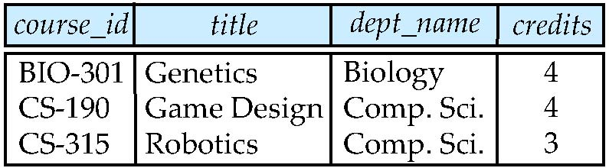
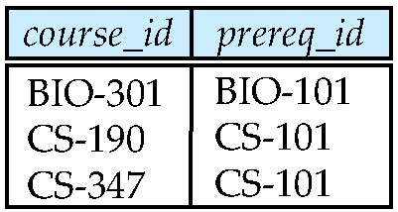
Join operations – Example
Relation course
Relation prereq
Observe that prereq information is missing for CS-315 and
course information is missing for CS-437

Slide 30
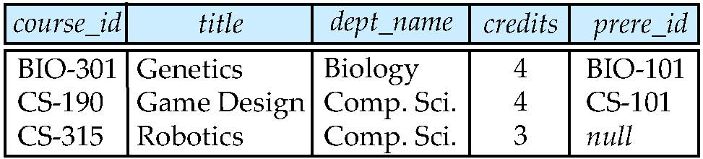
Left Outer Join
course natural left outer join prereq

Slide 31
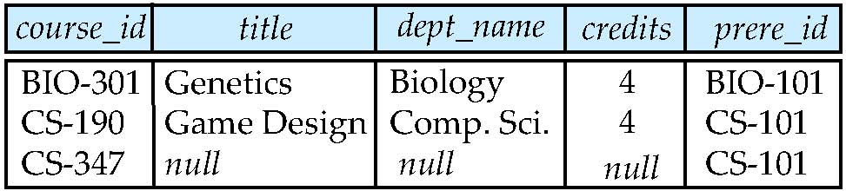
Right Outer Join
course natural right outer join prereq

Slide 32
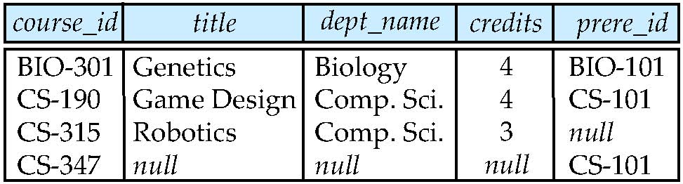
Full Outer Join
course natural full outer join prereq

Slide 33
Joined Relations
Join operations take two relations and return as a result another relation.
The join operations are typically used as subquery expressions in the from clause
Join condition – defines which tuples in the two relations match, and what attributes are present in the result of the join.
Join type – defines how tuples in each relation that do not match any tuple in the other relation (based on the join condition) are treated.
Join Types
Join Conditions
inner join
left outer join
right outer join
full outer join
natural
on <predicate>
using (A₁, A₂, ..., A_{n})

Slide 34
Modification of the Database
Deletion of tuples from a given relation.
Insertion of new tuples into a given relation
Updating of values in some tuples in a given relation

Slide 35
Deletion
Delete all instructors
delete from instructor
Delete all instructors from the Finance department delete from instructor where dept_name= ’Finance’;
Delete all tuples in the instructor relation for those instructors associated with a department located in the Watson building.
delete from instructor where dept name in (select dept name from department where building = ’Watson’);

Slide 36
Deletion (Cont.)
Delete all instructors whose salary is less than the average salary of instructors
Problem: as we delete tuples from deposit, the average salary changes
Solution used in SQL:
First, compute avg (salary) and find all tuples to delete
Next, delete all tuples found above (without recomputing avg or retesting the tuples)
delete from instructor
where salary < (select avg (salary)
from instructor);

Slide 37
Insertion
Add a new tuple to course
insert into course values (’CS-437’, ’Database Systems’, ’Comp. Sci.’, 4);
or equivalently ---Strong recommended!
insert into course (course_id, title, dept_name, credits) values (’CS-437’, ’Database Systems’, ’Comp. Sci.’, 4);
Add a new tuple to student with tot_creds set to null
insert into student values (’3003’, ’Green’, ’Finance’, null);

Slide 38
Insertion (Cont.)
Add all instructors to the student relation with tot_creds set to 0
insert into student select ID, name, dept_name, 0 from instructor
The select from where statement is evaluated fully before any of its results are inserted into the relation.
Otherwise queries like
insert into table1 select * from table1
would cause problem

Slide 39
Updates
Increase salaries of instructors whose salary is over $100,000 by 3%, and all others by a 5%
Write two update statements:
update instructor set salary = salary * 1.03 where salary > 100000; update instructor set salary = salary * 1.05 where salary <= 100000;
The order is important
Can be done better using the case statement (next slide)

Slide 40
Case Statement for Conditional Updates
Same query as before but with case statement
update instructor set salary = case when salary <= 100000 then salary * 1.05 else salary * 1.03 end

Slide 41
Updates with Scalar Subqueries
Re-compute and update tot_creds value for all students
update student S set tot_cred = (select sum(credits) from takes, course where takes.course_id = course.course_id and S.ID= takes.ID.and takes.grade <> ’F’ and takes.grade is not null);
The query will set tot_creds to null for students who have not taken any course
Instead of sum(credits), use:
case when sum(credits) is not null then sum(credits) else 0 end

Slide 42
Views
In some cases, it is not desirable for all users to see the entire logical model (that is, all the actual relations stored in the database.)
Consider a person who needs to know an instructors name and department, but not the salary. This person should see a relation described, in SQL, by select ID, name, dept_name from instructor
A view provides a mechanism to hide certain data from the view of certain users.
Any relation that is not of the conceptual model but is made visible to a user as a “virtual relation” is called a view.

Slide 43
View Definition
A view is defined using the create view statement:
create view v as <query expression>
where:
<query expression> is any legal expression
The view name is represented by v
Once a view is defined, the view name can be used to refer to the virtual relation that the view generates.
View definition by default would NOT create a new relation in the database.
When a view is created, the query expression is stored in the database;
The expression is substituted into queries using the view.

Slide 44
Example Views
A view of instructors without their salary create view faculty as select ID, name, dept_name from instructor
Find all instructors in the Biology department select name from faculty where dept_name = ‘Biology’
Create a view of department salary totals create view departments_total_salary(dept_name, total_salary) as select dept_name, sum (salary) from instructor group by dept_name;

Slide 45
View Expansion
One view may be used in the expression defining another view.
View expansion of an expression repeats the following replacement step:
repeat Find any view relation v_{i} in e₁ Replace the view relation v_{i} by the expression defining v_{i} until no more view relations are present in e₁
As long as the view definitions are not recursive, this loop will terminate

Slide 46
Views Defined Using Other Views
create view physics_fall_2009 as select course.course_id, sec_id, building, room_number from course, section where course.course_id = section.course_id and course.dept_name = ’Physics’ and section.semester = ’Fall’ and section.year = ’2009’;
create view physics_fall_2009_watson as select course_id, room_number from physics_fall_2009 where building= ’Watson’;

Slide 47
View Expansion
Expand use of a view in a query/another view
create view physics_fall_2009_watson as
(select course_id, room_number
from (select course.course_id, building, room_number
from course, section
where course.course_id = section.course_id
and course.dept_name = ’Physics’
and section.semester = ’Fall’
and section.year = ’2009’)
where building= ’Watson’;

Slide 48
Update of a View
Views are a useful tool for query, and it is an important feature to implement the logical data independence. However, it will create some difficulty to update a view.
Add a new tuple to faculty view which we defined earlier
insert into faculty values (’30765’, ’Green’, ’Music’);
This insertion would be represented by the insertion of the tuple
(’30765’, ’Green’, ’Music’, null)
into the instructor relation

Slide 49
Update of a View(Cont.)
create view history_instructors as select * from instructor where dept_name= ’History’;
What happens if we
insert into history_instructors values (’25566’, ’Brown’, ’Biology’, 100000)
By default, it would be allowed, however, the inserted tuple is not belong to the view. You can not find it using: select * from history_instructors.
So “With Check Option” is introduced in SQL, to check the WHERE clause condition in view definition before insert a tuple to the view. If we add “With Check Option” to the end of above view definition. The insertion will be rejected.

Slide 50
Updates cannot be Translated Uniquely
create view instructor_info as select ID, name, building from instructor, department where instructor.dept_name= department.dept_name;
insert into instructor_info values (’69987’, ’White’, ’Taylor’);
which department, if multiple departments in Taylor?
what if no department is in Taylor?

Slide 51
Updatable View
Most SQL implementations allow updates only on simple views defined on a single relation
The FROM clause has only one relation;
The SELECT clause contains only attribute names of the relation, and does not have any expressions, aggregates, or distinct specifications;
Any attributes does not listed in the select clause can be set to null, or has default value;
The query does not have a group by or having clause.
New SQL standard (SQL:1999) allow more views updatable, however, the rules becomes much more complex.

Slide 52
Materialized Views
Materializing a view: create a physical table containing all the tuples in the result of the query defining the view
If relations used in the query are updated, the materialized view result becomes out of date
Need to maintain the view, by updating the view whenever the underlying relations are updated.
Materialized view is not defined in SQL standard, but it been implemented by most of DBMS.
Use materialized view for frequently query over the view, and require high performance.

Slide 53
The end of lecture

