Slide 1
Ch.25 Testing Web Applications

Slide 2
25.1.1 Testing Quality Dimensions-I
Content is evaluated at both a syntactic and semantic level.
  syntactic level—spelling, punctuation and grammar are assessed for text-based documents.
  semantic level—correctness (of information presented), consistency (across the entire content object and related objects) and lack of ambiguity are all assessed.
Function is tested for correctness, instability, and general conformance to appropriate implementation standards (e.g.,Java or XML language standards).
Structure is assessed to ensure that it
  properly delivers WebApp content and function
  is extensible
  can be supported as new content or functionality is added.

Slide 3
25.1.1 Testing Quality Dimensions-II
Usability is tested to ensure that each category of user
  is supported by the interface
  can learn and apply all required navigation syntax and semantics
Navigability is tested to ensure that
  all navigation syntax and semantics are exercised to uncover any navigation errors (e.g., dead links, improper links, erroneous links).
Performance is tested under a variety of operating conditions, configurations, and loading to ensure that
  the system is responsive to user interaction
  the system handles extreme loading without unacceptable operational degradation

Slide 4
25.1.1 Testing Quality Dimensions-III
Compatibility is tested by executing the WebApp in a variety of different host configurations on both the client and server sides.
  The intent is to find errors that are specific to a unique host configuration.
Interoperability is tested to ensure that the WebApp properly interfaces with other applications and/or databases.
Security is tested by assessing potential vulnerabilities and attempting to exploit each.
  Any successful penetration attempt is deemed a security failure.

Slide 5
25.1.2 WebApp Testing Strategy-I
The content model for the WebApp is reviewed to uncover errors.
The interface model is reviewed to ensure that all use-cases can be accommodated.
The design model for the WebApp is reviewed to uncover navigation errors.
The user interface is tested to uncover errors in presentation and/or navigation mechanics.
Selected functional components are unit tested.

Slide 6
25.1.2 WebApp Testing Strategy-II
Navigation throughout the architecture is tested.
The WebApp is implemented in a variety of different environmental configurations and is tested for compatibility with each configuration.
Security tests are conducted in an attempt to exploit vulnerabilities in the WebApp or within its environment.
Performance tests are conducted.
The WebApp is tested by a controlled and monitored population of end-users
  the results of their interaction with the system are evaluated for content and navigation errors, usability concerns, compatibility concerns, and WebApp reliability and performance.

Slide 7
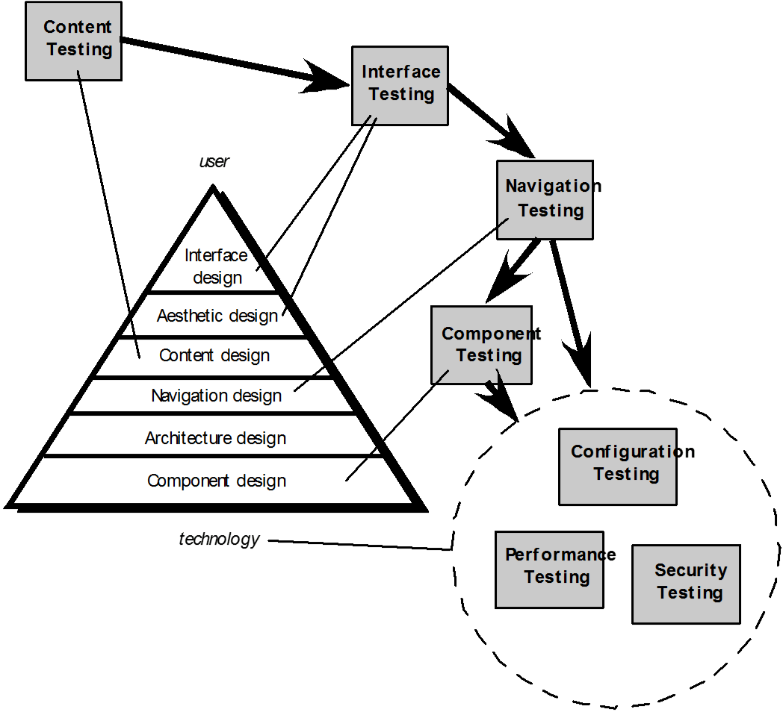
25.2 The Testing Process

Slide 8
25.3.1 Content Testing
Content testing has three important objectives:
  to uncover syntactic errors (e.g., typos, grammar mistakes) in text-based documents, graphical representations, and other media
  to uncover semantic errors (i.e., errors in the accuracy or completeness of information) in any content object presented as navigation occurs, and
  to find errors in the organization or structure of content that is presented to the end-user.

Slide 9
25.3.1 Assessing Content Semantics
  Is the information factually accurate?
  Is the information concise and to the point?
  Is the layout of the content object easy for the user to understand?
  Can information embedded within a content object be found easily?
  Have proper references been provided for all information derived from other sources?
  Is the information presented consistent internally and consistent with information presented in other content objects?
  Is the content offensive, misleading, or does it open the door to litigation?
  Does the content infringe on existing copyrights or trademarks?
  Does the content contain internal links that supplement existing content? Are the links correct?
  Does the aesthetic style of the content conflict with the aesthetic style of the interface?

Slide 10
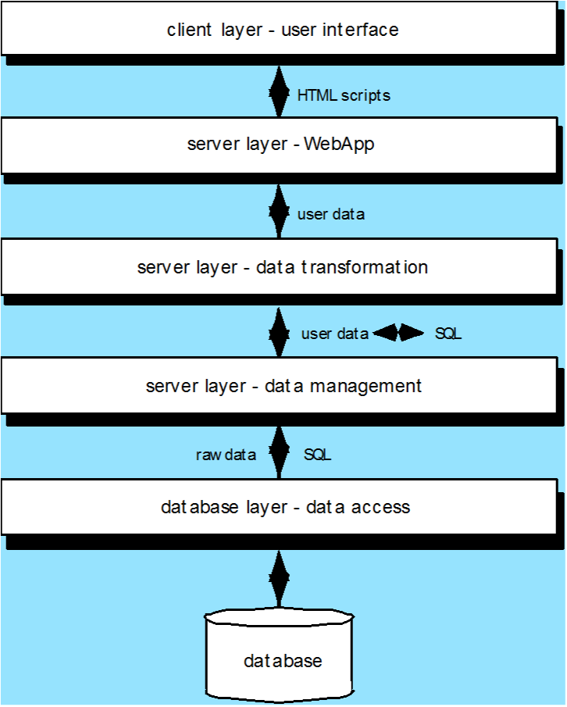
25.3.2 Database Testing
Tests are defined for
each layer

Slide 11
25.4.1 User Interface Testing
  Interface features are tested to ensure that design rules, aesthetics, and related visual content is available for the user without error.
  Individual interface mechanisms are tested in a manner that is analogous to unit testing.
  Each interface mechanism is tested within the context of a use-case or NSU for a specific user category.
  The complete interface is tested against selected use-cases and NSUs to uncover errors in the semantics of the interface.
  The interface is tested within a variety of environments (e.g., browsers) to ensure that it will be compatible.

Slide 12
25.4.2 Testing Interface Mechanisms-I
  Links — navigation mechanisms that link the user to some other content object or function.
  Forms — a structured document containing blank fields that are filled in by the user. The data contained in the fields are used as input to one or more WebApp functions.
  Client-side scripting — a list of programmed commands in a scripting language (e.g., Javascript) that handle information input via forms or other user interactions
  Dynamic HTML — leads to content objects that are manipulated on the client side using scripting or cascading style sheets (CSS).
  Client-side pop-up windows — small windows that pop-up without user interaction. These windows can be content-oriented and may require some form of user interaction.

Slide 13
25.4.2 Testing Interface Mechanisms-II
  CGI scripts — a common gateway interface (CGI) script implements a standard method that allows a Web server to interact dynamically with users (e.g., a WebApp that contains forms may use a CGI script to process the data contained in the form once it is submitted by the user).
  Streaming content — rather than waiting for a request from the client-side, content objects are downloaded automatically from the server side. This approach is sometimes called “push” technology because the server pushes data to the client.
  Cookies — a block of data sent by the server and stored by a browser as a consequence of a specific user interaction. The content of the data is WebApp-specific (e.g., user identification data or a list of items that have been selected for purchase by the user).
  Application specific interface mechanisms — include one or more “macro” interface mechanisms such as a shopping cart, credit card processing, or a shipping cost calculator.

Slide 14
25.4.3 Usability Tests
Design by WebE team … executed by end-users
Testing sequence …
  Define a set of usability testing categories and identify goals for each.
  Design tests that will enable each goal to be evaluated.
  Select participants who will conduct the tests.
  Instrument participants’ interaction with the WebApp while testing is conducted.
  Develop a mechanism for assessing the usability of the WebApp
Different levels of abstraction:
  the usability of a specific interface mechanism (e.g., a form) can be assessed
  the usability of a complete Web page (encompassing interface mechanisms, data objects and related functions) can be evaluated
  the usability of the complete WebApp can be considered.

Slide 15
25.4.4 Compatibility Testing
Compatibility testing is to define a set of “commonly encountered” client side computing configurations and their variants
Create a tree structure identifying
  each computing platform
  typical display devices
  the operating systems supported on the platform
  the browsers available
  likely Internet connection speeds
  similar information.
Derive a series of compatibility validation tests
  derived from existing interface tests, navigation tests, performance tests, and security tests.
  intent of these tests is to uncover errors or execution problems that can be traced to configuration differences.

Slide 16
25.5 Component-Level Testing
Focuses on a set of tests that attempt to uncover errors in WebApp functions
Conventional black-box and white-box test case design methods can be used
Database testing is often an integral part of the component-testing regime

Slide 17
25.6 Navigation Testing
The following navigation mechanisms should be tested:
  Navigation links — these mechanisms include internal links within the WebApp, external links to other WebApps, and anchors within a specific Web page.
  Redirects — these links come into play when a user requests a non-existent URL or selects a link whose destination has been removed or whose name has changed.
  Bookmarks — although bookmarks are a browser function, the WebApp should be tested to ensure that a meaningful page title can be extracted as the bookmark is created.
  Frames and framesets — tested for correct content, proper layout and sizing, download performance, and browser compatibility
  Site maps — Each site map entry should be tested to ensure that the link takes the user to the proper content or functionality.
  Internal search engines — Search engine testing validates the accuracy and completeness of the search, the error-handling properties of the search engine, and advanced search features

Slide 18
25.7.1 Configuration Testing
Server-side
  Is the WebApp fully compatible with the server OS?
  Are system files, directories, and related system data created correctly when the WebApp is operational?
  Do system security measures (e.g., firewalls or encryption) allow the WebApp to execute and service users without interference or performance degradation?
  Has the WebApp been tested with the distributed server configuration (if one exists) that has been chosen?
  Is the WebApp properly integrated with database software? Is the WebApp sensitive to different versions of database software?
  Do server-side WebApp scripts execute properly?
  Have system administrator errors been examined for their affect on WebApp operations?
  If proxy servers are used, have differences in their configuration been addressed with on-site testing?

Slide 19
25.7.2 Configuration Testing
Client-side
  Hardware — CPU, memory, storage and printing devices
  Operating systems — Linux, Macintosh OS, Microsoft Windows, a mobile-based OS
  Browser software — Internet Explorer, Mozilla/Netscape, Opera, Safari, and others
  User interface components — Active X, Java applets and others
  Plug-ins — QuickTime, RealPlayer, and many others
  Connectivity — cable, DSL, regular modem, T1
The number of configuration variables must be reduced to a manageable number

Slide 20
25.8 Security Testing
Designed to probe vulnerabilities of the client-side environment, the network communications that occur as data are passed from client to server and back again, and the server-side environment
On the client-side, vulnerabilities can often be traced to pre-existing bugs in browsers, e-mail programs, or communication software.
On the server-side, vulnerabilities include denial-of-service attacks and malicious scripts that can be passed along to the client-side or used to disable server operations

Slide 21
25.9.1 Performance Testing
Does the server response time degrade to a point where it is noticeable and unacceptable?
At what point (in terms of users, transactions or data loading) does performance become unacceptable?
What system components are responsible for performance degradation?
What is the average response time for users under a variety of loading conditions?
Does performance degradation have an impact on system security?
Is WebApp reliability or accuracy affected as the load on the system grows?
What happens when loads that are greater than maximum server capacity are applied?

Slide 22
25.9.2 Load Testing
The intent is to determine how the WebApp and its server-side environment will respond to various loading conditions
  N, the number of concurrent users
  T, the number of on-line transactions per unit of time
  D, the data load processed by the server per transaction
  Overall throughput, P, is computed in the following manner:
    P = N x T x D

Slide 23
25.9.3 Stress Testing
Does the system degrade ‘gently’ or does the server shut down as capacity is exceeded?
Does server software generate “server not available” messages? More generally, are users aware that they cannot reach the server?
Does the server queue requests for resources and empty the queue once capacity demands diminish?
Are transactions lost as capacity is exceeded?
Is data integrity affected as capacity is exceeded?
What values of N, T, and D force the server environment to fail? How does failure manifest itself? Are automated notifications sent to technical support staff at the server site?
If the system does fail, how long will it take to come back on-line?
Are certain WebApp functions (e.g., compute intensive functionality, data streaming capabilities) discontinued as capacity reaches the 80 or 90 percent level?

