Slide 1
高级数据结构和算法分析
Advanced Data Structures and Algorithm Analysis
主讲教师： 卜佳俊
Instructor: BU, Jiajun E-mail: bjj@zju.edu.cn
新浪微博：卜佳俊ZJU
助教：沈鑫(SHEN, Xin)
E-mail: sxstar@zju.edu.cn
Courseware and homework sets can be downloaded from https://pintia.cn/

Slide 2



 教材 (Text Book)
Data Structures and
Algorithm Analysis in C
(2nd Edition)
Mark Allen Weiss
陈 越 改编
Email: weiss@fiu.edu

Slide 3
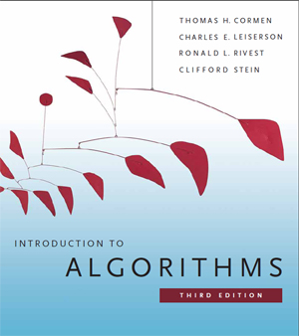
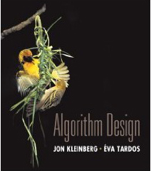
 教材 (Text Book)
Algorithm Design
Jon Kleinberg, Eva Tardos
Addison Wesley, 2005
Introduction to Algorithms
(3rd Edition)
Thomas H. Cormen, Charles E. Leiserson, Ronald L. Rivest and Clifford Stein
The MIT Press. 2009

Slide 4
 参考书目 (Reference)
➢ 数据结构课程设计
何钦铭、冯雁、陈越 著 浙江大学出版社
➢ 数据结构与算法分析（C语言版）
魏宝刚、陈越、王申康 编著 浙江大学出版社
➢ 数据结构学习与实验指导
陈越、何钦铭、徐镜春、魏宝刚、杨枨 编著
高等教育出版社

Slide 5







课程评分方法 (Grading Policies)
Homework
(10)
Discussions
(10)
Research Project
+Peer Review (30)
MidTerm
(10*)
Total ≤ 60
Q&A
(0.5 each)
Final Exam (40*)

Slide 6
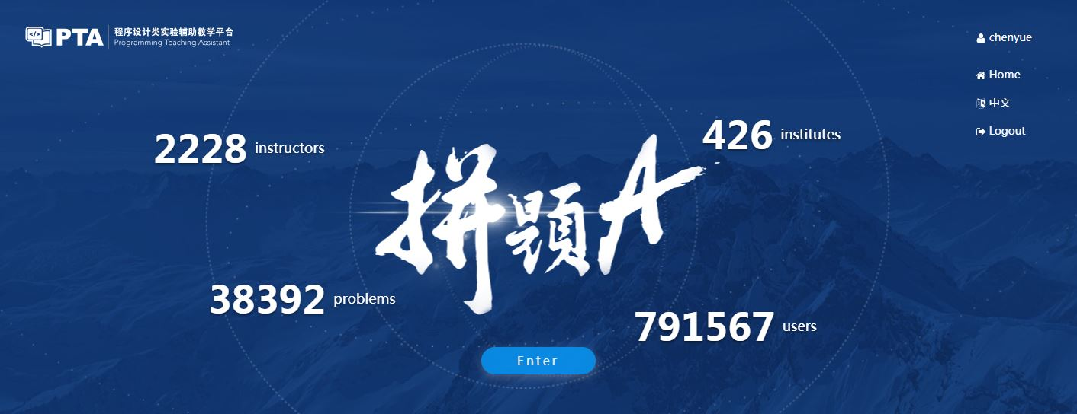
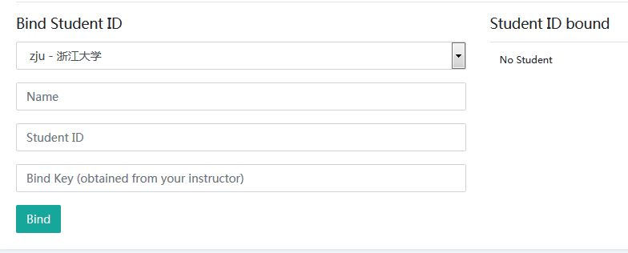
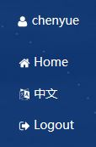
Homework Assignments (10)
Register and login at https://pintia.cn/
Bind your student ID with bind key
Enter
560911

Slide 7
Research topics (26)
Done in groups of 3
8 topics to choose from
Report (20 points)
In-class presentation (10~15 minutes, 6 points)
The speaker will be chosen randomly from all the contributors
If there are many volunteers, at most 3 groups will be chosen to give presentations
For those groups not to give presentations, each will gain bonus points = report points / 10

Slide 8

Research Reports
Peer Review
Group_Total = G_{T} × 50% + G_{PR} × 50%
Fullmark = 20

Slide 9
Peer review is for the reviewer
Editing someone else’s work is one of the best ways to learn how to edit your own
  It’s much easier to see what’s working and what isn’t in someone else’s paper than in your own.
Writing is revision
  The more you practice reading and critiquing someone else’s work, the stronger your editing skills will be when it’s time to apply them to your own work.
Any skill level works
  You can learn a great deal about the fundamentals of good writing from carefully reading and reviewing poor writing, figuring out why it’s not succeeding and what it needs to succeed.

Slide 10
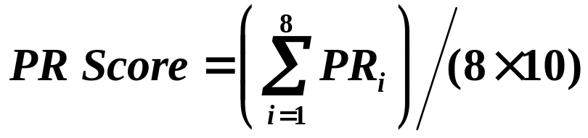
Process
Submit initial version for peer review (1 week)
Participate in peer review (2 days)
Revise paper and submit to TA (2 days)
Receive final grading from TA
ALL Groups
PR_{i} Fullmark = 40

Slide 11
Discussions (10)
Done in groups
Random in-class discussion topics
Each takes 3~5 minutes
Each full-mark is 10

Slide 12

Q&A
For volunteers only
0.5 point for each question asked/answered
come and claim your credits after each class session

Slide 13
诚信守则
（Code of Academic Honesty）
One must get a full mark to be eligible to take the final exam.
As long as there is one action of academic dishonesty in this semester, one will not be eligible to take the final exam and one’s course score will be zero.

Slide 14
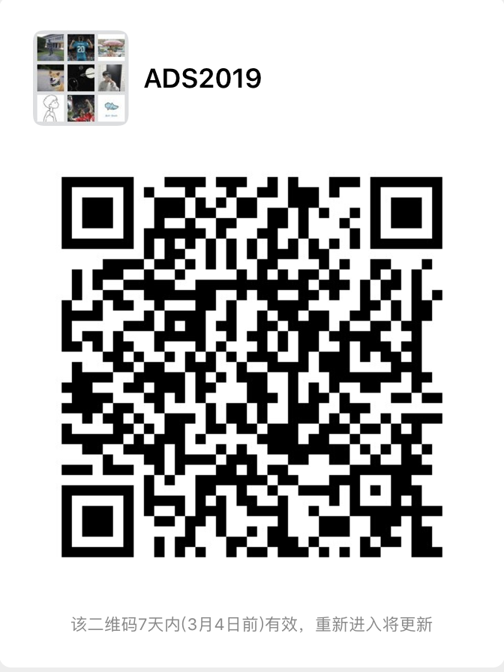
WeChat （微信答疑群）
Please send your group members’ names and student ID’s to sxstar@zju.edu.cn before 10pm today. In return, you will receive your group ID.
Please specify your group leader in the email.

