Slide 1
Printf and Scanf

Slide 2
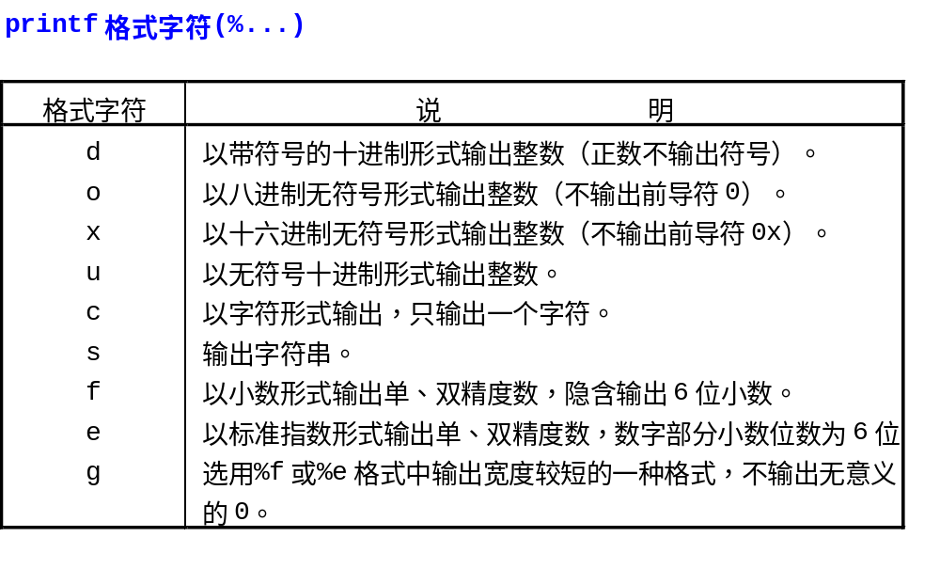

Slide 3
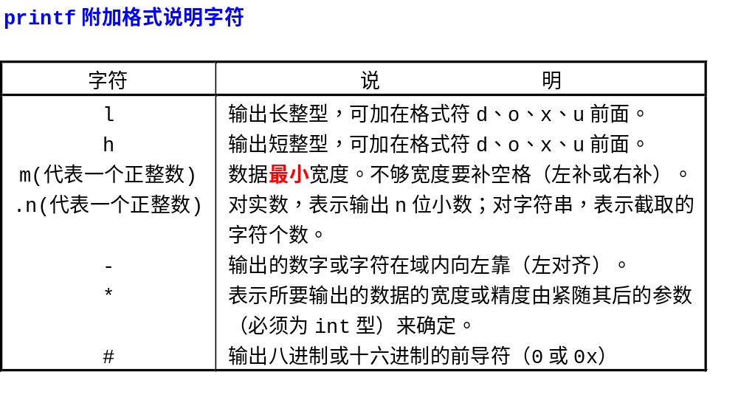

Slide 4
char *s=“Hello, world”;
printf(“%.*s”,5,s); ==> Hello
:%s: :hello, world:
:%10s: :hello, world:
:%.10s: :hello, wor:
:%-10s: :hello, world:
:%.15s: :hello, world:
:%-15s: :hello, world :
:%15.10s: : hello, wor:
:%-15.10s: :hello, wor :
printf(“%5.2f%%”, 1.0/3*100); ==> 33.33%
int sprintf(char *buffer, char *format,par1,...);
printf(“%#o,%#x\n”,10,10); ==> 012,0xa
Printf(“%hu\n”, -1);
Will print out ?

Slide 5
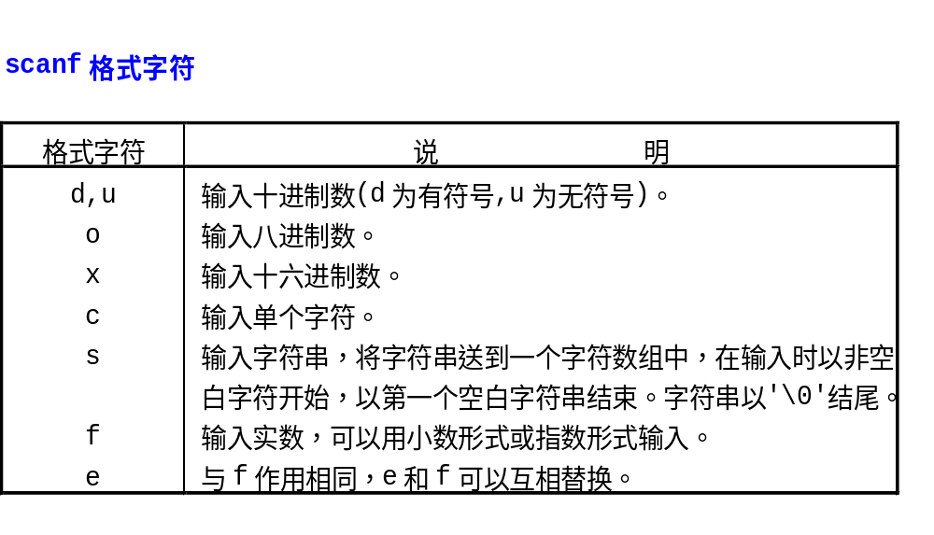

Slide 6
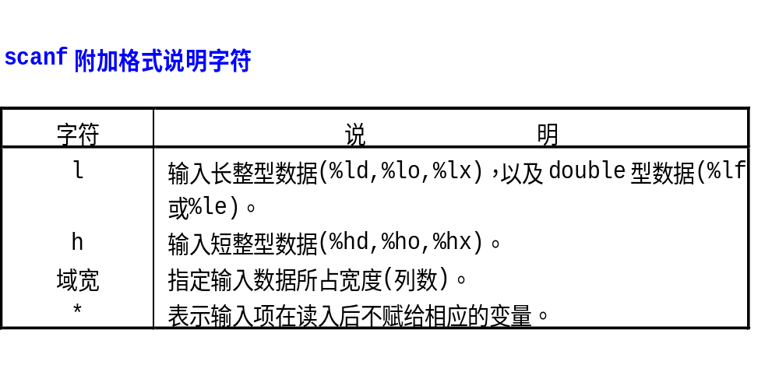

Slide 7
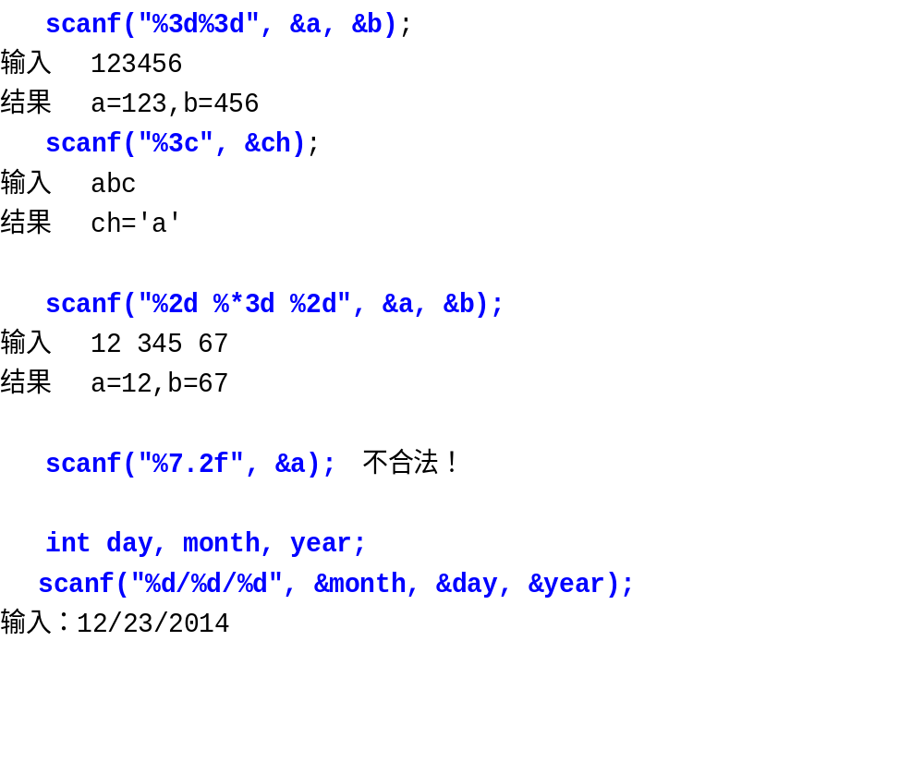

Slide 8
