Slide 1
Capstone Project: US Craft Beer and Breweries Study
Spencer Fogelman, Ryan Goodwin, Queena Wang

Slide 2
Agenda
Challenge/Solution/Benefits
Solution approach
Breweries present in each state
Observation on Beer and Breweries merged data
Number of NA’s in each column
Median alcohol content and international bitterness unit for each state
Sate with most alcoholic (ABV) beer and most bitter beer
Summary statistics for the ABV variables
Overall Findings and Business suggestions

Slide 3


Challenges
As an Oregon based brewery, the company “Oregon best beer” would like to understand if there is an apparent relationship between the bitterness of the beer and its alcoholic content. This would help company’s decision on explanation across the nation in U.S.
Solutions
Use existing data to find out which state has the maximum alcoholic (ABV) beer, as well as which state has the most bitter (IBU) beer. We then analysis and study the correlation between the two.
Benefits
Better Vision for the future business
Preparedness
Improve Business Execution
Predictive Maintenance

Slide 4

Solution Approach
First, we checked how many breweries are present in each state
Targeting states with fewer breweries
Merged the beer dataset with the breweries dataset to see the relationship

Slide 5
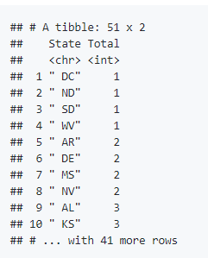
Breweries present in each state
library(ggplot2) library(dplyr) breweries=read.csv('/Users/spencerfogelman/Desktop/SMUDataScience/CapstoneProject/Breweries.csv', stringsAsFactors = FALSE) Beers=read.csv('/Users/spencerfogelman/Desktop/SMUDataScience/CapstoneProject/Beers.csv', stringsAsFactors = FALSE) head(breweries) head(beers) breweries %>% group_by(State) %>% summarise(Total = n())
Based on the data, DC, North Dakota, South Dakota and West Virginia all only have one brewery. Those may be the ideal location for “Oregon Best Beer” business expansion

Slide 6
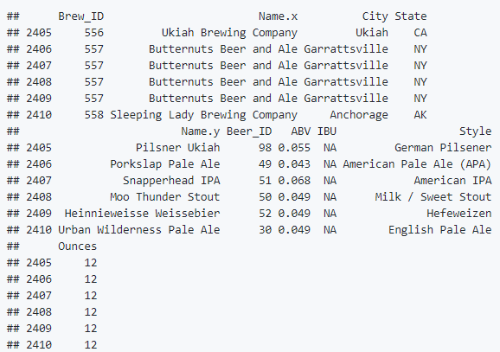
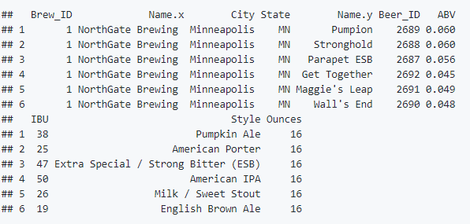
Observation on Beer and Breweries merged data
We then merged the Beer dataset with the breweries dataset to help us further analysis and understand the data. The diagram on the left shows the first 6 row of the merged data, whereas the diagram on the left display the last 6 row of the merged data.
merged = merge(x = breweries, y = beers, by.x = 'Brew_ID', by.y= 'Brewery_id', all = TRUE) head(merged, 6) tail(merged, 6)

Slide 7

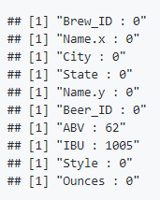
Number of NA’s in each column
In order to understand how complete the merged dataset is, we want to investigate how many NA values are in each column.
for (i in 1:length(names(merged))){ column = merged[,i] nas = sum(is.na(column)) print(paste(names(merged)[i], ':', nas)) }

Slide 8
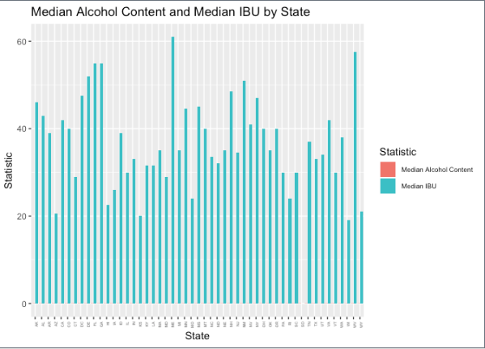
Median alcohol content and international bitterness unit for each state
summarydf = merged %>% group_by(State) %>% summarise(MedianAlcoholContent = median(ABV, na.rm=TRUE), MedianIBU = median(IBU, na.rm=TRUE)) summarydf library(reshape2) summarydfLong = melt(summarydf, id.vars='State') ggplot(summarydfLong, aes(x=State, y=value, fill=variable)) + geom_bar(stat='identity', position = 'dodge') + theme(axis.text.x = element_text(angle = 90, hjust = 1, size = 4), legend.text=element_text(size=7)) + labs(title='Median Alcohol Content and Median IBU by State', x = 'State', y='Statistic') + scale_fill_discrete(name = 'Statistic', breaks= c('MedianAlcoholContent', 'MedianIBU'), labels=c('Median Alcohol Content', 'Median IBU'))

Slide 9
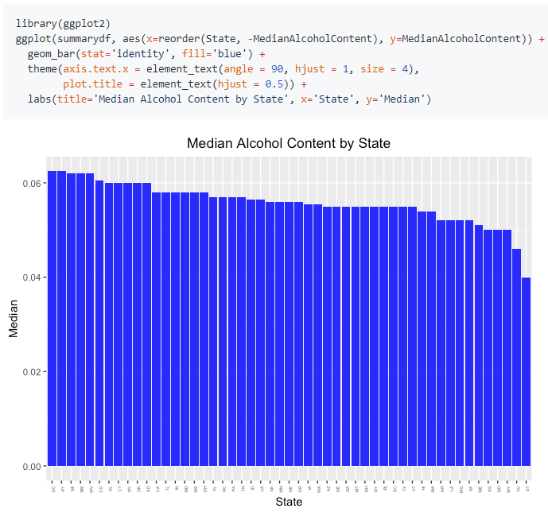
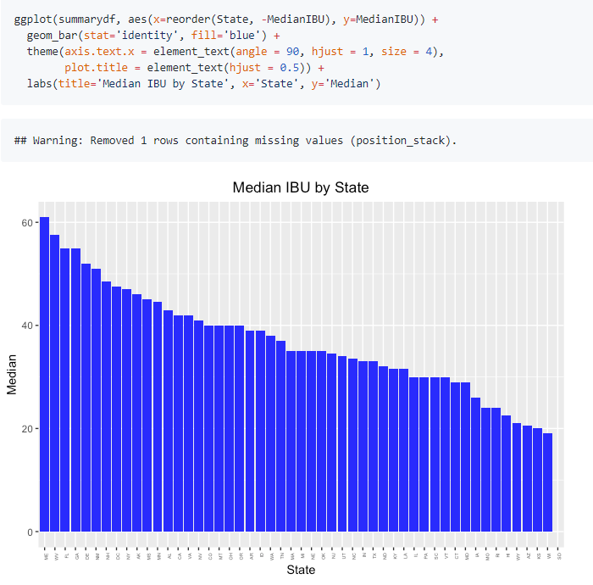
Because the units are very different, we decide it would be better to do 2 separate bar plots. Here we can see the DC has the largest median alcohol content and Utah has the smallest median alcohol content. Maine has the largest median IBU and Wisconsin has the lowest median IBU.

Slide 10
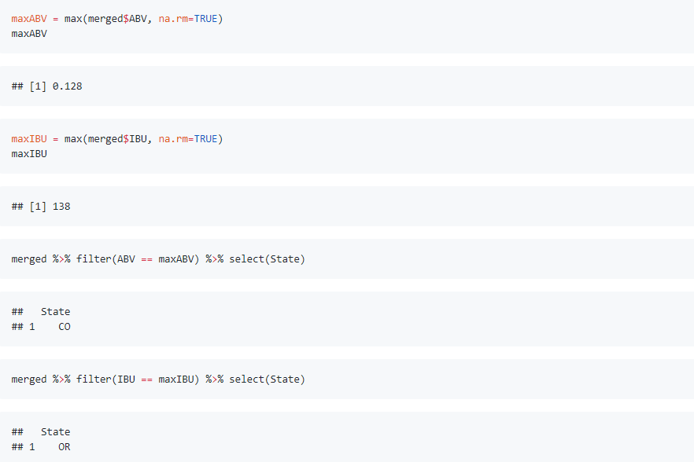
Sate with most alcoholic (ABV) beer and most bitter beer
Based on observation, we can see Oregon has the most bitter beer and Colorado has the strongest beer. West Coast beers tend to be more bitter than East Coast beers.

Slide 11
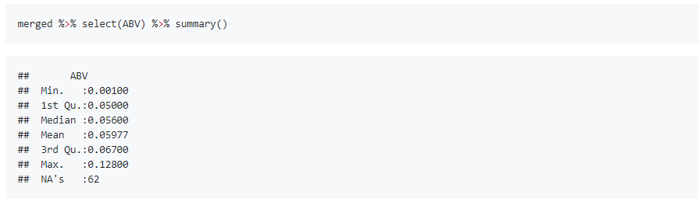
Summary statistics for the ABV variables
Here’s the nationwide summary statistics that provides the data of beer strengths.

Slide 12
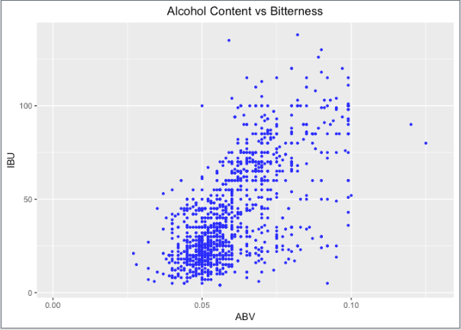
Apparent relationship between the bitterness of the beer and its alcoholic content
ggplot(merged, aes(x=ABV, y=IBU)) + geom_point(colour = "blue", size = 0.8, na.rm = TRUE) + labs(title='Alcohol Content vs Bitterness') + theme(plot.title = element_text(hjust = 0.5))
There is evidence to suggest a positive correlation IBU and ABV, meaning increasing the alcohol content results in more bitter beer. Using this data would help the company to create custom beer flavor for the customers.

Slide 13
Overall Findings and Business suggestions
Bitterness
West Coast > East Coast
When expanding business, we should keep in mind that west coast beers tend to be more bitter than East Coast beers. Therefore, the company may gain more profits by selling beers that more bitter on west coast.
Median IBU
Maine is the largest whereas Wisconsin has the lowest
When expanding business in Maine, we should keep in mind that it has the largest median IBU. In contrast, Wisconsin has the lowest median IBU.
Median alcohol content
DC has the largest median alcohol content and Utah has the smallest
The company should keep in mind the median alcohol context is the highest in DC and Utah has the smallest.

Slide 14

Questions??

