Slide 1
Capstone Project: US Craft Beer and Breweries Study
Spencer Fogelman, Ryan Goodwin, Queena Wang

Slide 2
Agenda
Challenge/Solution/Benefits
Solution approach
Breweries present in each state
Observation on Beer and Breweries merged data
Number of NA’s in each column
Median alcohol content and international bitterness unit for each state
Sate with most alcoholic (ABV) beer and most bitter beer
Summary statistics for the ABV variables
Overall Findings and Business suggestions

Slide 3


Challenges
As an Oregon based brewery, the company “Oregon’s Best Beer” would like to understand the distribution and characteristics of beers and breweries across the nation so as to be successful in other states
Solutions
Use existing data to find out which states have a small number of existing breweries. Also use the data to study how the alcohol content and bitterness of beers differs by state so that the company can tailor its beers to those states’ tastes.
Benefits
Better Vision for the future business
Preparedness
Improve Business Execution
Predictive Maintenance

Slide 4

Solution Approach
First, we checked how many breweries are present in each state
Targeting states with fewer breweries
Merged the beer dataset with the breweries dataset to see the relationship

Slide 5
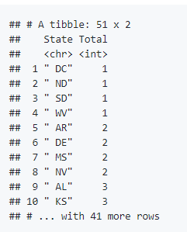
Breweries present in each state
library(ggplot2) library(dplyr) breweries=read.csv('/Users/spencerfogelman/Desktop/SMUDataScience/CapstoneProject/Breweries.csv', stringsAsFactors = FALSE) Beers=read.csv('/Users/spencerfogelman/Desktop/SMUDataScience/CapstoneProject/Beers.csv', stringsAsFactors = FALSE) head(breweries) head(beers) breweries %>% group_by(State) %>% summarise(Total = n())
Based on the data, DC, North Dakota, South Dakota and West Virginia all only have one brewery. Those may be the ideal location for “Oregon’s Best Beer” business expansion

Slide 6
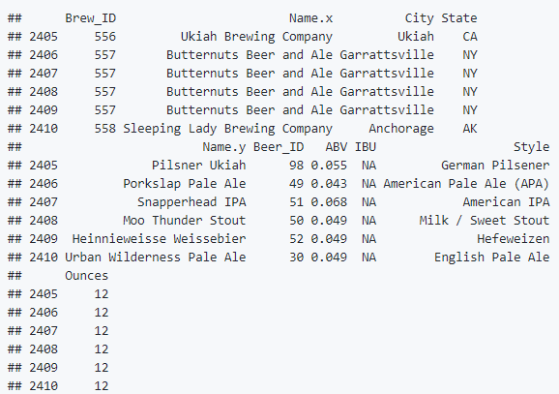
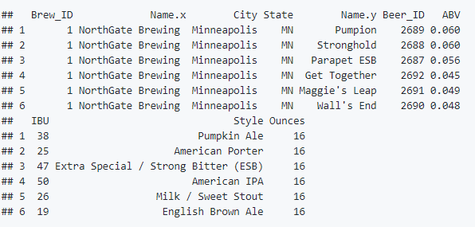
Observation on Beer and Breweries merged data
We then merged the Beer dataset with the Breweries dataset to help us further analyze and understand the data. The diagram on the left shows the first 6 row of the merged data, whereas the diagram on the right displays the last 6 rows of the merged data.
merged = merge(x = breweries, y = beers, by.x = 'Brew_ID', by.y= 'Brewery_id', all = TRUE) head(merged, 6) tail(merged, 6)

Slide 7

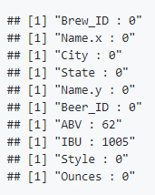
Number of NA’s in each column
In order to understand how complete the merged dataset is, we want to investigate how many NA values are in each column.
for (i in 1:length(names(merged))){ column = merged[,i] nas = sum(is.na(column)) print(paste(names(merged)[i], ':', nas)) }

Slide 8
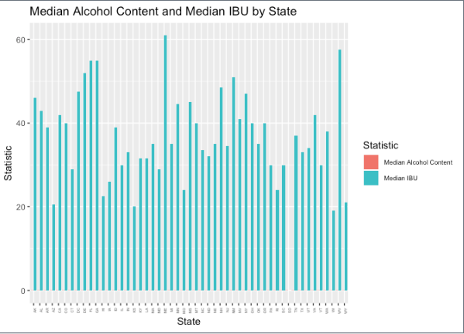
Median alcohol content and international bitterness unit for each state
summarydf = merged %>% group_by(State) %>% summarise(MedianAlcoholContent = median(ABV, na.rm=TRUE), MedianIBU = median(IBU, na.rm=TRUE)) summarydf library(reshape2) summarydfLong = melt(summarydf, id.vars='State') ggplot(summarydfLong, aes(x=State, y=value, fill=variable)) + geom_bar(stat='identity', position = 'dodge') + theme(axis.text.x = element_text(angle = 90, hjust = 1, size = 4), legend.text=element_text(size=7)) + labs(title='Median Alcohol Content and Median IBU by State', x = 'State', y='Statistic') + scale_fill_discrete(name = 'Statistic', breaks= c('MedianAlcoholContent', 'MedianIBU'), labels=c('Median Alcohol Content', 'Median IBU'))
As a side by side boxplot, this graph is not very informative because the units for alcohol content and bitterness (IBU) are so different

Slide 9
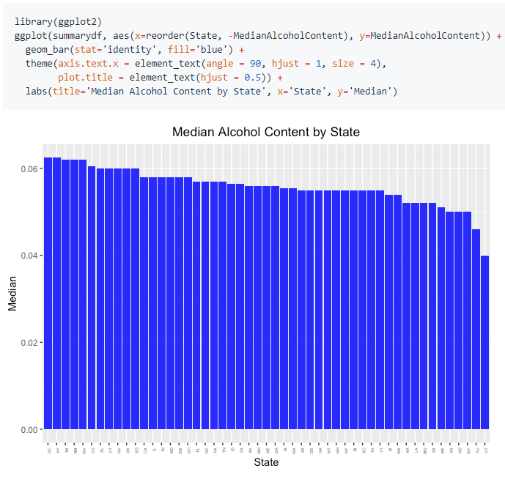
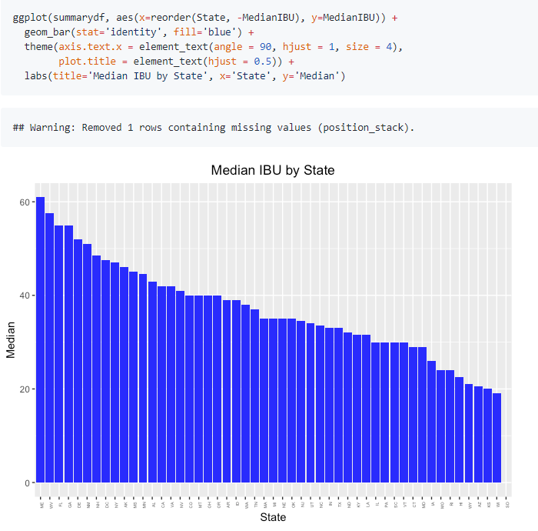
To better visualize the data, we decided it would be better to do 2 separate bar plots. Here we can see the DC has the largest median alcohol content and Utah has the smallest median alcohol content. Maine has the largest median IBU and Wisconsin has the lowest median IBU. South Dakota is missing information on its IBU, and this data should be collected.

Slide 10
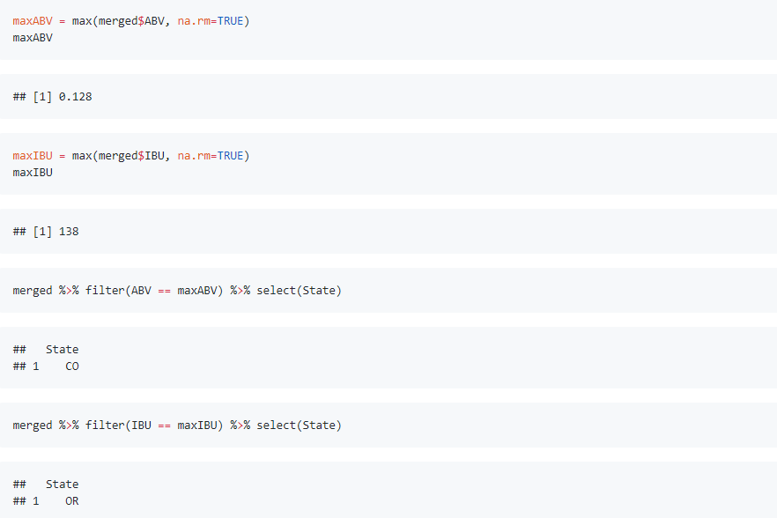
Sate with most alcoholic (ABV) beer and most bitter beer
Based on observation, we can see Oregon has the most bitter beer and Colorado has the strongest beer. For future research, we will investigate if west coast beers tend to be more bitter than east coast beers.

Slide 11
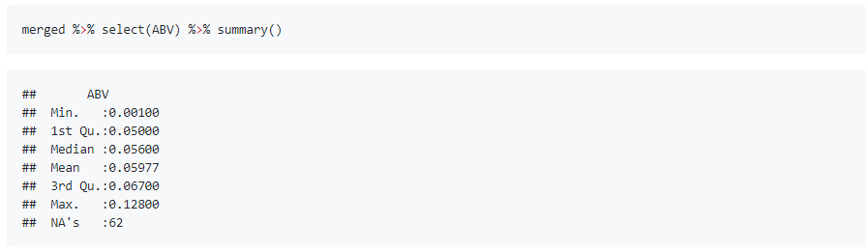
Summary statistics for the ABV variables
Here’s the nationwide summary statistics that provides the data of beer alcohol content. In making new beers it would be smart to stay within the limits that already exist.

Slide 12
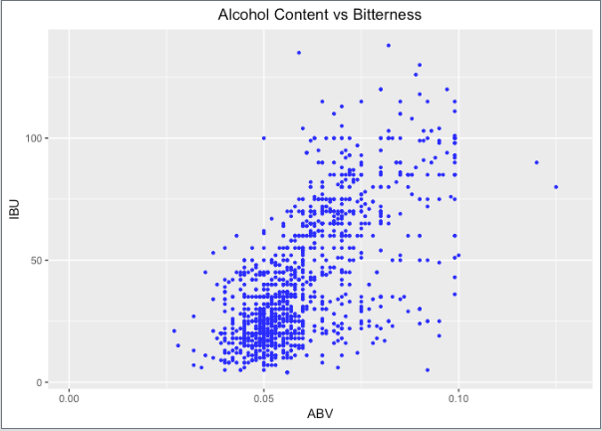
Apparent relationship between the bitterness of the beer and its alcoholic content
ggplot(merged, aes(x=ABV, y=IBU)) + geom_point(colour = "blue", size = 0.8, na.rm = TRUE) + labs(title='Alcohol Content vs Bitterness') + theme(plot.title = element_text(hjust = 0.5))
There is evidence to suggest a positive correlation between IBU and ABV. Using this data would help the company create custom beer flavors for its customers. However, because this is an observational study for future research we will run an experiment to see if there is an actual causal relationship.

Slide 13
Overall Findings and Business suggestions
Bitterness
West Coast > East Coast
When expanding business, we should keep in mind that west coast beers may be more bitter than East Coast beers. Therefore, the company may gain more profits by selling beers that more bitter on west coast. This will need further exploration.
Median IBU
Maine is the largest whereas Wisconsin has the lowest
When expanding business in Maine, we should keep in mind that it has the largest median IBU (the most bitter beer). In contrast, Wisconsin has the lowest median IBU. We should create custom beer flavors that follow these trends. We will need to explore whether increasing the alcohol content actually makes beers more bitter, as implied by our previous scatter plot.
Median alcohol content
DC has the largest median alcohol content and Utah has the smallest
The company should keep in mind the median alcohol context is the highest in DC and Utah has the smallest. We should follow these trends when customizing beers for these states.

Slide 14

Questions??

