Slide 1
Capstone Project: US Craft Beer and Breweries Study
Spencer Fogelman, Ryan Goodwin, Queena Wang

Slide 2

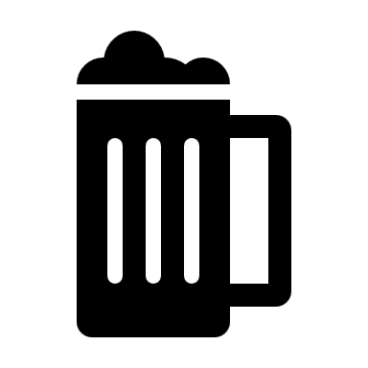
Challenges
As an Oregon based brewery, the company “Oregon best beer” would like to understand if there is an apparent relationship between the bitterness of the beer and its alcoholic content. This would help company’s decision on explanation across the nation in U.S.
Solutions
Use existing data to find out which state has the maximum alcoholic (ABV) beer, as well as which state has the most bitter (IBU) beer. We then analysis and study the correlation between the two.
Benefits
Better Vision for the future business
Preparedness
Improve Business Execution
Predictive Maintenance

Slide 3

Solution Approach
First, we checked how many breweries are present in each state
Targeting states with fewer breweries
Merged the beer dataset with the breweries dataset to see the relationship

Slide 4
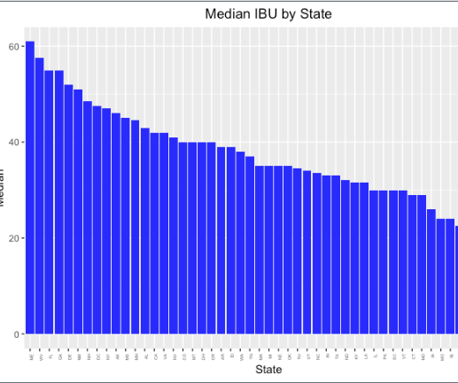

Here we can see the DC has the largest median alcohol content and Utah has the smallest median alcohol content. Maine has the largest median IBU and Wisconsin has the lowest median IBU. For some reason we do not have information on the IBU of South Dakota.

Slide 5
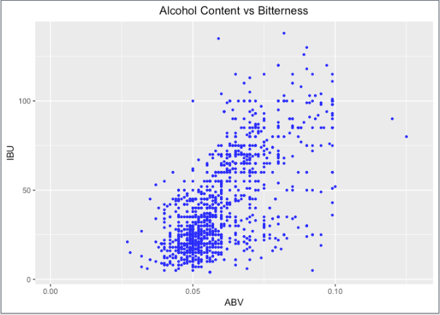
This is a scatter plot between bitterness and alcoholic content of beer. Examination of this scatter plot and the regression line suggests that here is a positive, linear relationship between IBU and ABC, meaning increasing the alcohol content results in more bitter beer. However, since this is an observational study, we must do an experiment to confidently say there is a causal relationship.

Slide 6
Observations
Based on the data, DC, North Dakota, South Dakota and West Virginia all only have one brewery. Those may be the ideal location for “Oregon Best Beer” business expansion.
There is evidence to suggest a positive correlation IBU and ABC, meaning increasing the alcohol content results in more bitter beer. Using this data would help the company to create custom beer flavor for the customers.
In addition, we noticed that DC has the largest median alcohol content whereas Utah has the smallest median alcohol content. Maine has the largest median IBU and Wisconsin has the lowest median IBU.
Lastly, Oregon has the most bitter beer and Colorado has the strongest beer. West Coast beers also tend to be more bitter than East Coast beers.

Slide 7
Conclusion
Bitterness
West Coast > East Coast
When expanding business, we should keep in mind that west coast beers tend to be more bitter than East Coast beers. Therefore, the company may gain more profits by selling beers that more bitter on west coast.
Median IBU
Maine is the largest whereas Wisconsin has the lowest
When expanding business in Maine, we should keep in mind that it has the largest median IBU. In contrast, Wisconsin has the lowest median IBU.
Median alcohol content
DC has the largest median alcohol content and Utah has the smallest
The company should keep in mind the median alcohol context is the highest in DC and Utah has the smallest.

Slide 8

Questions??

