Slide 1
Ethics in Data Science
We could but should we

Slide 2
Introduction
To do:
What is discrimination - types student discount
Why do we need to consider ethics
Model explainability
https://dl.acm.org/doi/pdf/10.1145/2871196
https://link.springer.com/content/pdf/10.1007/s00146-021-01154-8.pdf

Slide 3
Content
What is data ethics
AI Bias
Real-life use case - Insurance Pricing

Slide 4
Why?
Responsibility/Regulation
Discrimination / Fairness
Trust

Slide 5
Ethics of Data Science
Data Ethics (2016) - Floridi and Taddeo
Ethics of Data
Re-indentification of individuals
Group Privacy - identificiation of types of individuals - group discrimination
Ethics of Algorithms
Moral responsibility and accountability to Undesirable and unforeseen outcomes
Ethics of Practices
Consent
Users privacy
Secondary use

Slide 6
Ethics of Data - Re-indentification of individuals
Process of using (additional) data to discover the identify of individuals from anonymous data (removal of PII).
E.g. Barclays Geolocation Data -
Pings from Mobile
Can identify individuals by looking at their most frequent places (home, place of work, etc)
Other Examples - AOL re-identification
Data as a product - Spend Trends

Slide 7
Ethics of Data - Group Privacy - Group Discrimination
What is discrimination -
The 2010 Equality Act …
Protected characteristics
Are all discounts bad?

Slide 8
Ethics of Data - Group Privacy - Group Discrimination
Is the model discriminating against certain groups?
Example: Car insurance Pricing - By law gender cannot be used for pricing (2012). 2010 Equality Act prohibits pricing against ethnicity and religion
However, can we still identify gender by proxy of other information?
Information taken during quote: Car details, address details, Personal details including employment status, occupation
Combine with additional data sources - e.g. shopping data

Slide 9
Car Insurance - Discrimination by proxy
Female | Male
Nursery nurses and assistants (97.76%) | Vehicle technicians, mechanics and electricians (99.19%)
Legal secretaries (96.39%) | Carpenters and joiners (99.05%)
Medical secretaries (95.55%) | Welding trades (98.64%)
Personal assistants and other secretaries (95.19%) | Electricians and electrical fitters (98.26%)
Childminders and related occupations (95.12%) | Metal working production and maintenance fitters (98.09%)
Occupation Details
Top 5 occupations[1]
Postcode
From Census data - Can obtain ethnicity, religion, etc.
Shopping Data
Gender
Race/Religion
https://careersmart.org.uk/occupations/equality/which-jobs-do-men-and-women-do-occupational-breakdown-gender

Slide 10
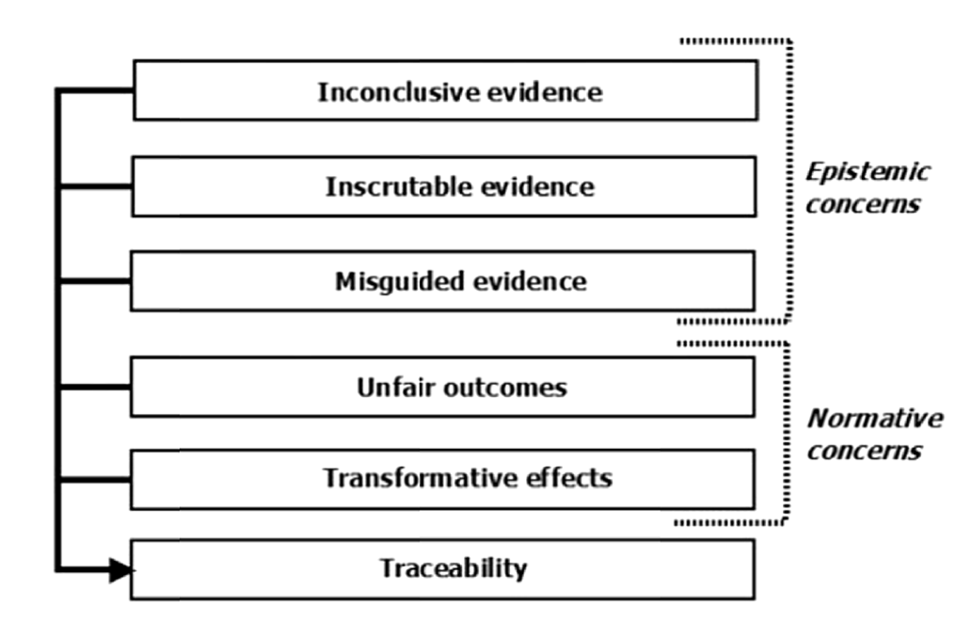
Ethics of Algorithms
We can split the ethics of algorithms into 3 parts

Slide 11
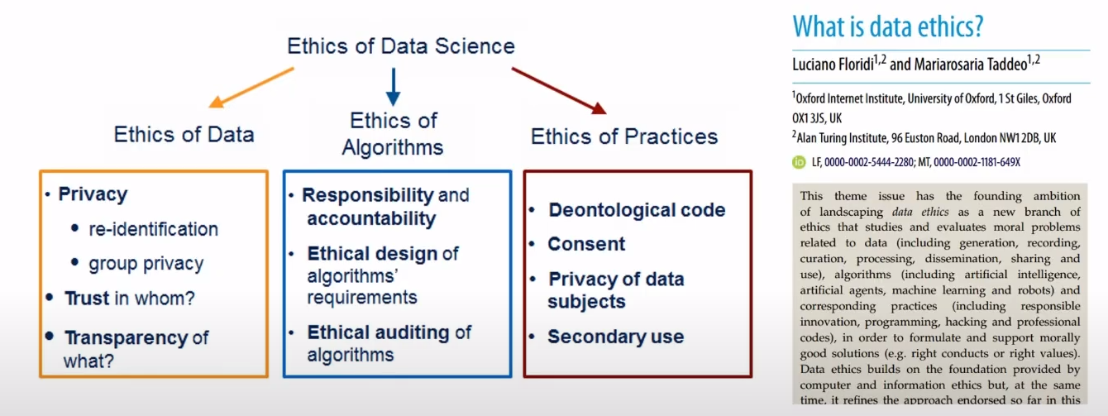
What is data ethics

Slide 12
Why do we need data ethics
Lack of Consent
Will this Algorithm do what i think it does?

Slide 13
Resources
Fairness
Responsibility
Respect of Human Rights

