Slide 1
Quick Introduction of Network Analysis

Slide 2
Network
Motivation
Problem Statements - Project Overview - Swift Routing
What is a network
  Use cases
  Worked Examples
  NetworkX

Slide 3
Intelligent Swift Routing
  International/cross-border payments usually goes through a number of intermediary banks before reaching the final destination
  Show example
  How are the fees calculated?
  The Routing path is determined by GPP Payment system by rules:
    If there are relationships

Slide 4
Intelligent Swift Routing
  Enriching swift transactions with routing data, we can gain insights into the following ….
  How can we achieve this? Networks

Slide 5
Introduction to Network Analysis
  Examples of networks
      Social media
      Web - Wikipedia
      Traffic flow
  Fraud Detection/Recommendations
Networks or Graphs are a set of objects (called nodes) having some relationship with each other (called edges)

Slide 6
Introduction to Network Analysis
A Graph is a pair of sets. G = (V,E). V is the set of vertices. E is a set of edges. E is made up of pairs of elements from V (unordered pair)
A DiGraph is also a pair of sets. D = (V,A). V is the set of vertices. A is the set of arcs. A is made up of pairs of elements from V (ordered pair)
Nodes (A,B,C,D,E in the example) are usually representing entities in the network, and can hold self-properties (such as weight, size, position and any other attribute) and network-based properties (such as Degree- number of neighbors or Cluster- a connected component the node belongs to etc.).
Edges represent the connections between the nodes, and might hold properties as well (such as weight representing the strength of the connection, direction in case of asymmetric relation or time if applicable).
These two basic elements can describe multiple phenomena, such as social connections, virtual routing network, physical electricity networks, roads network, biology relations network and many other relationships.

Slide 7
Introduction to Network Analysis
Types of Graphs - undirected / directed
Weighed Graphs
A weight graph is a graph whose edges have a "weight" or "cost". The weight of an edge can represent distance, time, or anything that models the "connection" between the pair of nodes it connects.

Slide 8
Centrality
Highly central nodes play a key role of a network, serving as hubs for different network dynamics. However the definition and importance of centrality might differ from case to case, and may refer to different centrality measures:
Degree — the amount of neighbors of the node
EigenVector / PageRank — iterative circles of neighbors
Closeness — the level of closeness to all of the nodes
Betweenness — quantifies the number of times a node acts as a bridge along the shortest path between two other nodes

Slide 9
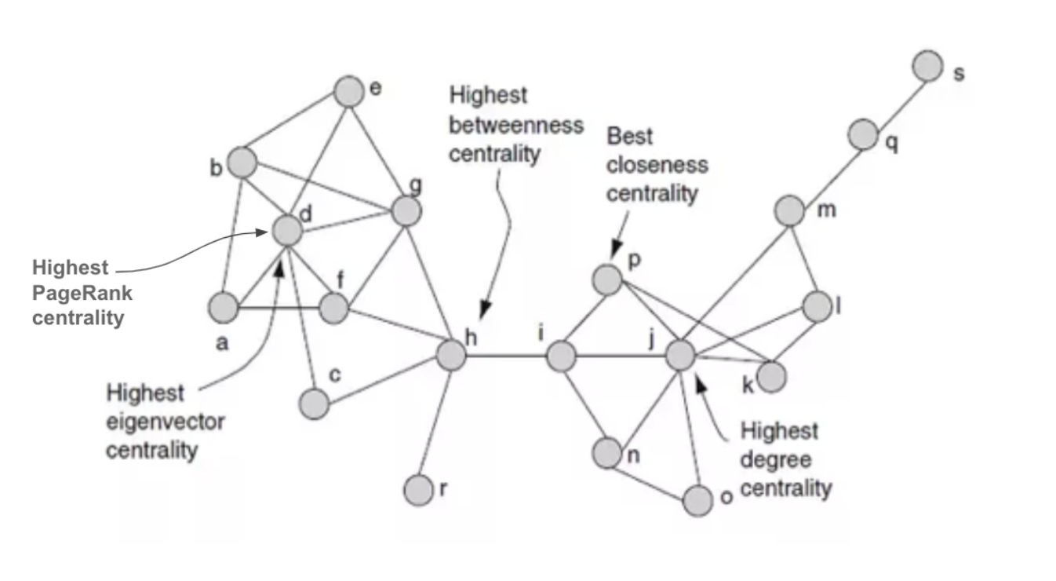
Centrality
Arroyo, D.. “Discovering Sets of Key Players in Social Networks.” Computational Social Network Analysis (2010)

Slide 10
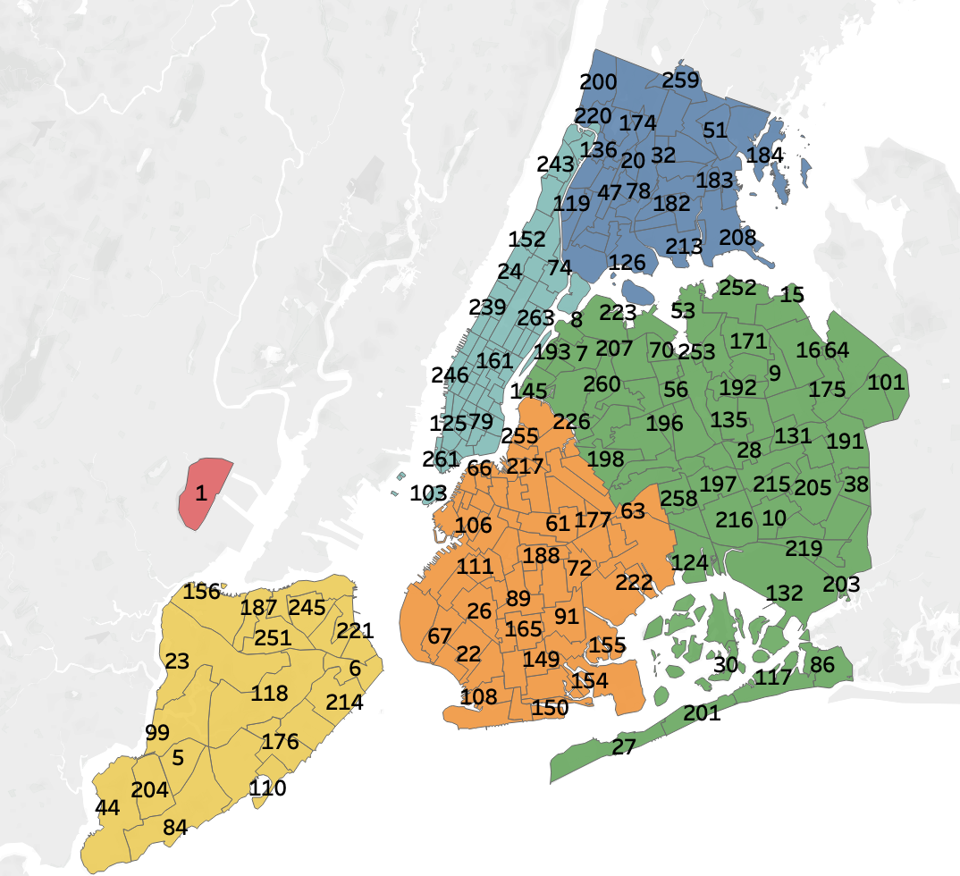
Preprocessing
Standard rate code:
April 2021
Removed duration > 180mins
Removed pickup location == drop off location
Removed drop ff/pick up location 265
Amount = total amount - tip (removed
Where amount is negative)
Aggregated data by pick up /drop off location, took average

Slide 11
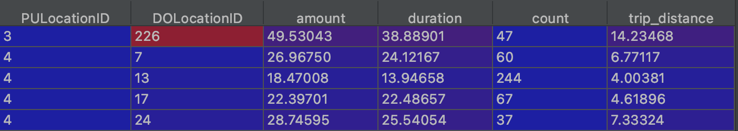
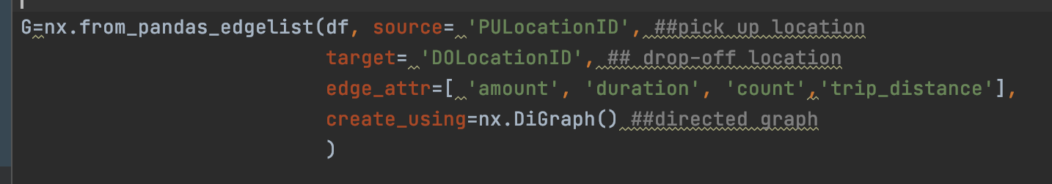
NetworkX Library - Creating a Graph
Example of processed data
We can easily create a graph using function

Slide 12
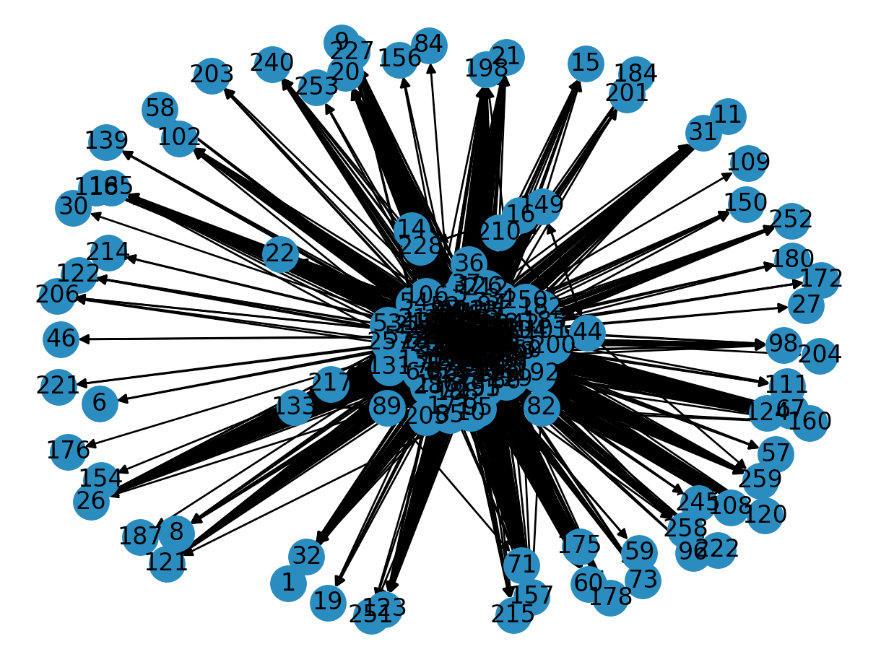
Visualisation of Graph

Slide 13
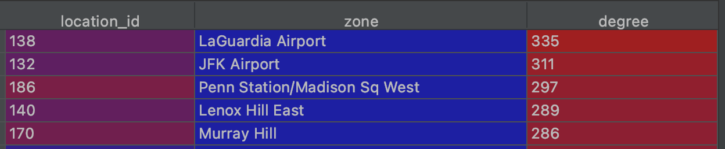
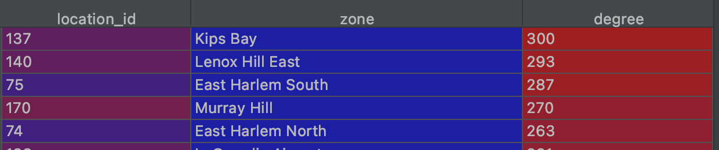
Centrality - Highest Degree Nodes
For 2021
How does this compare to April 2020?

Slide 14
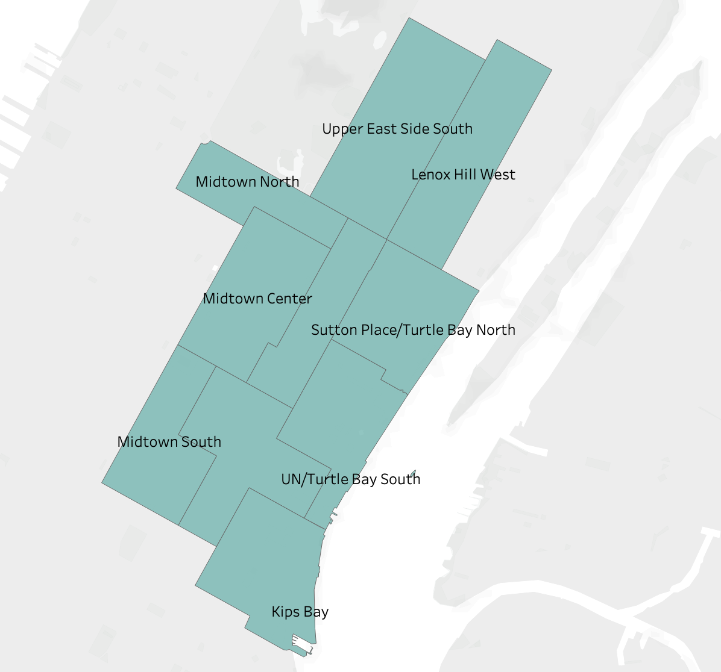
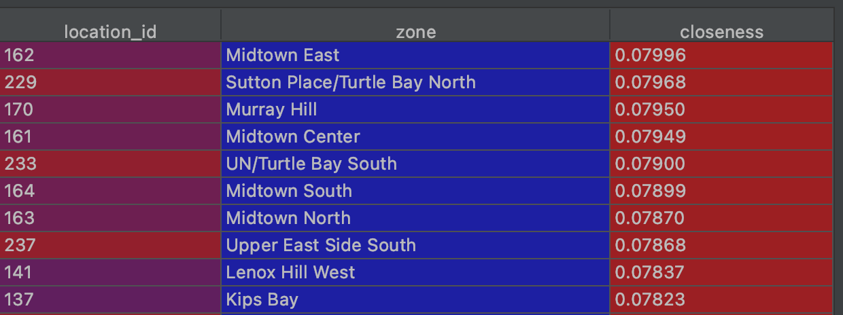
Centrality - Closeness (trip distance)
Manhattan borough closeness in distances

Slide 15
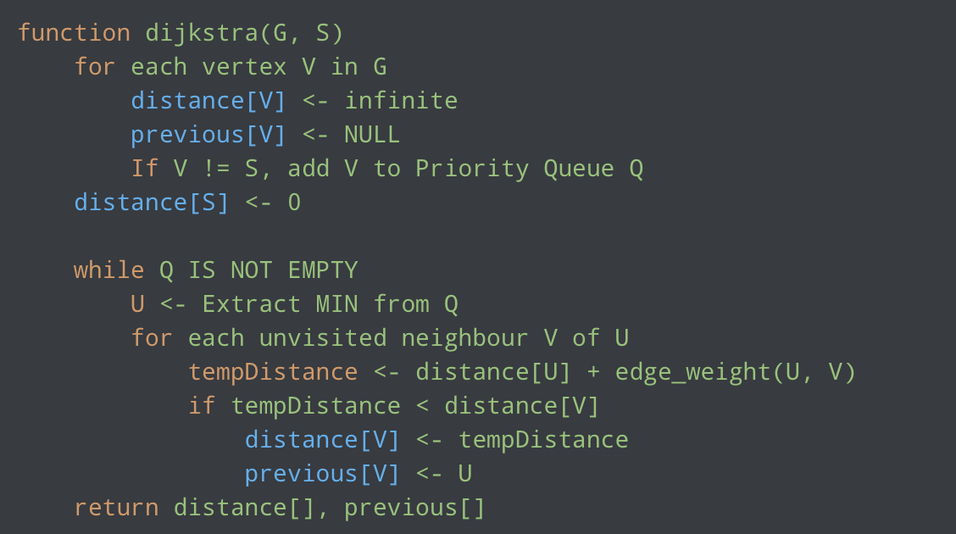
Shortest Path - Dijkstra’s algorithm
Created Dr. Edsger W. Dijkstra in 1959
The algorithm works on weighted undirected/directed graphs, the weights must be non-negative (Can use Bellman–Ford algorithm for negative weights)

Slide 16
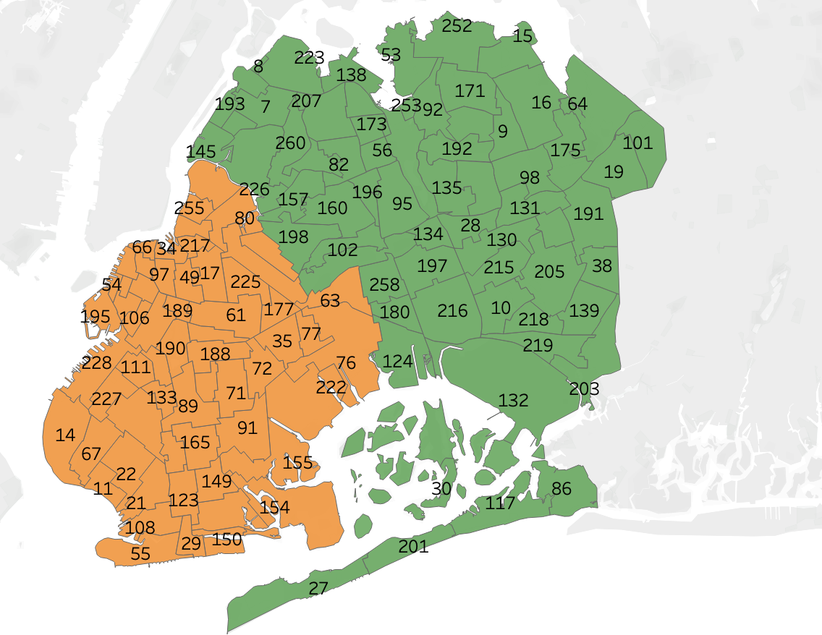
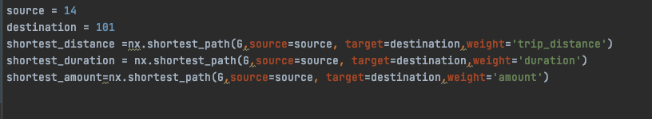
Shortest path
Lets say we want to travel from Bay Ridge (ID 14) to Glen Oaks (ID 101)
What is the shortest path in terms of distance, time and cost?

Slide 17
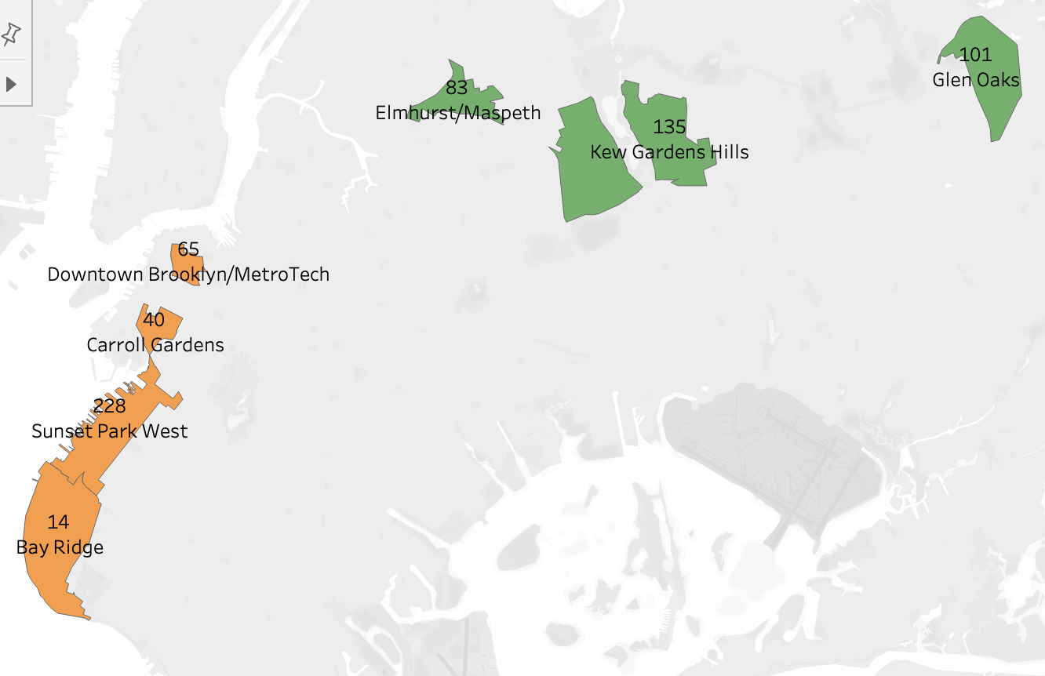
Shortest path - Trip Distance
Shortest Distance:
14->228->40->65->83->95->135->101
Bay Ridge->Sunset Park West->Carroll Gardens->Downtown Brooklyn/MetroTech->Elmhurst/Maspeth->Forest Hills->Kew Gardens Hills->Glen Oaks
Total Distance = 25.25miles

Slide 18
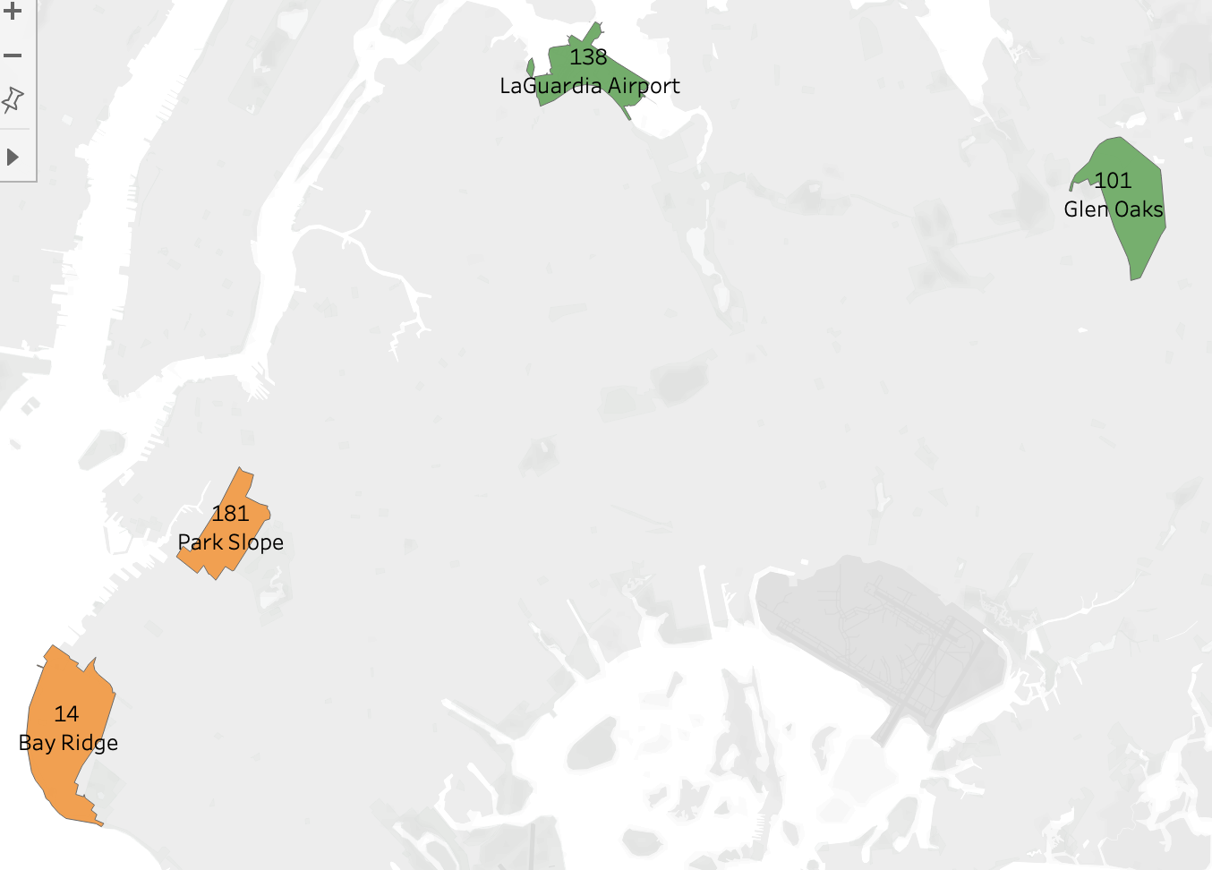
Shortest path - Fare Amount
Shortest Distance:
14->181->138->101
Bay Ridge->Park Slope->LaGuardia Airport->Glen Oaks
Total cost = $95.71

Slide 19
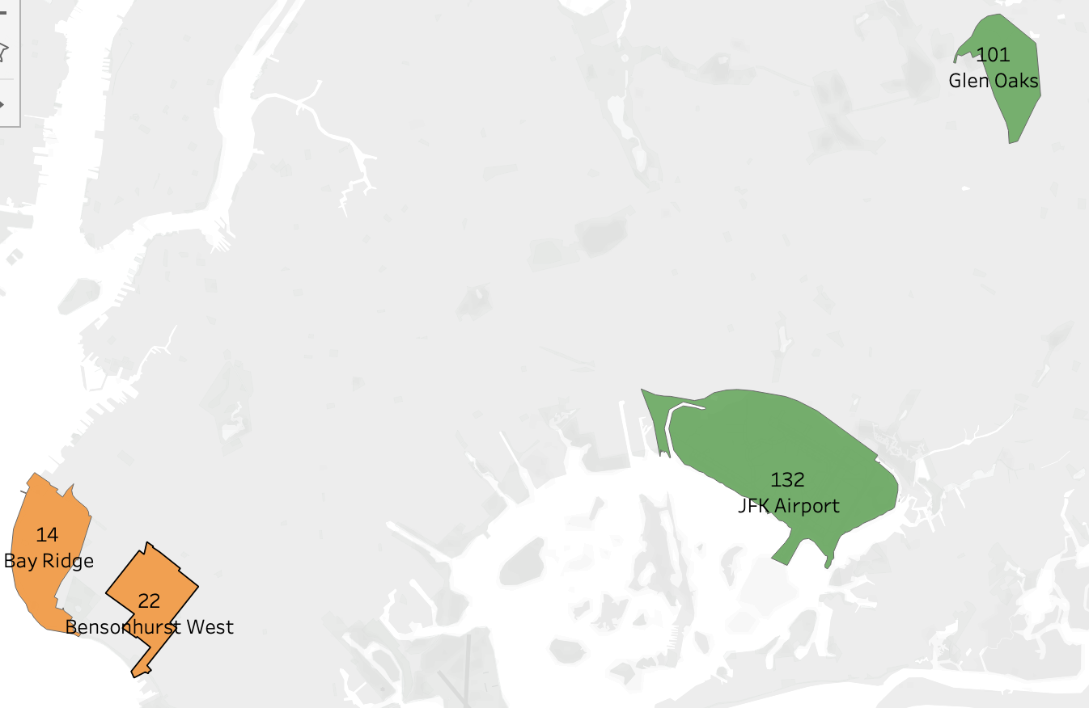
Shortest path - Time
Shortest Distance:
14->22->132->101
Bay Ridge->Bensonhurst West->JFK Airport-> Glen oaks
Total time = 76.35mins

Slide 20
Shortest path - Comparison
Shortest Path | Distance(miles) | Amount($) | Time(Mins)
Distance | 25.2547059866962 | 104.695304262134 | 95.4416587624209
Amount | 29.7025509926835 | 95.7079167232713 | 80.4518406207748
Time | 33.9879343395965 | 105.401131182647 | 76.3562448190108

Slide 21
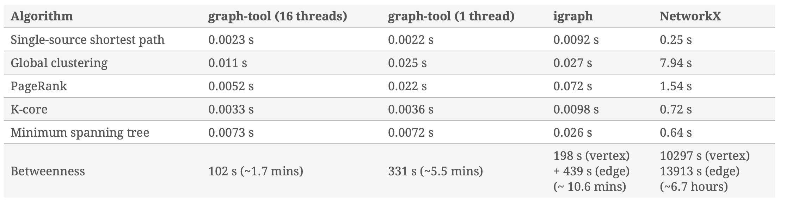
Python Alternatives to NetworkX
Alternatives to NetworkX: iGraph and Graph-tool both implemented in C/C++
https://graph-tool.skewed.de/performance

Slide 22
Network Use Cases in Barclays?
Creating a transactional network using payment data, enriching node attributes with internal (Risk rating, GCA, etc) and External (D&B, ESG) datasources.
Use cases:
Supply Chain Analytics - Identify supply chains (Aneek’s Project)
Identify relationships between entities - e.g. Company A risk rating changed to high-risk, identify which clients might be impacted.
Clustering
  Between graph clustering - Clustering set of graphs into clusters - identifying similar payment profile? E.g. this client has similar payment profile to another client but does not have product X, are they a good candidate for product X?
  Within graph clustering - Clustering nodes together within a graph.

Slide 23
Any questions?

