Slide 1

Increasing Infrastructure Efficiency via Optimized NFV Placement in OpenStack Clouds
Yathiraj Udupi, Debo Dutta – Cisco
Ram (Ramki) Krishnan - Brocade
OpenStack Atlanta Summit, May 2014

Slide 2
Who and why?
Debo/Yathi - Cisco Cloud CTO office
Ramki - Brocade CTO office
Goal: Drive Innovative Open Source solutions for NFV with OpenStack

Slide 3
Our Thesis
Toby Ford@AT&T’s NFV talk on Tue, May 13th
Worlds of IT and Telco are coming together
Telco Cloud - OpenStack as the infrastructure foundation
Goal: Transform OpenStack to a Carrier-grade cloud solution
We deep dive into some high-level gaps Toby identified
We demo some initial progress

Slide 4
Agenda
NFV Summary
Cloud NFV Use Case
Drive Innovation - Efficient Resource Placement Strategies
Extensions to OpenStack scheduler
Conclusion

Slide 5
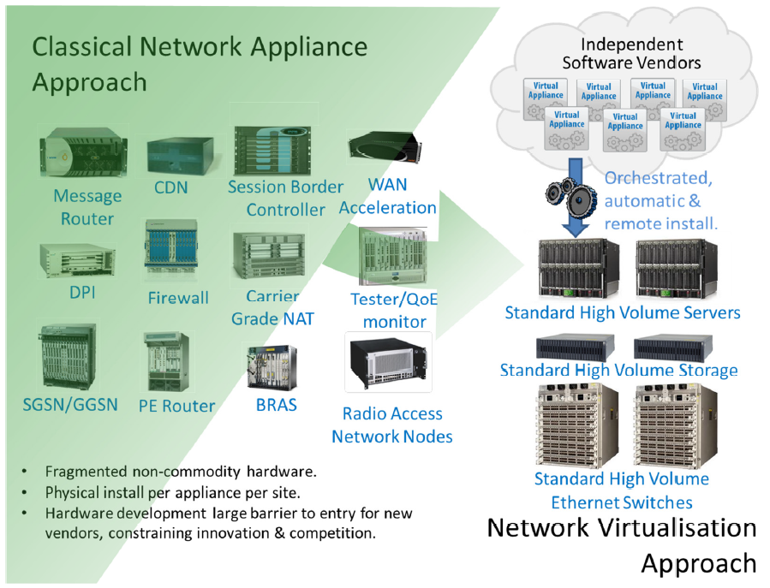
Network Functions Virtualization (NFV)
Global movement by network operators - AT&T, Verizon, BT, CenturyLink, Deutsche Telekom, Telefonica, KDDI etc.
General purpose hardware - OPEX and CAPEX savings
Increased automation – OPEX savings, faster time to market
New business models and value added services
NFV Vision
Source: ETSI NFV White Paper

Slide 6
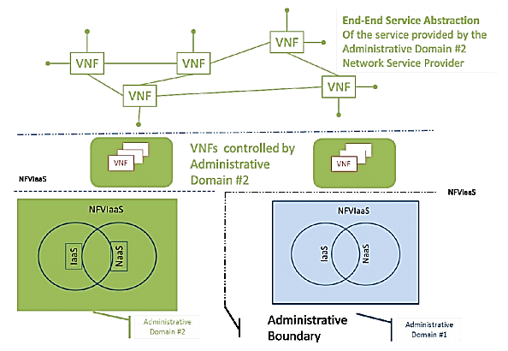
NFV Use Case - NFVIaas
Motivation
Network Functions in the cloud
Combined value – Infrastructure as a service (IaaS) – Compute/storage infra, Network as a service (NaaS) – WAN network infra
Leverage NFV Infra of another SP – increase resiliency, reduce latency (CDN), regulatory requirements
Where are we are today ?
Compute/storage is treated independent of network, no energy efficiency considerations
Service value is not maximized
NFV Use Case – NFVIaaS
Source: ETSI NFV Use Cases

Slide 7

NaaS
WAN Bandwidth on Demand
Data Center 1
Data Center 2
Bandwidth
Bandwidth
Virtual
Machine
Virtual Machine
Virtual Machine
Virtual Machine
Virtualized Network
Storage
Storage
Benefits
Use WAN bandwidth as needed, avoid fixed cost due to reservation (typically 1.5 times peak) – typically leverage MPLS technologies
Popular use cases - Disaster Recovery , On-demand backup across WAN

Slide 8
NFVIaas (IaaS+NaaS)
Compute/Storage/WAN Bandwidth on Demand + Energy Efficiency
Data Center 1
Data Center 2
Bandwidth
Bandwidth
Virtual
Machine
Virtual Machine
Virtual Machine
Virtual Machine
Virtualized Network
Storage
Storage
Where do we want to get to ?
Beyond WAN Bandwidth savings
Optimal resource placement across DCs - Increase Energy efficiency while maintaining multi-tenant fairness and improving performance – CAPEX/OPEX savings, Improve QoE, Address regulatory requirements
Popular use cases - Disaster Recovery, On-demand backup across WAN, Virtualized CDN

Slide 9
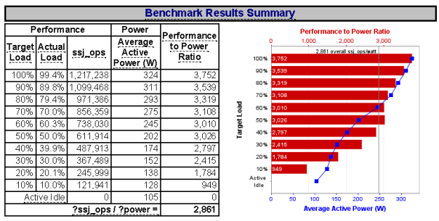
NFVIaas (IaaS+NaaS)
Energy Efficiency Issues
Power usage in DCs -- servers → heavy hitter
Server power profiles typically non-linear; ~45% of peak power with ~20% of offered load; ~30% power in idle state
Inefficient to keep servers powered on under low load conditions
SPEC Benchmark results: HP ProLiant DL380p rack server
Source: http://i.dell.com/sites/doccontent/shared-content/data-sheets/en/Documents/Comparing-Dell-R720-and-HP-Proliant-DL380p-Gen8-Servers.pdf

Slide 10
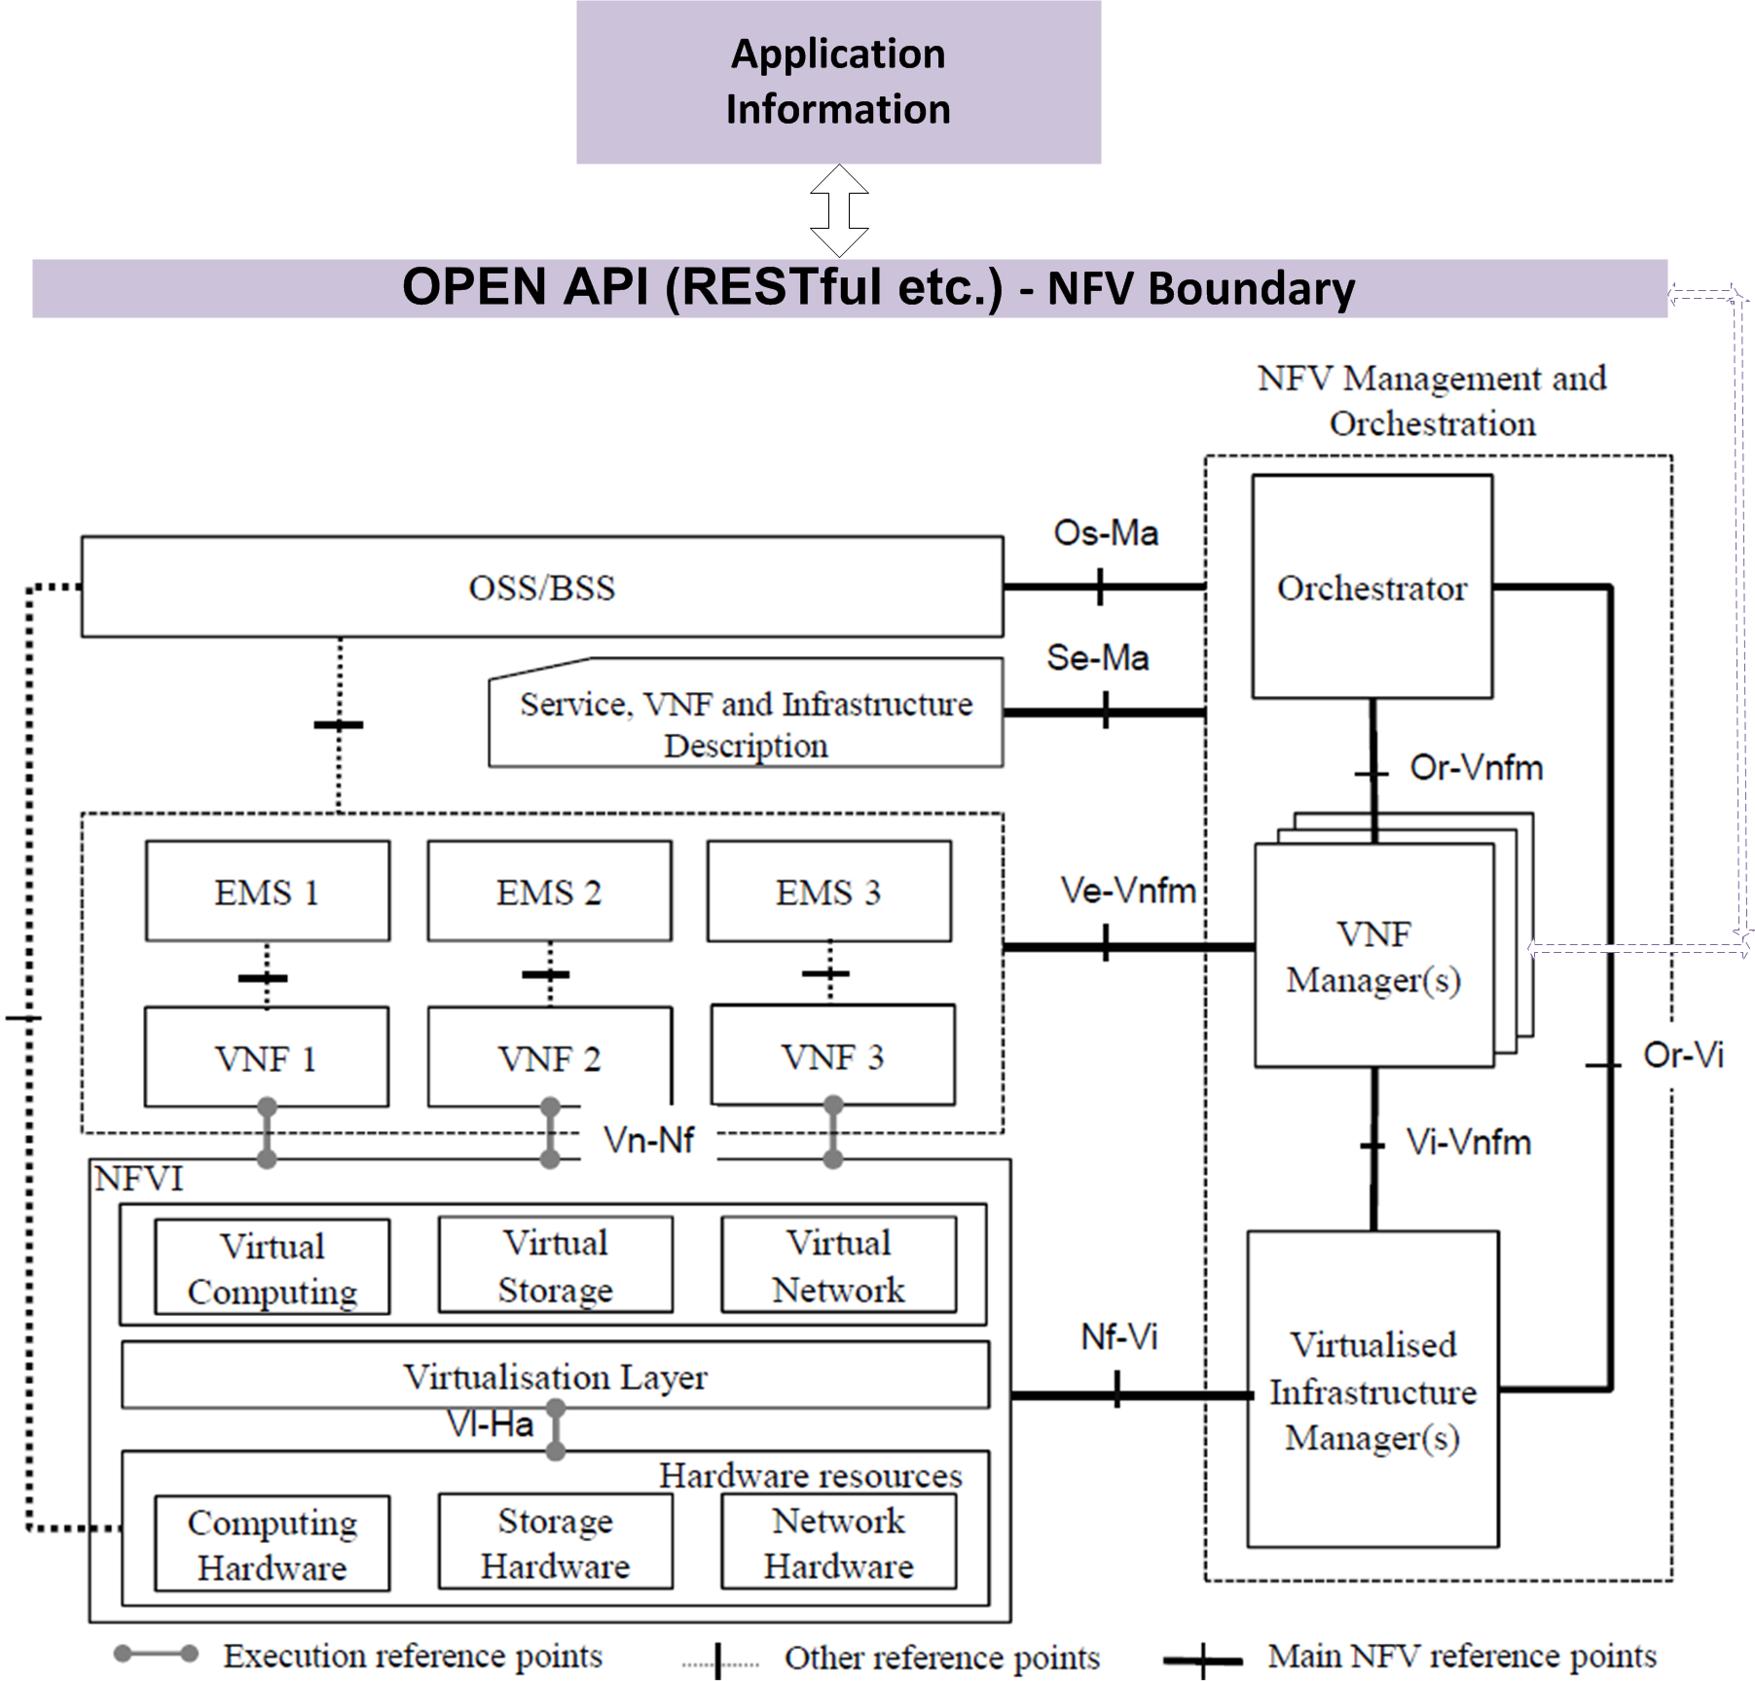

NFV – Huge opportunity for Openstack
How do we get there ?
Energy aware joint scheduling of compute/storage/networking resources – example below
NFV Customer submits job request, e.g. backup, with elasticity windows
NFV Provider returns back information about time window to schedule backup
Trigger other events e.g. Consolidate workloads; Finish one job and start and the next; Power down resources (especially servers) after job completion
Our Solution: Smart Scheduler in Openstack
Solver
Scheduler
Adapted from ETSI NFV Architectural Framework

Slide 11
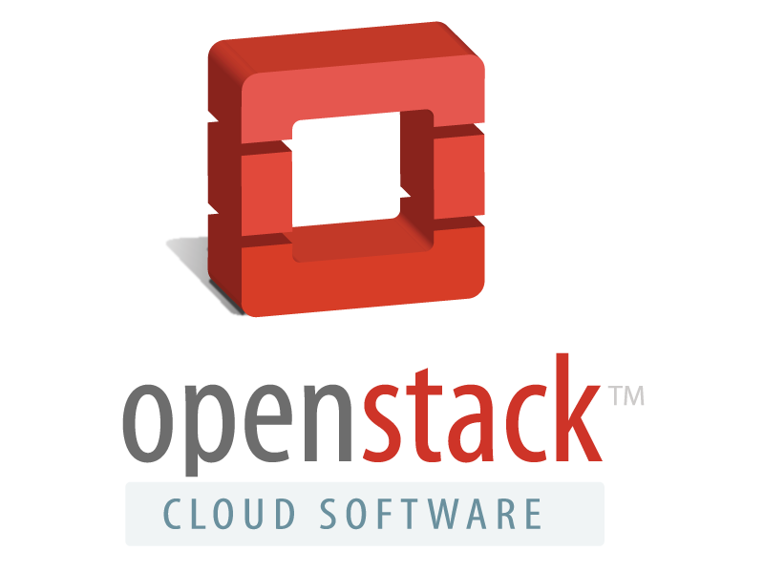
Smart Scheduling in OpenStack for Optimized NFV Resource Placements
Users:
Minimize costs… (Energy & Network Efficiency)
Maximize Performance...
Smart Scheduling in
Our Solution Smart Scheduler in Openstack
Use analytics to determine current state of the Openstack deployment.
Use resource management techniques to pick resources based on business constraints
Infrastructure:
State (BigData?)
(Storage/Network/Compute state, Energy Profiles, Policy/constraints etc.)
Notes:
Energy
Minimize total energy use based on server energy profiles, total number of powered on servers, etc.
Server Stacking or Spreading placement decisions based on other Energy, Memory, CPU, and Storage considerations
Network performance
Minimize network latency (distance) (VM to VM, VM to storage)
Maximize bandwidth (intra or inter data centers)

Slide 12
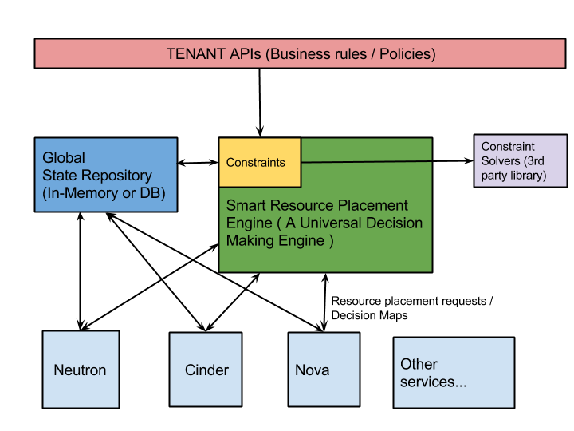
Candidate Solution: Unified Constraints-based Scheduling
A Smart Resource Placement Engine
Unified constraints involving network, storage, compute, energy, etc.
Global state + analytics
Blazing fast implementations via Apache licensed third-party Solver libraries
Sources:
https://docs.google.com/document/d/1IiPI0sfaWb1bdYiMWzAAx0HYR6UqzOan_Utgml5W1HI/edit
https://github.com/CiscoSystems/nova-solver-scheduler

Slide 13
Solver Scheduler: Smart Scheduling in OS
Users:
Minimize costs… (Energy & Network Efficiency)
Maximize Performance...
Plug in
Intelligent Placement
Engine
Plug in
Constraint
Functions
Cost
Functions
Scheduling
Decision
Infrastructure:
Server State...
Energy Profiles…
Network Link Capacities…
System Capacity...
Sources:
https://docs.google.com/document/d/1IiPI0sfaWb1bdYiMWzAAx0HYR6UqzOan_Utgml5W1HI/edit
https://github.com/CiscoSystems/nova-solver-scheduler
Notes:
Models complex constraints as an optimization problem
Two key aspects:
Leverages pluggable constraints-based solver engines, known to be efficient.
Emphasis on cross services placement, supporting complex constraints on resources across services such as Cinder, Neutron, and Nova.

Slide 14
Scheduling can be Complex
Supply
Demand
An Example LP Problem
Formulation
Cost Metric to
Minimize
Variables to solve
Cost
Constraints to satisfy

Slide 15
DEMO: Smart Scheduling for NFV Service VMs with Compute/Storage Affinity Constraints
Applicable Scenarios:
CDN NFV Service VMs that need data on certain storage volumes, on physical servers that are on or closest to the data.
Backup NFV Service VMs placement.
Multinode devstack setup:
Host-1: (Controller, Compute node)
Host-2: (Compute node with demo_vol_1 Volume)
Host-3: (Compute node with demo_vol_2 Volume)
Boot 2 VMs specifying the requested volumes to be close in proximity
Results: Optimal placement by picking the two physical volume hosts: Host-2 and Host-3.
Host-2:
Host-1:
demo_vol_1
Host-3:
demo_vol_2

Slide 16
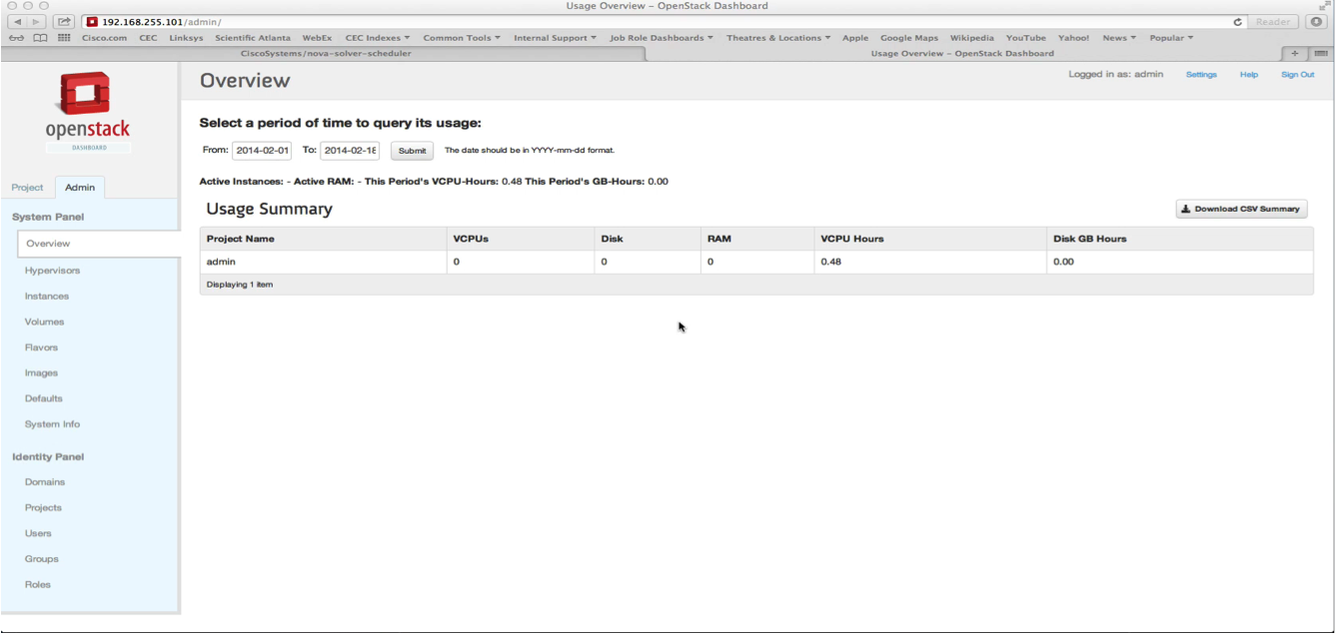
Demo: Smart Scheduling with Compute-Storage Affinity
Notes:
In this environment, there are 3 hosts capable of supporting VMs . . .
. . . But only two of those hosts (#’s 2 and 3) have storage volumes attached.
Using the new Solver Scheduler, it is a simple matter to add a proximity constraint to the instance request that will ensure the VM deploys to the same server whose attached volume will provide the storage for the instance.
Concluding remarks:
Optimal NFV placements applicable within a single datacenter, and also in the case of multiple datacenters over a WAN
Needs clean APIs at all levels: customer to SP, SP to Infrastructure providers, Infrastructure to Infrastructure providers.

Slide 17
Conclusion
NFV Value Proposition
NVF is a killer use-case for Openstack
Call for community action
Scheduler Gap and a candidate solution [e.g. SolverScheduler, blueprint exists, code pushed for review in Icehouse]
Cross-Scheduler API w. constraints [e.g. augment server-groups API released in Icehouse]
Neutron hooks for Virtual Network Services (and API)

