Slide 1

Docker at devo.ps
Lessons learnt building a SaaS with Docker

Slide 2
Who are we?
Vincent Viallet Operations
Ronan Berder Design, Product & Business
Juha Suomalainen Development

Slide 3
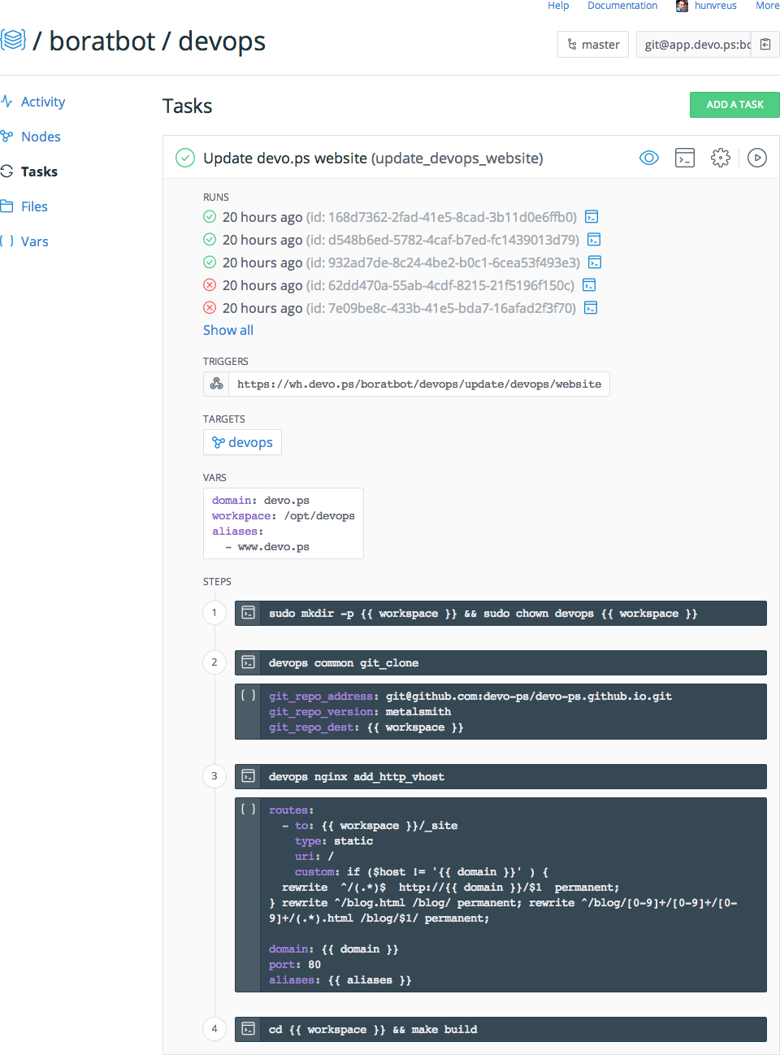
What is devo.ps?

Slide 4
What is devo.ps?
Manage servers with Git Update your servers with git commit + git push
Share your infrastructure PR a security fix, fork somebody else’s setup
Automate all the things Easily script tasks using simple commands and any variable from your infrastructure

Slide 5
Why using Docker?
Separation of concerns & Scalability Micro-services architecture, horizontal scaling
Deployment cycle Complex system with a complex release cycle
We love whales

Slide 6
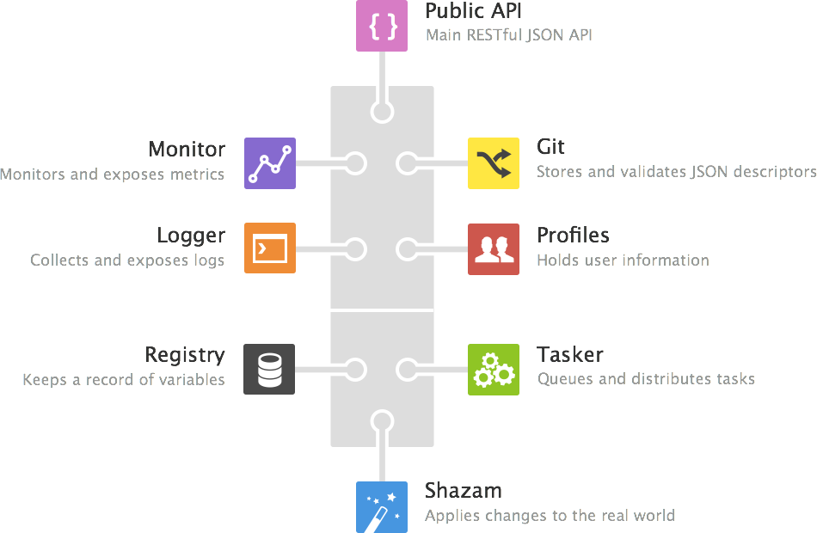
How do we use it?
Bus-centric architecture Many micro-services, one message bus in between.
Non-ephemeral containers We handle containers more like VMs.

Slide 7
The don't
If you hit a wall, others probably have You will often run into issues but you're not alone: GitHub & IRC (#docker on Freenode) are your friends e.g. DNS management (http://wiredcraft.com/posts/2014/07/30/dns-and-docker-containers.html)
If you write your own tools, keep it light Docker is moving extremely fast, your tool may become obsolete in the next version e.g. Orchestration was missing for a long time, wrote our own tool, the week after all was to deprecate
Docker isn't pixie dust It is another layer of complexity, use it to solve issues that containers are good at.

Slide 8
The do’s
Use caching writing your Dockerfiles ADD, VOLUMES are cache invalidators. Group your RUN commands together per type (e.g. ssh related). Speed up your container build. e.g. https://docs.docker.com/reference/builder/#usage
Maintain your containers in a registry It lets you deploy quickly, revert quickly and have matching versions of your containers. Same thing apply for your Dockerfiles - use a VCS. e.g. http://blog.docker.com/2013/07/how-to-use-your-own-registry/ Docker registry https://github.com/docker/docker-registry Docker hub https://hub.docker.com/

Slide 9
The do’s
Plan your containers life-cycles What is persistent vs. ephemeral vs. shared? Named volumes vs. devices vs. anonymous e.g. http://wiredcraft.com/posts/2014/06/25/data_migration_of_named_docker_containers.html
Log all the things Seems easy with stdout/err on a few containers, quickly become complex). e.g. syslog / log.io / kibana / logstash

Slide 10
The do’s
Define a proper start logic Containers are not servers, the start workflow is different.
no init scripts on containers
1 container = 1 exec on start, if the command exit, the container stops, use `run` scripts when needed
supervisord lets you manage your services ala init (hurray!)

Slide 11
Food for thoughts
Flocker (https://github.com/ClusterHQ/flocker) Let you manage a fleet of containers and handle data migration
Maestro-ng (https://github.com/signalfuse/maestro-ng) Containers management
Using docker for safe execution or multi-tenancy Safely executing arbitrary code or multiple applications on the same machine (ex: chato.ps)

Slide 12
Questions?

