Slide 1

Bundesliga-betting-predictor
Which soccer team will lose, win or play a draw in the upcoming game?
Which soccer team will win the next Bundesliga season?

Slide 2
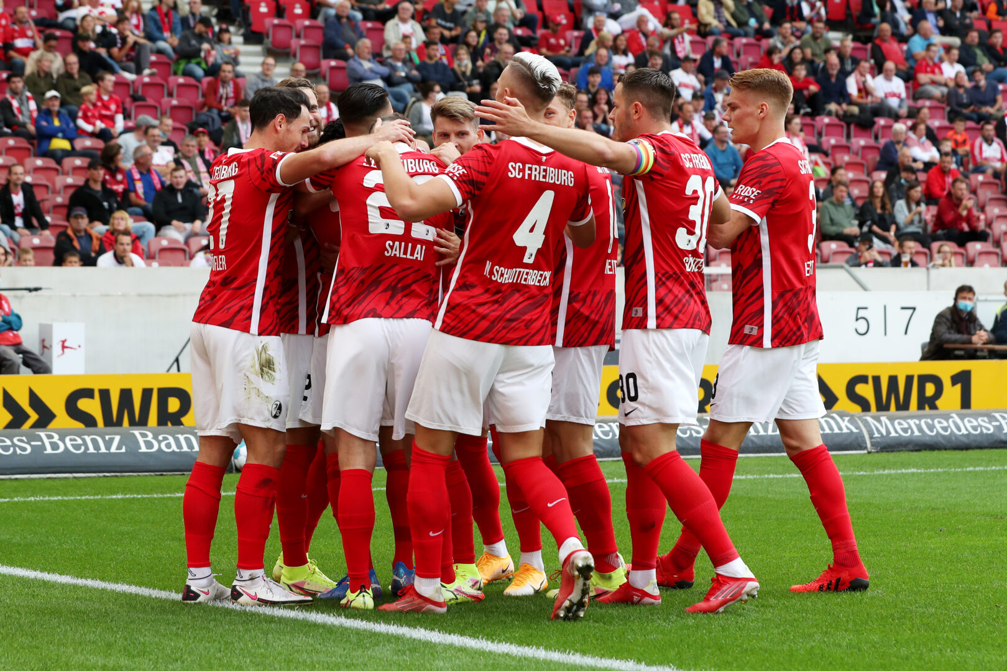
Components
API for played and upcoming games
analysis of influential attributes
machine learning to predict
results of teams
the winner of the next season

Slide 3
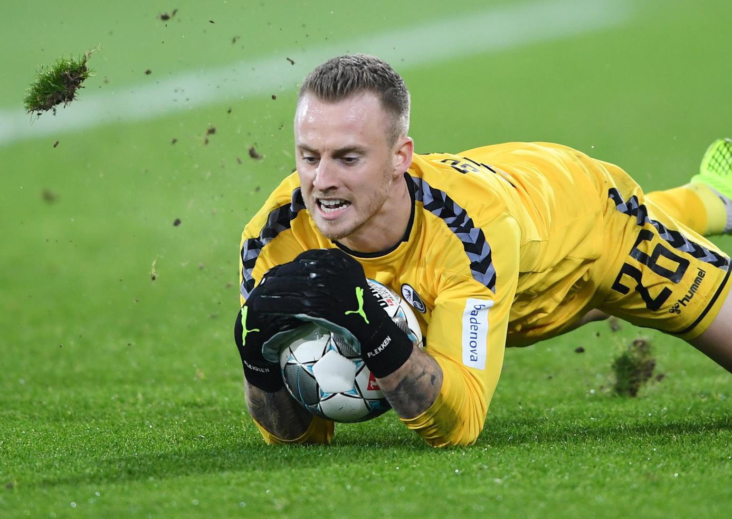
Goal
prediction of upcoming games
to win most of the bets
and to surprise the bookmaker

