Slide 1
CYCLE GRAPH
GRADED ALGEBRA & CYCLOHEDRA
Derriell Springfield
March 30, 2009

Slide 2



BASIC DEFINITIONS
Algebra: vector space V with a map • :V V V
  1. (c v) • w = c (v • w) = v • (c w)
  2. u • (v + w) = u • v + u • w
  3. (u v) • w = u • (v w)
Graded Vector Space
  V = V_{i}
    Each V_{i} is a vector space with basis B_{i}
Graded Algebra
  v_{i} • v_{j} = v_{i + j}
    v_{i is} made of combinations of b ε U B_{i}

Slide 3
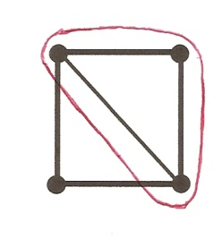
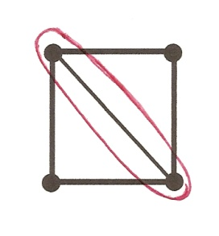
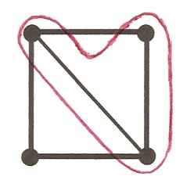

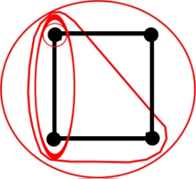
COMPLETE TUBINGS ON CONNECTED GRAPHS
A tube is a connected subgraph that contains all of its edges.
A tubing is any collection of tubes where each pair of tubes is either nested or non-adjacent.
Complete tubing

Slide 4
COMPLETE TUBINGS OF CYCLE GRAPHS AS A GRADED ALGEBRA
Let C_{i} be the free vector space over the complete tubing on the cycle graph of i nodes.
Basis = {set of complete tubings on C_{i}}
Vector = a formal linear combination of complete tubings (v = aT₁ + bT₂ + … + cT_{n})
+ , • by scalars are concatenating formal linear combinations and distributing the scalar multiplication.

Slide 5

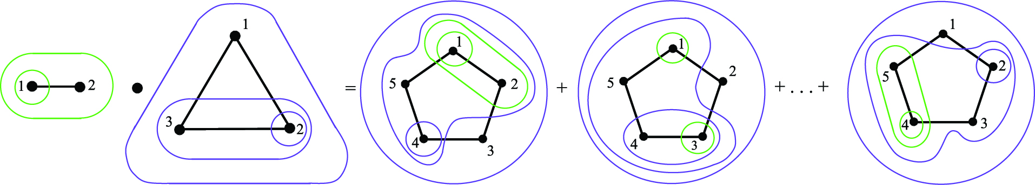
COMPLETE TUBINGS OF CYCLE GRAPHS AS A GRADED ALGEBRA(cont.)
Let C = the free vector space on all the complete tubings of cycle graphs.
  Therefore C = C C_{i} , C is a graded vector space.
Multiplication of tubing on cycle graphs

Slide 6

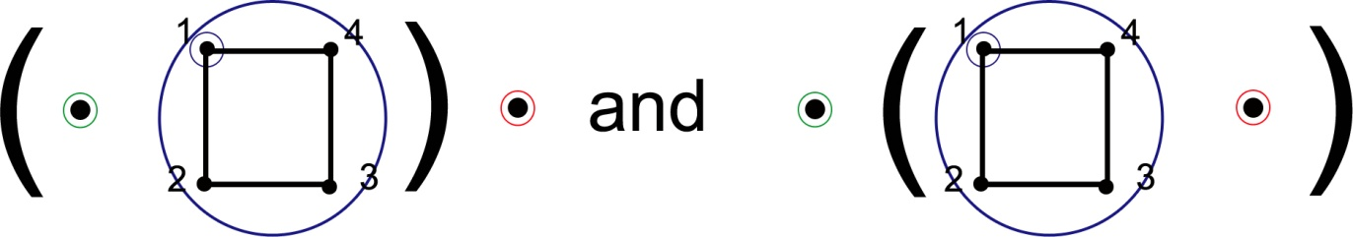
COMPLETE TUBINGS OF CYCLE GRAPHS AS A GRADED ALGEBRA (cont.)
Conjecture: C is a Graded Algebra.
  If we define • : C C C on the basis vectors and extend linearly.
    We must show associativity to demonstrate that this is true.

Slide 7
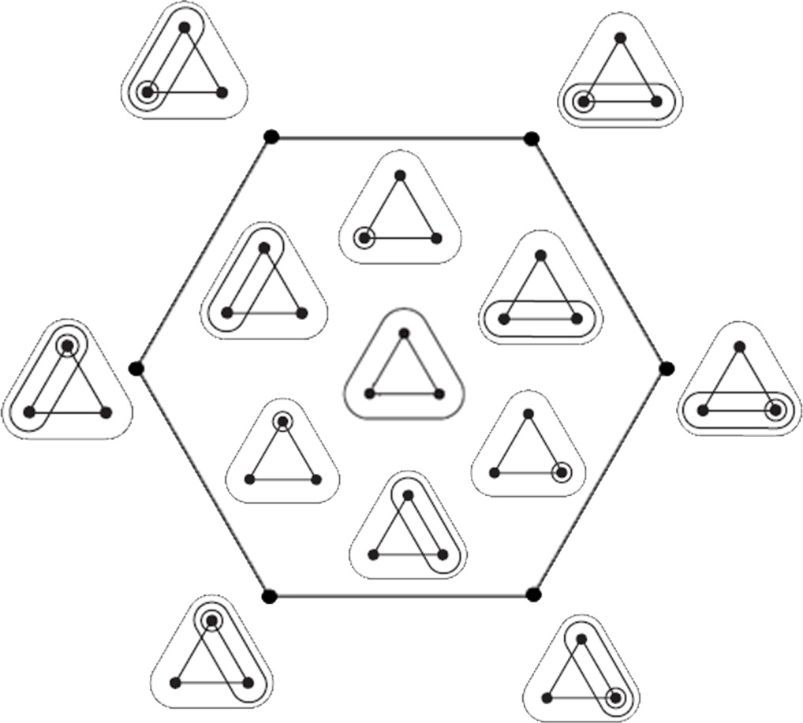
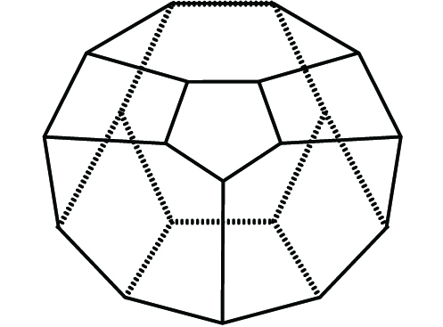
CYCLOHEDRON

Slide 8
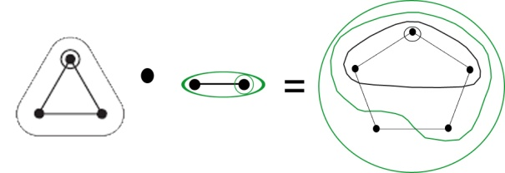
PROBLEM STATEMENT
If you include all the tubings (even incomplete) of cycles, is it still an algebra? Is the boundary map a derivative?
  Graded vector space
    Basis {Smaller tubings around the cyclohedron}
    Grading: 2 (nodes) – (tubes)
  Using the same multiplication
    (Associative)

Slide 9
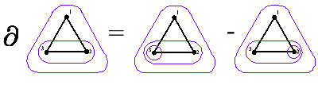

PROBLEM STATEMENT
  The derivative
    Obtained by way of the faces on the cyclohedron
      Takes you down level
    Check product rule
    (( • ) = ( ) • + •
    Second derivative ²= 0

Slide 10
QUESTIONS?

