Slide 1
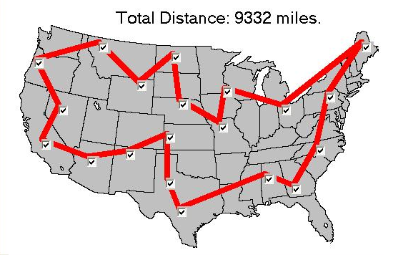
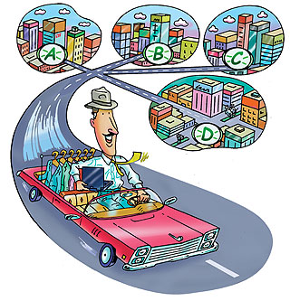
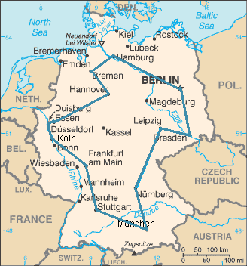
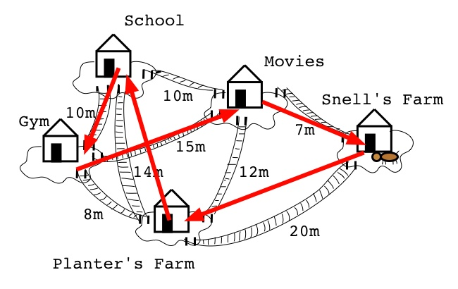

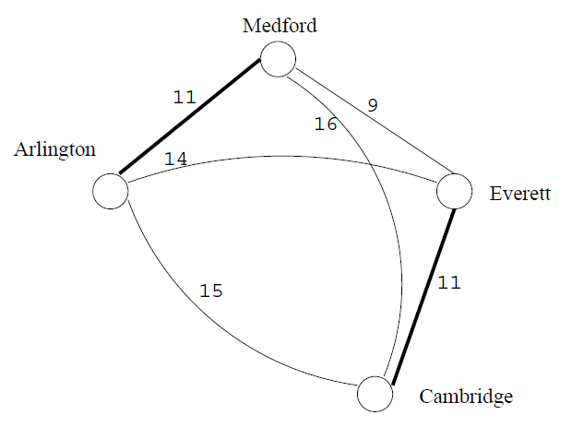
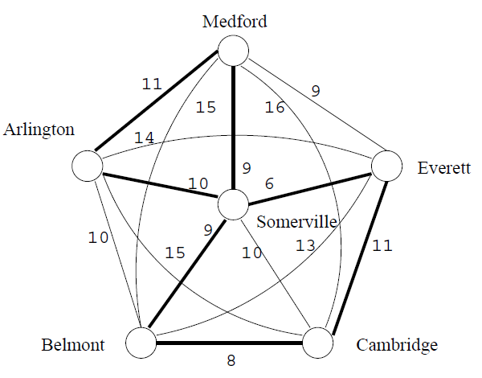
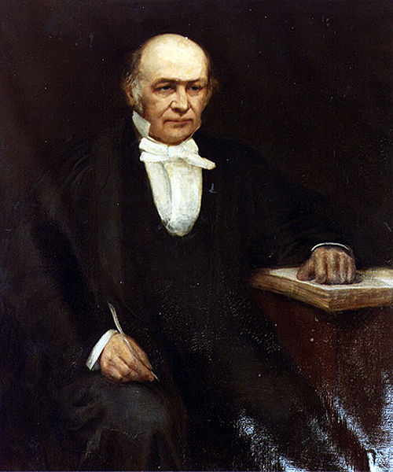
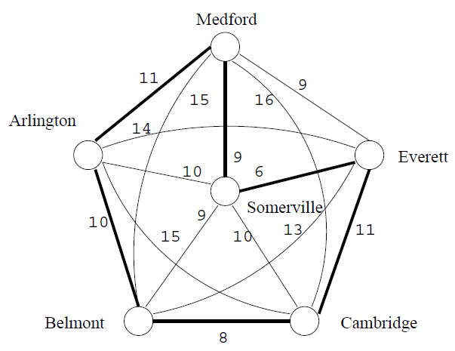
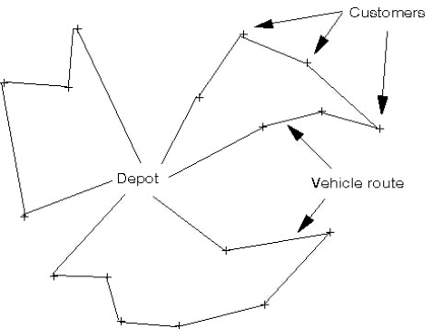
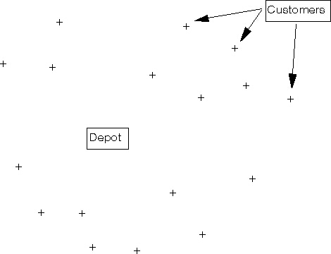
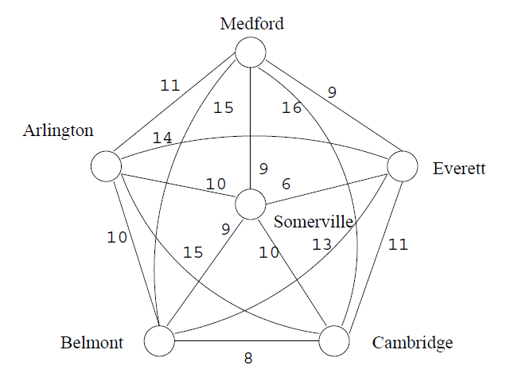
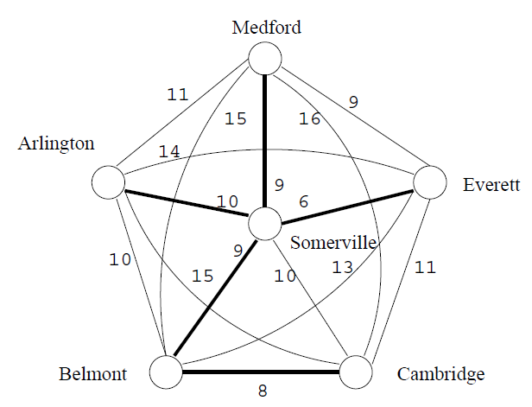
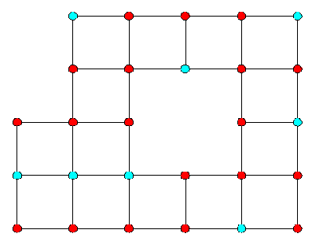
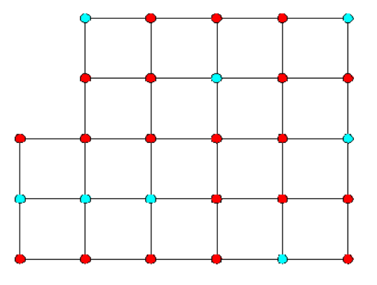
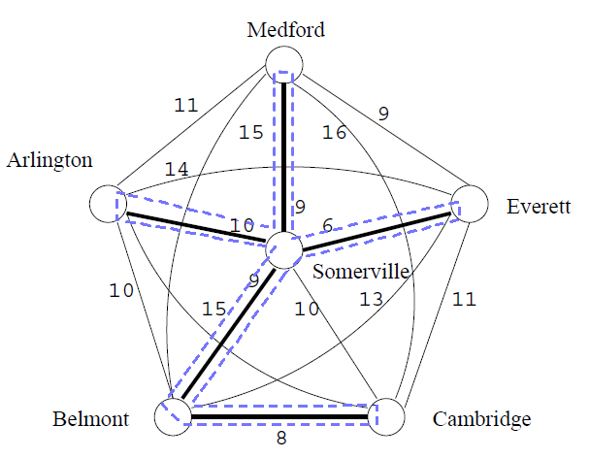
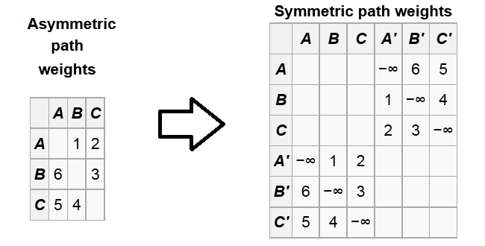
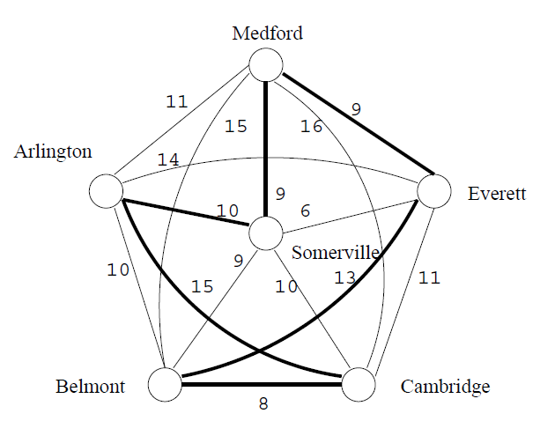
Travelling Salesman Problem (TSP)
Mehdi Malekipirbazari, and Mohammadmehdi Kafashan
The University of Akron [Adv. Combinatorics, Dr. Forcey]
Introduction
THE PROBLEM
The Traveling Salesman Problem (TSP) is one of the most intensively studied problems in computational mathematics. In TSP it is assumed that a traveling salesman has to travel through a bunch of cities, in such a way that the expenses on traveling are minimized.
HISTORY
The origins of the travelling salesman problem are unclear. A handbook for travelling salesmen from 1832 mentions the problem and includes example tours through Germany and Switzerland, but contains no mathematical treatment.
The travelling salesman problem was defined in the 1800s by the Irish mathematician W. R. Hamilton and by the British mathematician Thomas Kirkman. Hamilton introduced Icosian Game whose objective was finding a cycle along the edges of a dodecahedron such that every vertex is visited a single time, no edge is visited twice, and the ending point is the same as the starting point. The puzzle was distributed commercially as a pegboard with holes at the nodes of the dodecahedral graph and was subsequently marketed in Europe in many forms. The general form of the TSP appears to have been first studied by mathematicians during the 1930s in Vienna and at Harvard, notably by Karl Menger, who defines the problem, considers the obvious brute-force algorithm, and observes the non-optimality of the nearest neighbor heuristic:
Soon after Hassler Whitney at Princeton University introduced the name travelling salesman problem.
Solutions to TSP
EXACT ALGORITHMS
There have been many efforts to solve the travelling salesman problem ever since it was coined in 1930. The most direct solution would be to try all permutations and see which one is cheapest. The running time for this approach lies within a polynomial factor of O(n!), so this solution becomes impractical even for only 20 cities.
Linear Programming (LP) Relaxation
One of the exact solutions to TSP was provided by Dantzig in LP relaxation is used to solve the integer formulation by adding suitably chosen linear inequality to the list of constraints continuously.
Branch and Bound Technique
Another exact solution for TSP problem is branch and bound technique based algorithm. The algorithm branches into the set of all possible tours while calculating the lower bound on the length of the tour for each subset. Eventually it finds a single tour in a subset whose length is less than or equal to some lower bound for every tour. The algorithm however grows exponentially in time with the input, but it is able to calculate the TSP for 40 cities with appreciable average time consumption.
Other Methods
Other exact solutions to the problem include cutting plane method (introduced by Dantzig, Fulkerson, and Johnson), branch-and-cut (introduced by Padberg and Rinaldi), branch-and-bound (Land and Doig) and Concorde (introduced by Applegate, Bixby, Chatal, and Cook). Although each of these algorithms become highly inefficient as we increase the number of cities in the tour.
HEURISTIC AND APPROXIMATION ALGORITHMS
The exact solutions provide an optimal tour for TSP for every instance of the problem; however their inefficiency makes it unfeasible to use those solutions in practical applications. Therefore heuristic and approximation solution approach is more useful for the applications which prefer time of run of the algorithm over the accuracy of the result. There has been a vast research in past to solve the TSP for an approximate result.
Greedy solution to TSP
A greedy algorithm is an algorithm that follows the problem solving heuristic of making the locally optimal choice at each stage with the hope of finding a global optimum. A greedy strategy need not produce an optimal solution, but nonetheless a greedy heuristic may yield locally optimal solutions that approximate a global optimal solution.
Nearest Neighbor (NN) Algorithm
It follows a very simple greedy procedure: The algorithm starts with a tour containing a randomly chosen city and then always choose the nearest unvisited city as his next move. The algorithm stops when all cities are on the tour.
Insertion Algorithms
All insertion algorithms start with a tour consisting of an arbitrary city and then in each step choose a city not yet on the tour. This city is inserted into the existing tour between two consecutive cities i and j, such that the insertion cost (i.e., the increase in the tour’s length) is minimized. The algorithms stop when all cities are on the tour.
K-Opt Heuristics
The idea is to define a neighborhood structure on the set of all admissible tours. Typically, a tour t is a neighbor of another tour t/ if t can be obtained from t/ by deleting k edges and replacing them by a set of different feasible edges (a k-Opt move). In such a structure, the tour can iteratively be improved by always moving from one tour to its best neighbor till no further improvement is possible. Various algorithms optimizing the power of neural networks have been proposed for the approximation of the optimal cycle. Also a popular method is the Ant Colony optimization scheme.
Special Cases
Metric TSP
Metric TSP is an special that satisfies the triangle inequality. The triangle inequality ensures that a direct path between two vertices is at least as short as any indirect path.
This assumption seems reasonable especially when we consider the direct distances between cities as the weights. However there are some cases which TSP is non-metric. If the weights represent something like the cost of airline tickets, for example, there is no reason to expect the input would satisfy the triangle inequality; it is often the case that taking an indirect route is less expensive than a direct route.
Open Problems of TSP
Here, we introduce some challenges of TSP and provide some of the best known solutions for them.
SEQUENTIAL ORDERING PROBLEM (SOP)
This problem is an asymmetric TSP with additional constraints. Given a set of n nodes and distances for each pair of nodes, find a Hamiltonian path (a Hamiltonian path (or traceable path) is a path in an undirected graph that visits each vertex exactly once.) from node 1 to node n of minimal length which takes given precedence constraints into account. Each precedence constraint requires that some node i has to be visited before some other node j. The SOP has many real life applications and it has proved to be a great challenge (there are SOPs with 40-50 vertices which have not been solved optimally yet with significant computational effort).
L. M. Gambardella in 2000 showed that an Ant Colony System based on local search for the traveling salesman problem can be used to handle multiple constraints directly without increasing computational complexity.
CAPACITATED VEHICLE ROUTING PROBLEM (CVRP)
In this problem, we are given n-1 nodes, one depot and distances from the nodes to the depot, as well as between nodes. All nodes have demands which can be satisfied by the depot. For delivery to the nodes, trucks with identical capacities are available. The problem is to find tours for the trucks of minimal total length that satisfy the node demands without violating truck capacity constraint. The number of trucks is not specified. Each tour visits a subset of the nodes and starts and terminates at the depot.
T. K. Ralphs in 2003 proposed a heuristic separation algorithm for solving this problem.
TSP IN SOLID GRID GRAPHS
One of the applications of Traveling Salesman Problem is in Solid Grid Graphs. A planar grid graph is a graph with vertices on the planar integer lattice and edges connecting every pair of vertices at unit distance. A grid graph is solid if it does not have any holes. In other words there are not any missing vertices in the infinite grid.
E. M. Arkin in 2001 showed that this problem is polynomially solvable for thin grid graphs (i.e., grid graphs that do not contain an induced 2×2 square).
Algorithm 2 (Christofides’ Algorithm)
Step 1: Create an MST (T) of the input graph (G) in the same manner as for approximation algorithm 1 (Figure 3).
Step 2: Take G restricted to vertices of odd degree in T as the subgraph G*. This graph has an even number of nodes and is complete, because we have not removed any existing edges between the vertices that remain (Figure 6).
Step 3: Find a minimum weight matching M* on G* (solid graph in figure 6).
Note that Given a complete weighted graph with an even number of vertices, a minimal weight perfect matching can be found in polynomial time.
Step 4: Union the edges of M * with those of the MST T to create a graph H with all vertices having even degree (figure 7).
Step 5: Create a Hamiltonian cycle on H and reduce it to a plausible solution C using the triangle inequality (figure 8).
Figure 6. Minimal matching on vertices with odd degree in the MST [2]
Figure 7. Union of MST and minimal matching [2]
We denote by messenger problem (since in practice this question should be solved by each postman, anyway also by many travelers) the task to find, for ﬁnitely many points whose pairwise distances are known, the shortest route connecting the points. Of course, this problem is solvable by finitely many trials. Rules which would push the number of trials below the number of permutations of the given points, are not known. The rule that one first should go from the starting point to the closest point, then to the point closest to this, etc., in general does not yield the shortest route.
Figure 1. William Rowan Hamilton [1]
Figure 8. Final solution to TSP [2]
GRAPH PROBLEM
TSP can be modeled as an undirected weighted graph, such that cities are the graph's vertices, paths are the graph's edges, and a path's distance is the edge's length. It is a minimization problem starting and finishing at a specified vertex after having visited each other vertex exactly once. Often, the model is a complete graph (i.e. each pair of vertices is connected by an edge). If no path exists between two cities, adding an arbitrarily long edge will complete the graph without affecting the optimal tour.
In graph theory the symmetric TSP can be expressed as finding a Hamiltonian cycle with the least weight in a complete weighted graph.
  Asymmetric TSP
In symmetric TSP , the distance between two cities is the same in two different directions. This symmetry halves the number of possible solutions.
In the asymmetric TSP, paths may not exist in both directions or the distances might be different, forming a directed graph. Traffic collisions, one-way streets, and airfares for cities with different departure and arrival fees are examples of how this symmetry could break down.
Solving an asymmetric TSP graph can be somewhat complex. One method is to turn an asymmetric matrix of size N into a symmetric matrix of size 2N.
To double the size, each of the nodes in the graph is duplicated, creating a second ghost node. Using duplicate points with very low weights, such as −∞, provides a cheap route "linking" back to the real node and allowing symmetric evaluation to continue. The original 3×3 matrix shown in figure 9 is visible in the left and the inverse of the original in the right. Both copies of the matrix have had their diagonals replaced by the low-cost hop paths, represented by −∞.
Figure 10. example of CVRP [6]
Figure 2. Example of a symmetric TSP [2]
Algorithm 1
Step 1: The first step will be to create a minimum spanning tree (MST) for the graph G. This can be accomplished using algorithms such as Kruskal’s algorithm or Prim’s algorithm (figure 3).
Step 2: Now should create a cycle from the MST. In order to do this, we walk along the nodes in a depth first search, revisiting vertices as ascend. Graphically, this means outlining the tree. This is not the final solution, because we are visiting vertices multiple times (figure 4).
Step 3: Since we used an MST, we know that each vertex is visited at least once, so we need only remove duplicates in such a way that does not increase the weight. Using the triangle inequality, we can create our solution cycle C by using vertices only the first time that they are seen. This is possible because the triangle inequality allows us to remove any intermediate vertices in a path and not increase the path weight (figure 5).
Figure 3. MST of graph of figure 2 [2]
Figure 11. Finite subgraph of two-dimensional infinite integer grid [7]
Figure 4. Cycle in dashed line [2]
References
[1] http://en.wikipedia.org/wiki/Traveling_salesman_problem
[2] L. Cowen, “The Traveling Salesman Problem,” Lecture notes, Tufts University, Spring 2009.
[3] S. Goyal, “A Survey on Travelling Salesman Problem”.
[4] L.M. Gambardella and M. Dorigo, “Ant Colony System hybridized with a new local search for the sequential ordering problem,” INFORMS Journal on Computing, vol. 12, no. 3, pp. 237–255, 2000.
[5] Ralphs, T.K., Kopman, L., Pulleyblank,W.R., Trotter, L.E.: “On the capacitated vehicle routing problem”. Math. Program. 94, 343–359, 2003.
[6] Matko Botincan, “Solving Capacitated Vehicle Routing Problem with Branch-and-cut Methods” lecture notes, University of Zagreb.
[7] Ozgur Gonen, “Traveling Salesman Problem in Solid Grid Graphs”, Lecture notes, Smith College .
Figure 5. Final solution to TSP [2]
Figure 9. An example of conversion of asymmetric TSP to symmetric TSP [1]
Notes:
This poster template is from http://www.swarthmore.edu/NatSci/cpurrin1/posteradvice.htm. It is free, free, free for non-commercial use. But if you really like it, I’m always thrilled to get postcards from wherever you happen to be presenting your poster. Or, send me cookies! My kids made me put that last sentence in. Have fun. Sincerely, Colin Purrington, Department of Biology, Swarthmore College, Swarthmore, PA 19081, USA. Email: cpurrin1@swarthmore.edu

