Slide 1

Investigating Minimal Recursive Growth

Slide 2

we choose starting terms a₁ … a_{k} and then determine each later term
a₁ always equals zero
a₂ is any number, or zero
a₃ you pick any number that is greater than or equal to a₁ + a₂ = a₂
For a₂ to a_{k}, must obey the rule that a_{n} greater than or equal to max {a_{i} + a_{n-i}} for i=1…n-1
Then for n > k we define a_{n} = max {a_{i} + a_{n-i}} for i=1…n-1
Is there a shortcut?

Slide 3

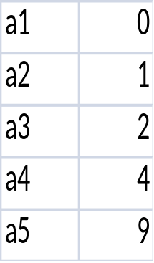
For example if the starting points are 0, 1, 2, 4, and 9 then what are the next five terms?
a1 | 0
a2 | 1
a3 | 2
a4 | 4
a5 | 9
a6 | 9
a7 | 10
a8 | 11
a9 | 13
a10 | 18

Slide 4

This is the Mathematica program to get the 1st 25 terms
clear[a]
a[1]=0;
a[2]=1;
a[3]=2;
a[4]=4;
a[5]=9;
a[n_]:=a[n]=Max[Table[a@i+a@(n-i),{i,1,n-1}]];Table[a@n,{n,1,25}]

Slide 5

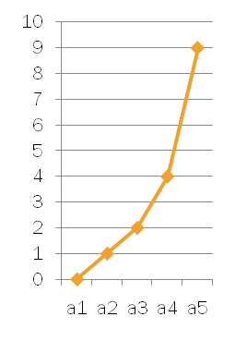
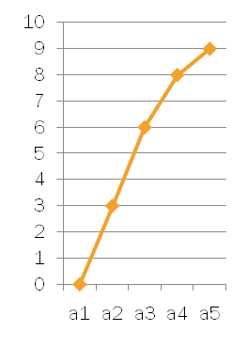
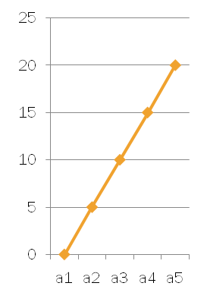
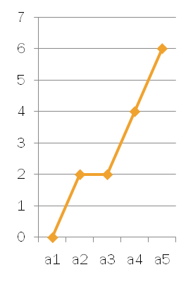
a1 | 0
a2 | 1
a3 | 2
a4 | 4
a5 | 9
a1 | 0
a2 | 3
a3 | 6
a4 | 8
a5 | 9
a1 | 0
a2 | 5
a3 | 10
a4 | 15
a5 | 20
a1 | 0
a2 | 2
a3 | 2
a4 | 4
a5 | 6

Slide 6

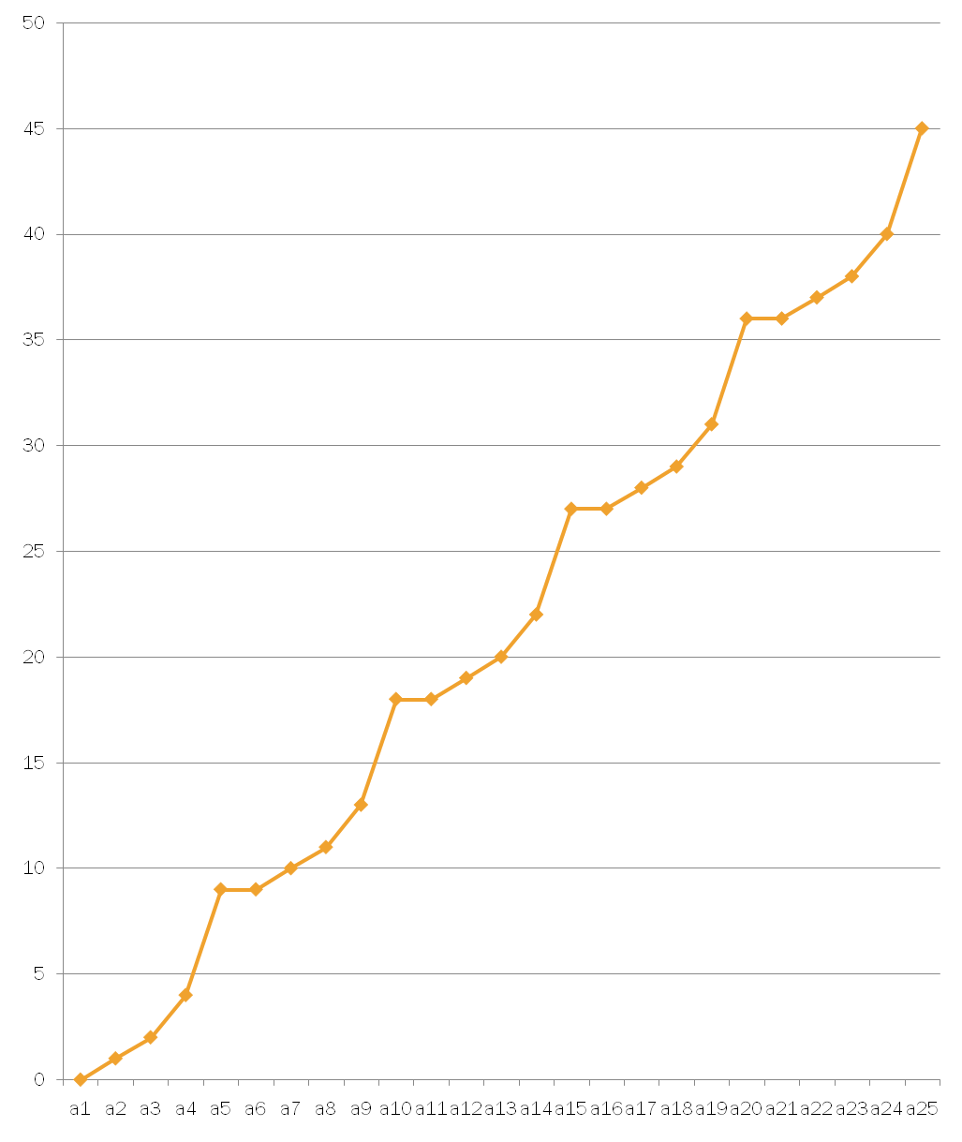
a1 | 0
a2 | 1
a3 | 2
a4 | 4
a5 | 9
a6 | 9
a7 | 10
a8 | 11
a9 | 13
a10 | 18
a11 | 18
a12 | 19
a13 | 20
a14 | 22
a15 | 27
a16 | 27
a17 | 28
a18 | 29
a19 | 31
a20 | 36
a21 | 36
a22 | 37
a23 | 38
a24 | 41
a25 | 45

Slide 7

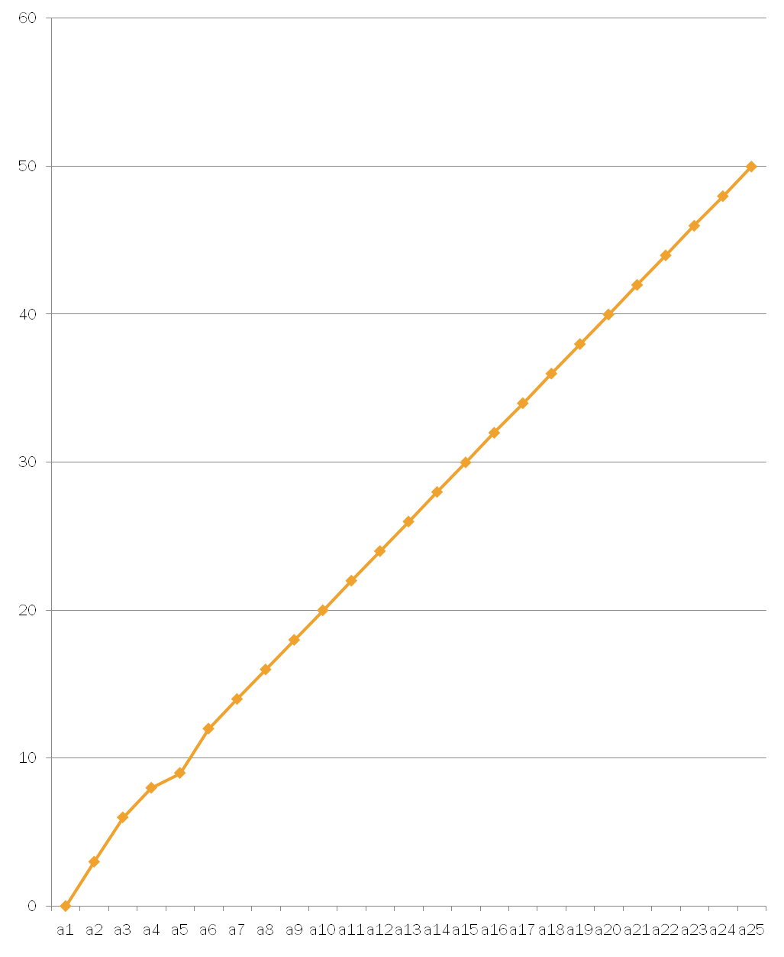
a1 | 0
a2 | 3
a3 | 6
a4 | 8
a5 | 9
a6 | 12
a7 | 14
a8 | 16
a9 | 18
a10 | 20
a11 | 22
a12 | 24
a13 | 26
a14 | 28
a15 | 30
a16 | 32
a17 | 34
a18 | 36
a19 | 38
a20 | 40
a21 | 42
a22 | 44
a23 | 46
a24 | 48
a25 | 50

Slide 8
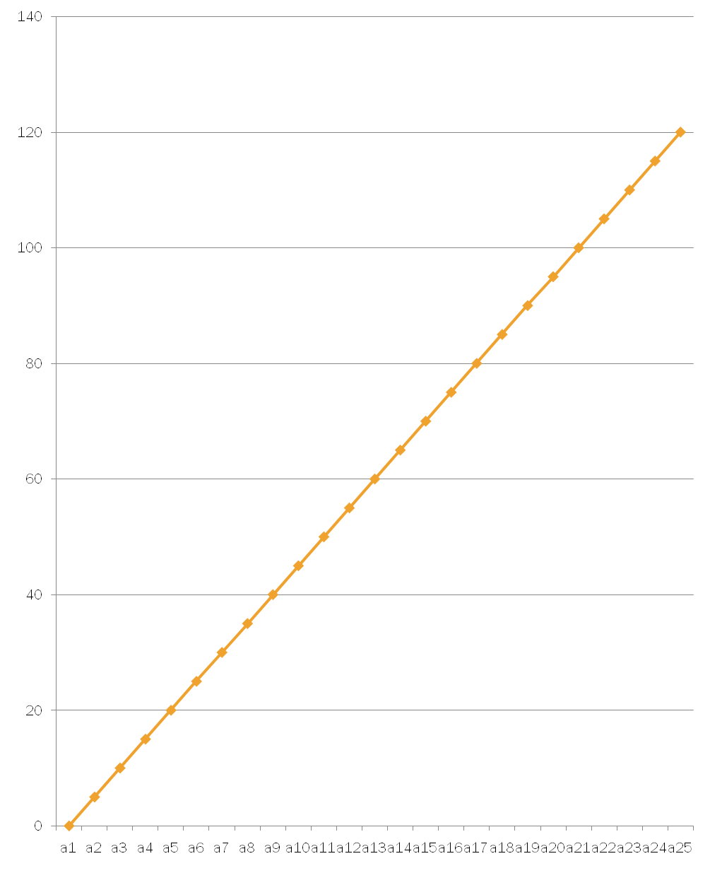
a1 | 0
a2 | 5
a3 | 10
a4 | 15
a5 | 20
a6 | 25
a7 | 30
a8 | 35
a9 | 40
a10 | 45
a11 | 50
a12 | 55
a13 | 60
a14 | 65
a15 | 70
a16 | 75
a17 | 80
a18 | 85
a19 | 90
a20 | 95
a21 | 100
a22 | 105
a23 | 110
a24 | 115
a25 | 120

Slide 9
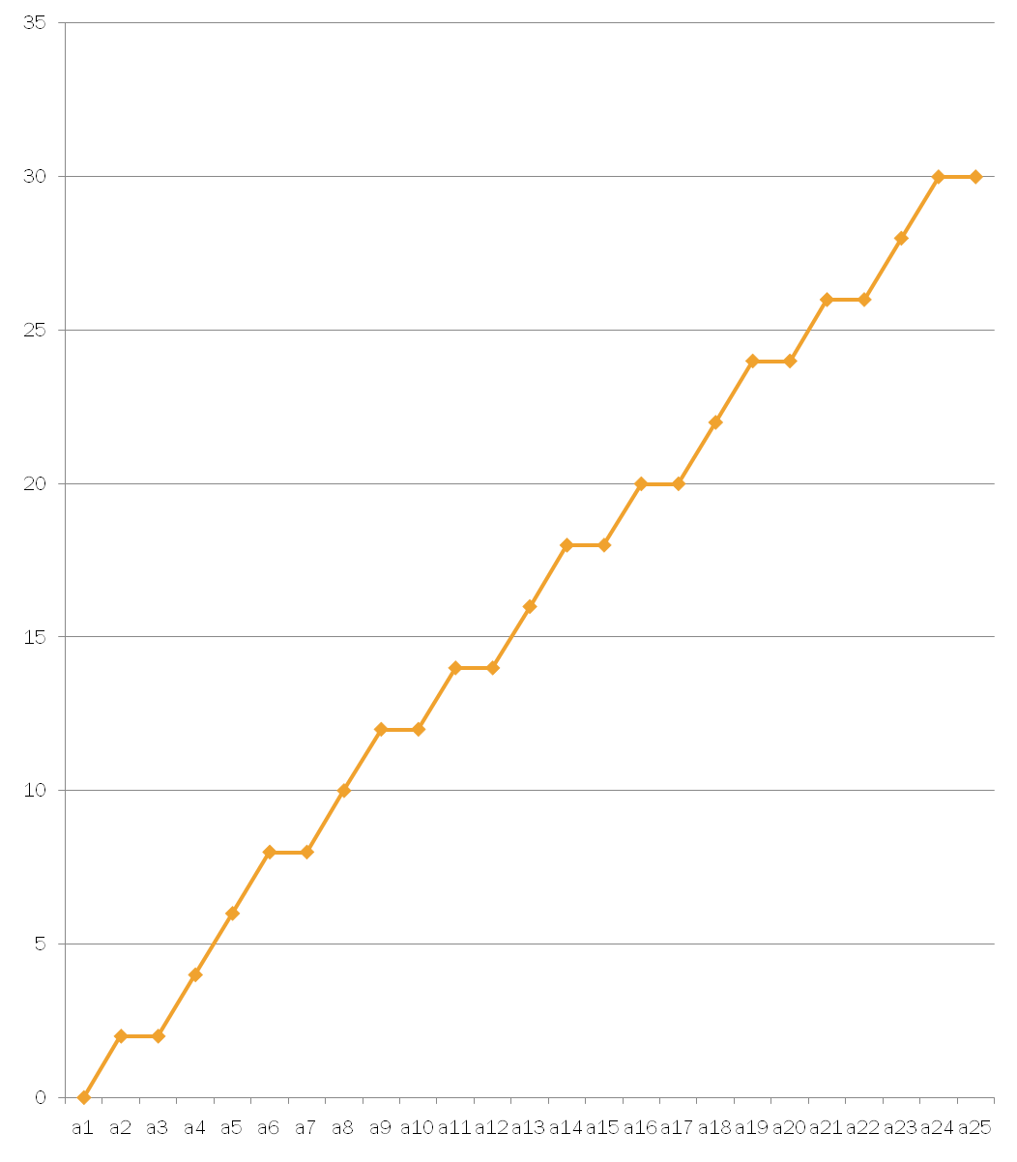
a1 | 0
a2 | 2
a3 | 2
a4 | 4
a5 | 6
a6 | 8
a7 | 8
a8 | 10
a9 | 12
a10 | 12
a11 | 14
a12 | 14
a13 | 16
a14 | 18
a15 | 18
a16 | 20
a17 | 20
a18 | 22
a19 | 24
a20 | 24
a21 | 26
a22 | 26
a23 | 28
a24 | 30
a25 | 30

Slide 10

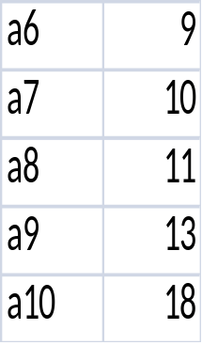

If the starting points are 0, 1,2, 4, and 9 then the next terms can be calculated by adding the last given term to the first to give the a₆ term then add the last term to second term to get a₇ and add last term to third term to get a₈ and add last term to fourth term to get a₉ and add last term to itself to get a₁₀
We found 0,1,2,4,9 by evaluating f(x) at the integers, for f(x) continuous, differentiable, increasing, and concave up on (1, 5).

Slide 11

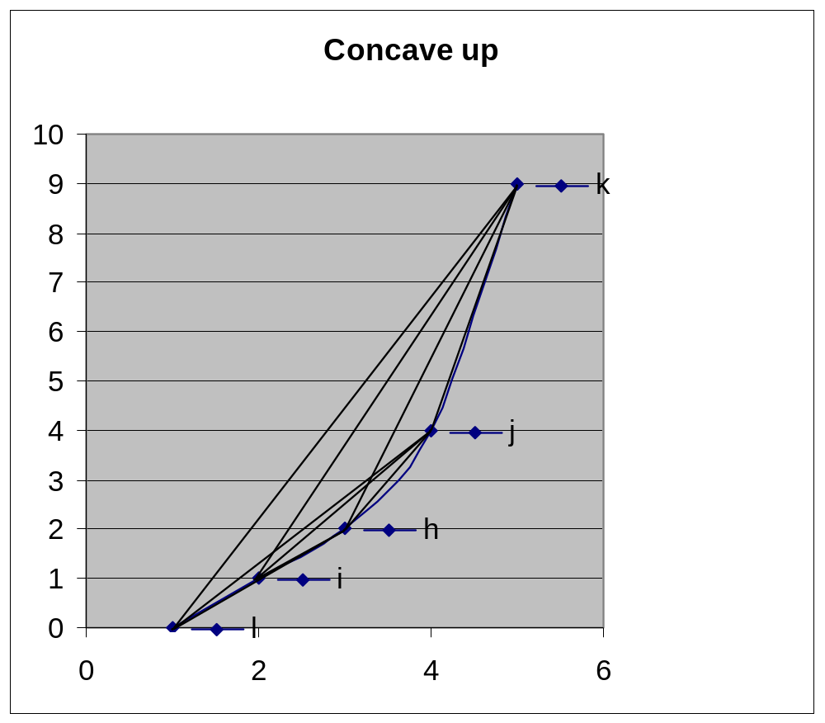
By concave up or flat we mean f’’(x) ≥ 0
for any two a_{i} , a_{j} where 1 ≤ i < j ≤ k
a_{h} for i ≤ h ≤ j lies below or on the line connecting a_{i} and a_{j}
The shortcut says that a_{n}= pa_{k} + a_{q} where n=pk+q, 0 ≤q<k

Slide 12

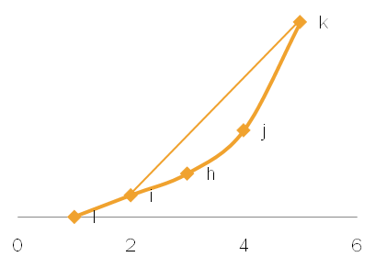
We conjecture that to have the shortcut the starting points should be found by evaluating f at the integers,
for f continuous, differentiable, increasing, and concave up on (1, k).
If for a_{i} , a_{j} where 1 ≤ i < j ≤ k , we have that a_{h} for
i ≤ h ≤ j lies on or below the line connecting a_{i} and a_{j}
Then a_{n}= pa_{k} + a_{q} where n=pk+q, 0 ≤q<k

Slide 13

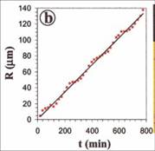
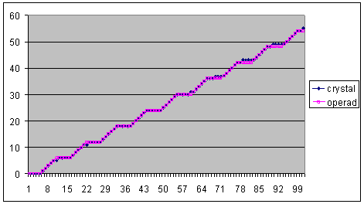
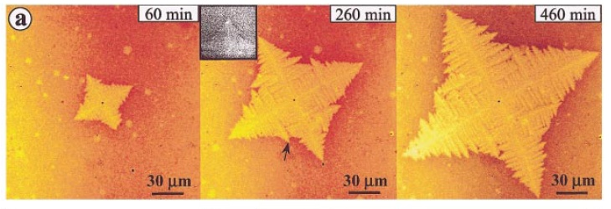
Our sequences are examples of Operads.
Illustrate the Vincent Ferreiro, Jack F. Douglas, James Warren, and Alamgir Karim
Measurements they took in 2002 as certain crystals formed in solution. Their first
study was
Graph of experimental Crystal growth is very
similar to one of our graphs
Graph of sinusoidal model of Crystal growth is very similar to one of our zigzag series of graphs
C_{0,0,0,0,0,1,2,3,4,5,6}
Dr. STEFAN FORCEY’s N-fold operads research

