Slide 1
Hobby Web App Vehicle Registration
Simon Forster

Slide 2
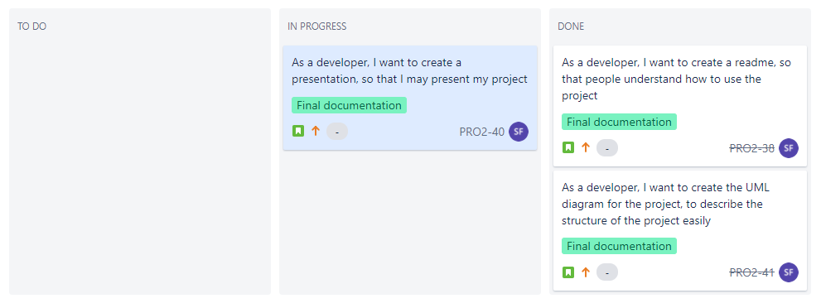
Project Setup
Planning processes used:
Jira board
Entity Relationship Diagram
MoSCoW table
Risk assessment table

Slide 3
MoSCoW Table
Must have | Should have | Could have | Would like to have
DB of people | Log in system | Name search function | Audit log (dependency on user login system)
DB of vehicles | Good UI flow for the web interface | Vehicle sarch by registration or make/model | Backup database
API to access the data
Web interface to let users manipulate the data

Slide 4
Risk Assessment Table
Ref | Risk Description | Cause | Risk Event | Action | Likelihood | Impact
1 | Lack of understanding of the technologies. | Not having studied the spec and technologies in detail. | Making mistakes in the assignment. | Make sure to spend time reading and understanding the spec & technologies. | Medium | High
2 | Lack of time. | Misusing my time. | Not being able to hand in a complete assignment. | Split up the entirety of the project into major goals, and those into smaller tasks. | Low | High
3 | Worldwide disruptions. | COVID-19 outbreak development. | Regulations changes that disrupt services, work and health. | Adhere to hygiene and social distancing standards. Work remotely. | High | Low
4 | Unauthorised user access. | An unauthorised person makes use of the system. | An unauthorised person has access to the details of people in the database. | Add a login system so only authorised people can use the system. | High | High
5 | Lose database data. | Many possible sources such as hardware failure or human error. | Lose some or all data related to the service. | Create a backup database that creates rollbacks in case of emergency. | Low | High
6 | Lose local project. | Misuse Github during development and do not create frequent copies of my work during development. | Lose some progress from my work. | Ensure I use and push to Github frequently. | Low | Medium

Slide 5
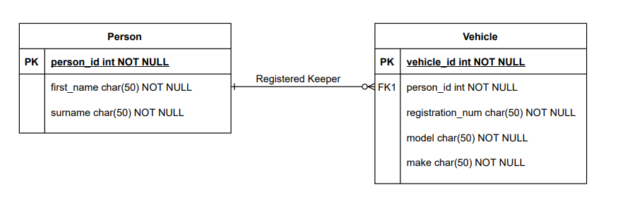
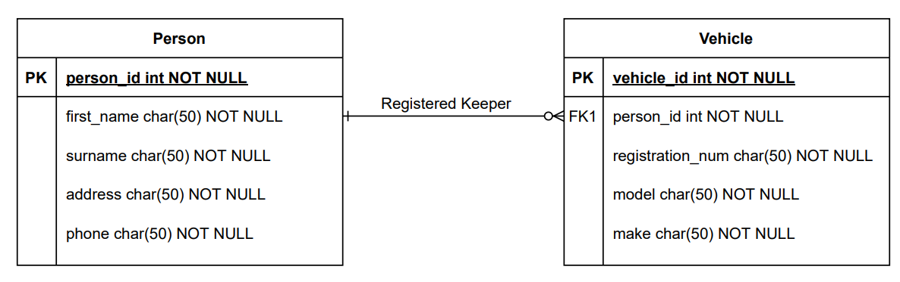
Entity Relationship Diagram
Planning ERD
Current ERD

Slide 6
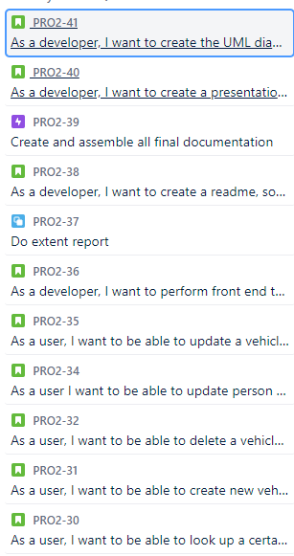
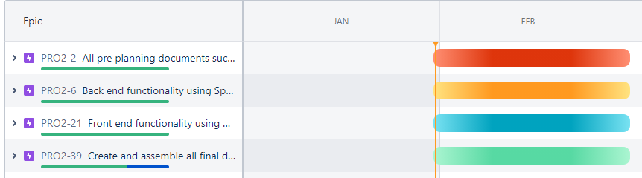
Jira Planning

Slide 7
Consultant Journey
Agile – SCRUM
Source Control – Git, GitHub
Database – MySQL
Programming Language – Java, HTML, JS
Framework – Spring Boot, Bootstrap
Build Tool – Maven
Testing – JUnit, Selenium
Diagram Usage – ERD, UML

Slide 8
Continuous Integration
Used Git & GitHub
Linked GitHub and Jira together, mentioned tickets in commits as often as possible.
Worked using a feature branch model.
What could have been done better:
Better use of the feature branches

Slide 9


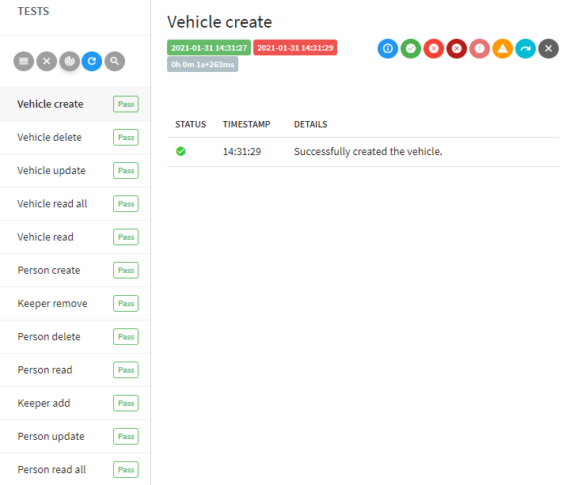
Testing
>90% coverage on the service and controller methods
Front end testing report
Could have made better failure tests
Could have added more details

Slide 10
Demo

Slide 11
Sprint Review
What was completed:
Each entity and their respective requirements
Ended with a functioning viable product
What got left behind:
Features from the lower priority columns in the MoSCoW table
Potential risk handling failures
Product/Test | Person | Vehicle
Backend | Sprint 1 | Sprint 2
Frontend | Sprint 3 | Sprint 4

Slide 12
Sprint Retrospective
What went well:
Sprints were very defined, usually last half a day each
Improved user stories since last project
Managed the documentation sprint a lot faster
Given timeline felt shorter, had to compromise on quality
What could be improved:
Planned the tasks for documentation earlier
Better difficulty estimates for testing development

Slide 13
Conclusion
More organised than the first project
Could have done better front end testing
Obtained a working viable product
Documentation felt a bit rushed, but also faster due to experience

