Slide 1

2024;
FYP;
codeXBuilder://
Code Editor Using Natural Language
// Student - Shagar Thangaraj || 2019446
// Supervisor - Mohanadas Jananie

Slide 2

Table of Content
<!Table of content>
<Problem Definition>
<Literature Review>
<Research Gap>
<Project Pipeline>
<Requirement Elicitation>
<SRS Summary>
<Functional & NFRs>
<Proof of Concept>
</End>
END

Slide 3
Increase in Programming Interest:
2020: 47% of high school students in the Asia enrolled in computer science courses (Code.org, CSTA, & ECEP Alliance, 2020).
Degrees in computer science doubled in the last decade worldwide (NCES, 2021).
Challenges in Learning Programming:
Students often struggle with basic programming courses despite rising interest.
Objective of Study:
Identify difficulties in learning programming.
Support the development of effective learning materials for basic programming courses.
Survey Details:
International survey conducted with 500+ students and teachers.
Focus on difficulties experienced and perceived in learning and teaching programming.
Analysis of Findings:
Highlights key challenges in programming education.
Provides insights to improve teaching strategies and learning outcomes (Lahtinen et al., 2005).
Problem
Definition ://

Slide 4
Shagar Thangaraj
LR
你好
مرحبا
नमस्ते
Literature://
Ciao
Review
안녕하세요.
codeXBuilder://

Slide 5
Key LR Summary
MORE DETAILS
03
02
01
NLP’s Role in Future Coders
Difficulty in traditional Coding
Attracted to Code Generation
Trends in Web Development
Wong, M.-F., 2023
Floyd, 2020,
Stack Overflow, 2023
Andreas et al., 2021

Slide 6



Github Copilot
Existing
Work
Addon for Code Editors
Paid
CodePEN
Browser Based CE
CodePen PRO Needed for Copilot
ChatGPT
No Standalone CE
Gives you code

Slide 7
Research Gap
Technological Gap
NLP in Code Generation
Lack of real time rendering
Instant Feed back , Split screen editors
Lack of RRR GPT or Copilot typically operate static (Khan et al., 2022).

Slide 8
//-
Project Aim
The aim of the project is to design, develop, and evaluate a novel code editor with artificial intelligence, enabling users to generate code through natural language inputs and real-time feedback, making programming more accessible for non-programmers.
</>
“NavBar with four Options”
ENTER
codeXBuilder://

Slide 9
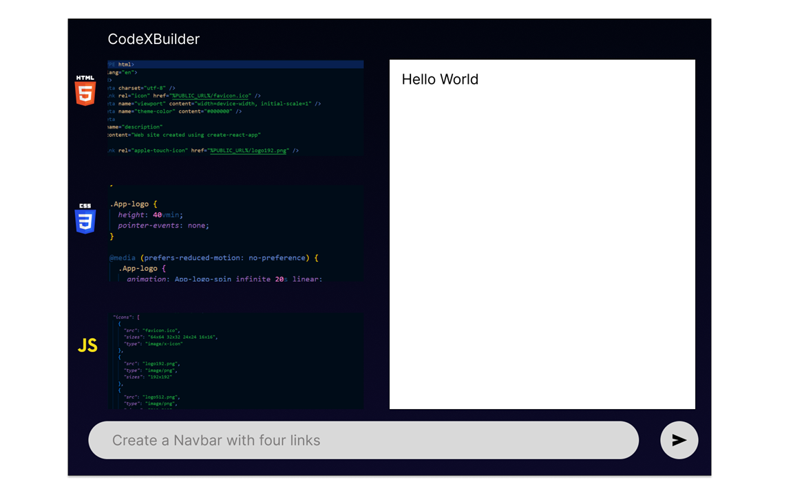
Proof of Concept
Generate HTML
Generate CSS
Generate JS
#1
Rendering in Real Time
Mock Diagram

Slide 10
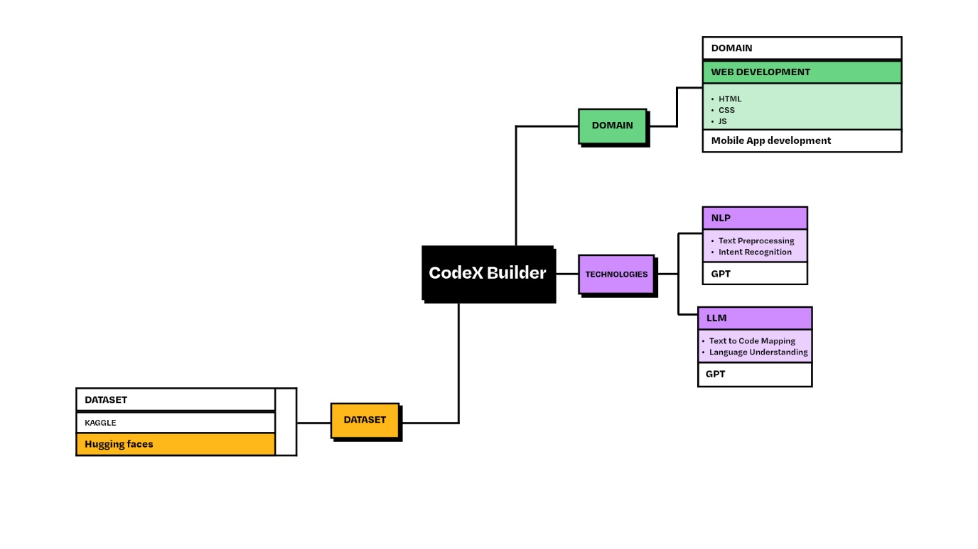
Project
Pipeline
MORE DETAILS
Generating Dataset
NLP (Text Preprocessing , Intent Recognition)
LLM (Text to code Mapping, Language Understanding)
codeXBuilder://
2019.All Rights Reserved

Slide 11

Methodologies
Surveys
Interviews
codeXBuilder://

Slide 12

Survey Questions
Demographics
Programming Experience
?
Learning Preferences and Resources
Coding Challenges and Motivation
Interest in NLP Based Coding
Preferred Feature in NLP Code Editor
codeXBuilder://

Slide 13
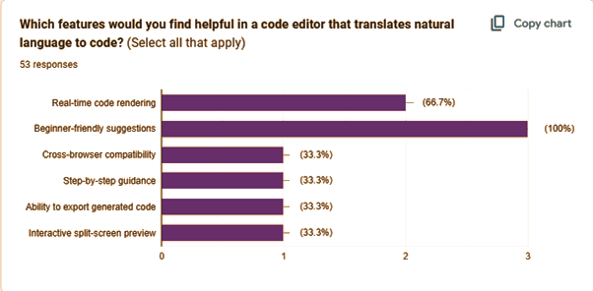
Python
There's no one "best" programming language, and once you've learned one.
More than “50%" Interested in coding with English (NLP) and Real Time Rendering

Slide 14
Functional & NFR
Functional Requirements
Non-Functional Requirements
English Input
Real-time Code Rendering
Customization Options
Error Handling
Export Functionality
Scalability
Cross-Browser Compatibility
Performance
Security

Slide 15
<15/>
Research Contribution
Collective Approach of NLP Elements
Targeting Beginners
#include <stdio.h>
int main(void)
{
printf("hello, world\n");
}

Slide 16


Conclusion
Web-based Code-Editor
Targeting Beginners
Future Updates
Key Takeaway

Slide 17


Questions
???
10k

Slide 18
2024;
Thank you://

Slide 19
Example
<table>
<tr>
<th>Company</th> <th>Contact</th> <th>Country</th>
</tr>
<tr>
<td>Alfreds Futterkiste</td> <td>Maria Anders</td><td>Germany</td>
</tr>
<tr>
<td>Centro Moctezuma</td> <td>Francisco Chang</td> <td>Mexico</td>
</tr>
<tr>
<td>Ernst Handel</td> <td>Roland Mendel</td> <td>Austria</td>
</tr>
</table>
c
Result
MORE DETAILS

Slide 20
Code to the web design
There's no one "best" programming language, and once you've learned one, it's fairly easy to pick up another, so don't get hung too up on choosing your first language.
MORE DETAILS

Slide 21
Coding is a fundamental skill that children need to learn.
There's no one "best" programming language, and once you've learned one, it's fairly easy to pick up another, so don't get hung too up on choosing your first language.
01.
Learn C Language
02.
Learn C# Language

Slide 22
Code Foundations
There's no one "best" programming language, and once you've learned one, it's fairly easy to pick up another.
MORE DETAILS

Slide 23
coder://
Ready to get started ?
There's no one "best" programming language, and once you've learned one, it's fairly easy to pick up another, so don't get hung too up on choosing your first language.
Learn more

Slide 24

Meet our team
Subtitle here
Position
Position
Position
Position
Simo Aldric
Tor Hildræd
Felix Artemisia
Pia Elian
MORE DETAILS

Slide 25
Meet our team
Web Mentor
“A wonderful serenity has taken possession of my entire soul,
Szonja Odilo
Maïa Eliisa
Dubhghlas Tera
Job position
Job position
Job position
Mobile Mentor
“A wonderful serenity has taken possession of my entire soul,
Irene Marianne
Andrey Lore
Lucy Bharat
Job position
Job position
Job position

Slide 26
Eino Williric
There's no one "best" programming language, and once you've learned one, it's fairly easy to pick up another, so don't get hung too up on choosing your first language.
C# Language
85%
Golang Language
60%
Python Language
72%
Hello! world

Slide 27
Frequently Asked Questions (FAQ)
General
How do I get started?
There's no one "best" programming language, and once you've learned one.
There's no one "best" programming language, and once you've learned one.
What time should I arrive?
Do I have to reserve my spot?
There's no one "best" programming language, and once you've learned one.
There's no one "best" programming language, and once you've learned one.

Slide 28
“First, solve the problem.
Then, write the code”
John Johnson://

Slide 29
Gallery slide
There's no one "best" programming language, and once you've learned one, it's fairly easy to pick up another, so don't get hung too up on choosing your first language.
01
text paragraph text
Build your website
Play://
Coder://

Slide 30
Build web
Pages and site.
HTML5
CSS3
There's no one "best" programming language, and once you've learned one, it's fairly easy to pick up another, so don't get hung too up on choosing your first language.

Slide 31
Development
There's no one "best" programming language, and once you've learned one.
Build your
app
Development
There's no one "best" programming language, and once you've learned one.

Slide 33
coder makes it easy and fun for you to code.
Fully support language
JAVA
PHP
Python
There's no one "best" programming language, and once you've learned one, it's fairly easy to pick up another, so don't get hung too up on choosing your first language.
C++
C#
C
MORE DETAILS
More programming language

Slide 34
Example
JavaScript Date Reference
<p id="demo"></p>
<script>
var d = new Date();
document.getElementById("demo").innerHTML = d;
</script>
The Date object is used to work with dates and times. Date objects are created with new Date(). There are four ways of instantiating a date:
Result
Wed Apr 24 2019 14:15:03 GMT+0700 (Western Indonesia Time)
Date Object
var d = new Date();
var d = new Date(milliseconds);
var d = new Date(dateString);
var d = new Date(year, month, day, hours, minutes, seconds, milliseconds);

Slide 35
Our agenda in this August
August
Sun
Mon
Tue
Wed
Thu
Fri
Sat
28
29
30
31
1
2
3
19
Learn C Language
4
5
6
7
8
9
10
11
12
13
14
15
16
17
21
Learn C# Language
18
19
20
21
22
23
24
22
Learn C++ Language
25
26
27
28
29
30
31
1
2
3
4
5
6
7

Slide 36
coder makes it easy and fun for you to code
There's no one "best" programming language, and once you've learned one, it's fairly easy to pick up another, so don't get hung too up on choosing your first language.
1
Choose what to learn
There's no one "best" programming language, and once you've learned one.
MORE DETAILS
coder://
2019.All Rights Reserved

Slide 37
<37/>
Learning by doing
There's no one "best" programming language, and once you've learned one.
2
Important subtitle text
Important subtitle text
Important subtitle text
Important subtitle text
coder://
2019.All Rights Reserved

Slide 38
if(coffee=true) {
/* let’break with a cup coffe */
break;
}

Slide 39
Slide Break

Slide 40


Go
Office Data Chart
C#
Important subtitle text
Programming
Important subtitle text
Language
Important subtitle text
Python
C++
Important subtitle text

Slide 41
Development
Development
There's no one "best" programming language, and once you've learned one.
There's no one "best" programming language, and once you've learned one.
MORE DETAILS
MORE DETAILS

Slide 42
<42/>
Office Data Chart
140
120
100
80
Important subtitle text
60
Important subtitle text
40
20
Important subtitle text
Jan
Feb
Mar
Apr
May
Jun
Jul
Aug
Sep
Oct
Important subtitle text

Slide 43
coder makes it easy and fun for you to code
There's no one "best" programming language, and once you've learned one, it's fairly easy to pick up another, so don't get hung too up on choosing your first language.
65%
45%
85%
Option one
Option two
Option three
Next
Next
Next

Slide 44
Analytics SWOT
Infographic Design With Modern Style

Slide 45
Strength slide
SWOT
Strength
Important subtitle text
Important subtitle text
Important subtitle text
<!--This is a comment. Comments are not displayed in the browser-->
Important subtitle text

Slide 46
Weakness
slide
SWOT
Development
Weakness
There's no one "best" programming language, and once you've learned one.
<!--This is a comment. Comments are not displayed in the browser-->
MORE DETAILS

Slide 47
Opportunity slide
SWOT
Opportunity
Important subtitle text
Important subtitle text
Important subtitle text
<!--This is a comment. Comments are not displayed in the browser-->
Important subtitle text

Slide 48
Threat
slide
SWOT
Development
Threat
There's no one "best" programming language, and once you've learned one.
<!--This is a comment. Comments are not displayed in the browser-->
MORE DETAILS

Slide 49
Process strategy to be master code
01
02
03
Learn by doing
Try Something new
Development
There's no one "best" programming language, and once you've learned one.
There's no one "best" programming language, and once you've learned one.
There's no one "best" programming language, and once you've learned one.

Slide 50
Coding is a fundamental skill that children need to learn.
1
There's no one "best" programming language, and once you've learned one, it's fairly easy to pick up another, so don't get hung too up on choosing your first language.
2
3
01.
Choose the Language
02.
Start Small
4
03.
Online Training
04.
Play Coding

Slide 51
Premium
Pricing Plan
Basic
Pro
$85,99
$47,99
$65,99
There's no one "best" programming language, and once you've learned one, it's fairly easy to pick up another, so don't get hung too up on choosing your first language.
Insert Text in This Text
Insert Text in This Text
Insert Text in This Text
Insert Text in This Text
Insert Text in This Text
Insert Text in This Text
MORE DETAILS
PURCHASE
PURCHASE
PURCHASE

Slide 52
Mind map infographic slide
C++
C#
There's no one "best" programming language, and once you've learned one.
06
There's no one "best" programming language, and once you've learned one.
Programming
Language
Python
Java
There's no one "best" programming language, and once you've learned one.
05
There's no one "best" programming language, and once you've learned one.
Php
There's no one "best" programming language, and once you've learned one.

Slide 53
mini puzzle game
Subtitle here
public class MyClass {
public static void main(String[] args) {
for (int i = 0; i < 5; i++) {
System.out.println(i) ;
} }
}
Result Code
1
2
3
4
5
for
(i)
i++

Slide 54
Binary tree
0
1
2
3
4
5
6
7
8
9
10
11
12
13
14
1000 <-> 2000
0
1000 <-> 1500
1500 <-> 2000
1
2
1000 <-> 1250
1250 <-> 1500
1500 <-> 1750
1750 <-> 2000
3
4
5
6
1000 <-> 1125
1125 <-> 1250
1250 <-> 1375
1375 <-> 1500
1500 <-> 1625
1625 <-> 1750
1750 <-> 1875
1875 <-> 2000
7
8
9
10
11
12
13
14

Slide 55
Learn Matrix
1
3
4
1
3
4
Matrix 1
2
4
3
Matrix 2
2
5
3
3
4
5
3
7
2
1+1
3+3
4+4
There's no one "best" programming language, and once you've learned one, it's fairly easy to pick up another, so don't get hung too up on choosing your first language.
Matrix x
2+2
4+5
3+3
3+3
4+7
5+2

Slide 56

Id card event
mockup
There's no one "best" programming language, and once you've learned one, it's fairly easy to pick up another, so don't get hung too up on choosing your first language.
MORE DETAILS

Slide 57
Mockup slide
http://www.website.com

Slide 58
<58/>
01
text paragraph text
Smartphone
mockup
A Coding Planner
C#
Go
Important subtitle text
Important subtitle text
Python
Important subtitle text
Important subtitle text
C++

Slide 59
75%
United Kingdom
Subtitle Here
50%
There's no one "best" programming language, and once you've learned one, it's fairly easy to pick up another.
Subtitle Here
MORE DETAILS
65%
Option one
Subtitle Here

Slide 60
Australia Map
Important subtitle text
85%
Important subtitle text
Important subtitle text
Important subtitle text
Option three
Next

Slide 61
World Map slide
Option one
There's no one "best" programming language, and once you've learned one, it's fairly easy to pick up another.
MORE DETAILS
<!--This is a comment. Comments are not displayed in the browser-->

Slide 62
Address
There's no one "best" programming language, and once you've learned one.
Our
Phone number
There's no one "best" programming language, and once you've learned one.
Office
Websites
@coder_officials
There's no one "best" programming language, and once you've learned one.

Slide 63
Thank you
For your attention

