Slide 1
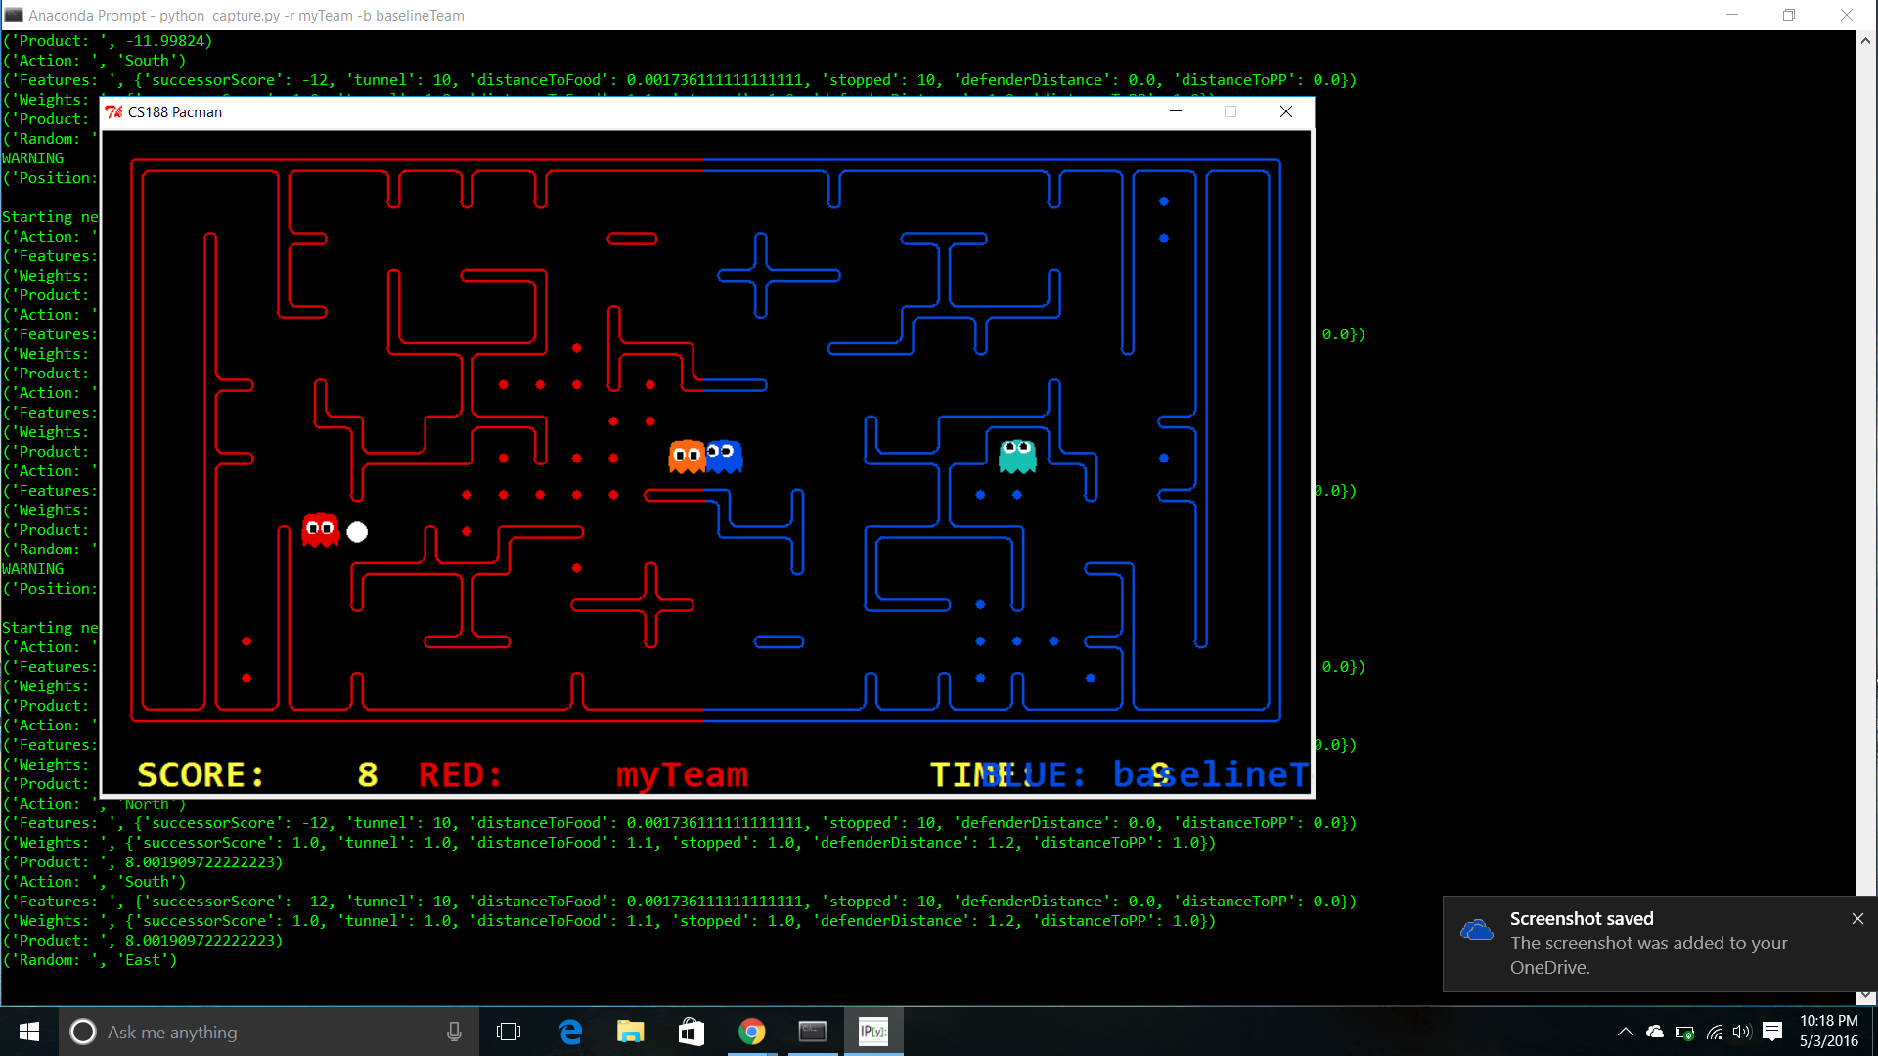
Pacman: Capture the Flag
Team 4: Sean Fox, Amal Morais, and Kushal Tiwari
Offensive agent uses approximated Q-values with features determining :
If path ends in a tunnel back out
Forces agent to keep moving.
Distance to closest enemy
Distance to closest pellet
Distance to closest power pellet
If the agent is backtracking
Offensive agent also determines if it is a safer option to return to it’s homeside before going after the next pellet
Defense agent uses a particle filtering algorithm to approximate an invader’s position has been detected
Score Average: 10 points.

