Slide 1
FILM PRODUCTION RECOMMENDATIONS
Shannon F. Hunley
September 10, 2025

Slide 2
OVERVIEW
Our company is interested in creating a new movie studio to make original video content.
Since we are unfamiliar with making movies, we need information about what films are performing best at the box office to make decisions about what type of films to make in our new studio.

Slide 3
DATA AND METHODS
We are using two datasets provided by IMDb and The Numbers. IMDb is an authoritative online database for video content, and The Numbers is another popular online database and research service which reports financial and business data regarding movies.
The data includes information about movies and their genres, ratings, staff, domestic and international gross revenue, budget, and more.

Slide 4
LIMITATIONS
Even though we have a good amount of data covering a long period of time, the rise of streaming movies is still a new development that will continue to change the way consumers watch movies and even what they watch. There are also societal changes that could cause preferences to evolve over time.
The data includes no information about marketing budget, so it’s worth evaluating how marketing our movies could impact ROI.

Slide 5
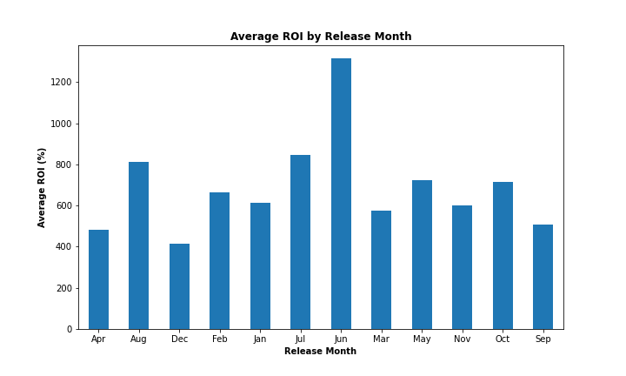
ROI BY RELEASE MONTH
June, July, and August release dates perform best in terms of ROI.
It looks like early summer is ideal, so a June release date would be recommended.

Slide 6
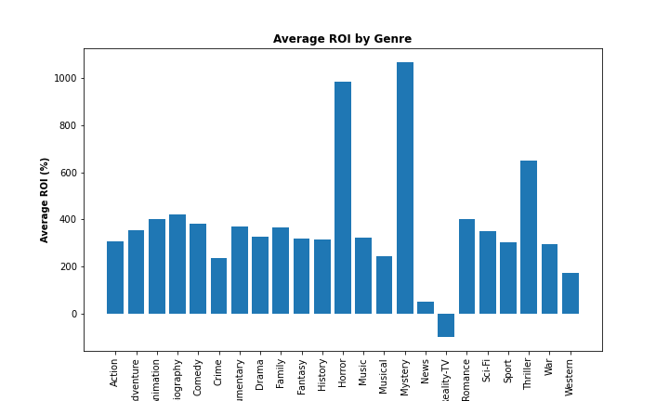
ROI BY GENRE
Mystery, Horror, and Thriller Genres perform best in terms of ROI.

Slide 7
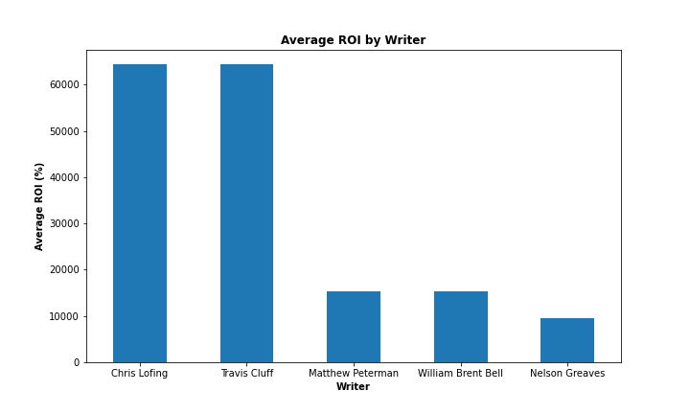
ROI BY WRITER
Here are the top five writers when evaluated by average ROI.
Chris Lofing and Travis Cluff are writers we should ideally try to work with.

Slide 8
CONCLUSIONS
1) Release dates in the summer, ideally early summer (June), are correlated with the best ROI.
2) Horror, mystery, and thriller genres are associated with the highest ROI.
3) Chris Lofing, Travis Cluff, and Matthew Peterman are writers associated with the highest ROI movies in the horror, mystery, and thriller genres.

Slide 9
NEXT STEPS
This is an ever-evolving industry, so keeping tabs on this data and how it changes frequently is essential.
We should evaluate some movie marketing data to find out to what extent a marketing budget could help achieve an even better ROI for our movies.
Transition to higher grossing films after some film production experience

Slide 10
Thank you!
Questions are welcome.
Email: Shannon.f.hunley@gmail.com
Github @ sfp13VA
LinkedIn: linkedin.com/in/Shannon-hunley

