Slide 1
Transitioning from Software Developer to Machine Learning DEVops Engineer
Scott Frame

Slide 2
Background
BS in EE/CE
Work for DoD as Electronics Engineer
Develop Real Time Software
MS in Computer Science
Develop Web Apps / Web Services
SW Eng >>> Tech Lead >>> Solution Architect
Machine Learning Engineer / ML Ops

Slide 3


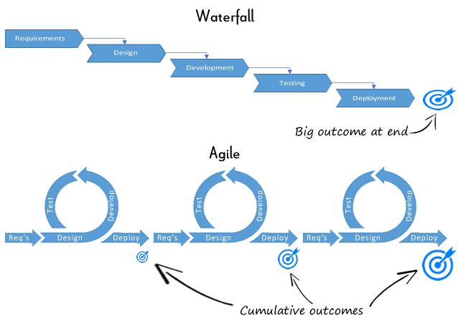

Slide 4
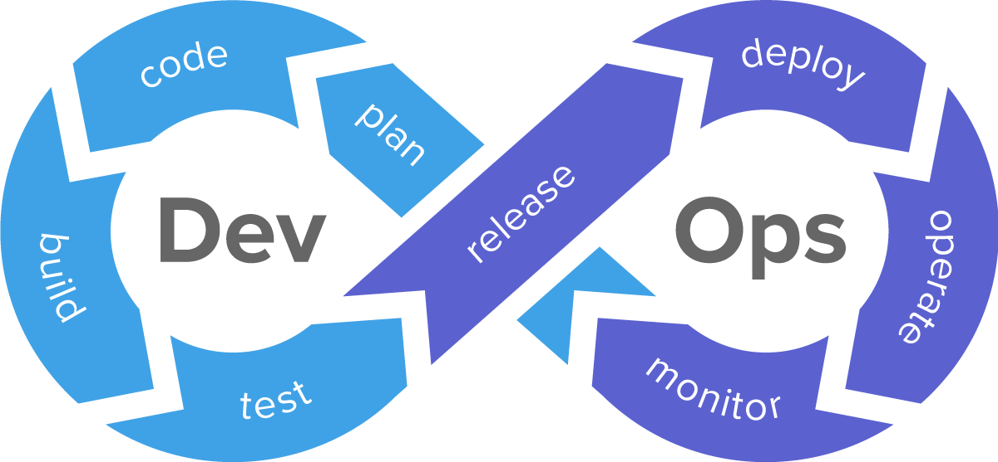
What is DevOps ?

Slide 5
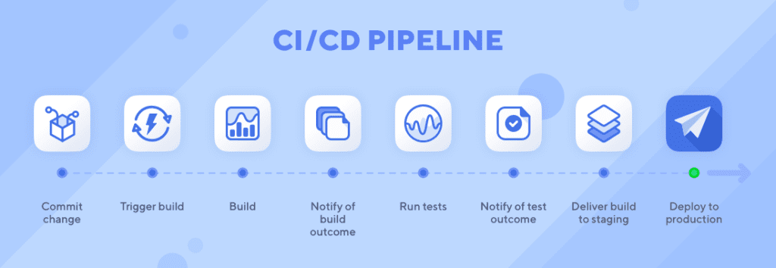

Slide 6
Data Analytics – measurement of traditional indicators and analysis to describe historical trends
Data Science – the use of advanced tools to extract data, make predictions, and discover trends
Machine Learning – the use of large data sets and extensive computing power to automate analytical model building with advanced algorithms

Slide 7
Developing a Machine Learning Model
Data Exploration
Data Wrangling
Feature Selection
Algorithm Selection
Tuning
Model Evaluation

Slide 8
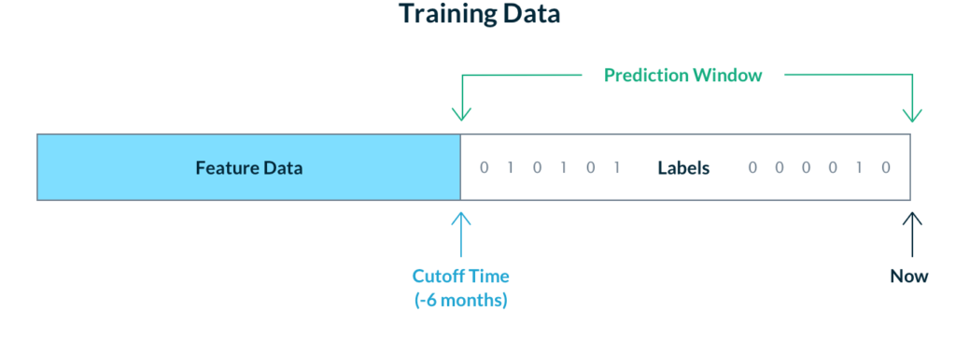
Use historical data to train a model with known outcome (Target)

Slide 9
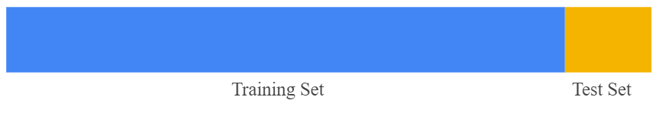
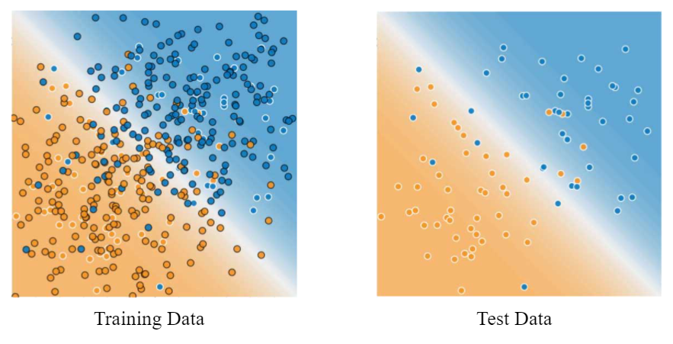
Images from Google Developers Machine Learning Crash Course
https://developers.google.com/machine-learning/crash-course/training-and-test-sets/splitting-data

Slide 10
Classification and Regression
Logistic/Linear Regression
Decision Tree
Random Forest
Gradient Boosted Tree
* Use one or some of ML algorithms to TRAIN a model that can be used to SCORE

Slide 11
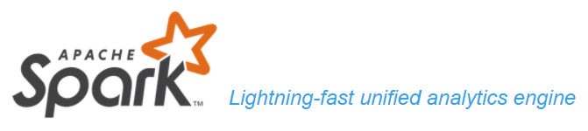
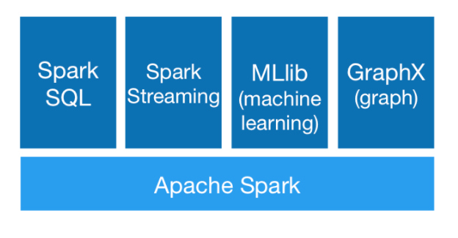

Slide 12
What is Industrialized
Machine Learning Ops (MLOps)
Standardize and Productionize ML Models
Deploy, Monitor, Evaluate ML Models
Free Up Data Scientists to Develop New Models

Slide 13
Industrialized Machine Learning Ops (MLOps)
Harden and Automate ML Model Notebooks
Develop and Maintain Feature Store
Build Utilities for Model Development/Analysis/Evaluation
Monitor Scoring Jobs, Retrain Training Jobs

Slide 14
QUESTIONS

