Slide 1

http://goo.gl/W6crOM

Slide 2
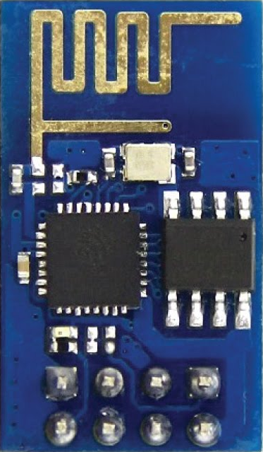
Introduction to The ESP8266
Micro Controller

Slide 3
Requirements for this class
Computer – Linux, Mac, or Windows
ESP8266 Development board
USB UART (programming cable)
Arduino IDE
ESP8266 Arduino Core

Slide 4
Outline for this class
Introduction to Micro Controllers & GPIOs
Overview of the ESP8266 Hardware & Software Development
Introduction to Arduino & Arduino IDE
Install the Arduino IDE & Upload a Sketch
Build a Web Server to control the LED on the ESP8266 remotely over WiFi
How to apply what you learned to your own designs
Resources

Slide 5
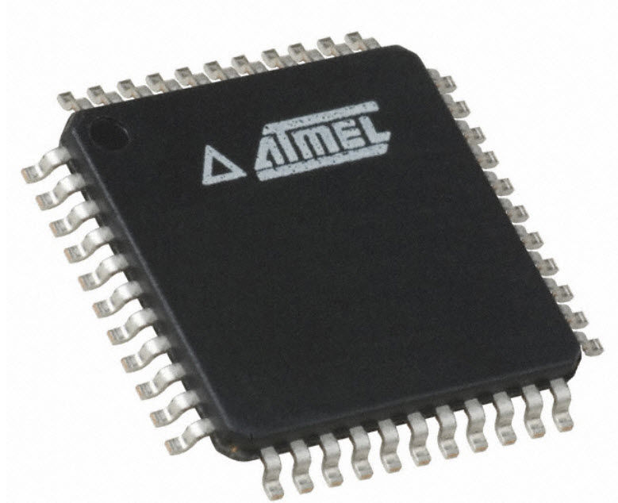
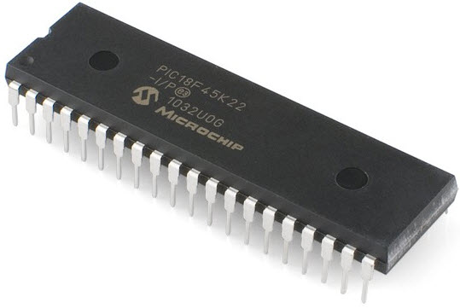
What is a Micro Controller?
“ A microcontroller (or MCU for microcontroller unit) is a small computer on a single integrated circuit. In modern terminology, it is a System on a chip or SoC. A microcontroller contains one or more CPUs (processor cores) along with memory and programmable input/output peripherals. Program memory in the form of Ferroelectric RAM, NOR flash or OTP ROM is also often included on chip, as well as a small amount of RAM. Microcontrollers are designed for embedded applications, in contrast to the microprocessors used in personal computers or other general purpose applications consisting of various discrete chips.”
~ Wikipedia

Slide 6


What is a Micro Controller?
Small Computer in a Chip
Special purpose
Does one thing well
Embedded inside other device
VS

Slide 7
All Micro Controllers have
CPU (central processing unit)
RAM (random-access memory)
ROM (read-only memory)
I/O (input and output)

Slide 8
GPIO
“General-purpose input/output (GPIO) is a generic pin on an integrated circuit or computer board whose behavior—including whether it is an input or output pin—is controllable by the user at run time.”
~ Wikipedia

Slide 9

Input
Data from some external source is being fed into the system to be manipulated

Slide 10
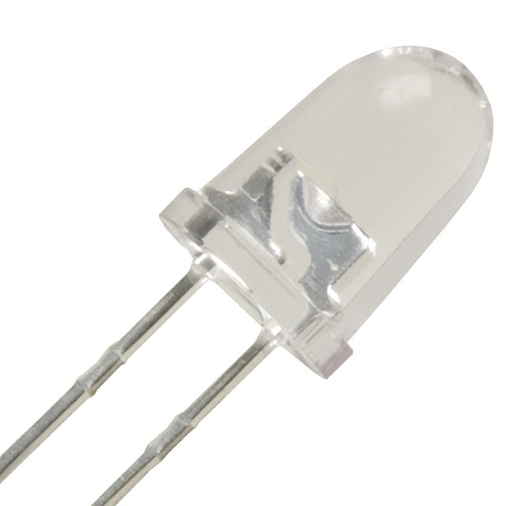
Output
Formatted date can be
transmitted efficiently to outside devices

Slide 11

Digital
Data (signal) expressed as series of the digits 0 and 1, typically represented by values of a physical quantity such as voltage or magnetic polarization.

Slide 12

Analog
Data (signal) or information represented by a continuously variable physical quantity such as spatial position or voltage.

Slide 13
Specialized GPIO
UART
universal asynchronous receiver/transmitter
SPI
Serial Peripheral Interface
I2C
Inter-Integrated Circuit
ADC
Analog to Digital Converter
DAC
Digital to Analog Converter (PWM)

Slide 14
Special GPIO
Limited to what pins are used
Limited number of interfaces

Slide 15

The ESP8266
Designed by Espressif Systems.

Slide 16
The ESP8266
The ESP8266 is a self-contained
WiFi IoT solution.

Slide 17
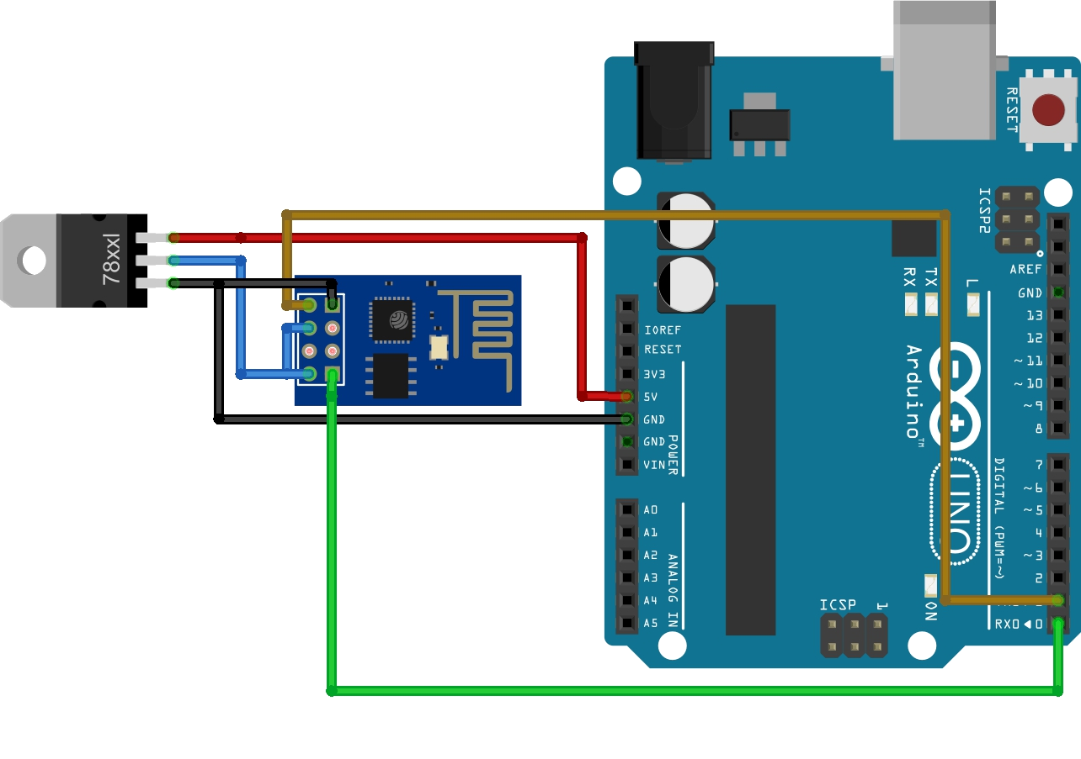
The ESP8266
The ESP8266 can be used as a bridge for existing micro controllers to WiFi networks accessible using AT commands

Slide 18









The ESP8266
The ESP8266 is capable of running self contained applications using a variety of development environments

Slide 19
The ESP8266
Voltage | 3.3V
Current consumption | 10uA – 170mA
Flash memory attachable | 16MB max (512K normal)
Processor | Tensilica L106 32 bit
Processor speed | 80-160MHz
RAM | 32K + 80K
GPIOs | 17 (multiplexed)
Analog to Digital | 1 input with 1024 steps
802.11 support | b/g/n/d/e/i/k/r
Max concurrent TCP | 5

Slide 20
The ESP8266
 | ESP8266 | Arduino (Uno)
GPIOs | 17 | 14
Analog input | 1 | 6
PWM channels | 8 | 6
Clock speed | 80/160MHz | 16MHz
Processor | Tensilica | Atmel
SRAM | 45KBytes | 2KBytes
Flash | 512Kb-16MB | 32KB (on chip)
Operating Voltage | 3.3V | 5V
Max current per I/O | 12mA | 40mA
UART (hardware) | 1 1⁄2 | 1
SPI (hardware) | 1(2) | 1
I2c | Yes | Yes
I2s | Yes | No
Networking | Built-in (WiFi) | Separate

Slide 21
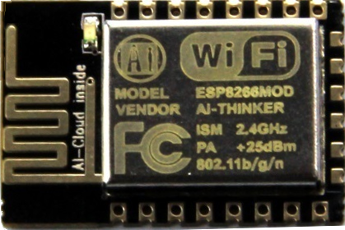
The ESP8266
There are a variety of board styles available
ESP-1 and ESP-12

Slide 22
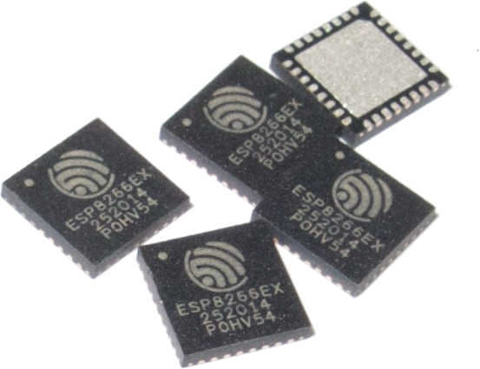
The ESP8266
There is only one ESP8266 processor and it is this processor that is found on ALL breakout boards.

Slide 23
The ESP8266
What distinguishes one board from another?
the number of GPIO pins exposed
the amount of flash memory provided
and the package footprint.
From a programming perspective,
they are all the same.

Slide 24
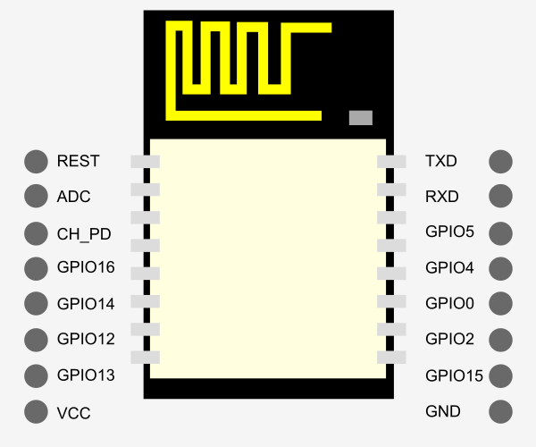
The ESP8266

Slide 25
The ESP8266
Name | Description
VCC | 3.3V
GPIO 13 | Also used for SPI MOSI
GPIO 12 | Also used for SPI MISO
GPIO 14 | Also used for SPI Clock
GPIO 16 | Regular GPIO
CH_PD | Chip enable. Should be high for normal operation
ADC | Analog to digital input
REST | External reset 0 – Reset 1 – Normal
TXD | UART 0 transmit (GPIO 1)
RXD | UART 0 Receive (GPIO 3)
GPIO 4 | Regular GPIO
GPIO 5 | Regular GPIO
GPIO 0 | Should be high on boot, low for flash update
GPIO 2 | Should be high on boot
GPIO 15 | Should be low on boot and flash
GND | Ground

Slide 26
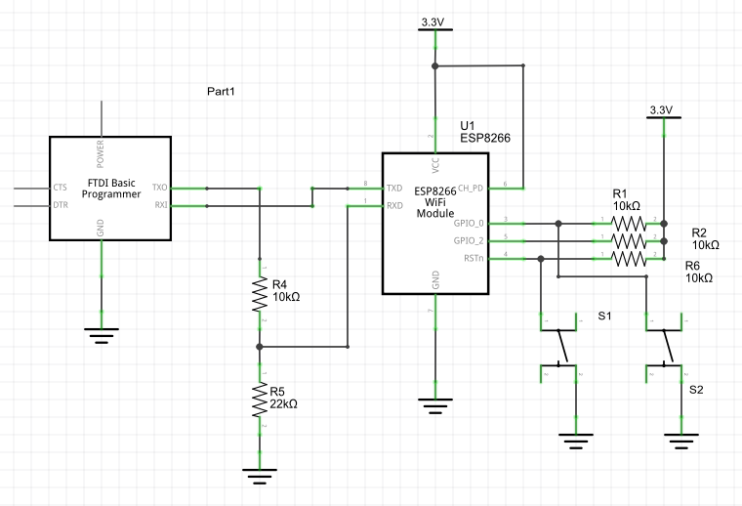
The ESP8266

Slide 27
The ESP8266
WiFi
An ESP8266 can be an Access Point, a Station, or both at the same time.
802.11 b/g/n/d/e/i/k/r

Slide 28
What is Arduino?
Open-Source hardware and software project
User community & support
Licensed under the GNU General Public License
Anyone can manufacture Arduino boards and software
Available commercially or as do-it-yourself kits

Slide 29
What is Arduino IDE?
Integrated Development Environment
Code Editor
Libraries
Compiler
Upload Utility

Slide 30

What is Arduino IDE?
Integrated Development Environment
Makes it easy to write code and upload it to the board
Cross-platform application ~ Windows, Mac OS & Linux
Programs written with the IDE are called a "sketch"
Supports C and C++ using special rules
Software library for common input and output procedures

Slide 31
Install the Arduino IDE
Arduino IDE Download
Select version 1.6.8
Windows, Mac OS & Linux

Slide 32
Install the Arduino IDE
Install the ESP8266 Addon With the Boards Manager
Open up Arduino,
go to the Preferences
(File > Preferences)
Copy this URL into the
“Additional Board Manager URLs” text box
http://arduino.esp8266.com/stable/package_esp8266com_index.json
ESP8266 Arduino Core Github

Slide 33
Install the Arduino IDE
Install the ESP8266 Addon With the Boards Manager
Navigate to the Board Manager by going to
Tools > Boards > Boards Manager
Look for esp8266
Click on that entry
then select Install.
ESP8266 Arduino Core Github

Slide 34
Install the Arduino IDE
Select the ESP8266 Board
select “Generic ESP8266 Module” from the
Tools > Boards menu
(Or the appropriate selection for your board)
ESP8266 Arduino Core Github

Slide 35
Install the Arduino IDE
Upload Blink sketch
select “Blink” from the
File > Examples > ESP8266 menu
If using ESP-12 Add
#define LED_BUILTIN 2
Just above the line
void setup() {

Slide 36
Install the Arduino IDE
Upload sketch from the
Sketch > Upload menu
Or Click on the Upload Icon

Slide 37
Troubleshoot

Slide 38
Building a Web Server
Create a New Sketch
File > New
Every Arduino Sketch has two basic functions
Startup() And Loop()

Slide 39
Building a Web Server
Source Code
Copy & Paste source code into our Sketch
(Use Select All)
GitHub Page

Slide 40
Building a Web Server
Save the Sketch
File > Save
Name the Sketch
WiFiWebControl

Slide 41
Building a Web Server
Edit The Variables in the Sketch
Review Source Code Line by Line
Upload The Sketch to the ESP8266
Connect & Control the ESP8266 over WiFi

Slide 42
Resources
http://bbs.espressif.com/
http://www.esp8266.com/
https://www.arduino.cc/en/Guide/HomePage
https://github.com/esp8266/Arduino
https://leanpub.com/ESP8266_ESP32
Neil Kolban ESP8266 pdf

Slide 43
Conclusion

