Slide 1


www.4i2i.com
www.abdn.ac.uk
A High Capacity Reversible
Watermarking Technique Based
On Difference Expansion
Stewart Fraser and Alastair Allen
IASTED SIP, Kailua-Kona, Hawaii, USA
August 18-20, 2008
4i2i Communications Ltd. Doig Scott Building, Craibstone Estate, Bucksburn, Aberdeen, AB21 9YA Scotland UK Tel: +44 (0) 1224 712844 Fax: +44 (0) 1224 714413 www.4i2i.com
US Office: 226 Airport Parkway, Suite 470 San Jose, CA 95110 USA Tel: (408) 467 5088 Fax: (408) 436 5524

Slide 2
Reversible Watermarking
Image I
Watermarked
Image I
Image I
User Payload
User Payload
INSERTION
RECOVERY
The original image I can be recovered EXACTLY from I'
Watermark recovery is a BLIND process
Military and medical applications

Slide 3
Reversible Watermarking Methods
Data compression schemes
Histogram bin exchanging
Difference expansion
Novel method here based upon Tian's difference expansion method (with some important adaptations)
Will overview Tian's method and then describe the adaptations and how they provide an improvement

Slide 4
Tian Method
Blind watermaking scheme using difference expansion
Watermark consists of image information and payload
Integer (Haar) transform applied to host image, [1x2] or [2x1] non-overlapping
Fundamental property:
Pixels pairs either changed or expanded
Changed pairs provide no extra storage
Expanded pairs give one free bit of storage
Image Info
User Payload
W =

Slide 5
Forward Integer Transform
for a neighboring pair of pixels (x,y) in a grayscale image ...
average (a) =
x = a + y = a -
x + y
difference (h) = x - y
2
Inverse Integer Transform
h + 1
h
2
2
... pixel pair averages and differences obtained

Slide 6
Watermark Insertion
A pixel pair difference (h) can be either changed, expanded or unaltered
An altered h must still result in an image in range [0,255], this can be determined mathematically: |h| ≤ min(2(255-a),2a+1)
Alterable h values:
Preferably, h values are expanded
If h value cannot be expanded, they are changed
h values are left unaltered if they cannot stay in [0,255]
Rearrangement
of integer
transform

Slide 7
Altering “h” value via Changing
A pixel pair are changeable if:
New difference value (h_new) for a changed pixel pair:
Remove LSB and replace with the watermark bit (b)
Removed LSB must be stored (in vector C) in order to restore original image
This DOES NOT provide extra storage space
h
2
+ b
≤ min(2(255-a),2a+1)
2
h
h_new =
2
+ b
2

Slide 8
Altering “h” value via Expanding
A pixel pair are expandable if:
New difference value (h_new) for a expanded pixel pair:
Left shift all values by one
Insert watermark bit (b) into newly freed LSB
This DOES provide one extra bit of storage space
Note that if a pixel pair are expandable, they are by definition changeable too (used for watermark recovery)
|2h + b| ≤ min(2(255-a),2a+1)
h_new = 2h + b

Slide 9
Visual degradation
In order control payload capacity .v. image quality, user defined threshold (th) introduced to restrict expandable pairs
Expandable pair:
if (h_new ≥ th)
pixel pair are changed rather than expanded
Detection problem created!
Example: expandable pair where th=10, h=6, b=1
h_new = 2h+b = 2(6)+1 = 13
At detection, cannot tell if this pixel has been expanded (h=6) or changed (because 13 > th)
Solution: Map showing location of all expanded pairs

Slide 10
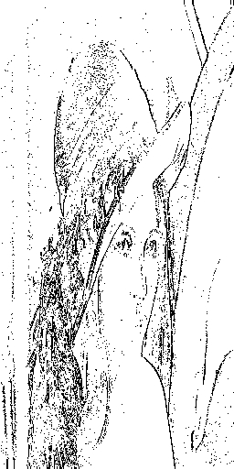
Location Map
Shows location of all expanded pairs
Binary format
Losslessly compressed JBIG compression
EOS
Watermark Construction
Comp Loc Map
C bits
Payload
WM =
Stored LSBs from changed h values
Binary Location
Map of Lena

Slide 11
Watermark Recovery
Apply integer transform to a watermarked image (get h')
Find all changeable pairs (expandable are changeable)
Collect all LSB from the changeable/expandable pairs
Identify the EOS symbol for JBIG compressed location map
Decompress the location map
Locations of expanded and changed pairs found
Find the original differences (h_orig)
Expandable: h_orig = h'/2
Changeable: h_orig = 2 h'/2 + c
Comp Loc Map
C bits
Payload
WM =
Apply inverse integer
transform using h_orig
to restore original image

Slide 12
Tian Summary
Integer transform
Difference values changed (no gain) or expanded (1 extra bit)
Visual degradation, threshold introduced
Threshold causes some expanded pairs to be changed instead
Better visual quality, less capacity
Threshold requires position of expanded pairs to be marked (location map)
User payload inserted and recovery of original image possible

Slide 13
Novel scheme
Integer transform
For unaltered and changed pixel pairs, no difference
Drastic difference for expanded pixel pairs
Basic premise: companding technique used to increase the amount of pixel pairs that are expanded (rather than changed)
More expanded but no extra capacity (companding errors)
However ...
Leads to very sparse location maps
Easy to JBIG compress these location maps
More space for user payload (higher capacity)
High capacity user payload inserted and recovery of original image possible

Slide 14
Companding technique
Companding = Portmanteau of compression followed by expanding
Compress (C) and then decompress (D) a signal (x) magnitude ≥ threshold (th)
C(x) = sgn(x) [ (|x|-th)/2 + th]
D(x) = sgn(x) [2|x|-th]
C(x) has the effect of shrinking magnitudes towards th
Errors (r) occur when |x| ≥ th
r = |x| - |D(C(x))| where r ∈ {0,1}

Slide 15
Companding application
If difference value (h) between a pixel pair ≥ th
Shrink h towards th via companding compress
Calculate and store the companding error (r) in vector R
h can now be expanded
MAJOR DIFFERENCE:
Tian: if h ≥ th; h value changed (store LSB of changed value)
Novel: if h ≥ th; h value expanded (store companding error)
Expanding after companding compress does NOT provide higher payload capacity ...
Comp Loc Map
C bits
R bits
Payload
WM =

Slide 16

Novel scheme improvement
... however, companding allows more difference values to be expanded rather than changed ... sparse location maps
Sparse location map easier to compress; more space for payload
original
compressed
PBM JBIG
(bytes) (bytes)
Tian 16396 3785
Novel 16396 101
Results for Lena
512 x 512
Tian
Novel

Slide 17
Watermark Recovery
Apply integer transform to a watermarked image (get h')
Find all changeable pairs (expandable are changeable)
Collect all LSB from the changeable/expandable pairs
Identify the EOS symbol for JBIG compressed location map
Decompress the location map
Locations of expanded and changed pairs found
Find the original differences (h_orig)
Changeable: h_orig = 2 h'/2 + c
Expandable: h_orig = h'/2
if h_orig ≥ th; h_orig = sgn(h_orig) ((2|h_orig|-th+r) [Decompress]
Comp Loc Map
C bits
R bits
Payload
WM =
Apply inverse integer
transform using h_orig
to restore original image

Slide 18
Results
Lena test image
Scanning Laser Ophthalmoscope (SLO) Eye image
Synthetic Aperture Radar (SAR) image
Payload capacity measured in Bits Per Pixel (bpp)
(just payload, not L, C, or R included)
Visual degradation measured in PSNR (dB)
Multiple embedding (vertical then horizontal) > 0.5bpp
Results show that for approximately equal payload bitrates, the visual quality of the novel scheme outperforms the Tian scheme consistently across all images
Especially so at lower payload bitrates

Slide 19
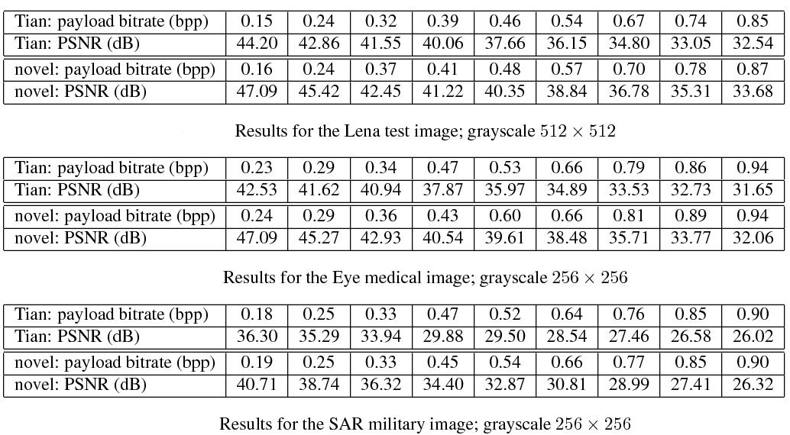
Results: Test, Medical and Military

Slide 20
Conclusions
Novel scheme applies companding technique to Tian scheme
results in sparser location maps more capacity for payload
Results show that the novel scheme outperforms the Tian scheme
for similar PSNRs, the novel scheme returns much higher payload capacities

Slide 21
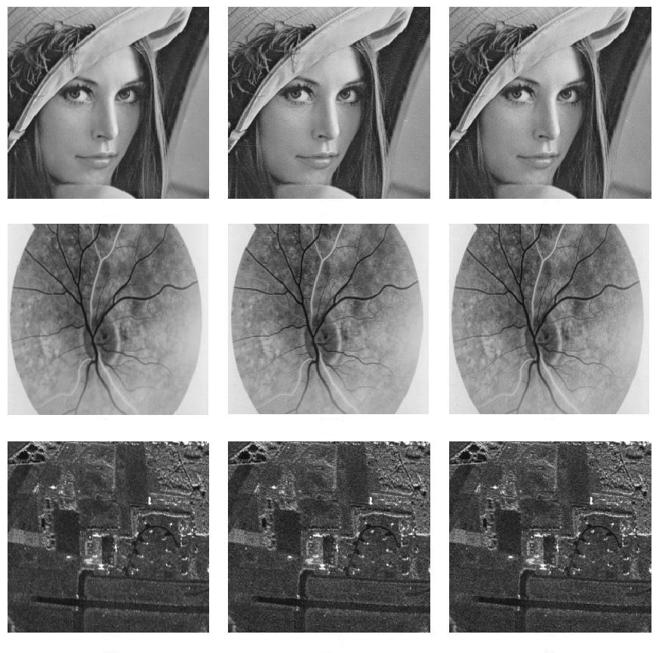
Sample Images
Original
Tian, 0.38bpp, 40.06dB
Novel, 0.48bpp, 40.35dB
Original
Tian, 0.47bpp, 37.87dB
Novel, 0.66bpp, 38.48dB
Original
Tian, 0.18bpp, 36.30dB
Novel, 0.33bpp, 36.32dB

