Slide 1



www.4i2i.com
www.abdn.ac.uk
Benchmarking Tools For
Fairly Comparing
Watermarking Algorithms
Stewart Fraser and Alastair Allen
IASTED SPPRA, Innsbruck, Austria
Feb. 13-15, 2008
4i2i Communications Ltd. Doig Scott Building, Craibstone Estate, Bucksburn, Aberdeen, AB21 9YA Scotland UK Tel: +44 (0) 1224 712844 Fax: +44 (0) 1224 714413 www.4i2i.com
US Office: 226 Airport Parkway, Suite 470 San Jose, CA 95110 USA Tel: (408) 467 5088 Fax: (408) 436 5524

Slide 2
Background
Looking at Digital Image Watermarking
Many published watermarking algorithms
  No two algorithms are identical, they can operate in different domains using completely different insertion methods (some with ECC)
Get algorithms from the web
Code algorithms myself
But which algorithm is the best? How can I measure which algorithm is best?
Solution: Benchmarking tools.

Slide 3
Introduction:
Watermarking Issues
Many issues to consider when watermarking
  Type of host image
  Length and type of watermark
  Parameters used (e.g. Embedding strength)
  Attacks likely to be suffered
How to compare different watermarking systems?
  Different parameters (e.g. JPEG quality factor, window size, wavelet levels, embedding strength)
  For example, embedding strength of 5 may be strong in one algorithm and weak in another

Slide 4
Summary of the
Problem
WM algorithm 1
- spatial domain
- block skip thresh?
- grids (what size?)
WM algorithm 2
- DCT domain
- JPEG value?
- block size?
How to compare
these algorithms
fairly?
WM algorithm 3
- wavelet domain
- wavelet levels?
- window size?
Blind. Copyright protection. Binary payload. Signal proc. attacks

Slide 5






The Watermarking Algorithms
Bruyndonckx
  Spatial domain
  Non-overlapping 8x8 blocks
  Perceptual calculations performed in blocks to classify pixels into zones of homogeneous luminance
  One watermark bit embedded in the relationship between mean values in these zones of homogeneous luminance
      Koch
    DCT
    Non-overlapping 8x8 blocks
    2 Random DCT coefficients (mid frequency)
    Relationship between 2 DCT coeffs altered to embed watermark bit
  Xie
    Wavelet domain (LL sub-band)
    Non-overlapping 1x3 window
    Median of window quantised to embed watermark bit

Slide 6
Adding Error Correcting Codes
Message Generation
Message Generation
Watermark = ECC + Message
(ECC = BCH)
Message Insertion
Watermark Insertion
ATTACK
(JPEG)
Watermark Recovery
Message Recovery
ECC Decode Message
Message Comparison
Message Comparison
Message (no ECC)
Message + ECC
Watermark

Slide 7
The Benchmarking Tools
Watson Metric
  Uses the Human Visual System (HVS) to rate the quality of a processed digital image compared to the unprocessed original (fair watermark insertion)
Normalised Correlation (NC)
  Gives a quantitative of measure between the embedded and recovered watermarks (measures watermark similarity)
Probability of false alarm calculation (Pfp)
  Computes the probability that an image that was NOT watermarked is flagged as being marked (detector thresholds for different message lengths)
Receiver Operating Characteristic (ROC) analysis
  Uses a continuously varying threshold value to evaluate the detector performance (measures reliability)

Slide 8
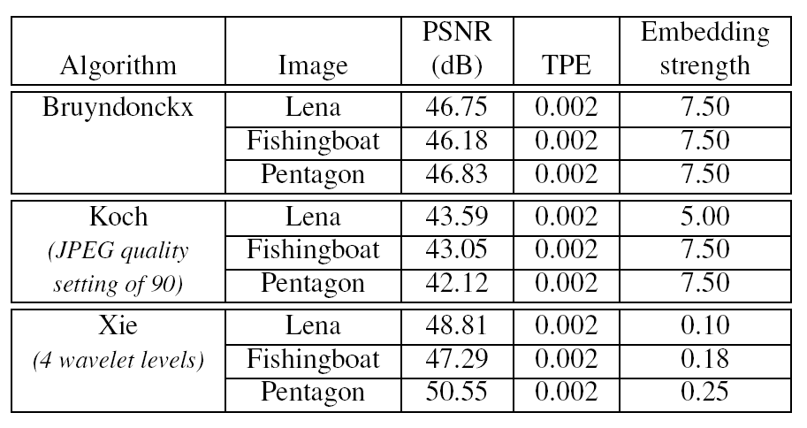
Visual Quality
Diff.
Same
Diff.
Table 1: Visual Quality of Images Set Equal Using
The Watson Metric

Slide 9
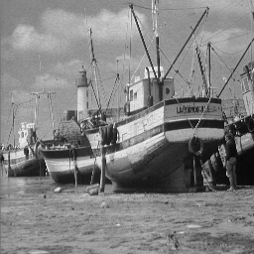

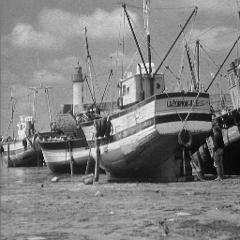
Original
Bruyndonckx
Koch
Xie

Slide 10
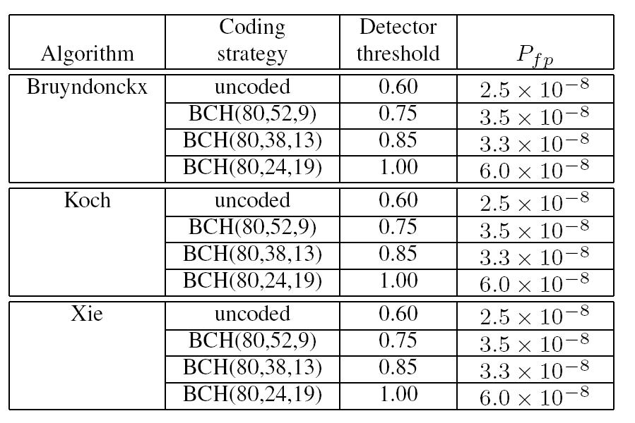
Table 2: Different Detector Thresholds for Different Message Lengths
Different message lengths require different detector thresholds

Slide 11
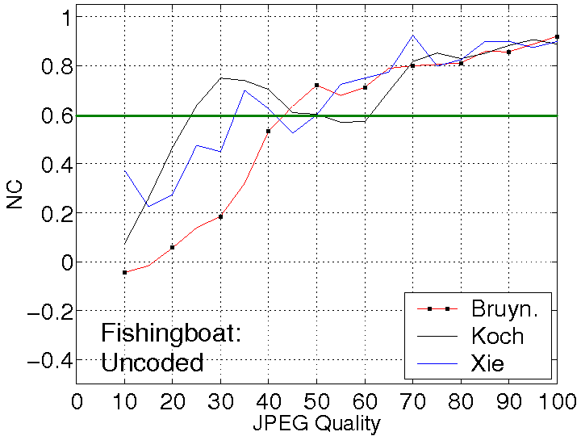
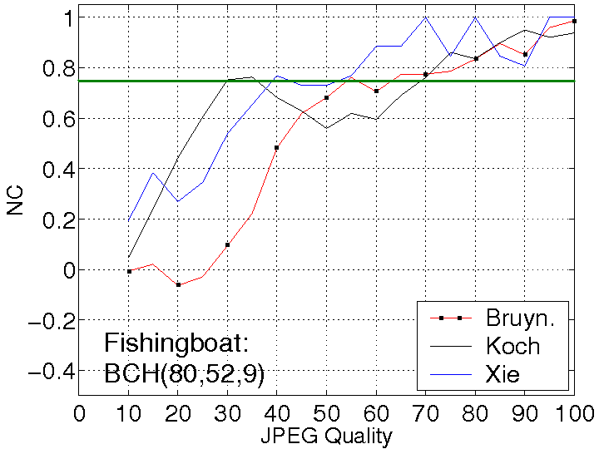
Results
JPEG attacks from quality 10% to 100% in steps of 5%
Each JPEG attack run 50 times and averaged
Different binary watermarks and different seeds each run
Total of 950 runs for each watermark / ECC combination
BCH (watermark length, message length, correct errors)

Slide 12
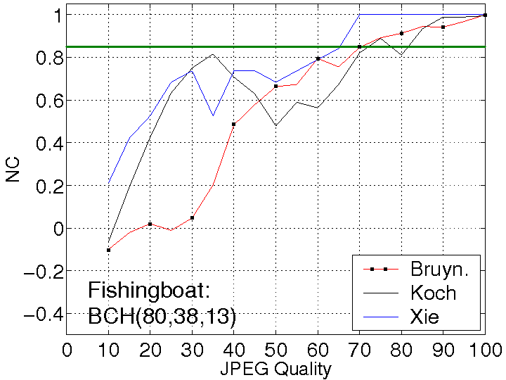
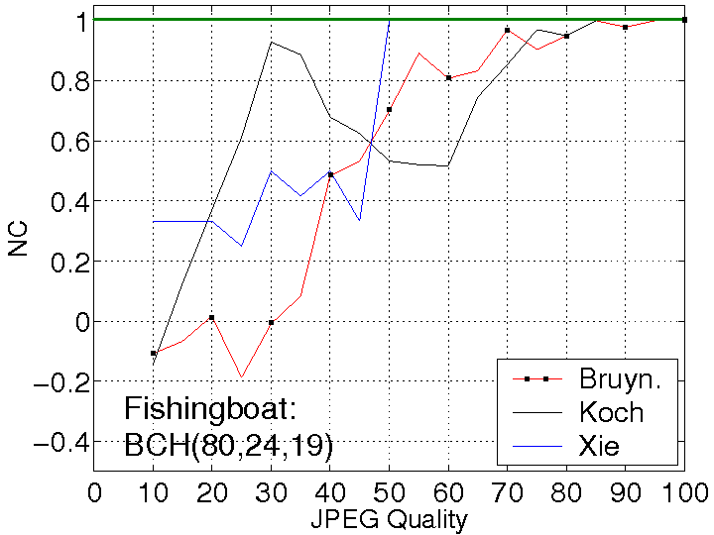
Results
  In general, as more ECC added, worse robustness
  Worse robustness, but higher NC values, an apparent increase in robustness
  Embedding strength (TPE of 0.002) and image specific!

Slide 13
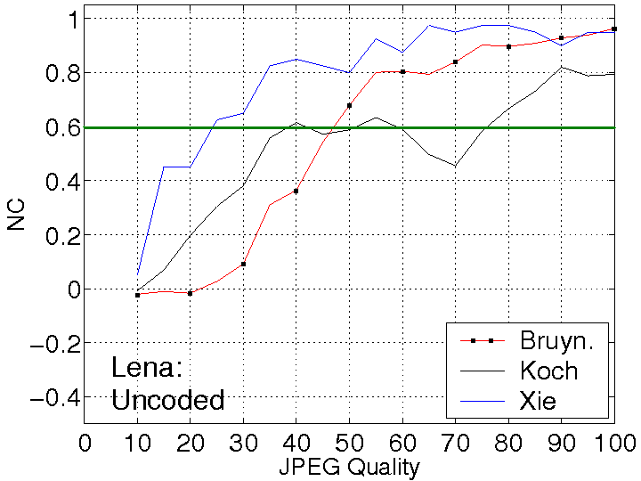
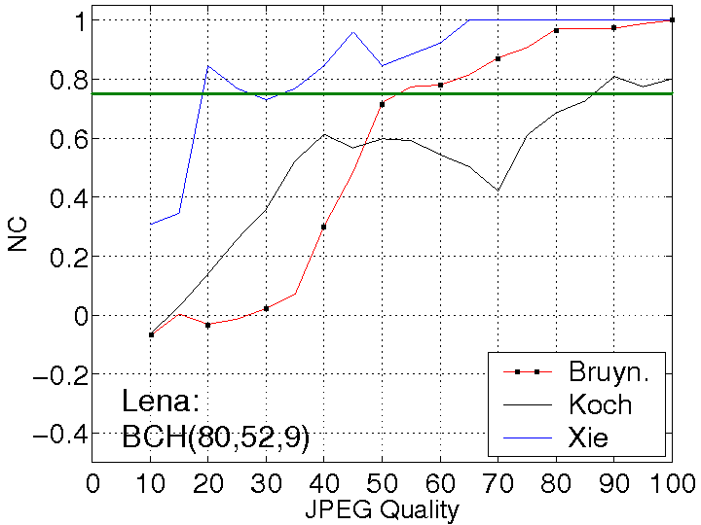
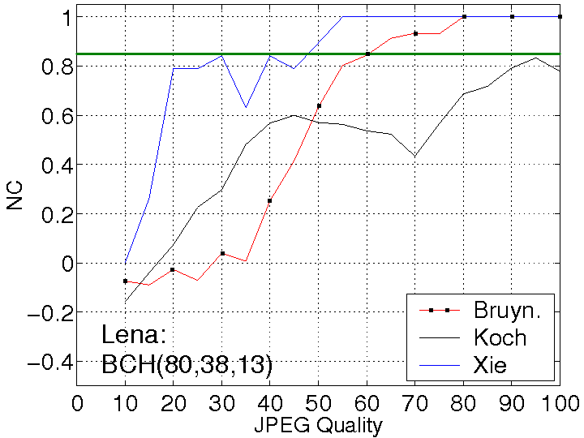
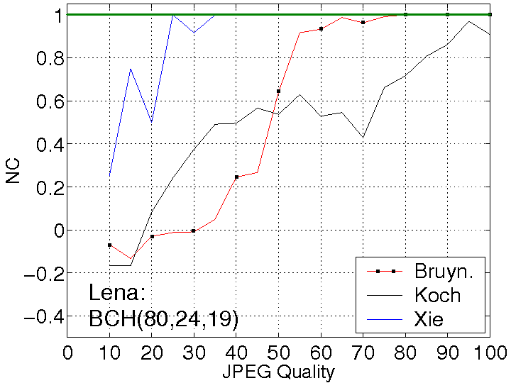
Results: Lena

Slide 14
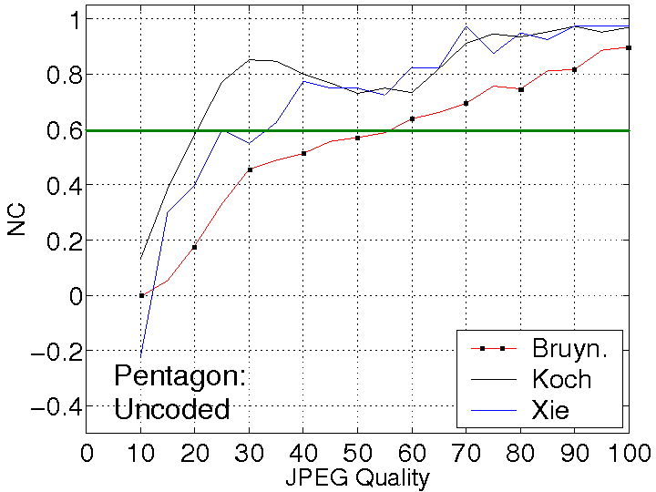
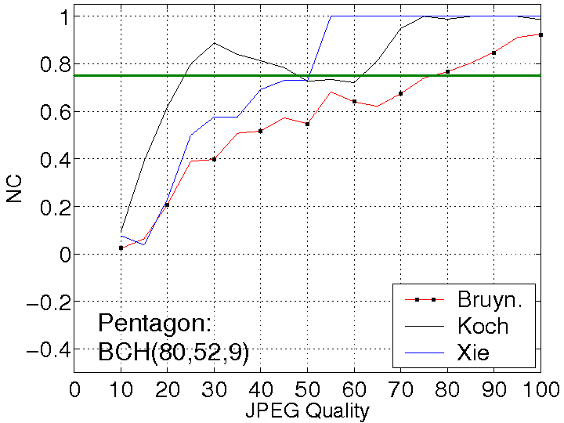
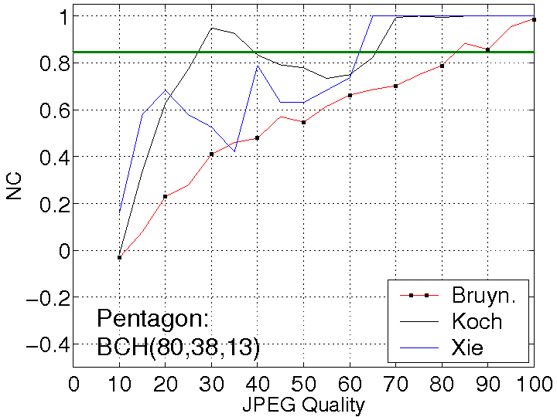
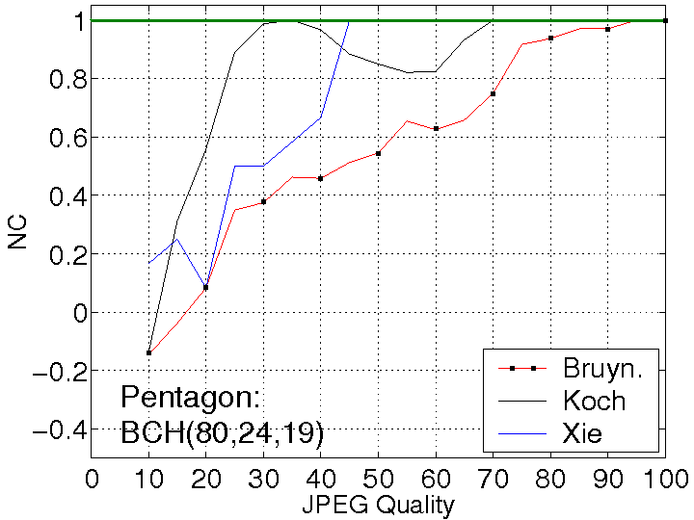
Results: Pentagon

Slide 15
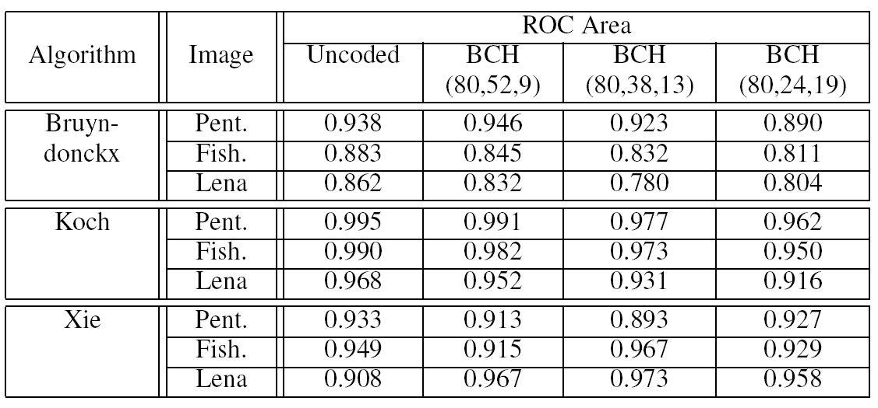
ROC curves
Table 3: Area Under ROC Curves
All systems reliable as areas under ROC curves closer to 1.0 than to 0.5

Slide 16
Conclusions
Application of benchmarking tools
  Watson Metric, NC, Pfp, ROC
  Applied to three different images with and without ECCs
  From graphs, appeared to be an increase in robustness
  But using fair benchmarking tools, it was shown that there was a decrease in robustness
This work formed part of a bigger project
  More images, more attacks, more ECCs, bigger messages / watermarks
  Webpage: www.abdn.ac.uk/~eng565

Slide 17
Caveat
This work focuses on:
  Blind watermarking for copyright protection
    not tamper proofing nor reversible watermarking
  Binary payloads
    not 1-bit yes/no watermarks
  Signal processing attacks
    not geometrical attacks
    assumes geometrical attacks have been corrected

Slide 18
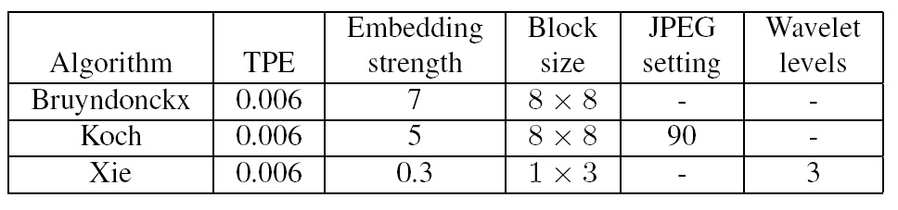
Visual Quality
Diff
Same
Table 4: Visual Quality of Lena (320)

Slide 19




WM
Length
320
Original
Bruyndonckx
Koch
Xie

Slide 20
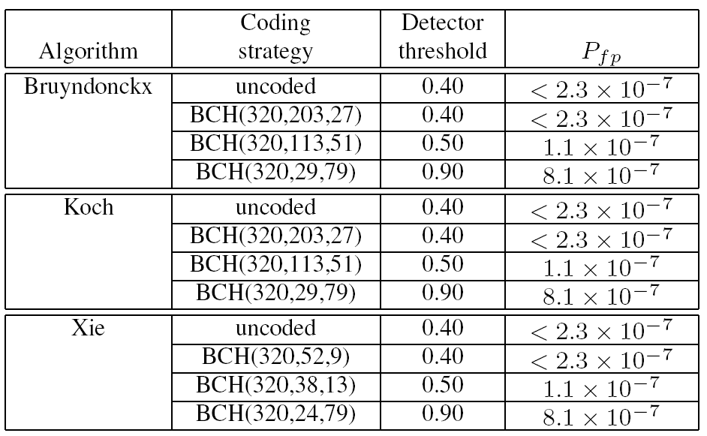
Table 5: Different Detector Thresholds for Different Message Lengths (320)

Slide 21
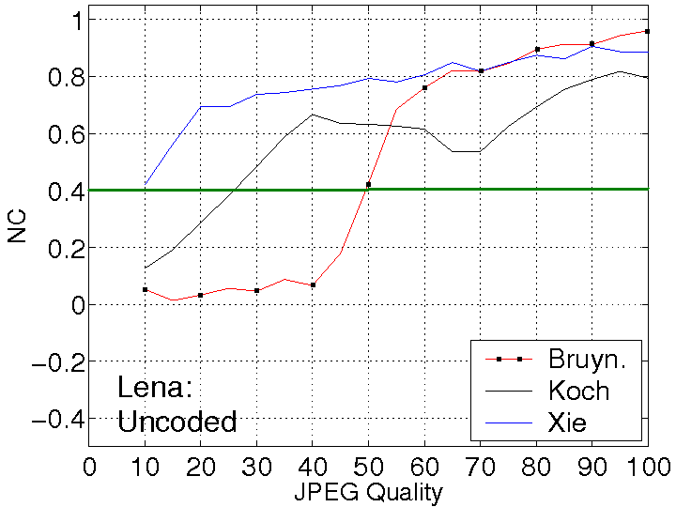
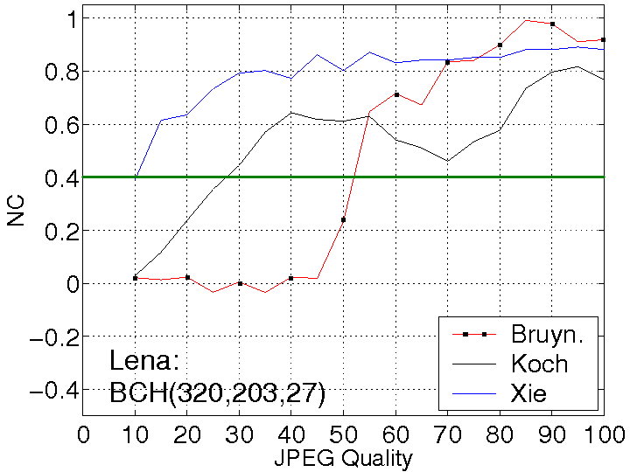
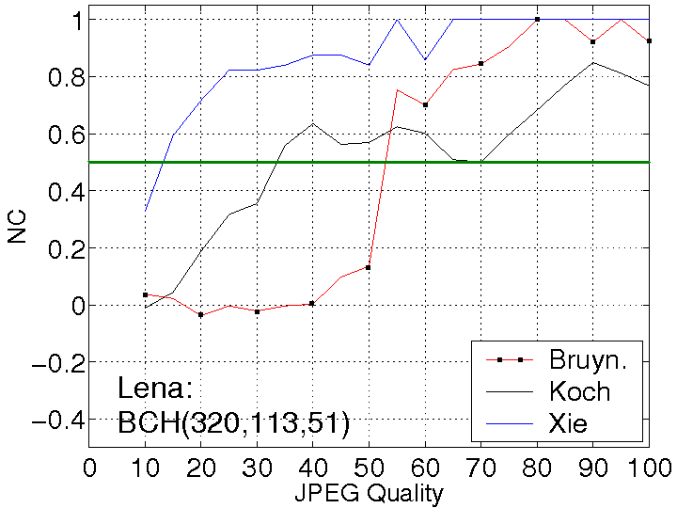
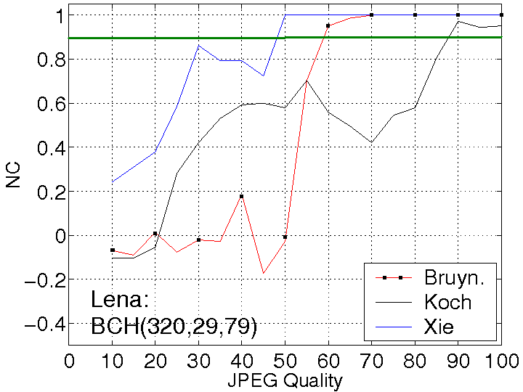
Results: Lena (320)

Slide 22
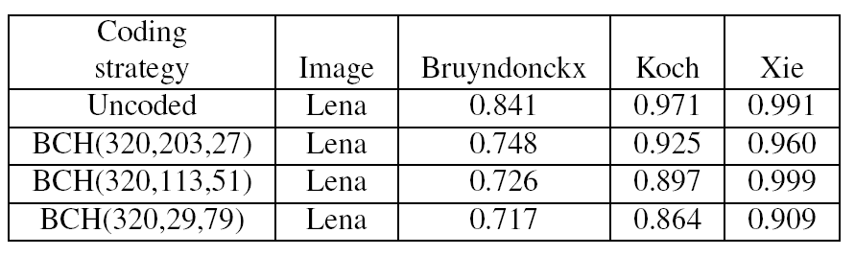
Table 6: Area Under ROC curves (320)

Slide 23
Watson Metric
  TPE: Total Perceptual Error.
  HVS: Human Visual System
  Better than pixel based PSNR
  DCT based.
  TPE is a function of:
    Contrast sensitivity
      Total luminance of display (background + image)
      Visibility of DCT basis functions as function of luminance
      Verified via substantial subjective tests
    Luminance masking
      Visual threshold increases with luminance (increase watermark in bright areas)
    Contrast masking
      Visibility of one pattern is reduced in the presence of another patter (hide watermark in hetrogenous areas)

Slide 24
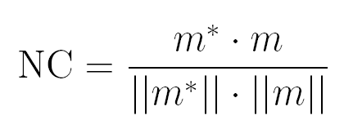


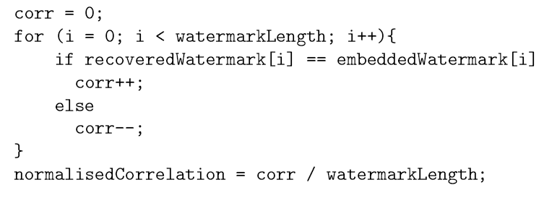
Normalised Correlation (NC)
m = original watermark
m* = recovered watermark
Convert unipolar vectors
to bipolar vectors
Code snippet

Slide 25
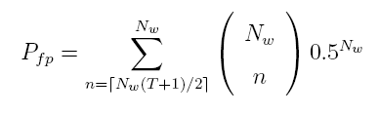
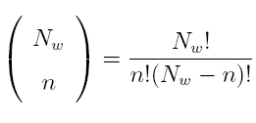
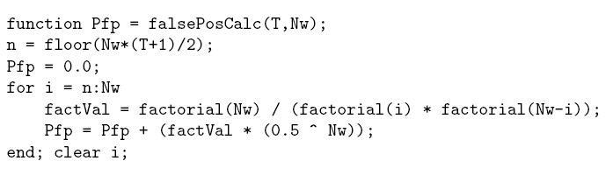
Probability of false alarm (Pfp)
What is the probability of randomly generating a vector that
is similar enough to the watermark?
Based on binomial coefficients (Pascal's Triangle):
Nw = message length, T = chosen detector threshold
Code snippet

Slide 26
ROC Curves
Estimate the influence of threshold selection
Calculating ROC curves experimentally
  Feed detector with lots of original images (no watermark). Store results in C0
  Feed detector with many watermarked images. Store results in C1
  Chose some threshold values (T) between min(C0) and max(C1). For each T, count:
    FPF = C0 > T (False Positive Fraction, Pfp)
    TPF = C1 > T (True Positive Fraction, Pp)
    Plot TPF (y-axis) against FPF (x-axis)

Slide 27
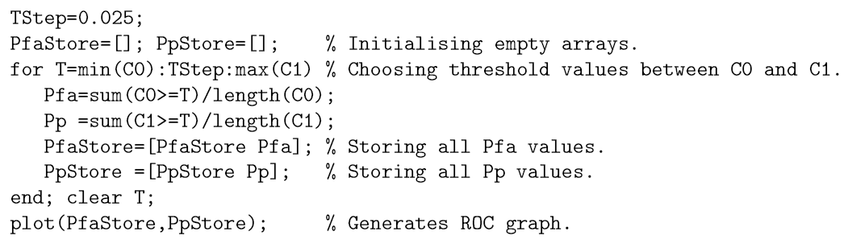
ROC Curves
Code snippet
Threshold step
FPF
TPF

Slide 28
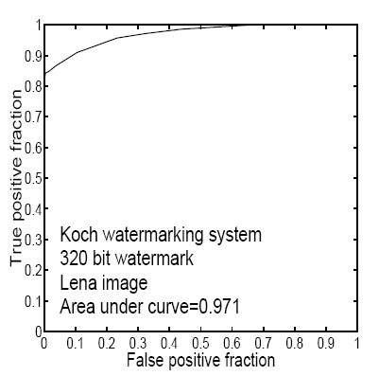
ROC Curves
Ideal detector:
Area under curve = 1.0
Random detector:
Area under curve = 0.5

Slide 29
ROC curves
Amount
Threshold
Non
watermarked
images
Watermarked
images
True
Positive
NC
False Positive

Slide 30
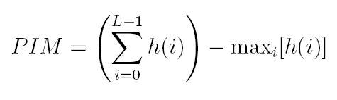
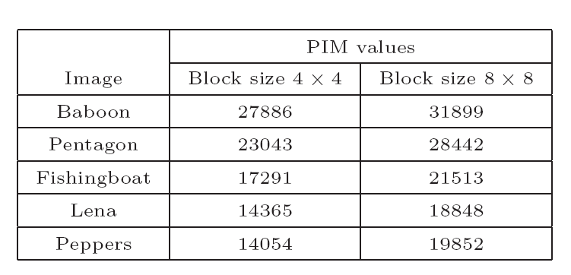
Image Specific:
Picture Information Measure (PIM)
  Measures the complexity of an image
  Non-overlapping 4x4 and 8x8 blocks
  The higher the PIM value, the more heterogeneous an image is
L = number of gray levels in a block
h(i) = histogram for grey level i in a block
  Bruyndonckx and Xie perform best in smooth images (sub-block mean values and wavelet LL subband)
  Koch performs best in busy images

