Slide 1
A Speckle Reduction Algorithm Using The À Trous Wavelet Transform
by
Stewart I. Fraser and Alastair R. Allen
Department of Engineering,
University of Aberdeen,
Scotland, UK

Slide 2
Introduction
Speckle noise.
Speckle reduction using the Orthogonal Discrete Wavelet Transform (ODWT).
Speckle reduction using the À Trous WT.
Quantitative filter results.
Conclusions.

Slide 3
Speckle Noise
Interference of coherent light/waves.
Ultrasonic imaging, holography and radar.
‘Blobs’ of different shape, size and position.
Engineers regard speckle as form of noise.
Speckle noise is multiplicative in nature.
Ultrasonic
Transducer
Tx and Rx
Ultrasonic waves
Rough surface

Slide 4
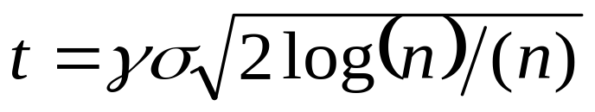
Speckle Reduction Using the ODWT
Noisy
Image
Log|.|
ODWT
Thresh
Inverse
ODWT
Exp|.|
Clean
Image
Calc.
Thresh
Apply
Thresh
• Log transform, speckle to additive Gaussian noise.
• Donoho’s optimal threshold calculation:
• Threshold applied globally to all coefficients.

Slide 5
Threshold Application
Soft-thresholding,
threshold = 0.3
Hard-thresholding,
threshold = 0.3
0.5
0.5
0.3
0.2
Thresholded Pixel Value
Thresholded Pixel Value
0
0
-0.2
-0.3
-0.5
-0.5
-0.5
-0.3
0
0.3
0.5
-0.5
-0.3
0
0.3
0.5
Original Pixel Value
Original Pixel Value

Slide 6




De-noised Images
Original
Noisy
Hard
Thresh
Soft
Thresh

Slide 7
The À Trous WT
Input
Image
1st
Wavelet
Level
• No decimation performed.
• B₃-spline scaling function
used to smooth image.
• Sampling distance of the
scaling function increases.
• Reconstruction:
Residual+WL4+WL3+
WL2+WL1 = Input Image.
-
1st
Approx.
2nd
Wavelet
Level
-
2nd
Approx.
3rd
Wavelet
Level
-
3rd
Approx.
4th
Wavelet
Level
-
4th
Approx.:
Residual

Slide 8
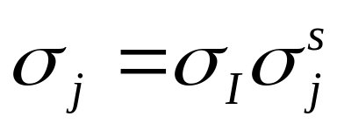
Noise in the À Trous Wavelet Domain
No decimation and smoothing performed.
Noise measure within wavelet levels decreases as analysis becomes coarser.
Global threshold inappropriate.
Threshold for each wavelet level j required.
Calculated by passing simulated noise image (STD = 1) through À Trous WT:

Slide 9
Estimate The
Noise STD
At This
Level
Threshold
Wavelet
Coefficients
Measure
Removed
Noise STD
Is The
Removed
Noise STD Within
The Tolerance Of
The Estimated
Noise
STD
Start
Thresholding
Wavelet Level
Increment
Threshold
Value
No
Iterative Thresholding
Flow Diagram
Yes
Found Threshold
Value For This Level

Slide 10
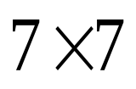
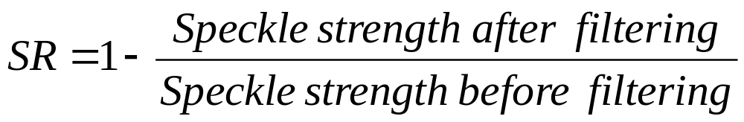
Quantifying Speckle Reduction
Manually select a box within a homogeneous region in the test image.
Speckle strength defined as STD/mean ratio.
Speckle Reduction (SR) given by:

Slide 11
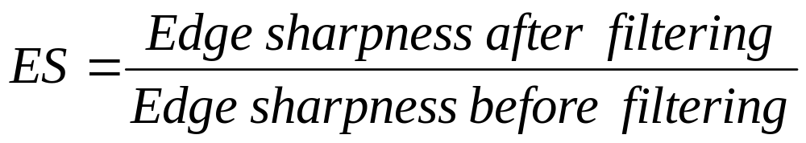
Quantifying Edge Sharpness
Manually select a box about an edge in the test image.
Calculate the mean values either side of the edge.
Edge sharpness (ES) defined as the absolute difference between means; quantified by:

Slide 12
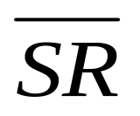
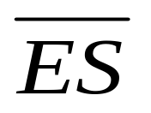
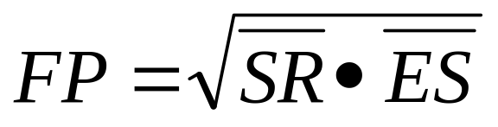
Quantifying Filter Performance
Measure SR and ES three times in each image.
Average each, giving and .
Both and will be bounded to range 0-1.
Hence, the overall ability of a filter to reduce speckle and preserve edges can be quantified via the filter performance (FP):

Slide 13
Parameters for Tested Filters
Median filter parameters chosen to maximize the image smoothing.
Lee and wavelet filter parameters chosen to give de-noised images that are visually clean and unblurred.
De-noised images using Lee and wavelet filters have identical PSNR values.

Slide 14
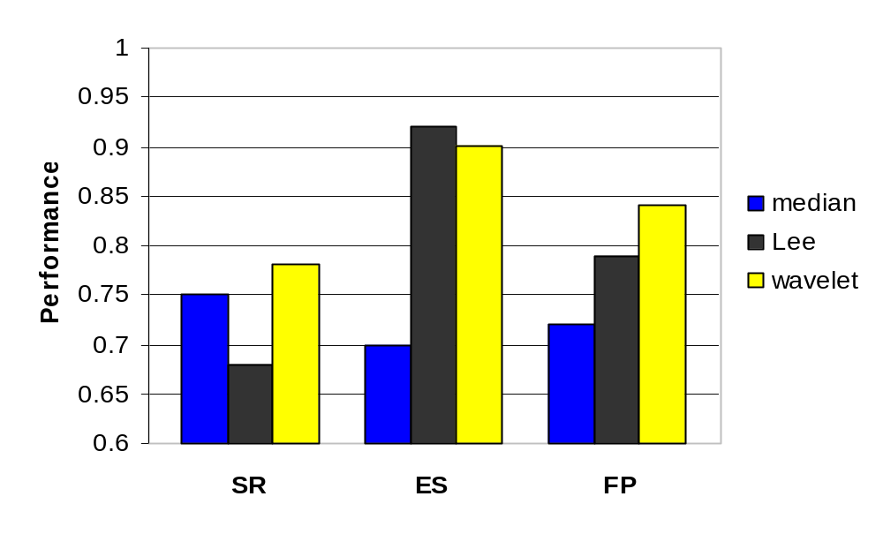
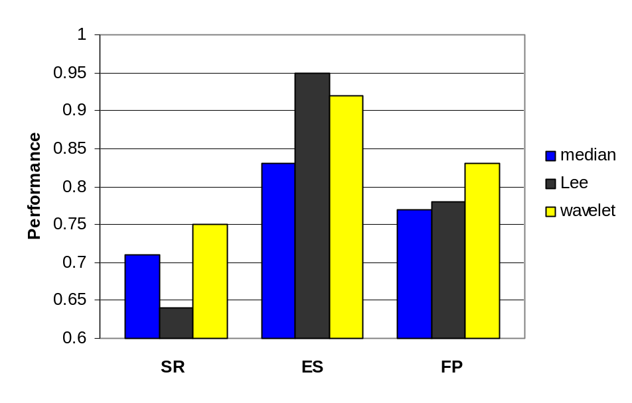
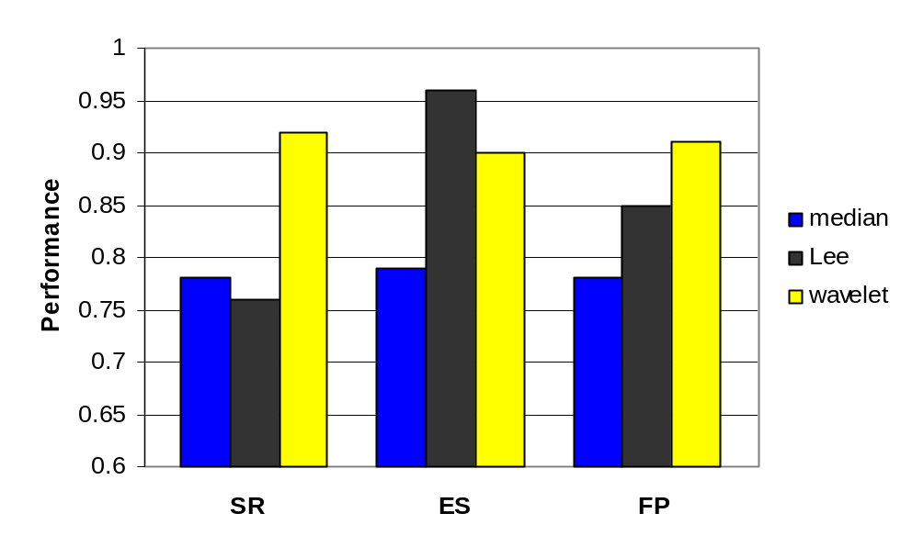
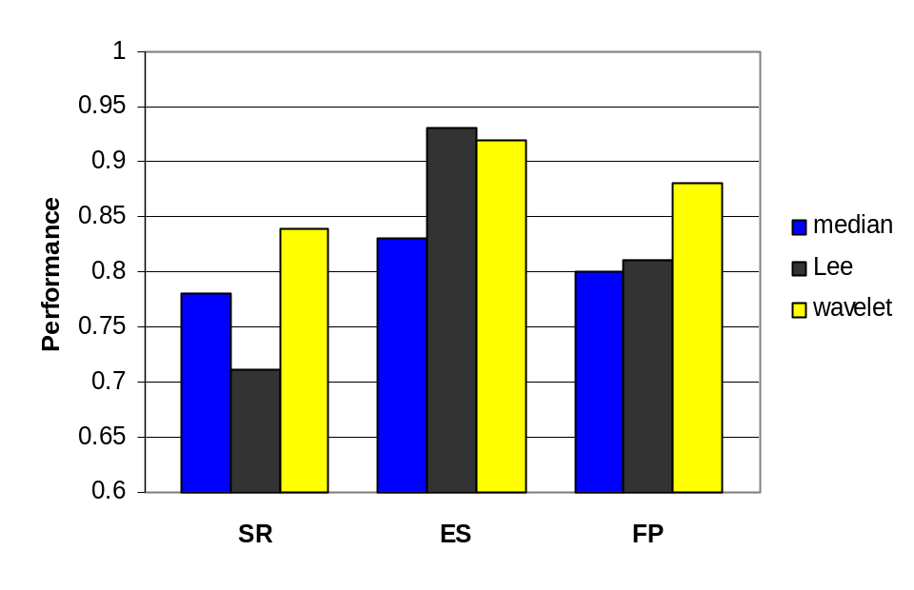
Quantitative Results
Lena
Peppers
F16
Goldhill

Slide 15
Conclusions
An iterative filtering algorithm for the shift-invariant À Trous WT introduced.
Filter performance metric established.
Overall, the introduced filter algorithm was shown to outperform the Lee and median filters.

Slide 16
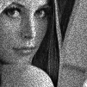

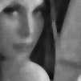
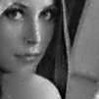
De-noised Lena Images
Original
Lena
Lee
Filter
Median
Filter
Wavelet
Filter

Slide 17
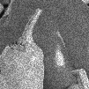

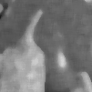
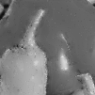
De-noised Pepper Images
Original
Peppers
Lee
Filter
Median
Filter
Wavelet
Filter

Slide 18
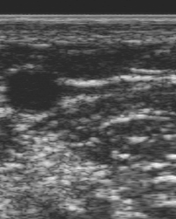
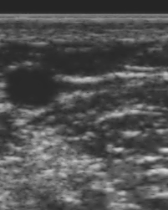
De-noised Ultrasound Images
Original
Wavelet Filter

Slide 19
Approximation (With Holes)
-4
-3
-2
-1
0
1
2
3
4
Input
Signal
h(0)
h(-1)
h(1)
h(-2)
h(2)
-4
-3
-2
-1
0
1
2
3
4
First
Approximation
h(-2)
h(-1)
h(0)
h(1)
h(2)
-4
-3
-2
-1
0
1
2
3
4
Second
Approximation

Slide 20
Edge Sharpness
7
E
D
7
G
E
Calculate Mean
Calculate Mean

Slide 21
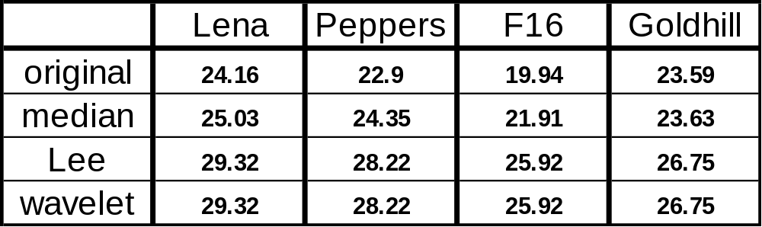
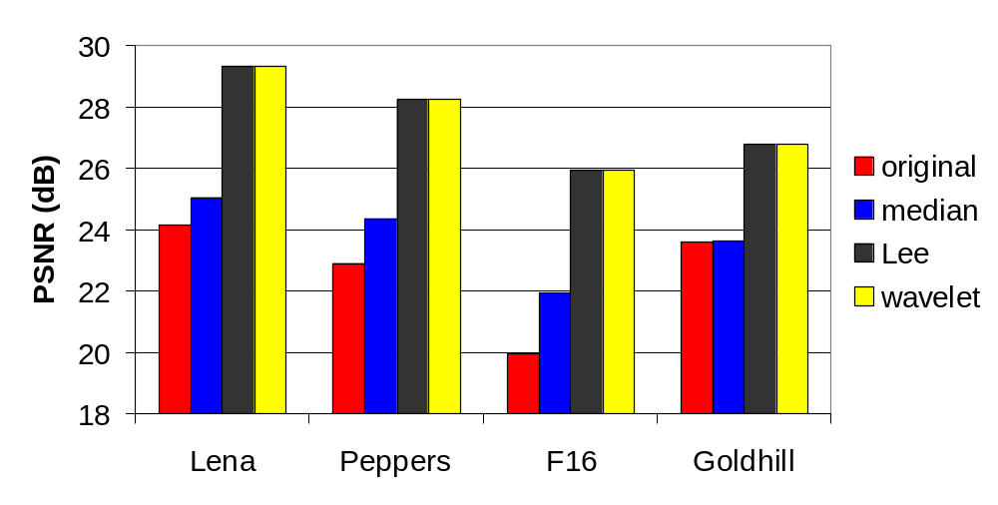
PSNR Values for the Images

