Slide 1
Backprophet

Slide 2
General idea
Build a deep learning-based procedure to predict the close value of an asset for the next day (regression). As an example we took the META share.
Scenario:
Once the tradefaire has closed train model using all available data including the last trading day.
Act based on the prediction once the tradfaire has reopened:
if an increase is predicted buy, if a decrease is predicted sell the asset.
Prerequisite:
Training of the procedure needs to be finished within the 1 hour in which the US tradefaire is closed.

Slide 3
Our input data (list of features)
Data was crawled from yfinance.com
DATE
SPX_CLOSE
SPX_VOLUME
DJI_CLOSE
DJI_VOLUME
META_CLOSE
META_VOLUME
GPRD
FEARANDGREED
SPX: S&P 500
DJI: Dow Jones Industrial
GPRD: Geopolitical Risk Index (GPR) Daily
FEARANDGREED: measures general mood at the stock exchange
Optional our code also contains:
Moving average of values: 5 (week), 21 (month), 50 (traditionally) and 200 (long-term)

Slide 4
Data preprocessing
Drop dublicate rows
Missing values were filled with previous traiding days
Remove data point including NaN values
Lookback periode: 60 days

Slide 5
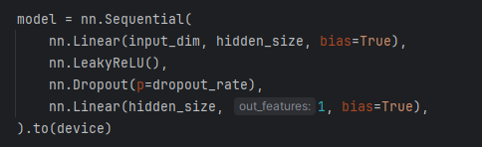
Applied models
First step: scale data using MinMaxScaler
Multilayered Perceptron (MLP)

Slide 6
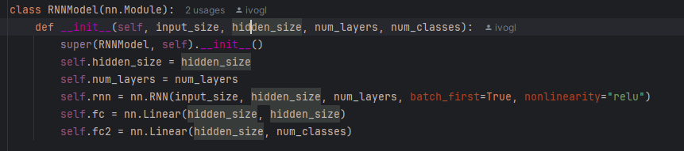
Applied models
First step: scale data using MinMaxScaler
Recurrent Neural Network (RNN)

Slide 7
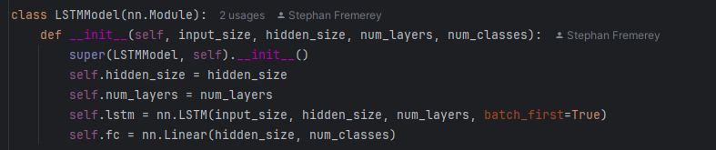
Applied models
First step: scale data using MinMaxScaler
Long short-term memory (LSTM)

Slide 8
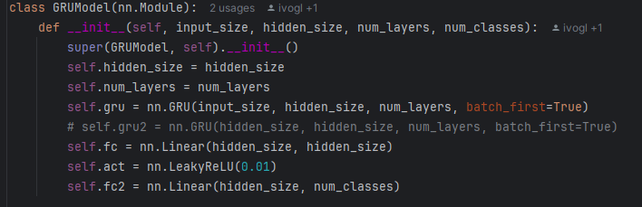
Applied models
First step: scale data using MinMaxScaler
Gated Recurrent Unit (GRU)

Slide 9
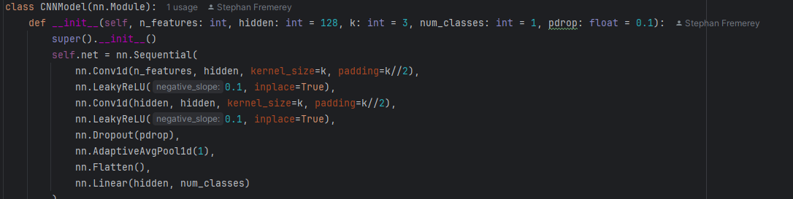
Applied models
First step: scale data using MinMaxScaler
Convolutional Neural Network (CNN)

Slide 10
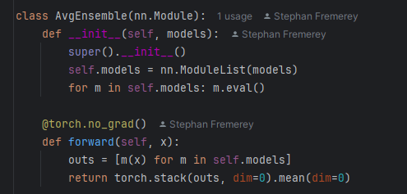
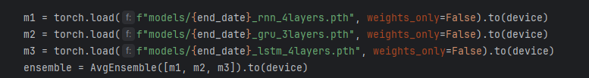
Applied models
First step: scale data using MinMaxScaler
Ensemble Model

Slide 11
Results after training on the entire data set
MLP

Slide 12
Results after training on the entire data set
RNN

Slide 13
Results after training on the entire data set
LSTM

Slide 14
Results after training on the entire data set
GRU

Slide 15
Results after training on the entire data set
CNN

Slide 16
Results after training on the entire data set
Ensemble

Slide 17
Evaluation with 1 year historical data
MLP

Slide 18
Evaluation with 1 year historical data
RNN

Slide 19
Evaluation with 1 year historical data
LSTM

Slide 20
Evaluation with 1 year historical data
GRU

Slide 21
Evaluation with 1 year historical data
CNN

Slide 22
Evaluation with 1 year historical data
Ensemble

