Slide 1
Backprophet
A deep learning-based tool for stocks prediction
Presented by: Ivo Glück, Stephan Fremerey

Slide 2
General idea
Build a deep learning-based procedure to predict the close value of an asset for the next day (regression). As an example, we took the META share.
Scenario:
Once the tradefaire has closed and data are available (about 0:00 CET), train model using all available data including the last trading day.
Act based on the prediction once the tradfaire has reopened:
if an increase is predicted buy, if a decrease is predicted sell the asset.
Prerequisite:
At best, training needs to be finished within the 1 hour in which indices like the S&P 500 or the DJI are not tradeable.

Slide 3
Our input data (multivariate analysis)
Data was crawled from finance.yahoo.com using Python yfinance package (18.09.2020 – 17.09.2025)
List of features:
DATE
SPX_CLOSE
SPX_VOLUME
DJI_CLOSE
DJI_VOLUME
META_CLOSE
META_VOLUME
GPRD
FEARANDGREED
SPX: S&P 500
DJI: Dow Jones Industrial
GPRD: Geopolitical Risk Index (GPR) Daily
FEARANDGREED: measures general mood at the stock exchange
Optionally our code also contains:
Moving average of values: 5 (week), 21 (month), 50 (traditionally) and 200 (long-term)

Slide 4
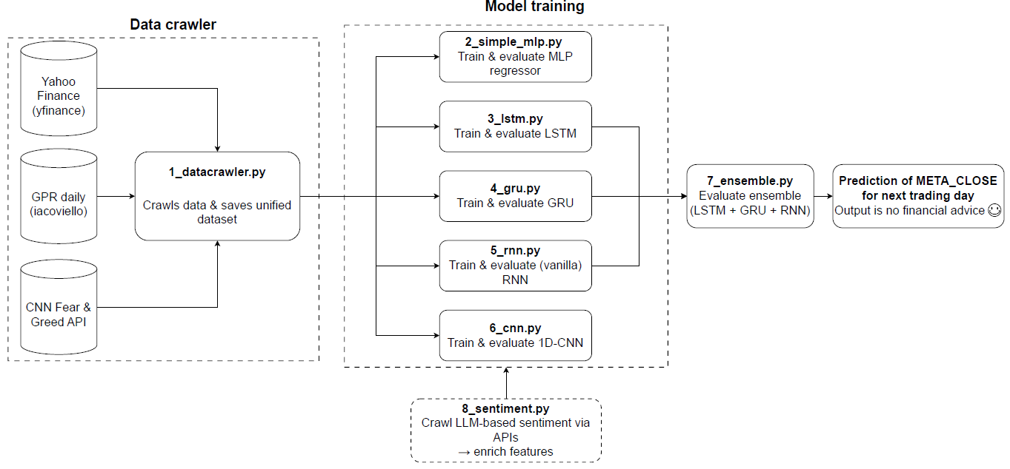
General structure

Slide 5
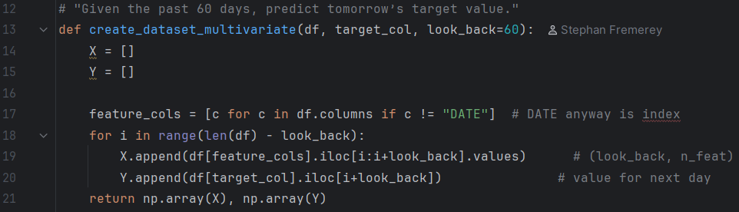
Data preprocessing
Drop dublicate rows
Missing values were filled with previous trading days
Remove data point including NaN values
Lookback period: 60 days

Slide 6
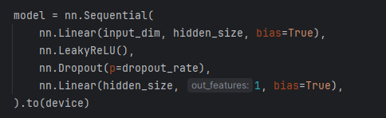
Applied models
First step: scale data using MinMaxScaler
Multilayered Perceptron (MLP)

Slide 7
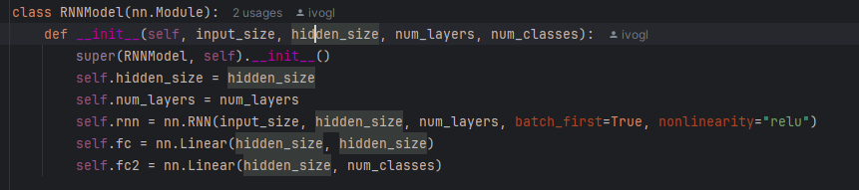
Applied models
First step: scale data using MinMaxScaler
Recurrent Neural Network (RNN)

Slide 8
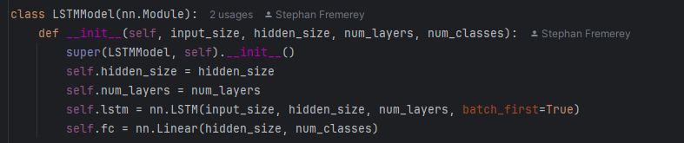
Applied models
First step: scale data using MinMaxScaler
Long short-term memory (LSTM)

Slide 9
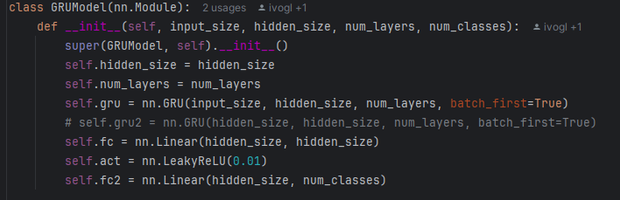
Applied models
First step: scale data using MinMaxScaler
Gated Recurrent Unit (GRU)

Slide 10
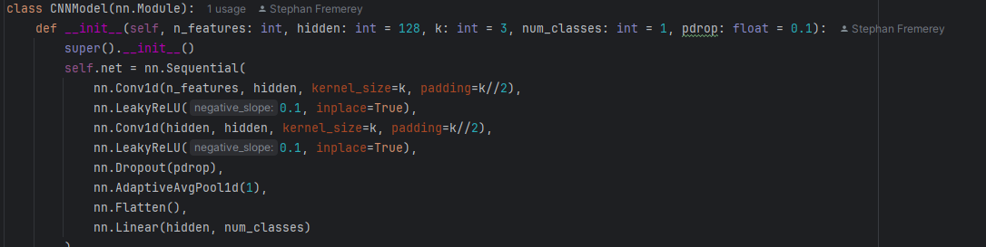
Applied models
First step: scale data using MinMaxScaler
Convolutional Neural Network (CNN)

Slide 11
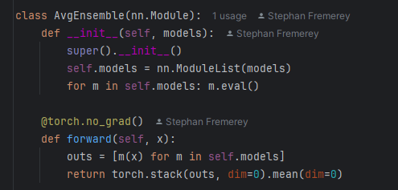
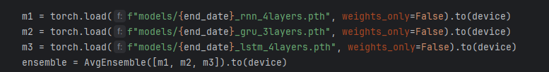
Applied models
First step: scale data using MinMaxScaler
Ensemble Model based on RNN, GRU and LSTM (3 top-performing models)

Slide 12
Results after training on the entire data set
MLP

Slide 13
Results after training on the entire data set
RNN
Incl.
dropout

Slide 14
Results after training on the entire data set
LSTM

Slide 15
Results after training on the entire data set
GRU

Slide 16
Results after training on the entire data set
CNN

Slide 17
Results after training on the entire data set
Ensemble

Slide 18
Would a shorter training time period for training also be sufficient?

Slide 19
Evaluation with 1 year historical data
MLP

Slide 20
Evaluation with 1 year historical data
RNN

Slide 21
Evaluation with 1 year historical data
LSTM

Slide 22
Evaluation with 1 year historical data
GRU

Slide 23
Evaluation with 1 year historical data
CNN

Slide 24
Evaluation with 1 year historical data
Ensemble

Slide 25
Table from data in plots_5years/results.txt comes here to compare prediction with real-world data from the real closes

Slide 26

Extra: Sentiment analysis
Access APIs of two LLMs to do sentiment analysis on daily basis
Google Gemini („allrounder“)
Perplexity (focused on real-time information)
Prompt: “Please give me an assessment of Meta shares (ISIN: US30303M1027) based on current news within the past 7 days, using at least 6 reputable financial sources. Use sentiment analysis and any major events impacting the stock. Rate on a scale of 1-100 (1 very poor, 100 very good). Return only a single int as the answer. ”
Returns .csv file
Could be integrated for future modelling, if enough data is available

Slide 27
Outlook
Code optimization → Move parts of code used more frequently into class
Generate a confidence measure of prediction by applying dropout when applying the trained model

