Slide 1
Backprophet
A deep learning-based tool for stocks prediction
Presented by: Ivo Glück, Stephan Fremerey

Slide 2
General idea
Build a deep learning-based procedure to predict the close value of an asset for the next day (regression). As an example, we took the META share.
Scenario:
Once the tradefaire has closed and data are available (about 0:00 CET), train model using all available data including the last trading day.
Act based on the prediction once the tradfaire has reopened:
if an increase is predicted buy, if a decrease is predicted sell the asset.
Prerequisite:
At best, training needs to be finished within the 1 hour in which indices like the S&P 500 or the DJI are not tradeable.

Slide 3
Our input data (multivariate analysis)
Data was crawled from finance.yahoo.com using Python yfinance package (18.09.2020 – 17.09.2025)
List of features:
DATE
SPX_CLOSE
SPX_VOLUME
DJI_CLOSE
DJI_VOLUME
META_CLOSE
META_VOLUME
GPRD
FEARANDGREED
SPX: S&P 500
DJI: Dow Jones Industrial
GPRD: Geopolitical Risk Index (GPR) Daily
FEARANDGREED: measures general mood at the stock exchange
Optionally our code also contains:
Moving average of values: 5 (week), 21 (month), 50 (traditionally) and 200 (long-term)

Slide 4
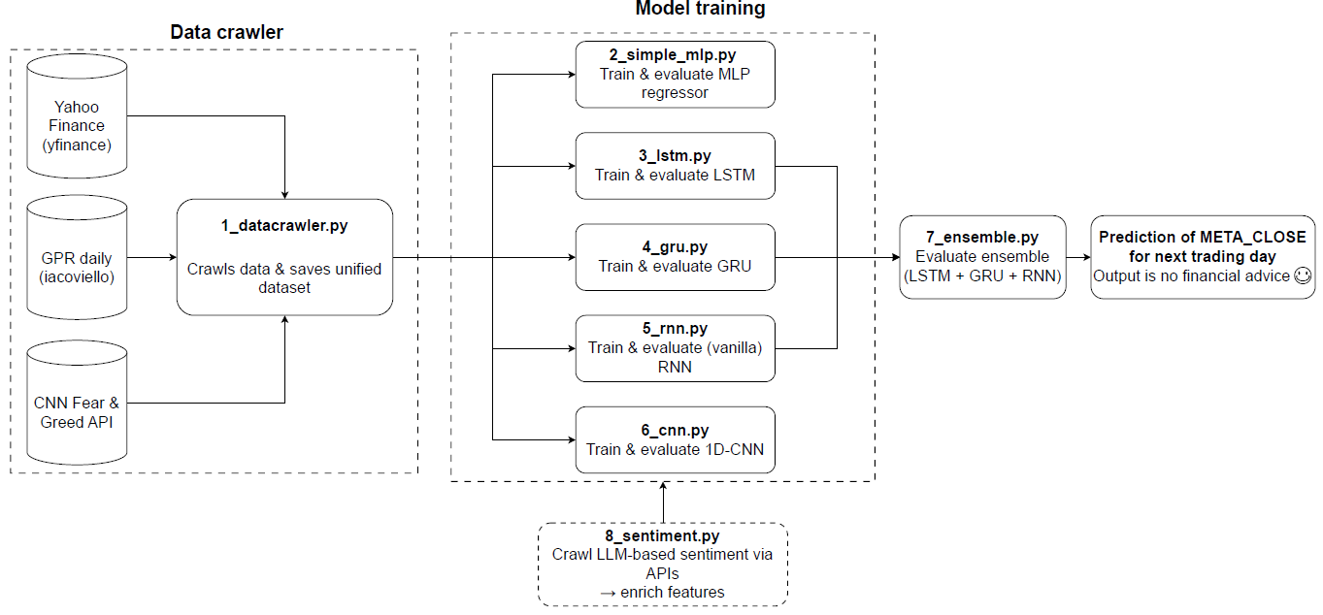
General architecture

Slide 5
Datacrawler – Data preprocessing
Drop duplicate rows
Missing values were filled with previous trading days
Remove data points including NaN values

Slide 6
Applied models – Data preparation
First step: scale data using MinMaxScaler
Second step: lookback
Third step: train/test split (80/20)
Rather for evaluation
In production, probably train on more data

Slide 7
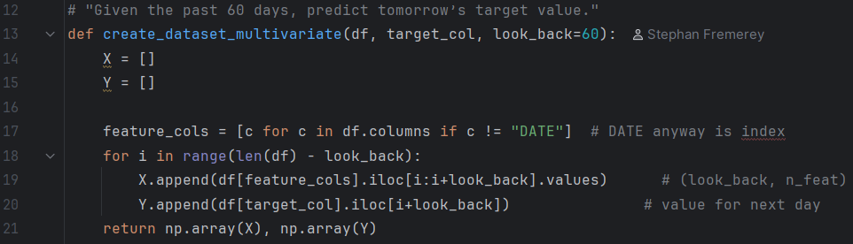
Applied models – Data preparation – lookback
Lookback period: 60 days

Slide 8
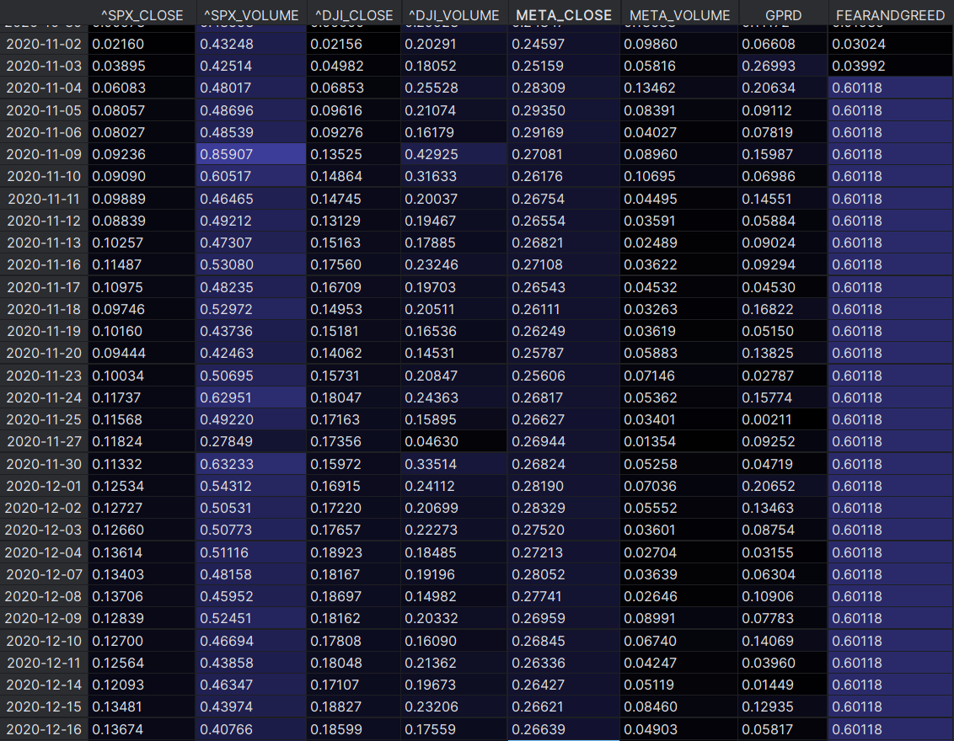
X
(lookback period=60)
Iterate over
whole
scaled data
Y (target)

Slide 9
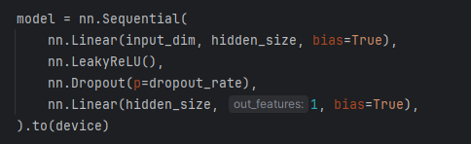
Applied models
Multilayered Perceptron (MLP)
Simple basic version of model, especially if less time for training

Slide 10
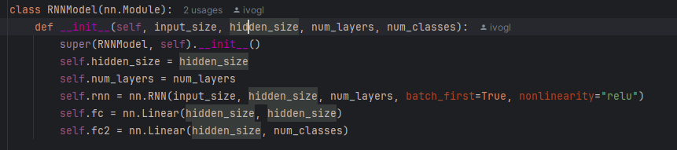
Applied models
Recurrent Neural Network (RNN)

Slide 11
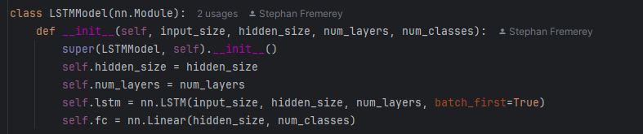
Applied models
Long short-term memory (LSTM)

Slide 12
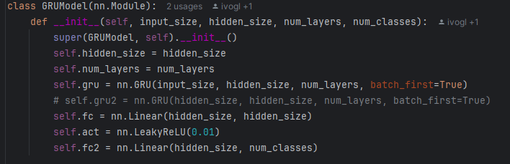
Applied models
Gated Recurrent Unit (GRU)

Slide 13
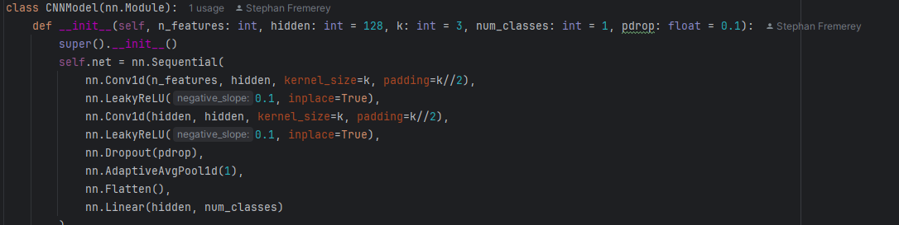
Applied models
Convolutional Neural Network (CNN)

Slide 14
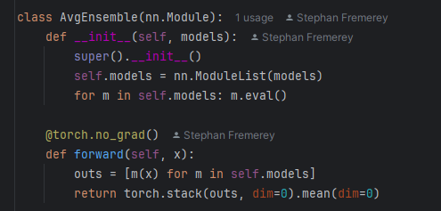
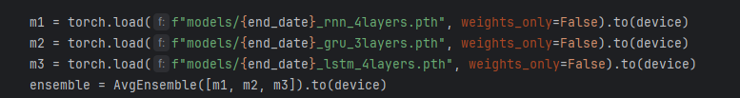
Applied models
Ensemble Model based on RNN, GRU and LSTM (3 top-performing models)

Slide 15
Results after training on the entire data set
MLP

Slide 16
Results after training on the entire data set
RNN

Slide 17
Results after training on the entire data set
RNN
Incl.
dropout

Slide 18
Results after training on the entire data set
LSTM

Slide 19
Results after training on the entire data set
GRU

Slide 20
Results after training on the entire data set
CNN

Slide 21
Results after training on the entire data set
Ensemble (RNN + GRU + LSTM)

Slide 22
Would a shorter training time period for training also be sufficient?

Slide 23
Evaluation with 1 year historical data
MLP

Slide 24
Evaluation with 1 year historical data
RNN

Slide 25
Evaluation with 1 year historical data
LSTM

Slide 26
Evaluation with 1 year historical data
GRU

Slide 27
Evaluation with 1 year historical data
CNN

Slide 28
Evaluation with 1 year historical data
Ensemble (RNN + GRU + LSTM)

Slide 29
Evaluation
Evaluation of model performance on META_CLOSE for a few days
Date | Model | Prediction [USD] | Actual [USD]
2025-09-17 | RNN | 718.32 | 775.72
2025-09-17 | GRU | 768.19
2025-09-17 | LSTM | 755.71
2025-09-17 | Ensemble | 747.41
2025-09-18 | RNN | 724.68 | 780.25
2025-09-18 | GRU | 766.21
2025-09-18 | LSTM | 751.32
2025-09-18 | Ensemble | 747.40
2025-09-19 | RNN | 741.17 | ???
2025-09-19 | GRU | 770.34
2025-09-19 | LSTM | 739.54
2025-09-19 | Ensemble | 750.35

Slide 30

Extra: Sentiment analysis
Access APIs of two LLMs to do sentiment analysis on daily basis
Google Gemini („allrounder“)
Perplexity (focused on real-time information)
Prompt: “Please give me an assessment of Meta shares (ISIN: US30303M1027) based on current news within the past 7 days, using at least 6 reputable financial sources. Use sentiment analysis and any major events impacting the stock. Rate on a scale of 1-100 (1 very poor, 100 very good). Return only a single int as the answer. ”
Returns .csv file
Could be integrated for future modelling, if enough data is available

Slide 31
Conclusion
Which model would we take?
Based on current results: GRU
Simulations based on past data necessary, but not enough time
Was the project successful?
More evaluations and simulations (!) necessary
Trading costs important factor not yet considered
The future will show

Slide 32
Outlook
Code optimization → Move parts of code used more frequently into class
Generate a confidence measure for prediction:
Apply trained model (inference) with dropout → results differ slightly
Use different results to create confidence interval of model
Evaluate with existing models/algorithms (prophet, ETS, ARIMA)
Try shorter training periods, e.g. 180 days, 90 days or even less
Crawl data with increased time resolution, e.g. on hourly base
Evaluate performance of Transformers on data

