Slide 1


Internship
Opportunity @ jFork
Dr. S.R.Mangalwede, CEO, jFork TS

Slide 2
About the Company
Incorporated on 8/8/2022 with an aim to offer diverse set of services that include software development, internship, project guidance, placement coaching and technology training

Slide 3
What is Internship
The position of a student or trainee who works in an organization, sometimes without pay, in order to gain work experience or satisfy requirements for a qualification.

Slide 4
Facets of Internship
Learn industry best practices
SELF LEARNING and TEAM WORK
Learn FRAMEWORKS & PROCESSES to CARRY OUT SOFTWARE PROJECTS

Slide 5
Objectives of Internship
Trial Run - Exposure to Job or Profession
Resume Building – Make your resume appealing
to Employer
Develop contacts – Can help you get a job
Potential Job – If you demonstrate good work ethic
the company may offer employment

Slide 6
Internship @ jFork Technology Services
Programming skills and Coding Standards - Functional and OOPs
Version control Tools – Git or BitBucket
IDEs – intelliJ, Eclipse, NetBeans, VSCode
Build-Tools – Maven and Graddle
Design tools – UML and ER ( Dia, StarUML )
Technologies – WebFramworks, Data Analytics with Python and
ML, IoT, BigData – Spark and Hadoop, tinkerCad
7. Case Study - Project

Slide 7
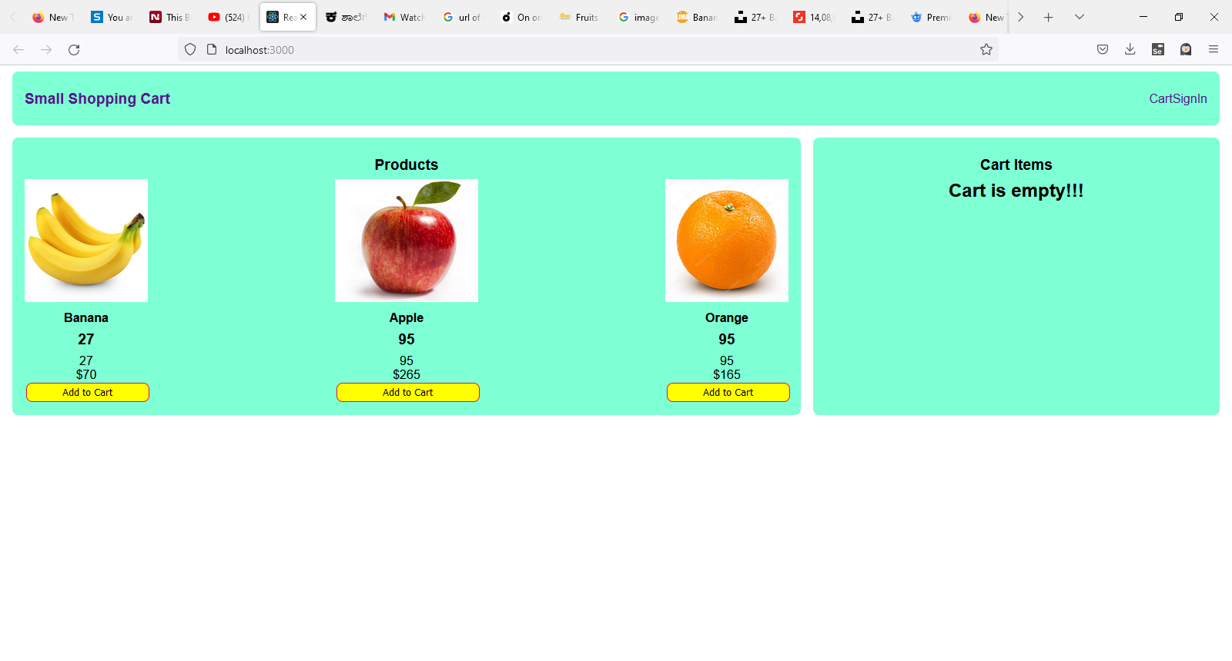

Shopping-Cart using ReactJS
HTML + CSS + JavaScript + ReactJS - Front-End Developer

Slide 8
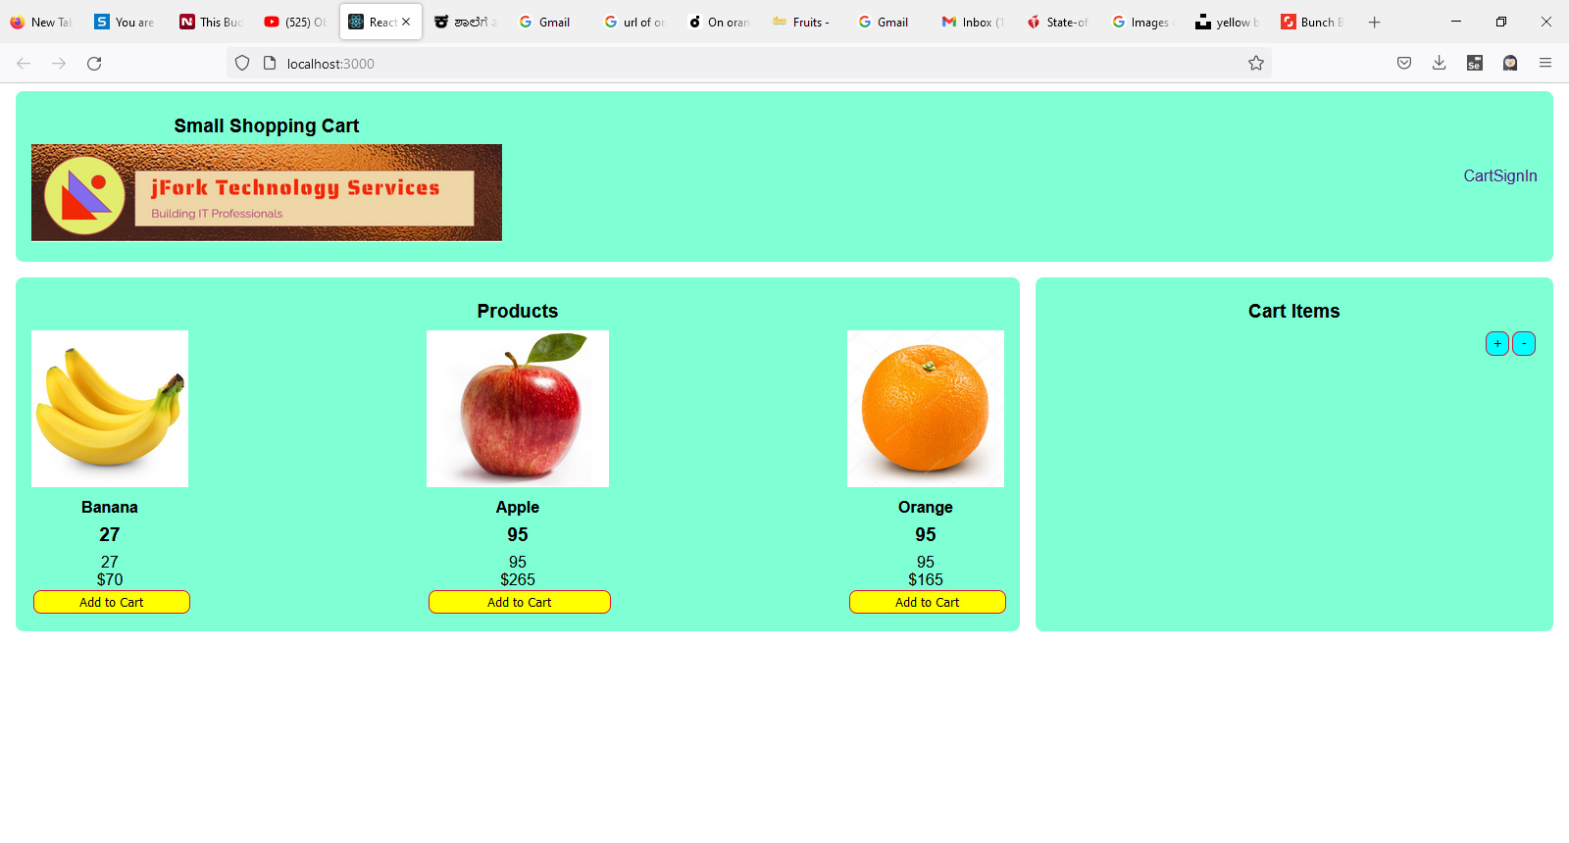


Shopping-Cart
NodeJS/SpringBoot – Back End Developer
Full Stack Developer – ReactJS + NodeJS / Spring Boot

Slide 9
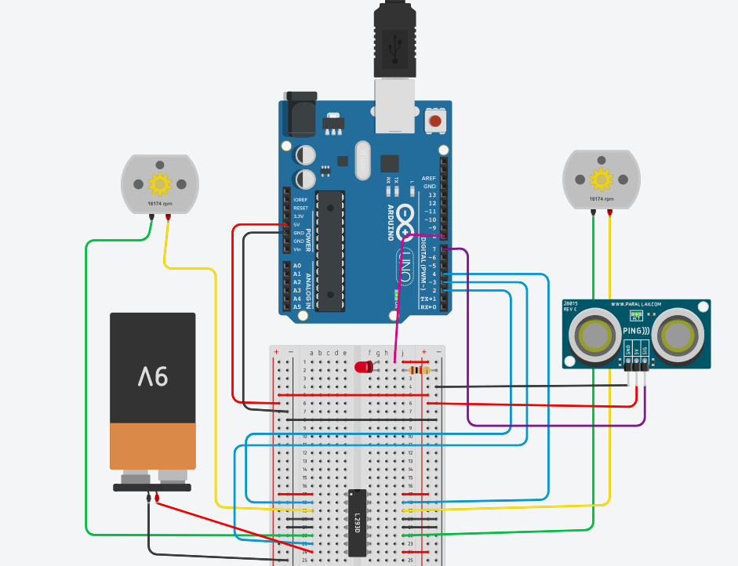
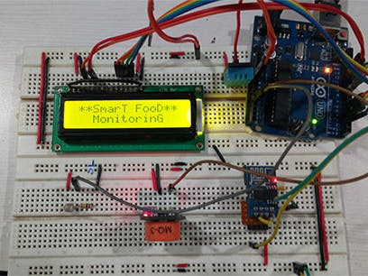
IoT App Development – Simulation using TinkerCad and its Realization

Slide 10
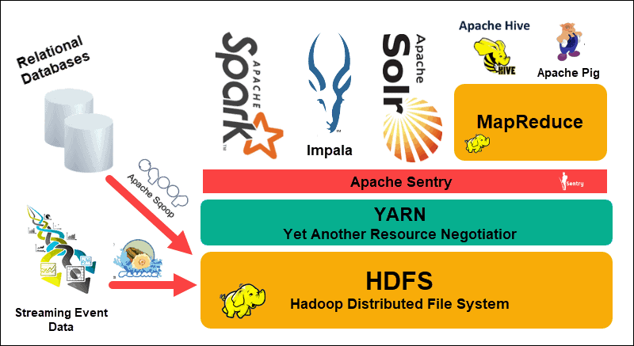
BigData Platforms

Slide 11
Data Analytics and Visualization through Tableau

Slide 12

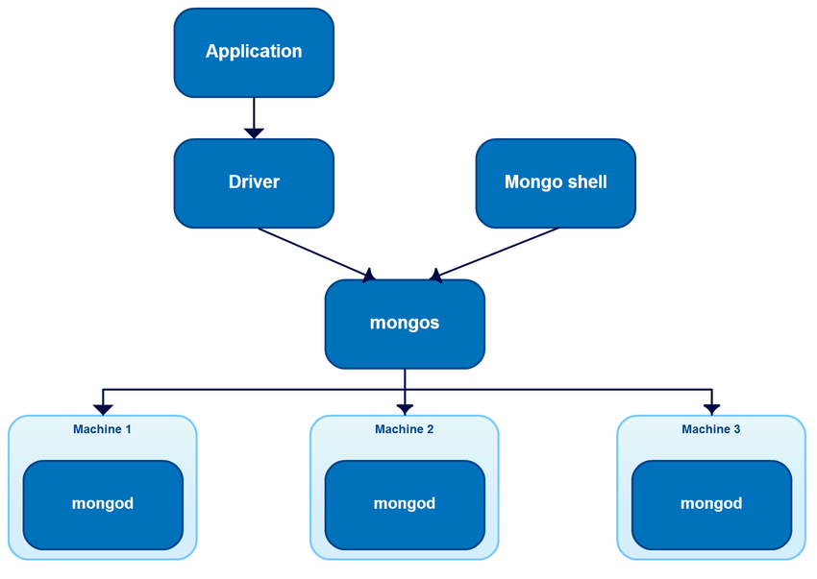

MongoDB – NoSQL Databases – Dealing with unstructured data

Slide 13
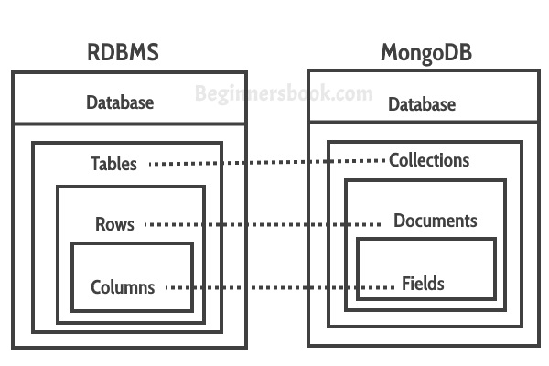
MongoDB – NoSQL Databases

Slide 14
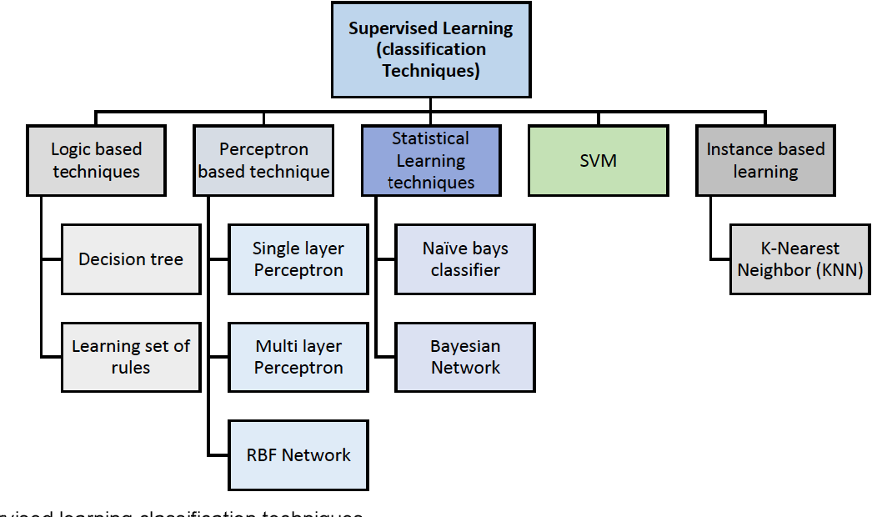
AI-ML Techniques using Python
AI
ML
DL

Slide 15
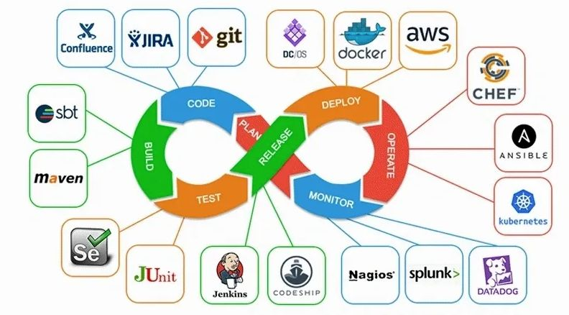
DevOps the software Development Life Cycle

Slide 16
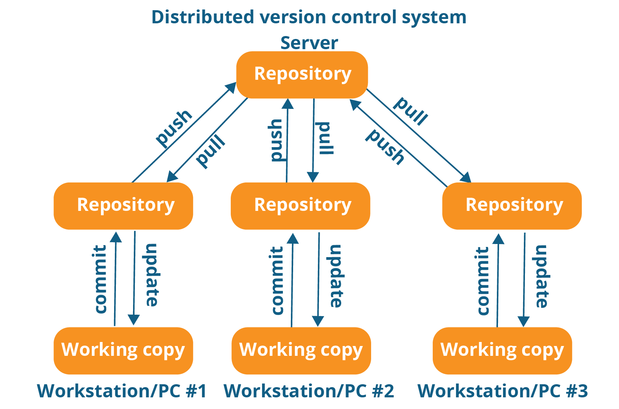
Git – Distributed Version Control System

Slide 17
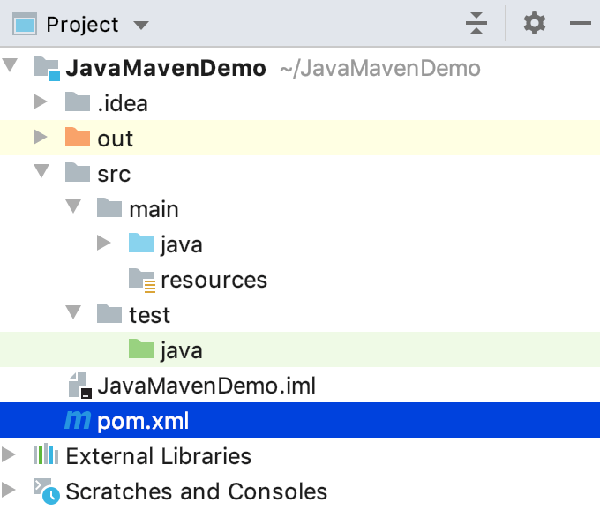
The Compile and Build Tools – Maven/Graddle

Slide 18
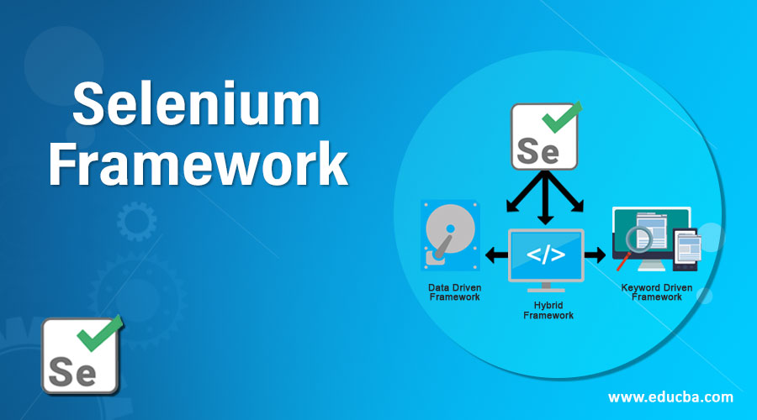

Testing Tool – Junit or Selenium

Slide 19
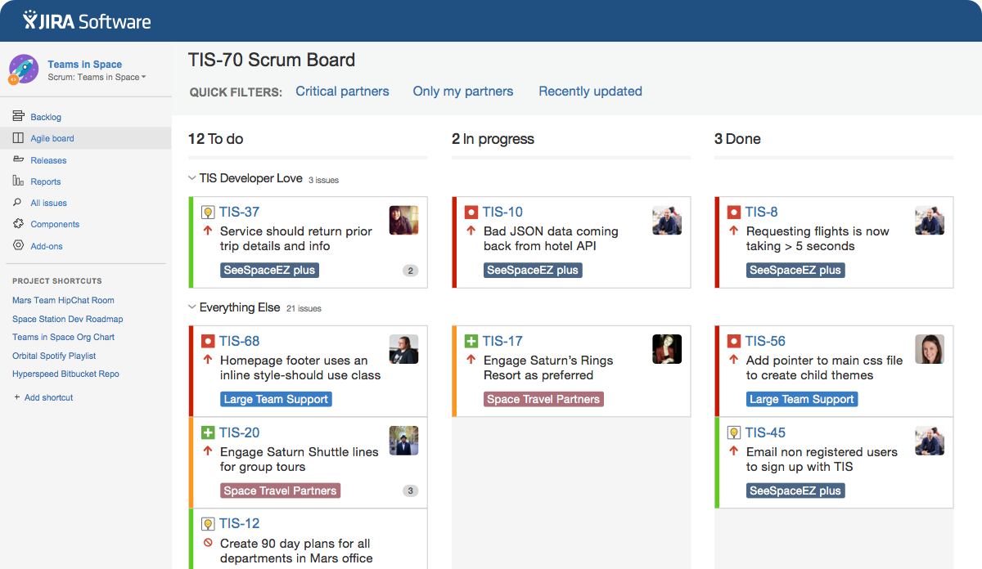
The Agile software development – Use of Jira Tool

Slide 20
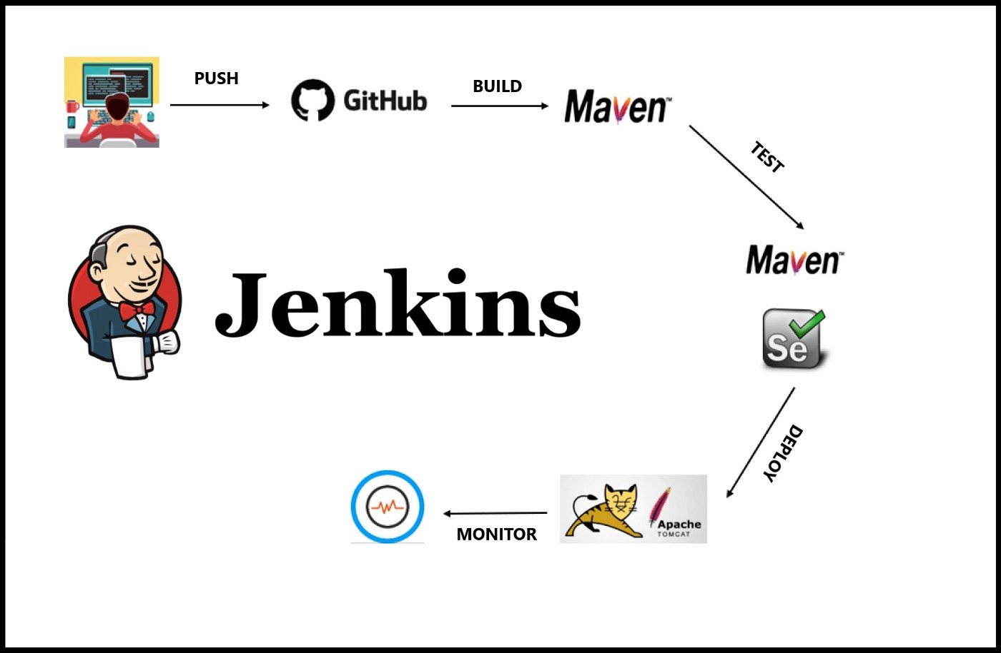
The Devops Automation Tool - Jenkins

Slide 21
Internship Flow
Brushing up Language Features and Coding Skills
Exploring Design and Development Tools
Python with ML
Case Study and Project
HTML+CSS+JavaScript
And
React JS - Project
Embedded IoT/BigData
Case Study and Project

Slide 22
Live Projects
Predicting Loan Defaulter using ML Technique – For People’s Coop Society
Developing a App to automate the Chit-Fund Processes -
Developing UI and Reports for a SAP module – For a Free Lancer
Invoice Digitization using OCR technique – Poel Software, Bangalore
Invoice Identification and Processing using Image processing and Deep Learning techniques – PEOL Software, Bangalore
Website Development for jFork TS, Belgaum using ReactJS

Slide 23
Future plans…
Software Development for SME segment
Placement Coaching and Placement Assistance
Project Guidance
Technology Training
To emerge as a leading Finishing School in the north Karnataka region

Slide 24
Your Role as an Intern
Attend all sessions
Actively participate in learning
Practice at home
Take lead in a team & contribute
Transform yourself into a true Professional with desirable traits

Slide 25
Thank You All…
Any Questions ?

Slide 26
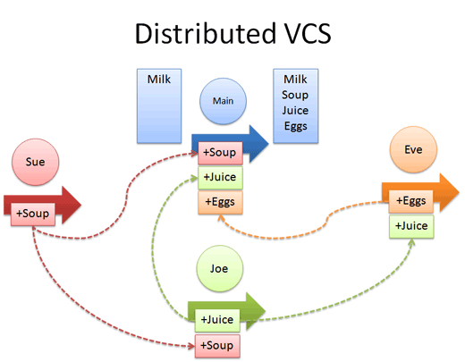
Session – I GitHub – Version Control Tool

Slide 27
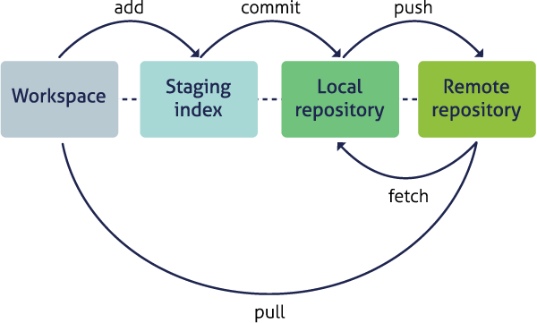
Session – I GitHub – Version Control Tool

Slide 28
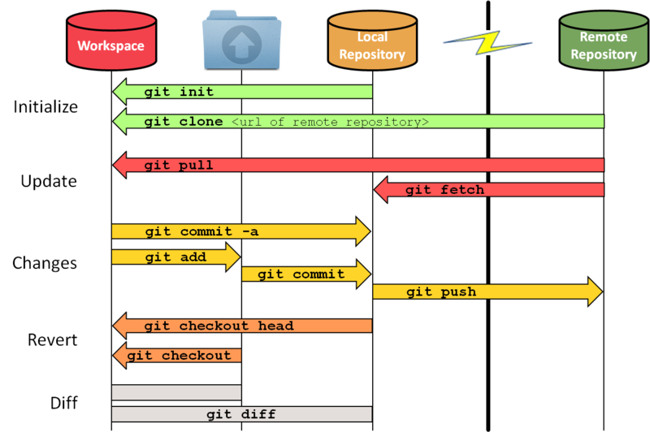
Git commands and workflow

Slide 29
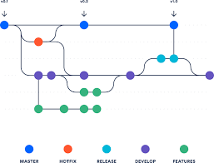
Project Management with github

Slide 30
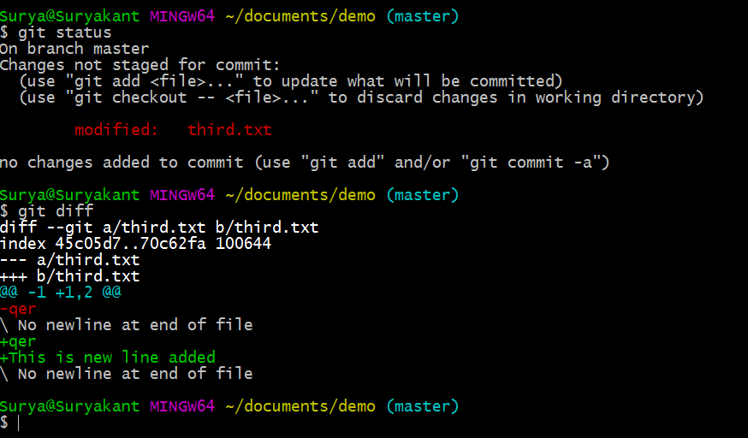
Git CommandLine Version

Slide 31
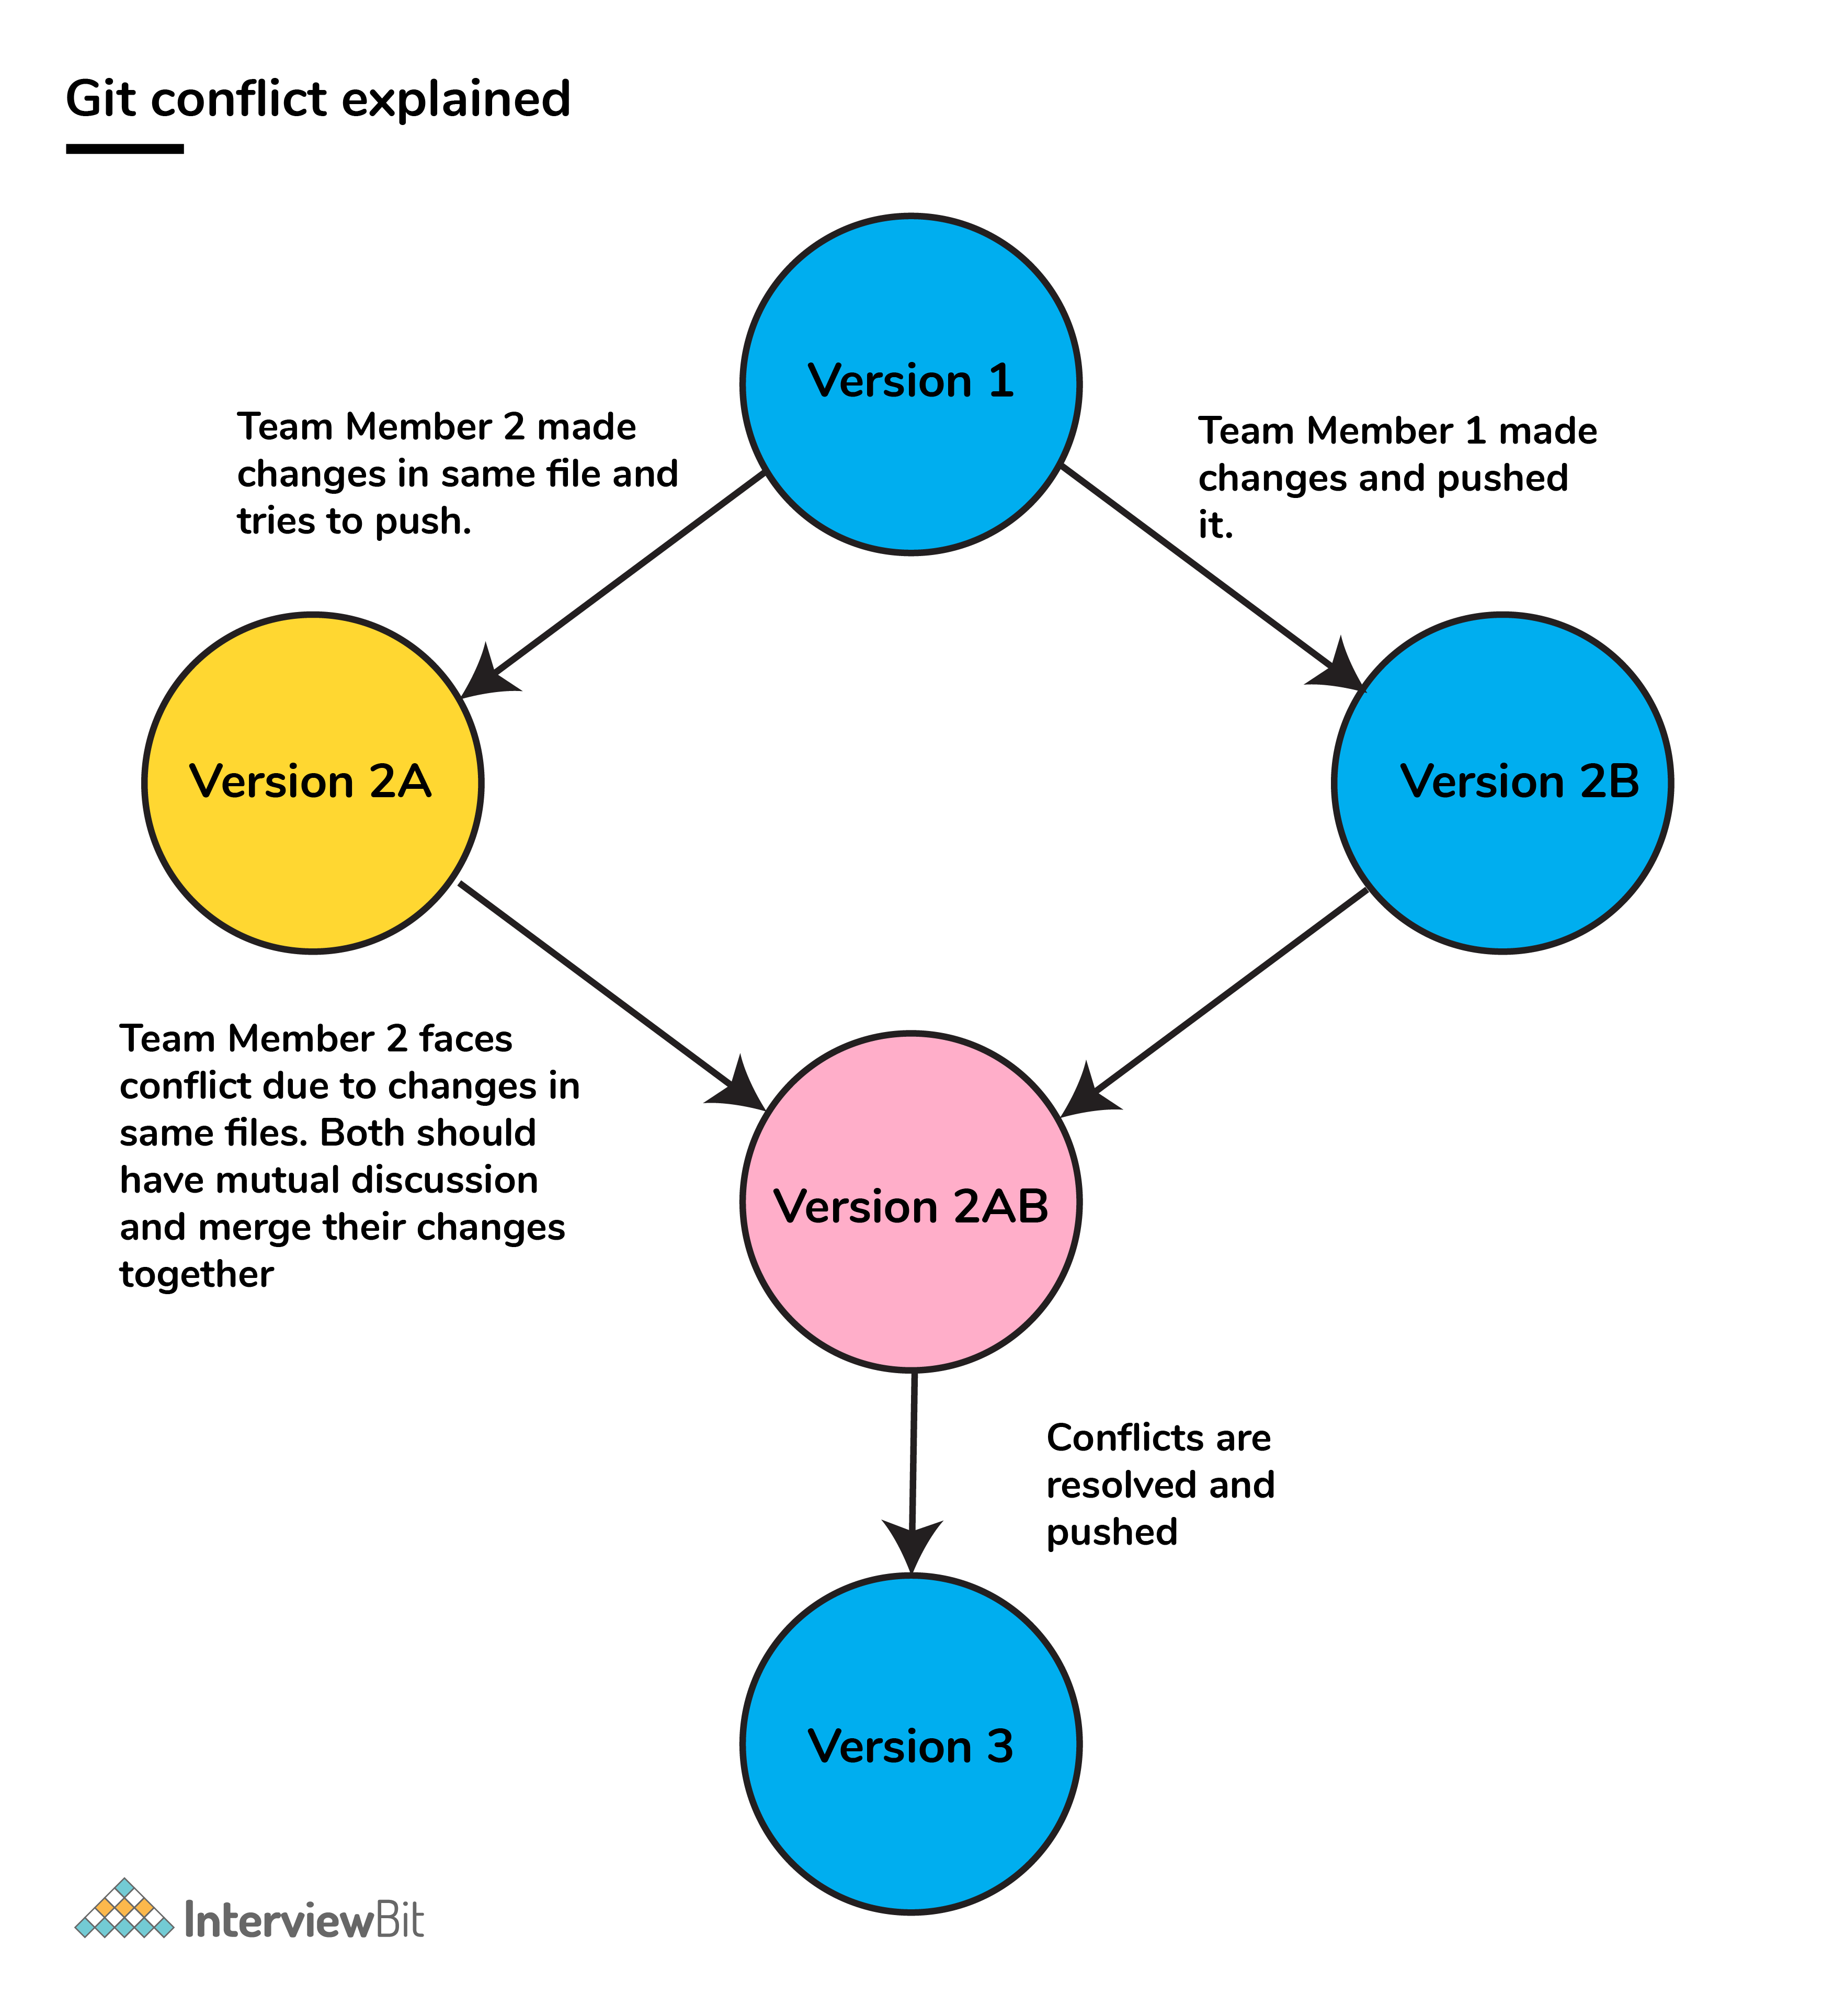
Conflict Handling in Git

Slide 32
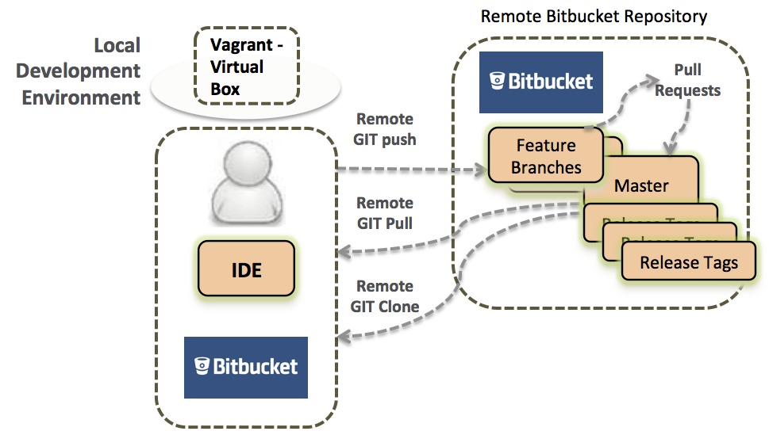
Other Version control systems – bitBucket by Atlasian

Slide 33
Conflict Handling in Git

Slide 34
Role of git in Devops cycle – The Agile software Development approach

Slide 35
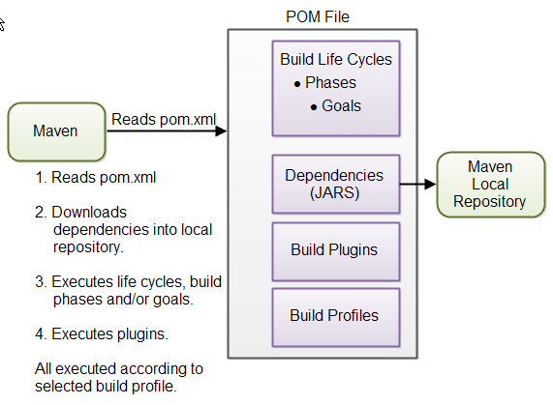
Role of git in Devops cycle – The Agile software Development approach

Slide 36
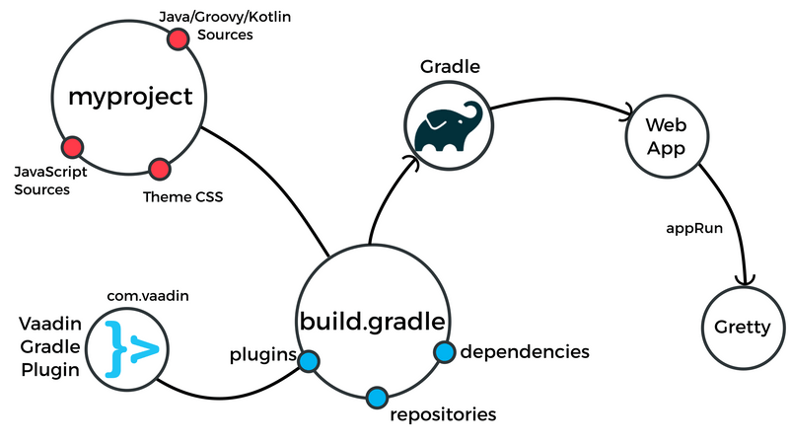
Role of git in Devops cycle – The Agile software Development approach

Slide 37
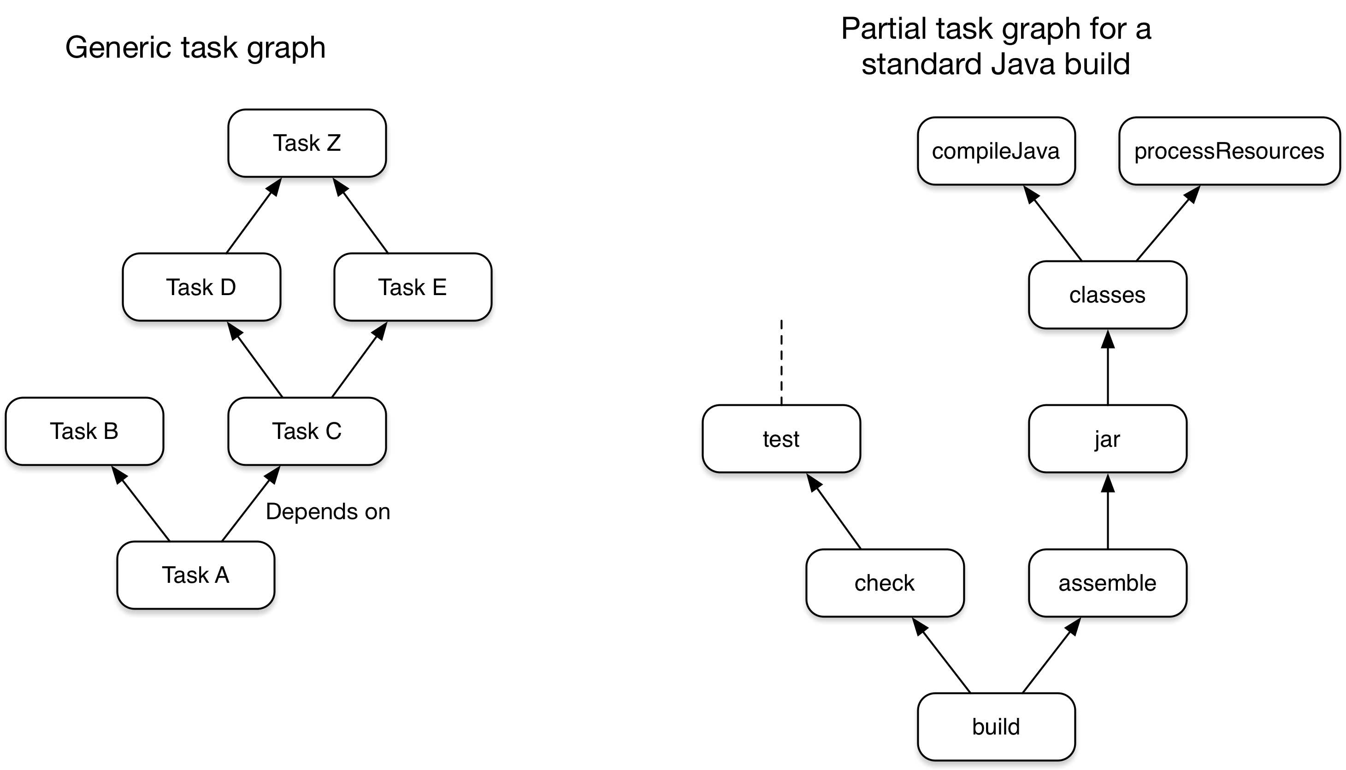
Role of git in Devops cycle – The Agile software Development approach

Slide 38
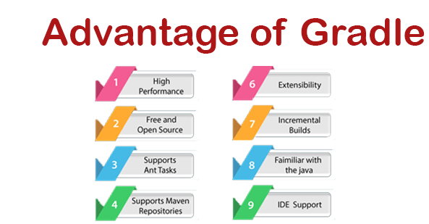
Role of git in Devops cycle – The Agile software Development approach

Slide 39
Role of git in Devops cycle – The Agile software Development approach

Slide 40
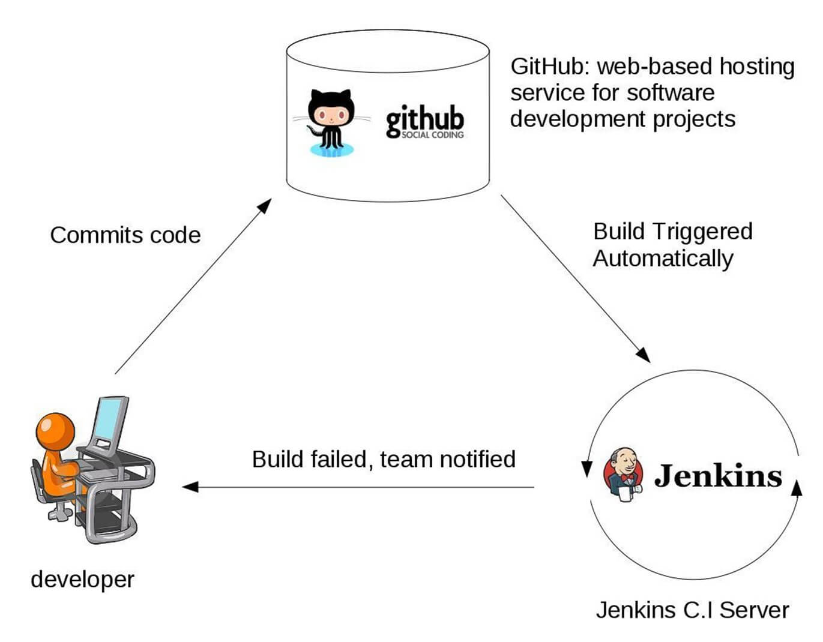
Role of git in Devops cycle – The Agile software Development approach

Slide 41
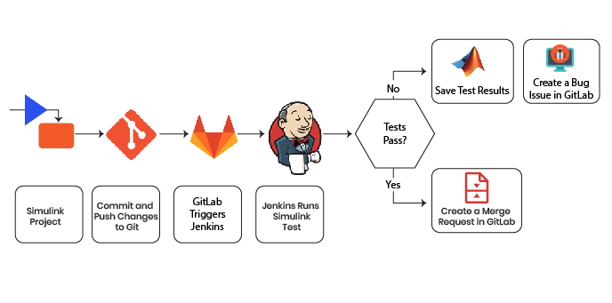
Role of git in Devops cycle – The Agile software Development approach

Slide 42
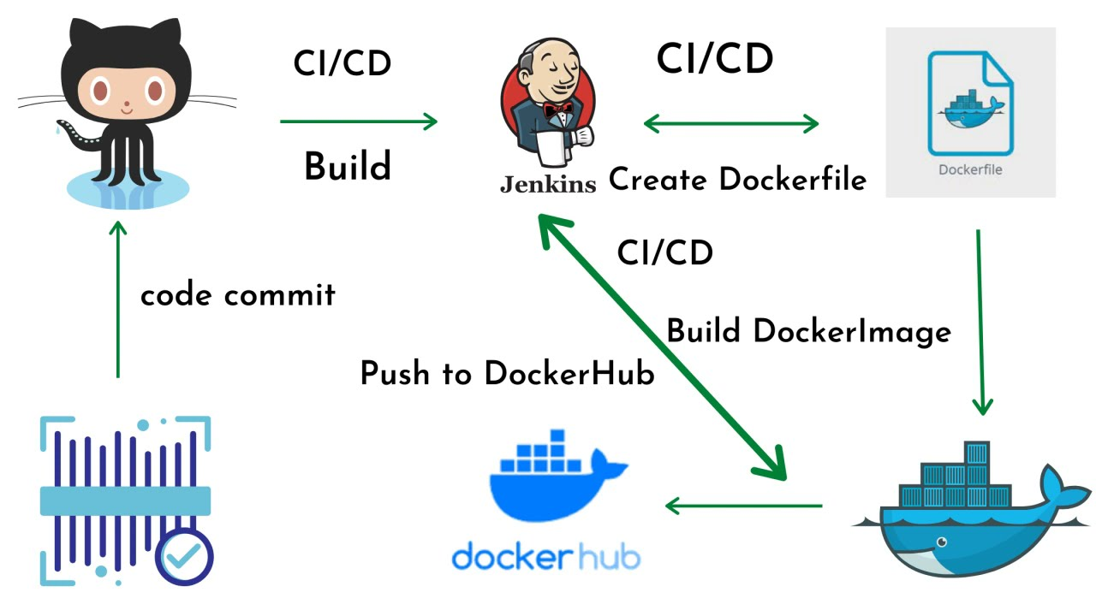
Role of git in Devops cycle – The Agile software Development approach

Slide 43
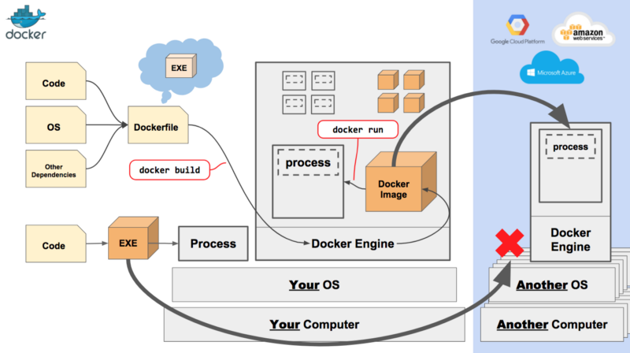
Role of git in Devops cycle – The Agile software Development approach

Slide 44
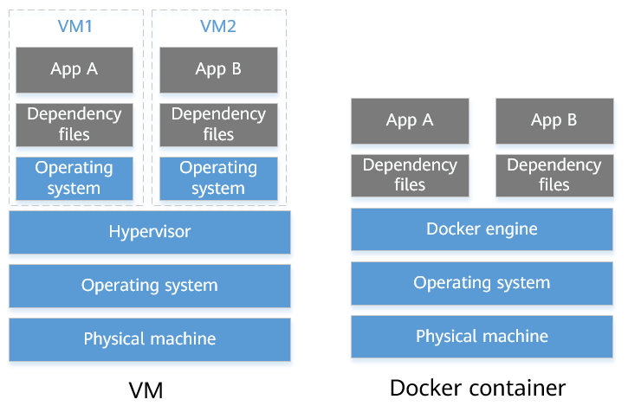
Role of git in Devops cycle – The Agile software Development approach

