Slide 1




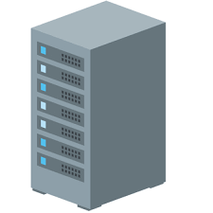
Local
Web Server

Slide 2


Local
Local
Repository
Remote
Repository
add
commit
push

