Slide 1
Introduction to Python Programming
4. Importing data and plotting
BIOM 1720 Honors Track
University of Memphis
Spring 2018
March 17, 2018

Slide 2

Python for Everybody (py4e)…
Charles Severance, aka Dr. Chuck (University of Michigan)
Textbook: https://www.py4e.com/html3/
Lessons: https://www.py4e.com/lessons

Slide 3
Outline
Today
Open files to read text data
Make calculations (numpy)
Generate plots
FINAL PROJECTS DUE Saturday 4/28/18
Data, code and output
Jupyter Notebook (optional)

Slide 4
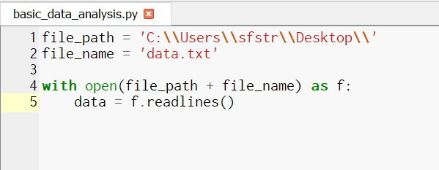
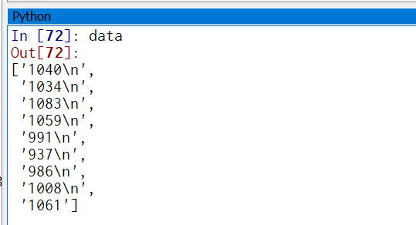
Importing text
See Chapter 7 (Files)
Context managers (‘with’ statement)

Slide 5
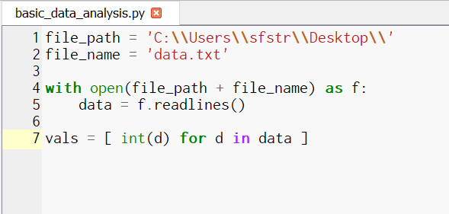
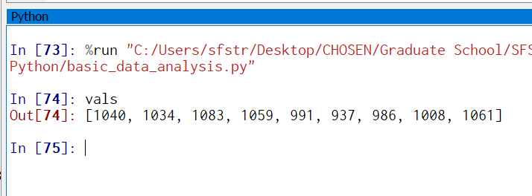
Processing text
Need to convert to numbers!
List comprehension syntax
(Very useful!!!)

Slide 6
Using numpy
numpy is a library for creating MATLAB-style arrays in Python
numpy is available by default in the IPython interpreter
BUT YOU MUST IMPORT numpy to use it in a script!!
Import statement at beginning of code:
“import numpy as np”
Use np and dot operator to access library functions:
“t = np.linspace(0, duration, numpts)”

Slide 7
Most useful functions from numpy
linspace() – similar to MATLAB’s linspace function
ndarray() – converts a sequence into a Python object that behaves like a MATLAB array
Python lists
“a = [1, 2, 3]; b = [4, 5, 6]”
“print(a + b)” => [1, 2, 3, 4, 5, 6]
ndarray()
“A = np.array(a); B = np.array(b)”
“C = A + B; print(C)” => [5, 7, 9]
“type(C)” => numpy.ndarray

Slide 8
Using matplotlib.pyplot
matplotlib.pyplot gives MATLAB-style plotting functionality
ALSO available by default in the IPython interpreter
ALSO, YOU MUST IMPORT numpy to use it in a script!!
“import matplotlib.pyplot as plt”
“plt.plot(t, data)”
“plt.title(“Plotting demonstration”)
“plt.show()”
You MUST use show() to generate plots from a script in Canopy

Slide 9
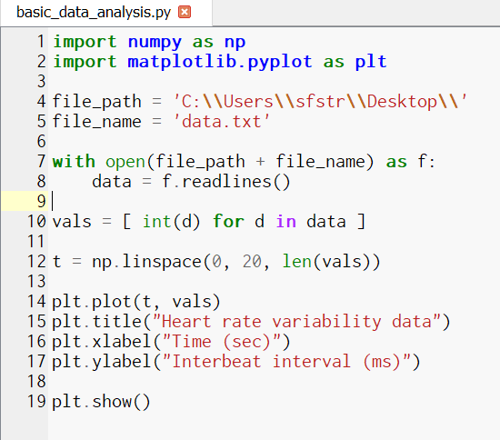
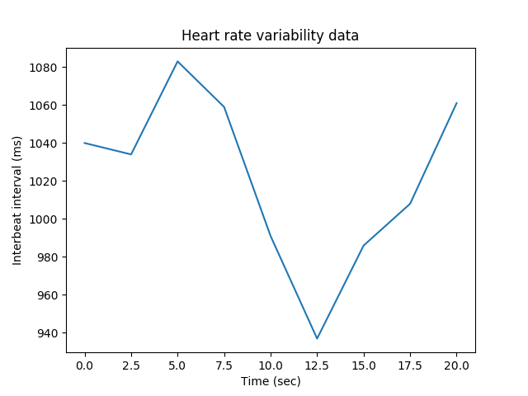

Slide 10
Jupyter Notebooks
Interactive web document
Combines text, graphics, and code
Needs running server (can use Canopy)
Non-interactive form
Example: https://github.com/sfstrain/Python1720/blob/master/hodgkinhuxley.ipynb
In this form, you can’t edit it or run the code cells
If you save it and open it in Canopy as a Notebook, you can!!

