Slide 1
Introduction to Python Programming
BIOM 1720 Honors Track
University of Memphis
Spring 2018

Slide 2
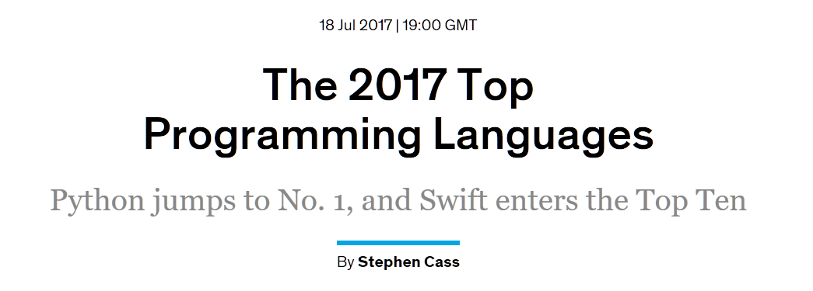

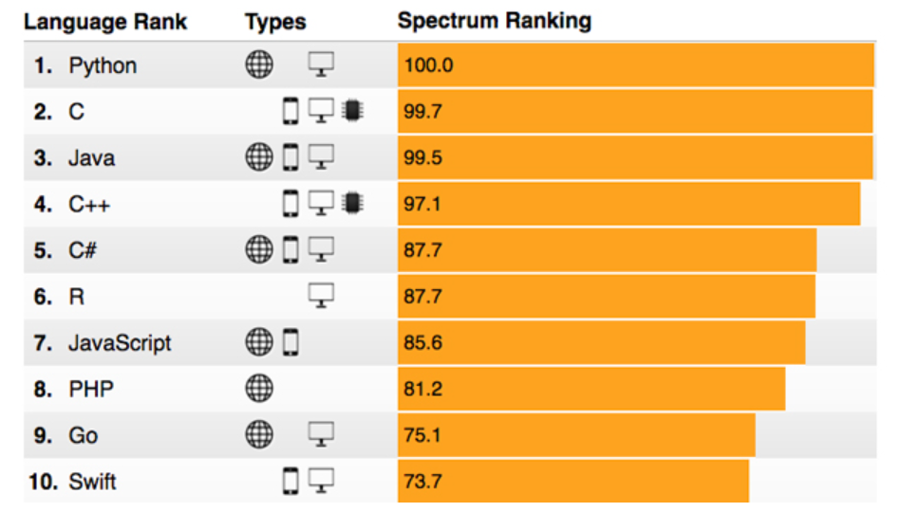
https://spectrum.ieee.org/computing/software/the-2017-top-programming-languages

Slide 3
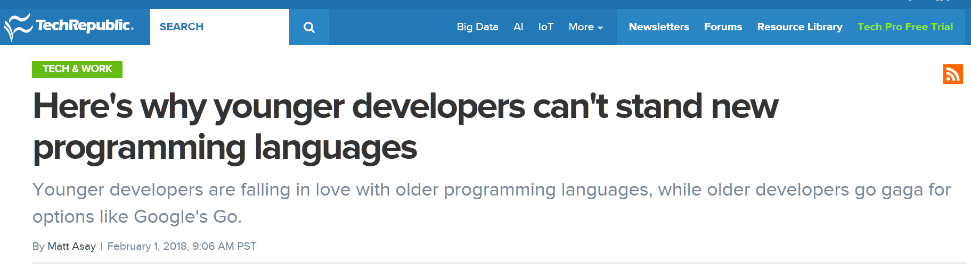
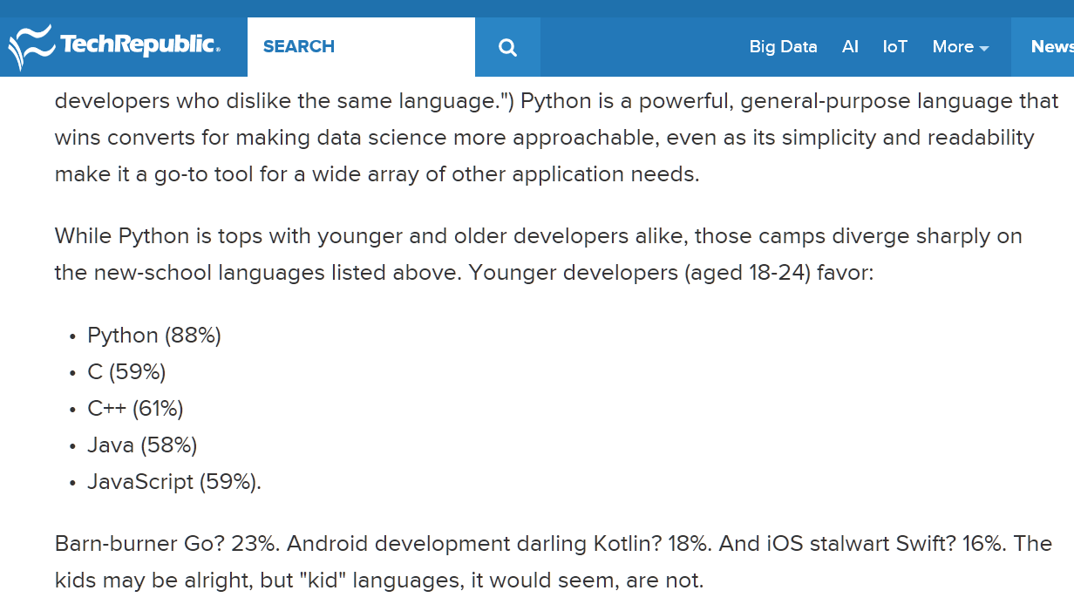
https://www.techrepublic.com/article/heres-why-younger-developers-cant-stand-new-programming-languages/

Slide 4
Python is…
Free and open-source
Easier to learn than competing languages
Growing in popularity and importance
For example, TensorFlow
Developed by Google
Central to deep learning
https://en.wikipedia.org/wiki/TensorFlow
http://playground.tensorflow.org

Slide 5
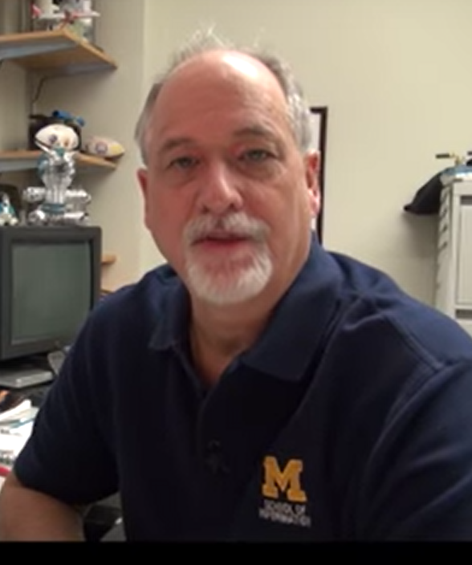
Python for Everybody (py4e)…
Charles Severance, aka Dr. Chuck (University of Michigan)
Textbook: https://www.py4e.com/html3/
Lessons: https://www.py4e.com/lessons

Slide 6
Outline
Today
Variables, expressions and statements (Chapter 2)
Conditional execution (Chapter 3)
Class #2 (Saturday 2/24/18)
Functions (Chapter 4)
Iteration (Chapter 5)
Class #3 (Saturday 3/17/18)
Data types (parts of Chapters 6-10)
Final meeting (Saturday 4/14/18)
Projects and wrap up

Slide 7
Python comes in many flavors…
Python 2 or Python 3
We will try to stick with Python 3
Development environments
Command-line Python and text editor (Dr. Chuck)
IPython
Canopy Express (our approach)
Jupyter Notebook
Operation system issues
Linux
Windows
MacOS
File sharing and collaboration
GitHub

Slide 8
Differences between Python and MATLAB
“python vs matlab syntax differences”
http://www.pyzo.org/python_vs_matlab.html
http://phillipmfeldman.org/Python/Advantages_of_Python_Over_Matlab.html
https://www.mathworks.com/products/matlab/matlab-vs-python.html
http://researchcomputing.github.io/meetup_fall_2014/pdfs/fall2014_meetup13_python_matlab.pdf

